Slide 1
Cross Power Spectra

Slide 2
Testing the Null Hypothesis

Slide 3
Neutrino Radial Kernel

Slide 4
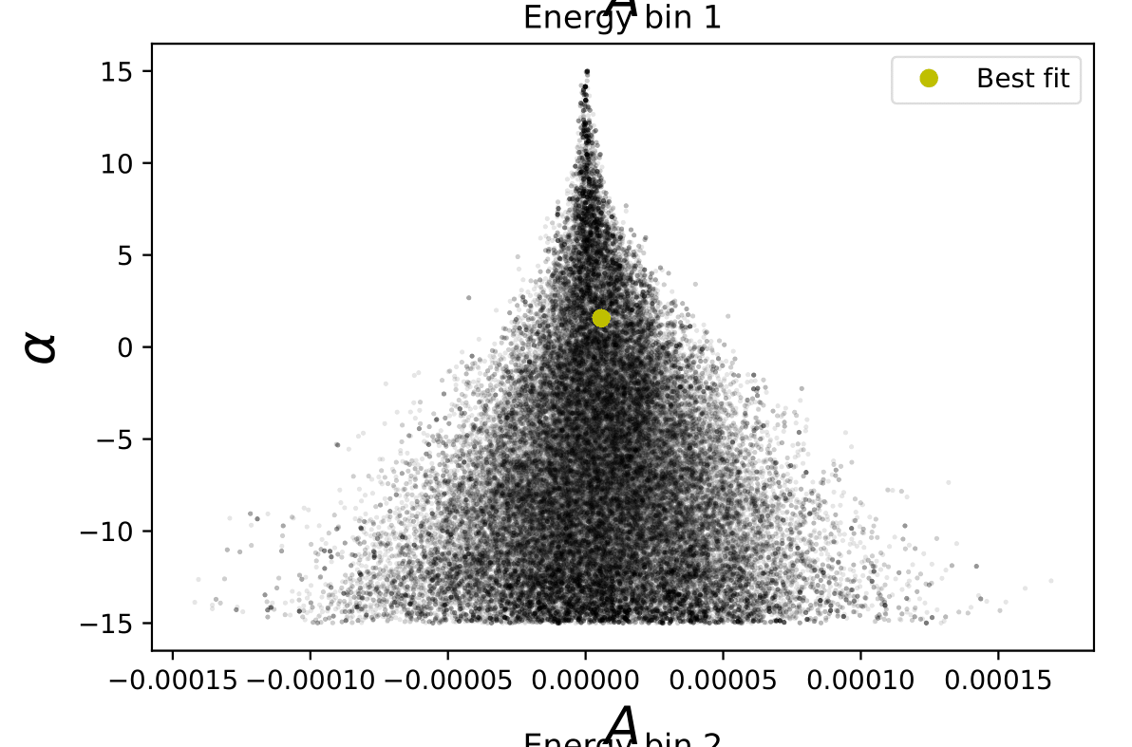
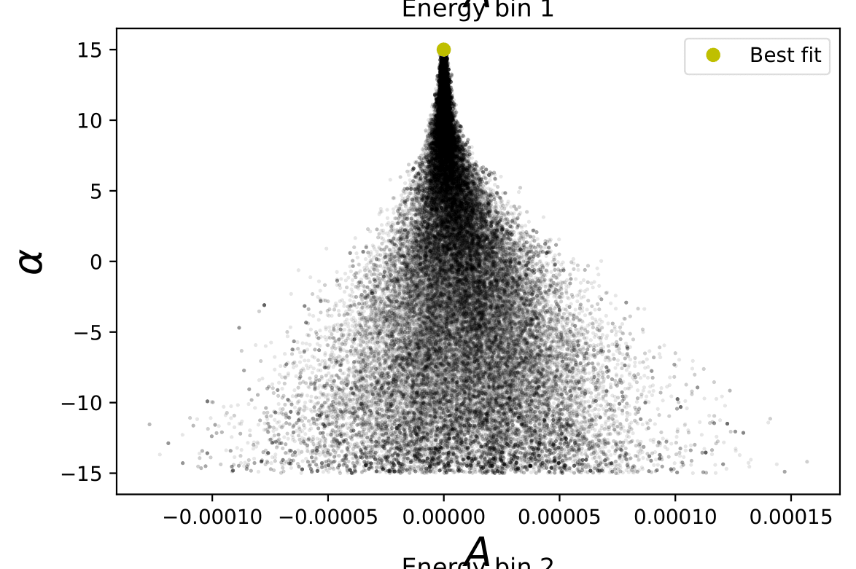
Constraining A and alpha
Volume prior on alpha

Slide 5
Constraining A and alpha
Energy bin 1
alpha = +2
alpha = 0
alpha = -2

Slide 6
Constraining Neutrino Densities
Use energy flux maps
Use number flux maps
Constrain the luminosity density of neutrinos,
Constrain the number density rate of neutrinos,

Slide 7
Constraining Neutrino Densities

