Slide 1
Neutrino Cross-correlations
by Ben Patterson
Supervisors: David Alonso, Felipe Oliveira Franco

Slide 2
Background
IceCube detects cosmic neutrinos from unknown sources
Mechanism to produce these high energy neutrinos unclear
Cross-correlate these neutrino events with galaxy surveys
Earth
IceCube detector

Slide 3
IceCube Data
Detects muons produced from neutrino-ice interactions
Atmospheric neutrinos dominate
3 logarithmic energy bins from 0.3 to 300 TeV
Earth
IceCube detector

Slide 4
Atmospheric Neutrinos
Earth
Northern hemisphere
Declination = 0
Southern hemisphere
IceCube detector

Slide 5
Effective Area
Earth
Northern hemisphere
Declination = 0
Southern hemisphere
IceCube detector

Slide 6
2MPZ+WIxSC Data

Slide 7
Overdensity Maps

Slide 8
Cross Power Spectra

Slide 9
Testing the Null Hypothesis

Slide 10
Neutrino Radial Kernel

Slide 11
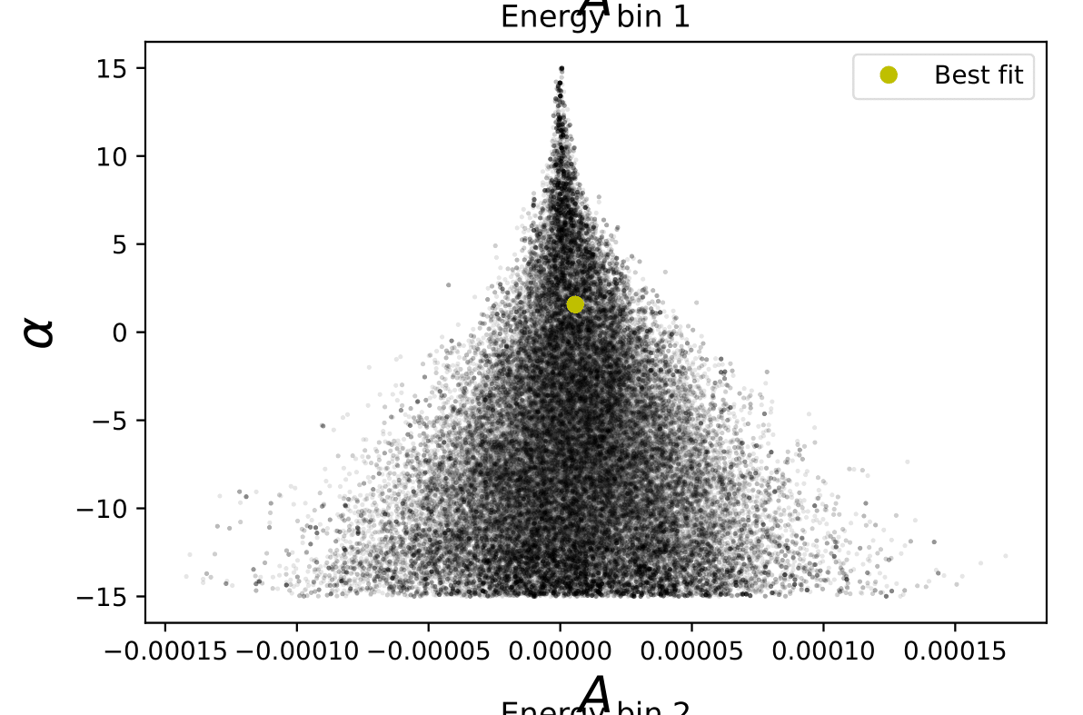
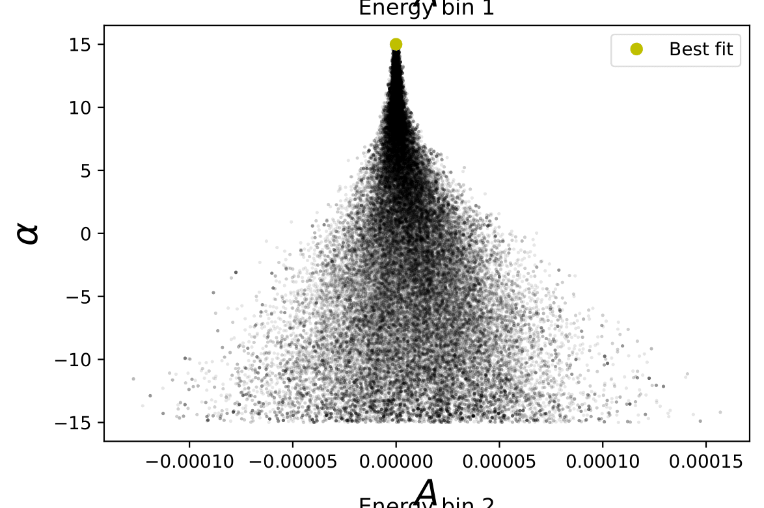
Constraining A and alpha
Volume prior on alpha

Slide 12
Constraining A and alpha
Energy bin 1
alpha = +2
alpha = 0
alpha = -2

Slide 13
Constraining Neutrino Densities
Use number flux maps
Use energy flux maps
Constrain the number density rate of neutrinos,
Constrain the luminosity density of neutrinos,

Slide 14
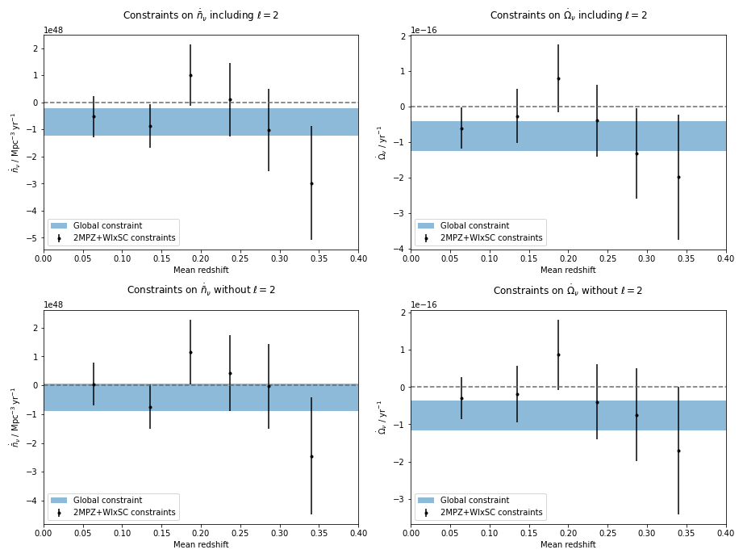
Constraining Neutrino Densities

Slide 15
Higher Redshift Galaxies

Slide 16
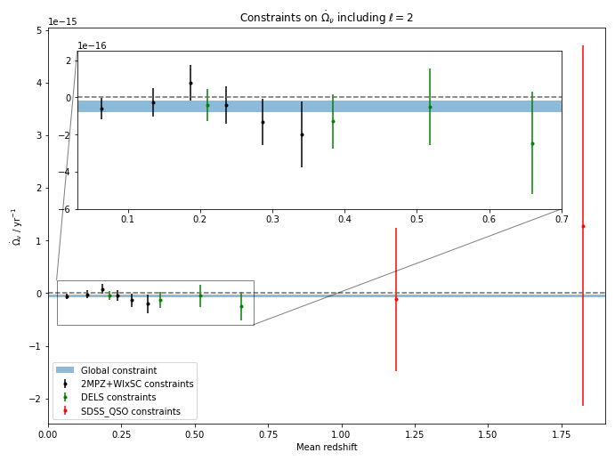
Constraining Neutrino Densities

Slide 17
Summary
Attempted to find source of astrophysical neutrinos
Present constraints on and
Can be used to constrain future models of neutrino emissivity

Slide 18
Extra Slides

Slide 19
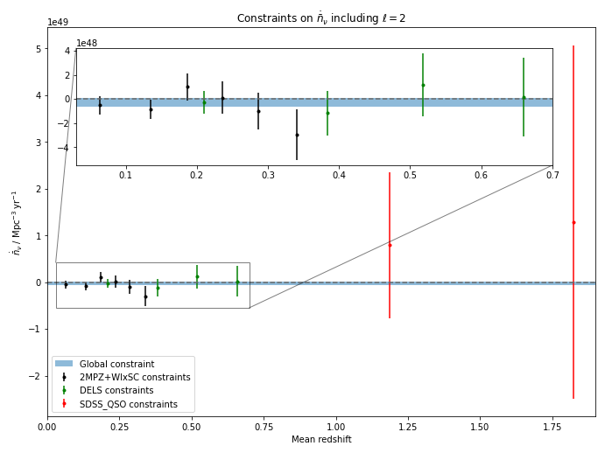
Number Density Rate Constraints

Slide 20
Removing First Data Point

Slide 21
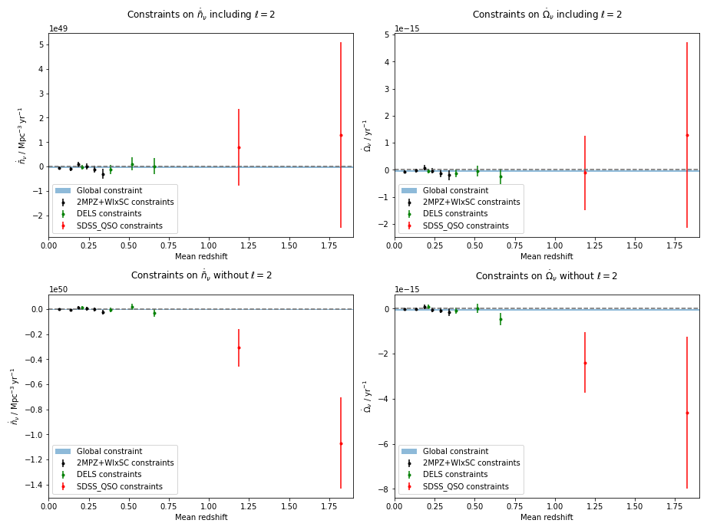
Removing First Data Point

