Slide 1
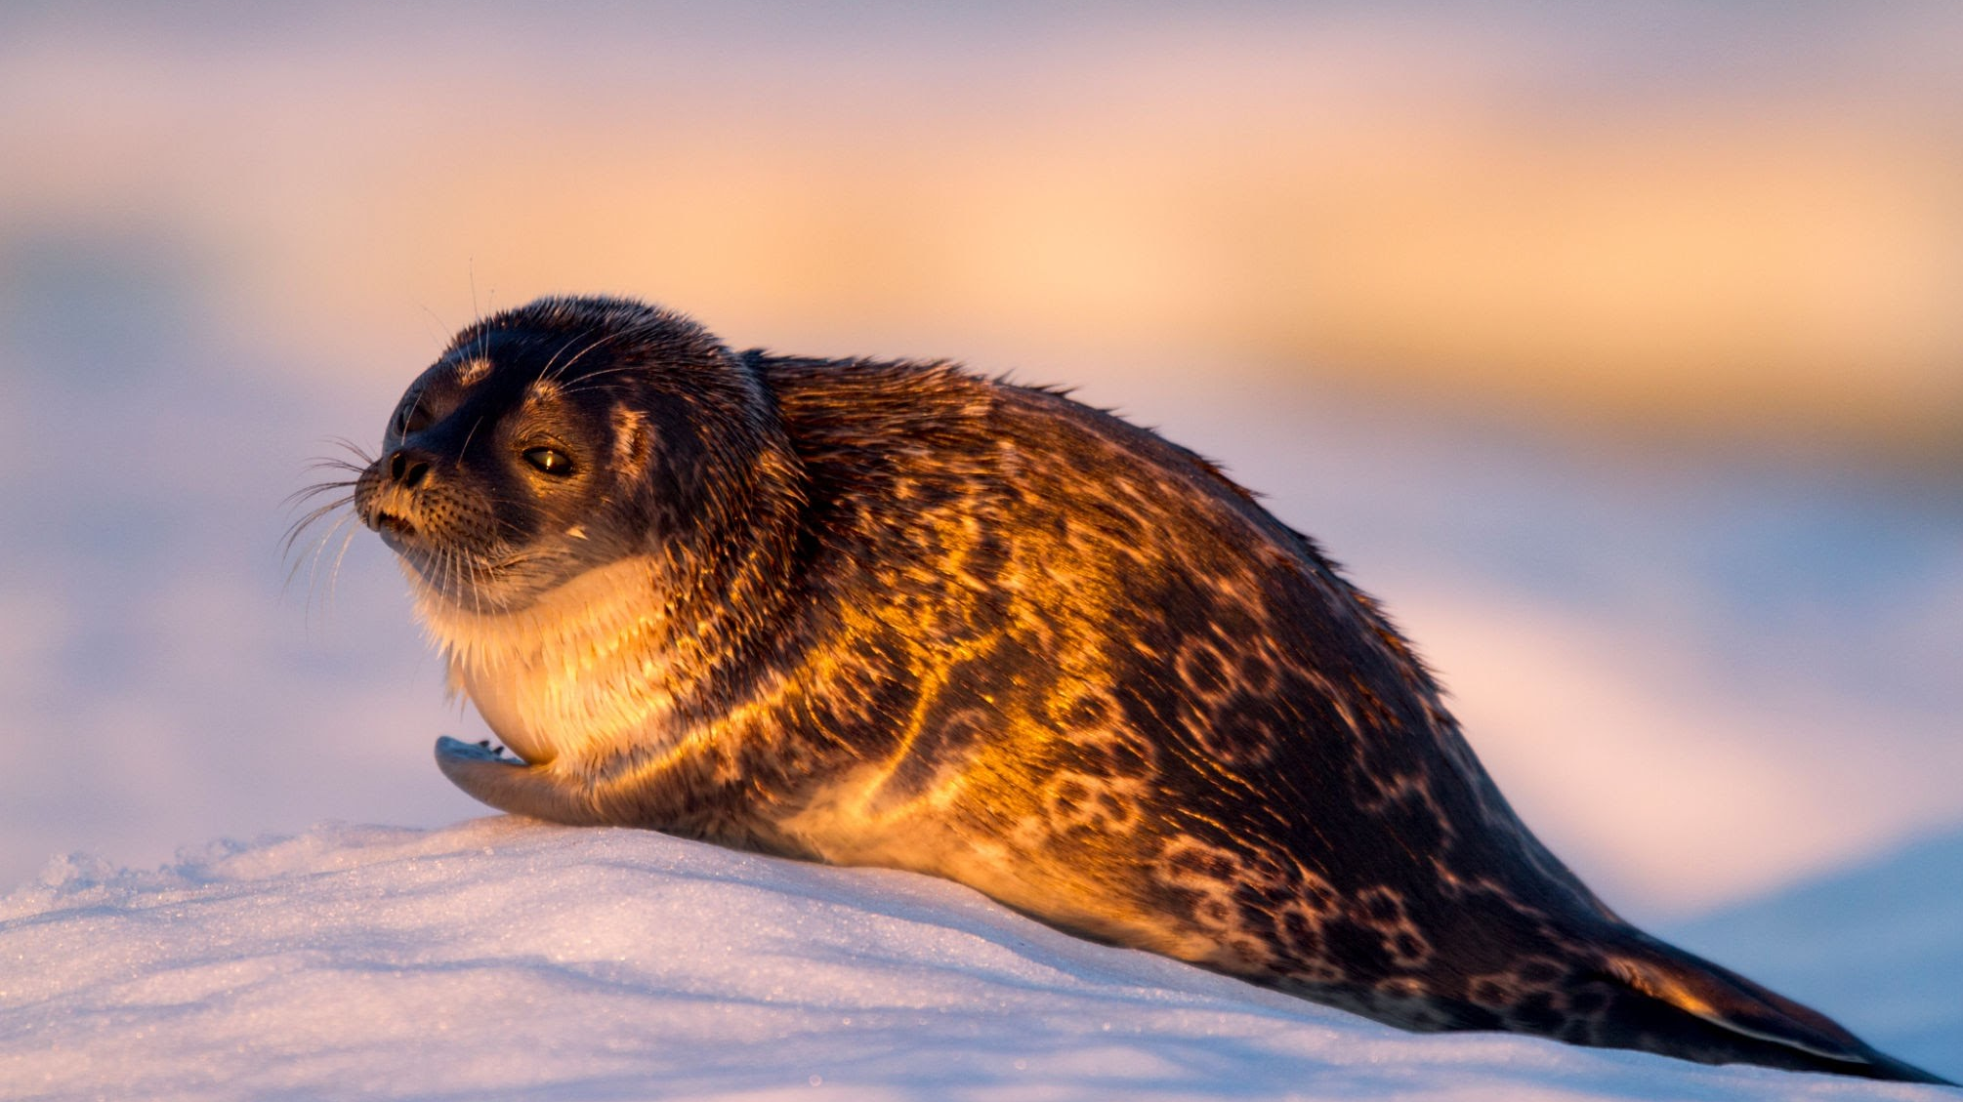
What’s up with these seals?
Global Sensitivity Analysis of Matrix Population Models
Abby Hardin-Kohli and Ben Gillen

Slide 2
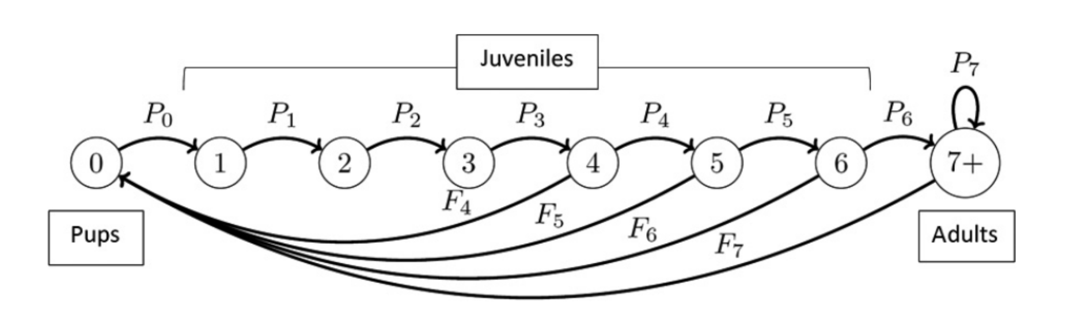
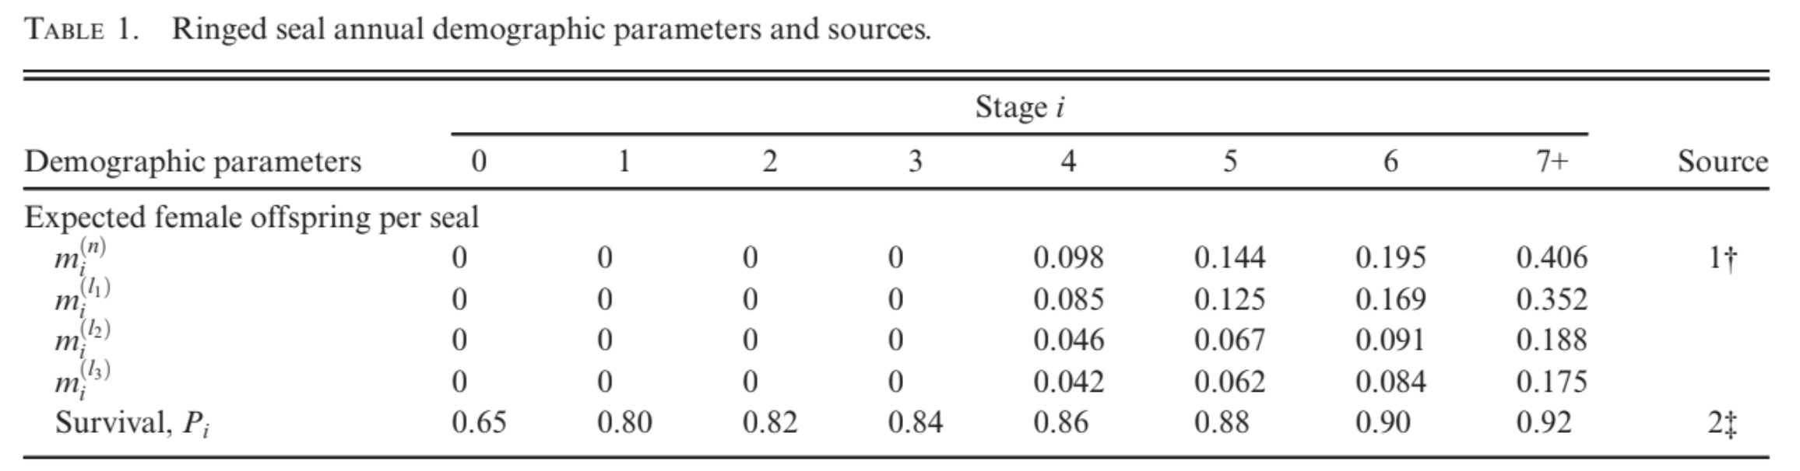
Leslie Matrix Population Model for Ringed Seals
Reimer, 2019

Slide 3
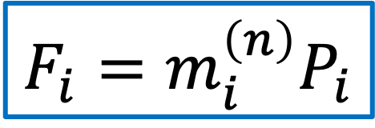
Leslie Matrix Population Model for Ringed Seals
Reimer, 2019
$$F_{i}=m_{i}^{\left(n\right)}P_{i}$$

Slide 4
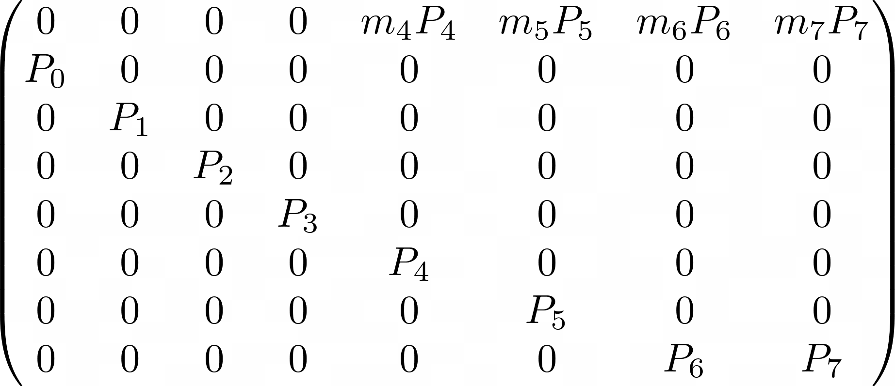
Treating Parameters as Random Variables
Each of these random variables are drawn from normal distributions with mean equal to the values used in Reimer 2019 and standard deviation 0.1

Slide 5
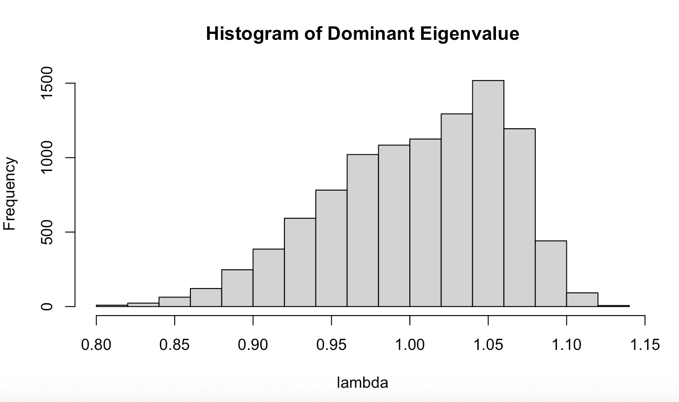
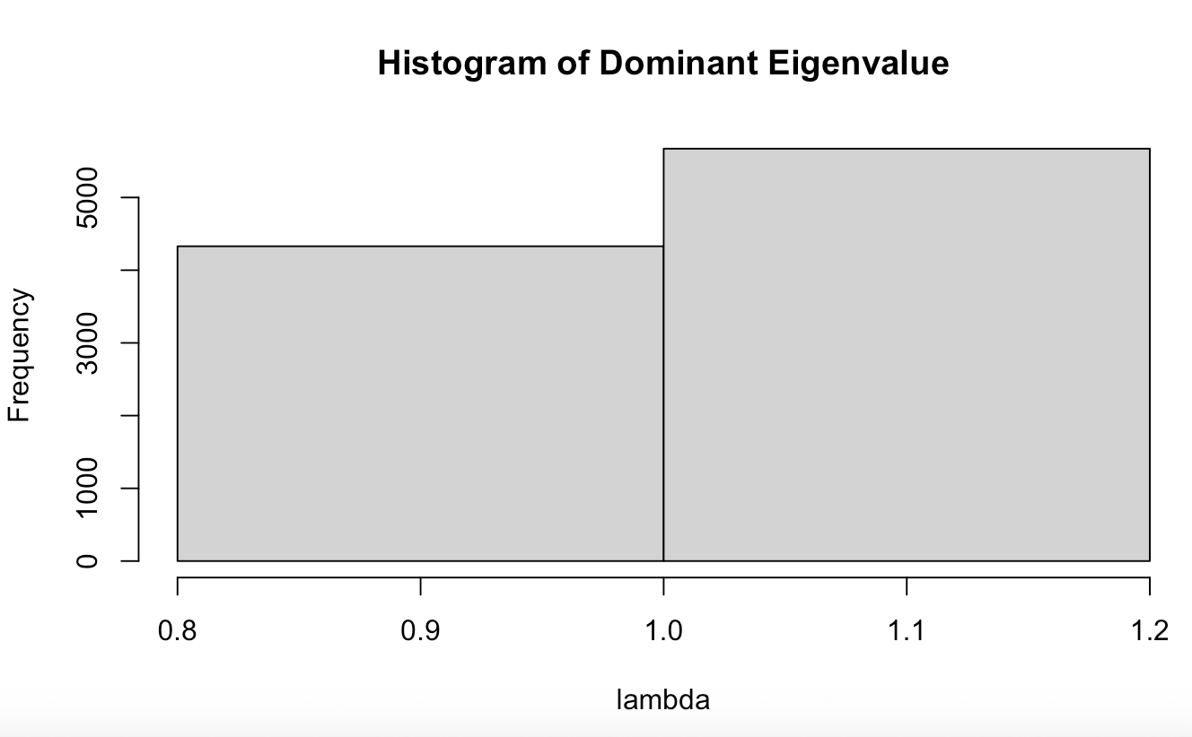
Distribution of Dominant Eigenvalues

Slide 6
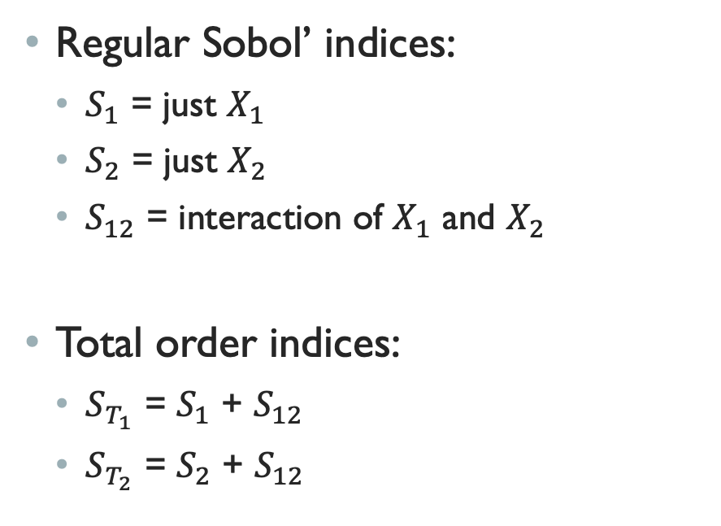
Sobol’ Indices
Regular Sobol’ indices:
$S_{1}$ = just $X_{1}$
$S_{2}$ = just $X_{2}$
$S_{12}$ = interaction of $X_{1}$ and $X_{2}$
Total order indices:
$S_{T_{1}}$ = $S_{1}$ + $S_{12}$
$S_{T_{2}}$ = $S_{2}$ + $S_{12}$
First order indices:
P0 0.03398497
P1 0.03047988
P2 0.02443335
P3 0.02735786
P4 0.03075422
P5 0.02785937
P6 0.02374405
P7 0.81871442
m4 0.01354772
m5 0.01259092
m6 0.01267436
m7 0.06655528
Total indices:
P0 0.029266600
P1 0.018581131
P2 0.017879912
P3 0.016556139
P4 0.014837544
P5 0.012247413
P6 0.009681944
P7 0.822666869
m4 0.001185111
m5 0.001185306
m6 0.001153797
m7 0.056416479

Slide 7
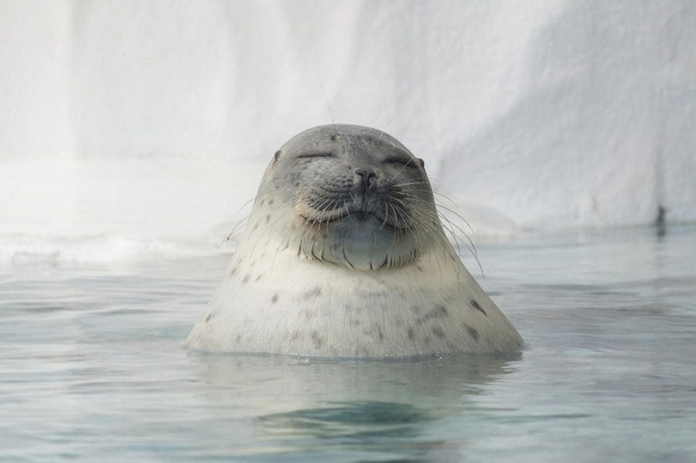
Thank you!

