Slide 1
Design continuous time-linear equalizer (ctLE)
Báo cáo thực tập ngoài trường
Giảng viên hướng dẫn: Cô Phan Võ Kim Anh

Slide 2
Sinh viên thực hiện:
Tên | MSSV
Hà Lê Ngọc Hưng | 2211358

Slide 3
Contents
Analyse requirements and design equation
Test & Simulations
Channel
Frequency response
CTLE design
DC analysis ( for gm require)
AC analysis ( for peaking gain )
CTLE + Channel
AC analysis ( Frequency response)
Transient analysis ( Eye diagram)
Summary & Conclusion

Slide 4
Design Topology & Requirements

Slide 5
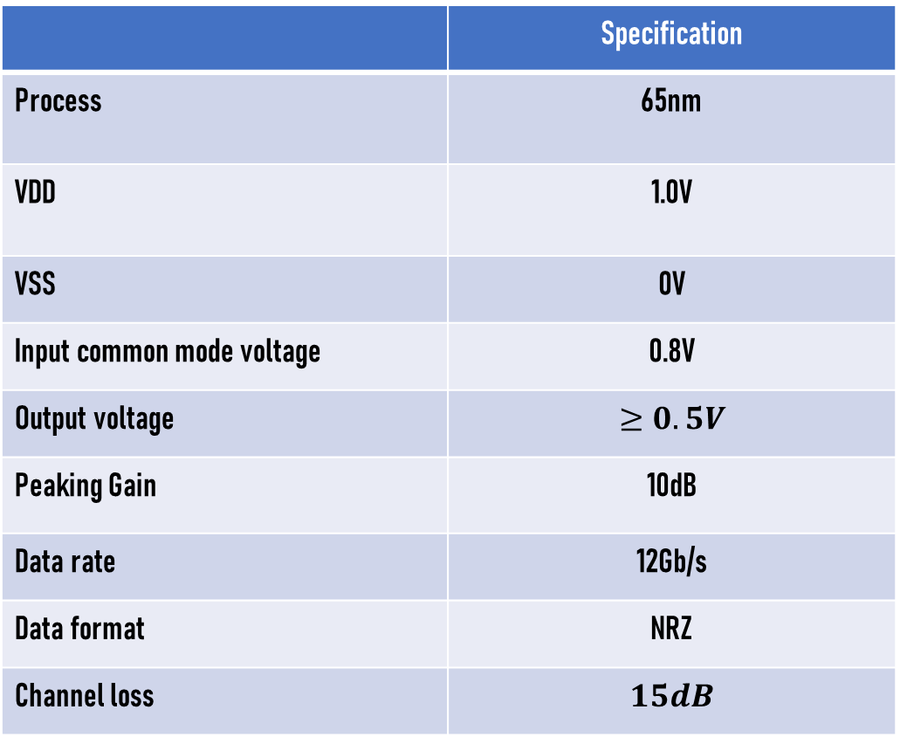
Requirements
 | Specification
Process | 65nm
VDD | 1.0V
VSS | 0V
Input common mode voltage | 0.8V
Output voltage | $$≥0.5V$$
Peaking Gain | 10dB
Data rate | 12Gb/s
Data format | NRZ
Channel loss | $$15dB$$

Slide 6
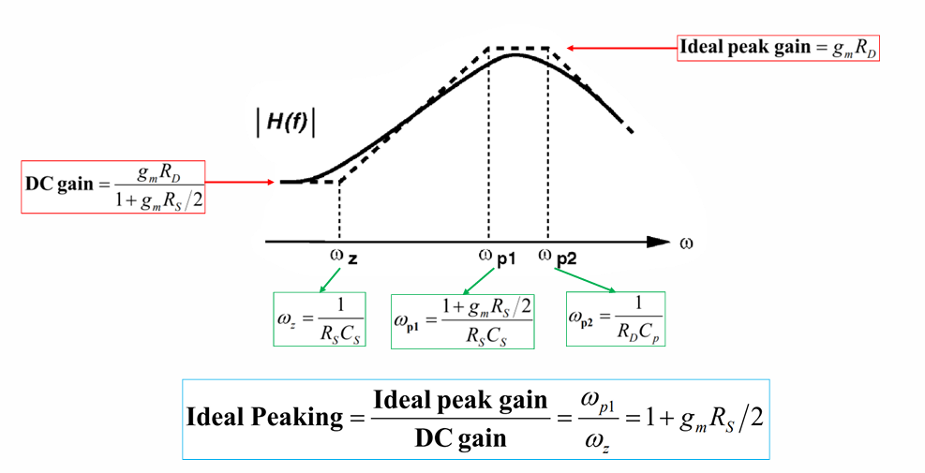
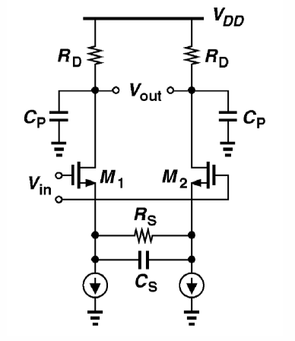
Design Topology
Active CTLE

Slide 7
Test & Simulations

Slide 8
Channel

Slide 9
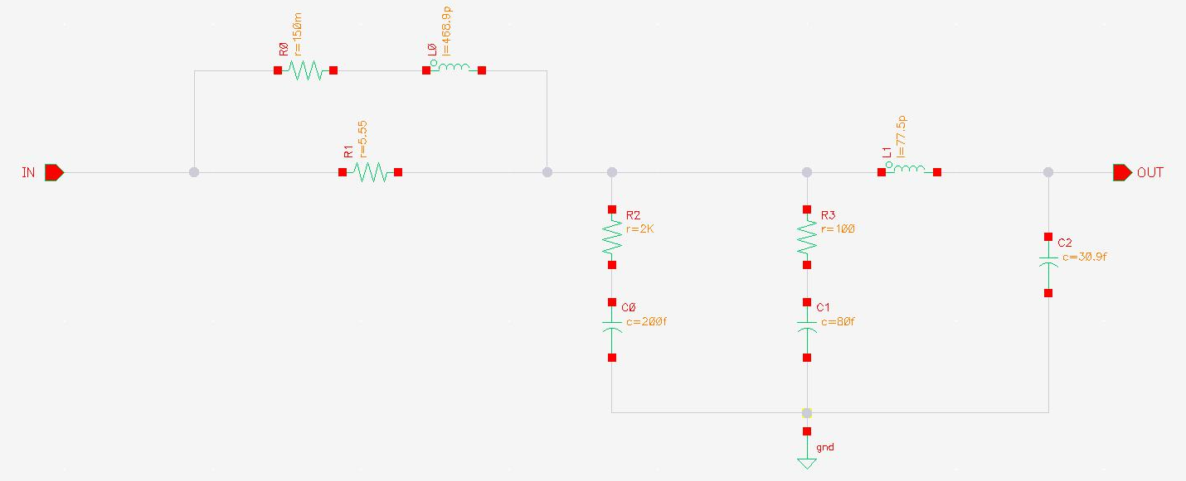
12 x 1-inch FR4 section

Slide 10
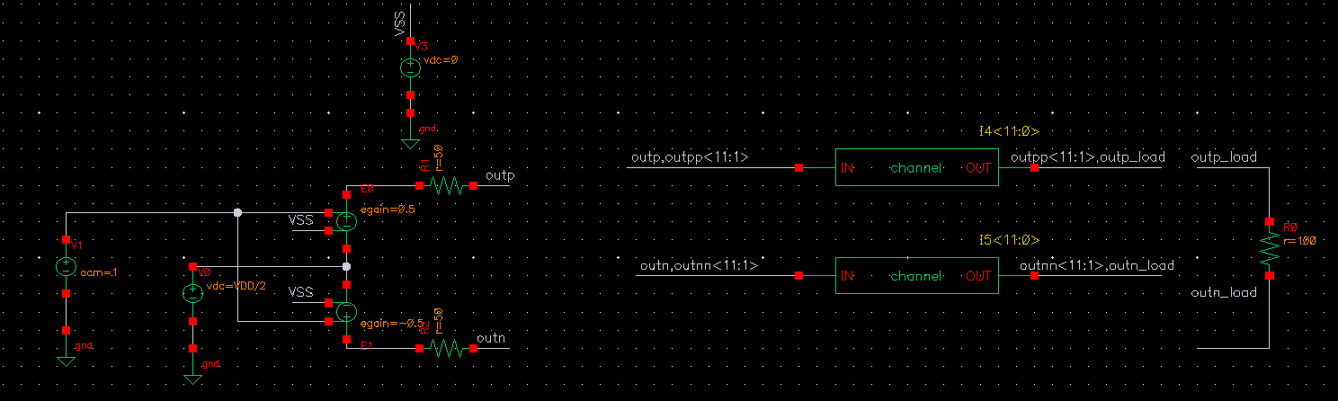
Testbench
Library : analogLib
Cell name: vdc
Ac mag : 1V
Library : analogLib
Cell name: vcvs
Voltage gain : +/-0.5

Slide 11
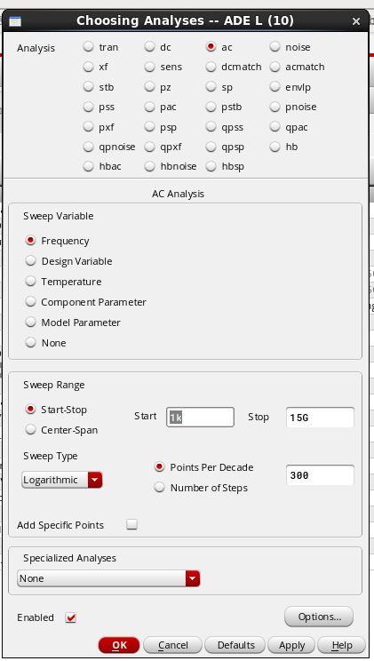

SET UP
Measurement

Slide 12
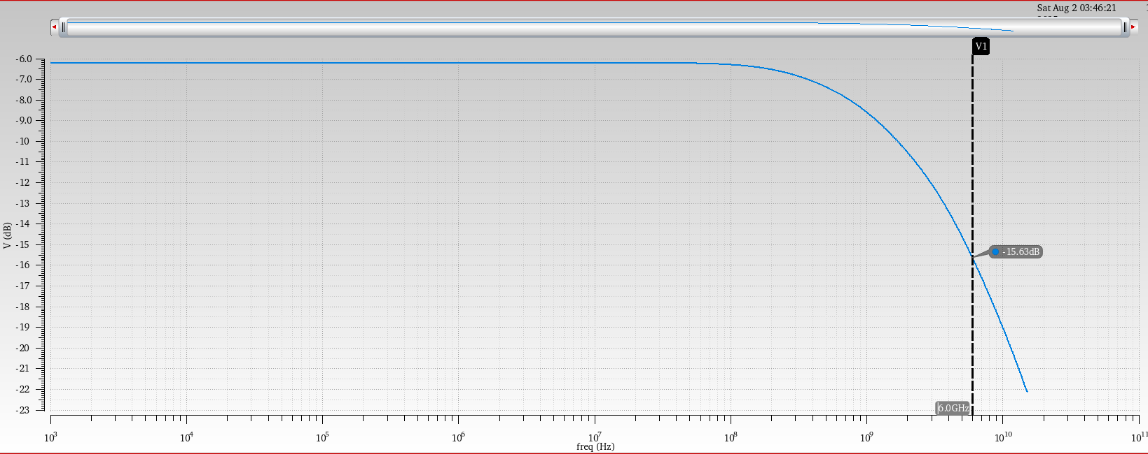
Frequency Response

Slide 13
CTLE

Slide 14
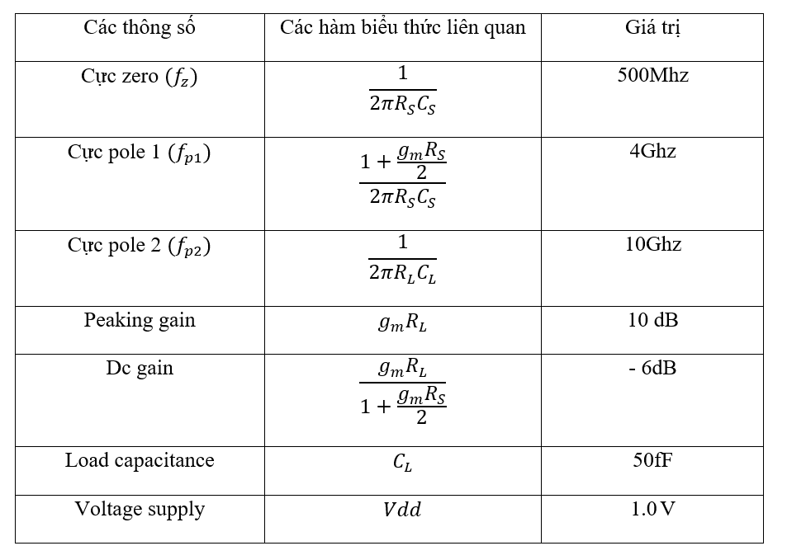
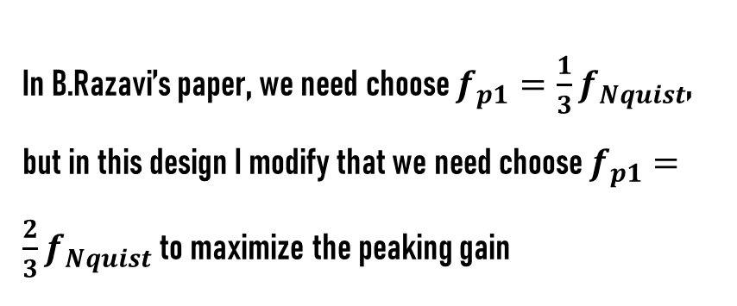
Calculation
In B.Razavi’s paper, we need choose $f_{p1}=\frac{1}{3}f_{Nquist}$, but in this design I modify that we need choose $f_{p1}=\frac{2}{3}f_{Nquist}$ to maximize the peaking gain
Also we need to ensure that DC gain not change to much so -6dB is choosed in this case

Slide 15
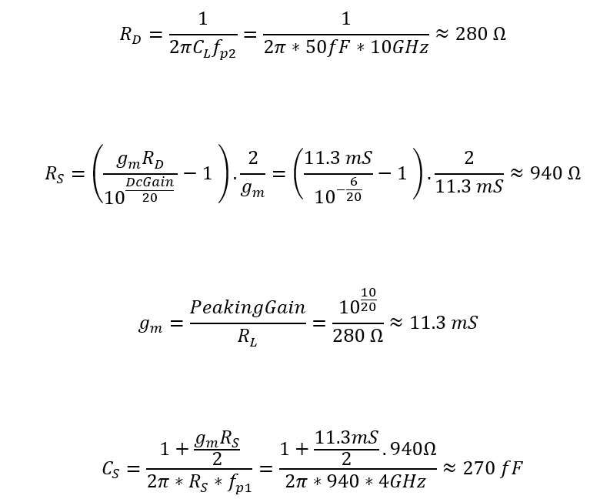

Slide 16
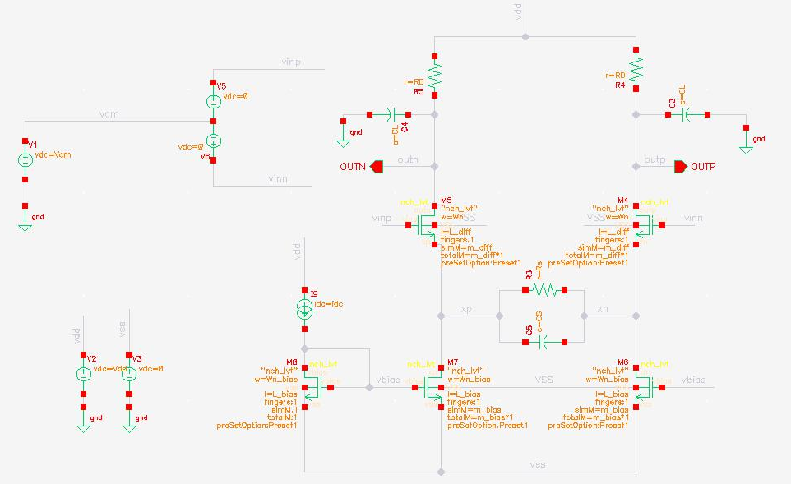
TESTBENCH
1. DC analysis

Slide 17
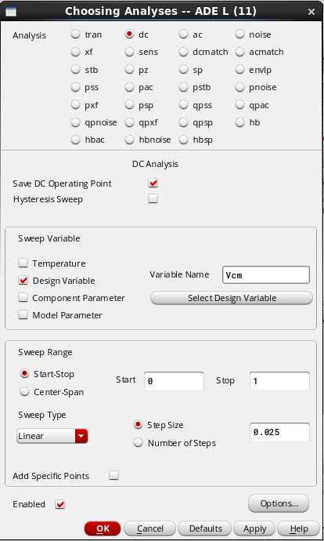
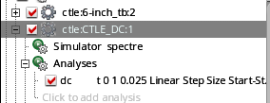
SET UP
Measurement

Slide 18

Result
The result is good , satisfied the requirements

Slide 19
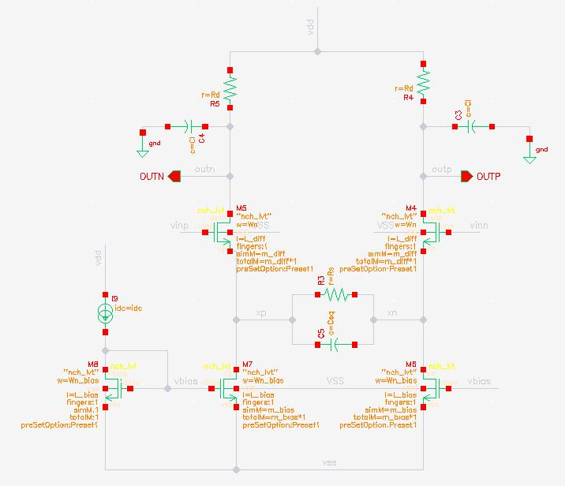
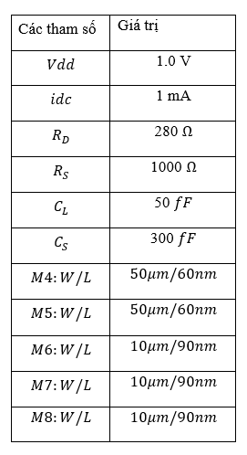
Choose size CMOS

Slide 20
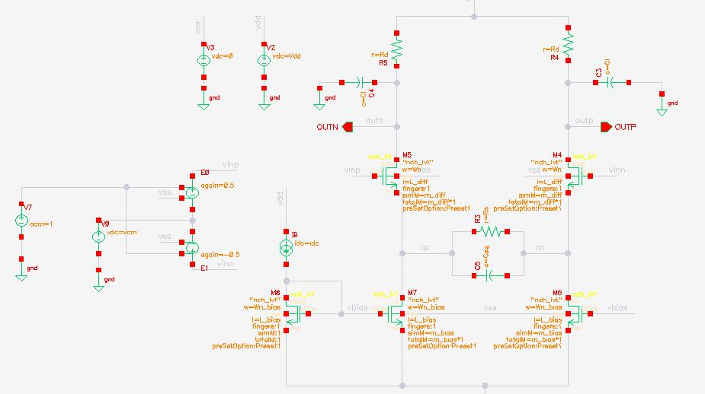
2. AC Analysis
TESTBENCH

Slide 21
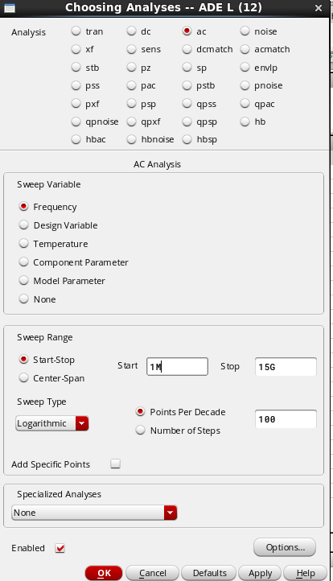
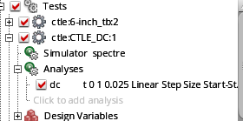
SET UP
Measurement

Slide 22
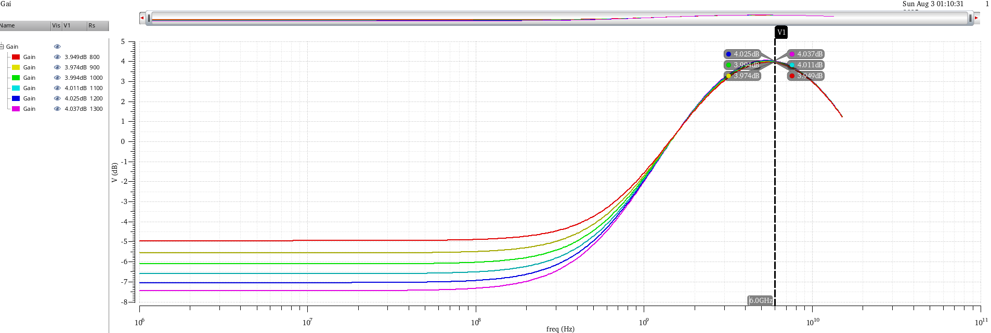
Result
Sweep Rs
DC gain descreased when Rs increased
Wz goes to lower frequency allow having higher peaking gain
Wz

Slide 23
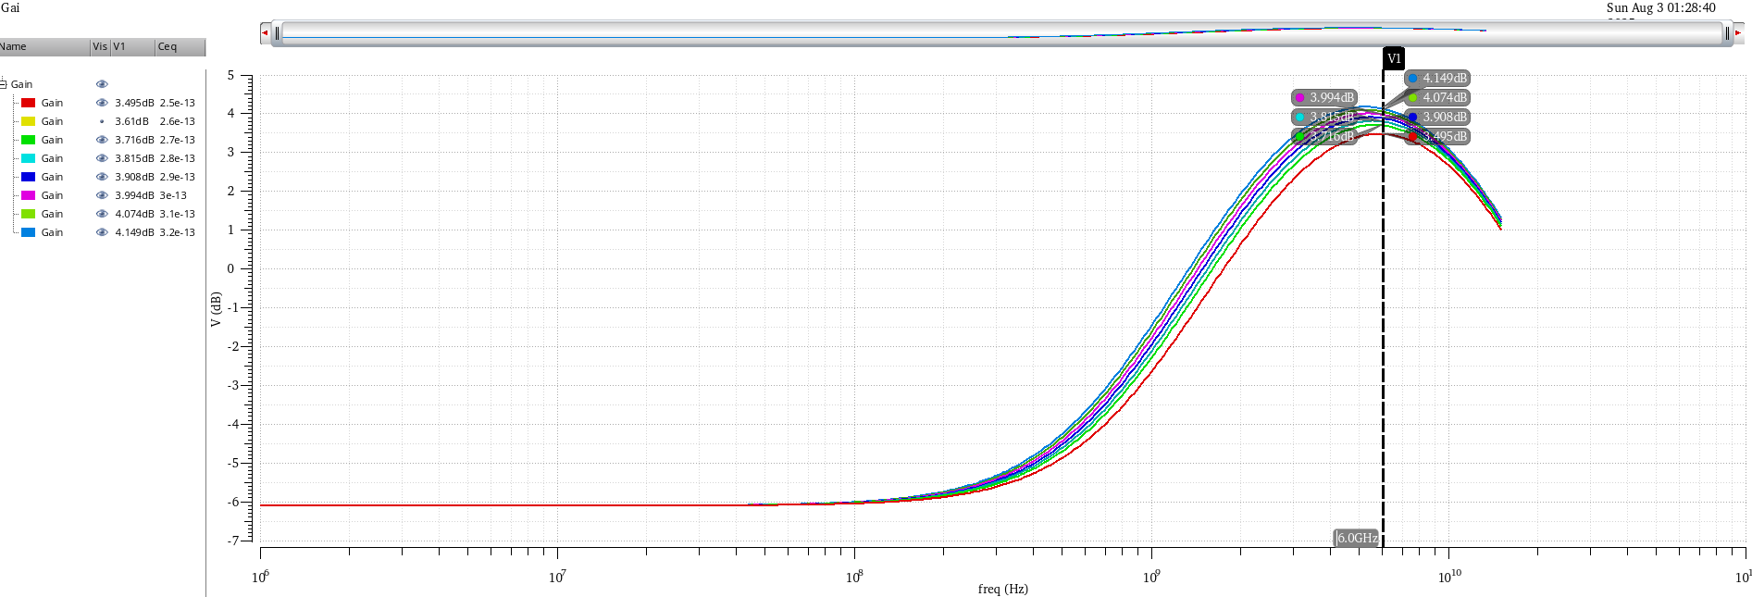
Result
Sweep Cs
As Cs increased , wp2 goes to higher frequency allow wider bandwidth, also we get higher peaking gain
Wz

Slide 24
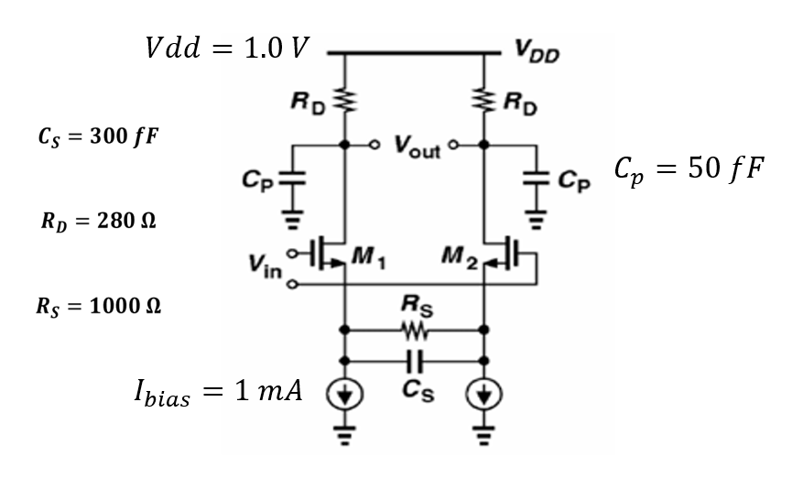
Design parameter

Slide 25
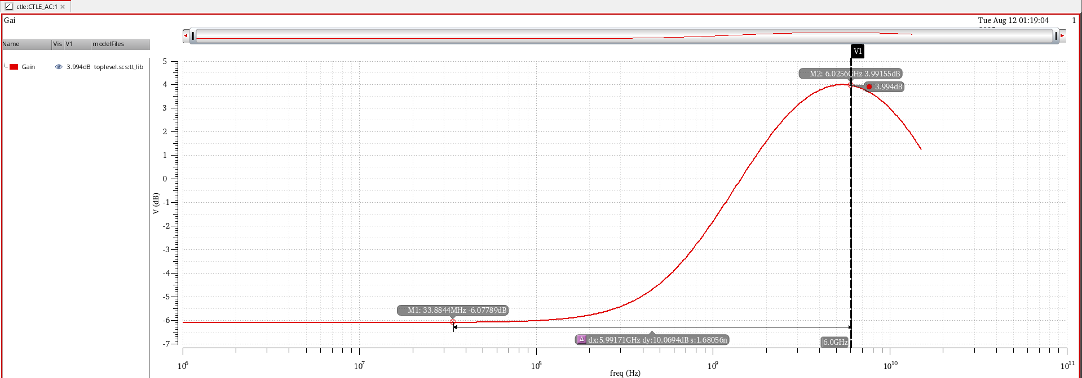


CTLE frequency response
Gain at Nquist $≈4dB$
Peaking gain = 10 dB
DC Gain $≈−6dB$

Slide 26
CTLE + Channel

Slide 27

SET UP
Measurement

Slide 28
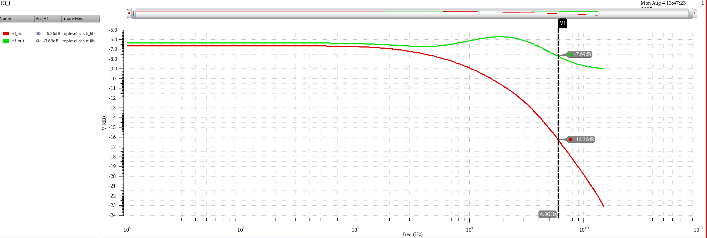
Frequency response
+8.57 dB
Dc gain doesn’t change to much

Slide 29
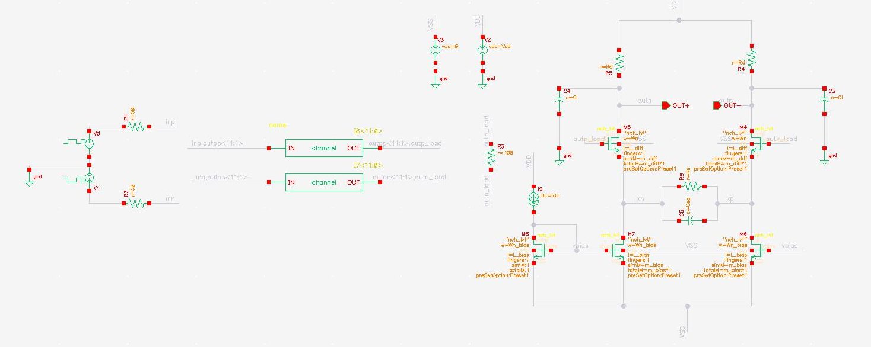
Transient Analysis
Testbench
Library : analogLib
Cell name: vrps
Zero/one value : Vcm +/- Vsw
Tperiod: 1/12G ( data rate)
Rise/fall time: 20ps

Slide 30
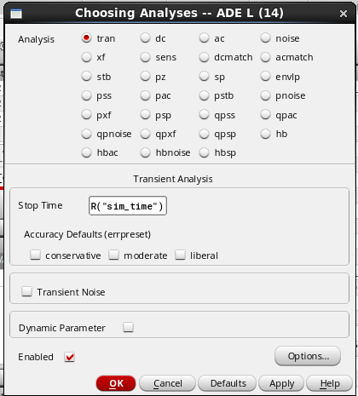
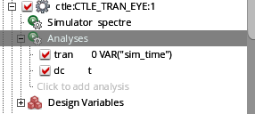
Set up

Slide 31
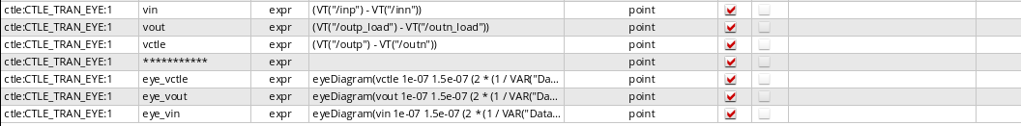
Measurement
2*UI
2*UI
Before CTLE
After CTLE

Slide 32
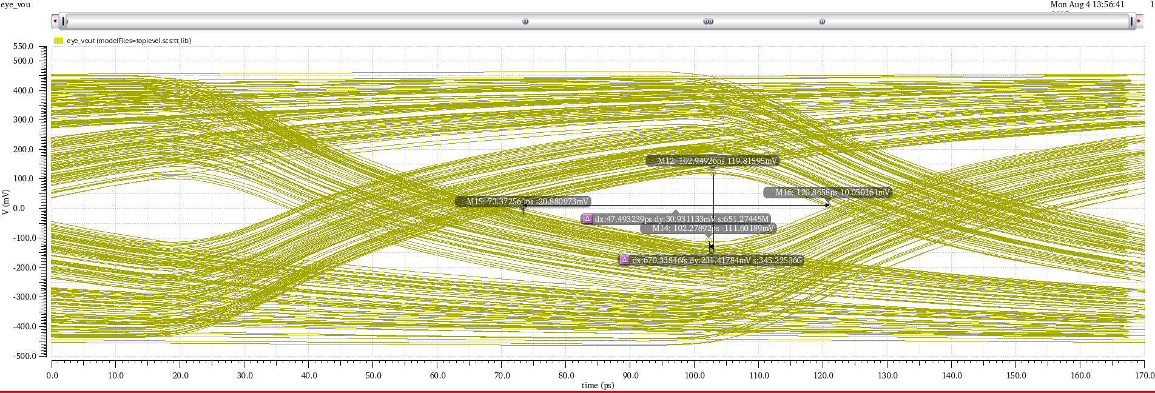
Result
Eye diagram
Before CTLE

Slide 33
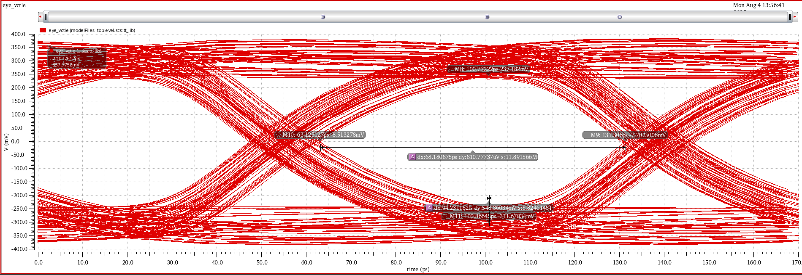
Result
Eye diagram
After CTLE

Slide 34
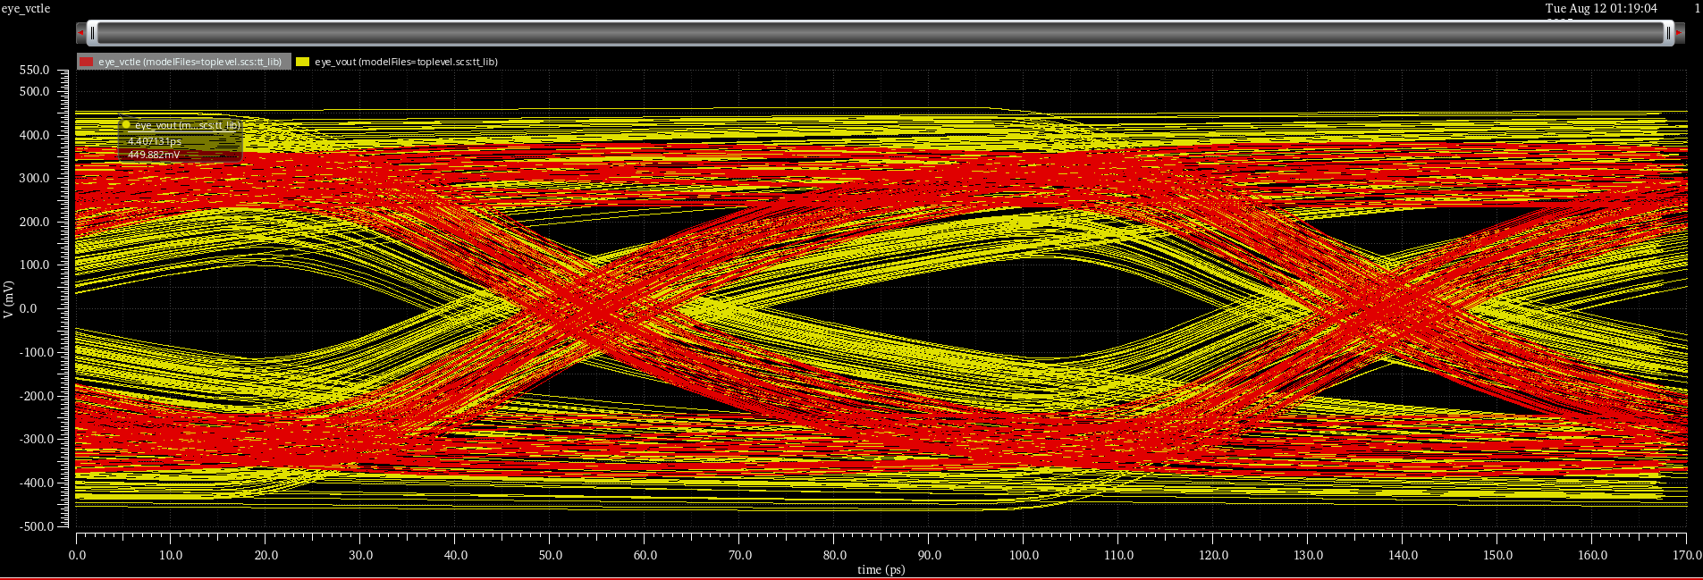
Eye diagram

Slide 35
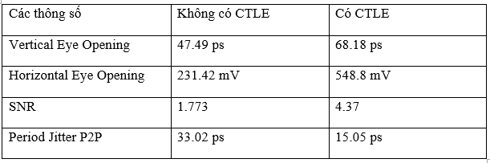
Comparison

Slide 36
Thank you

