Slide 1
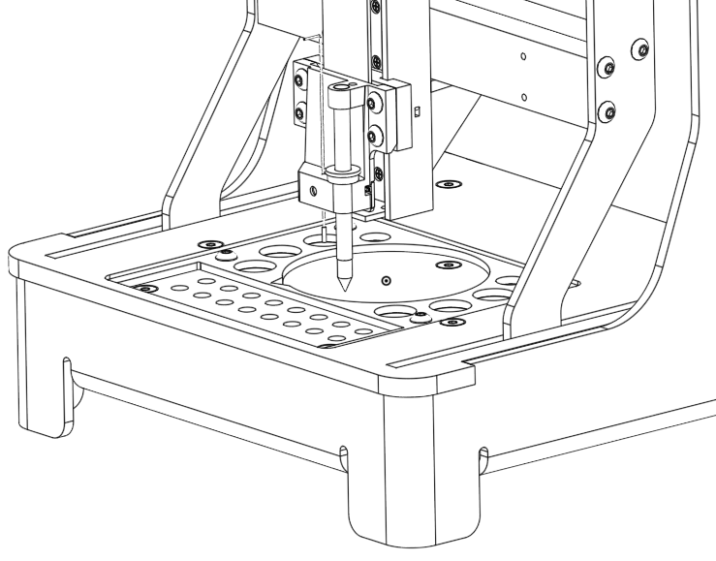
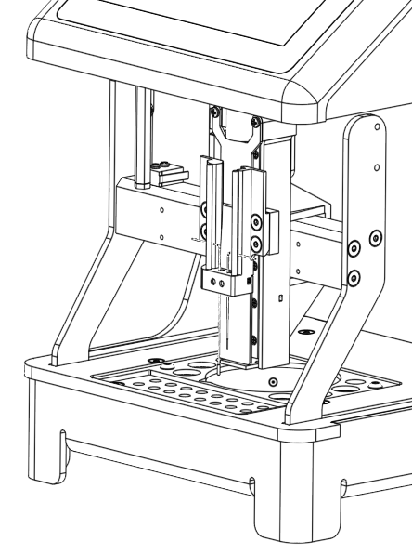
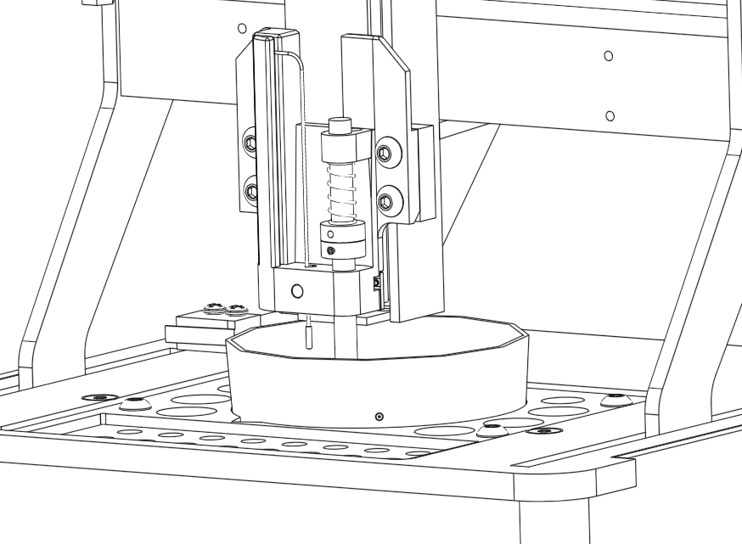
Collar resting on tool holder ledge
Point of split tip resting on bed
Spring
Needle clamp buttons
Top of collar just touching bottom of spring

Slide 2



Slide 3
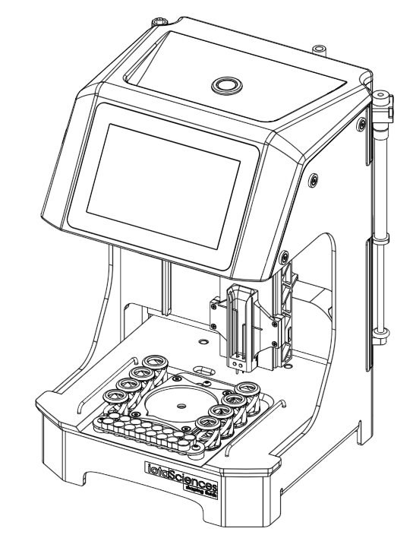
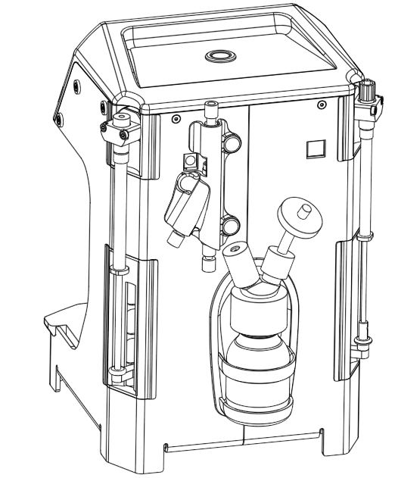
Touchscreen
Power button
Needle holder
Power socket
Valve assembly
USB port
Selection pillar (deployed)
Bed
Jetting syringe
FC40^{STAR} bottle
Dispensing syringe

Slide 4
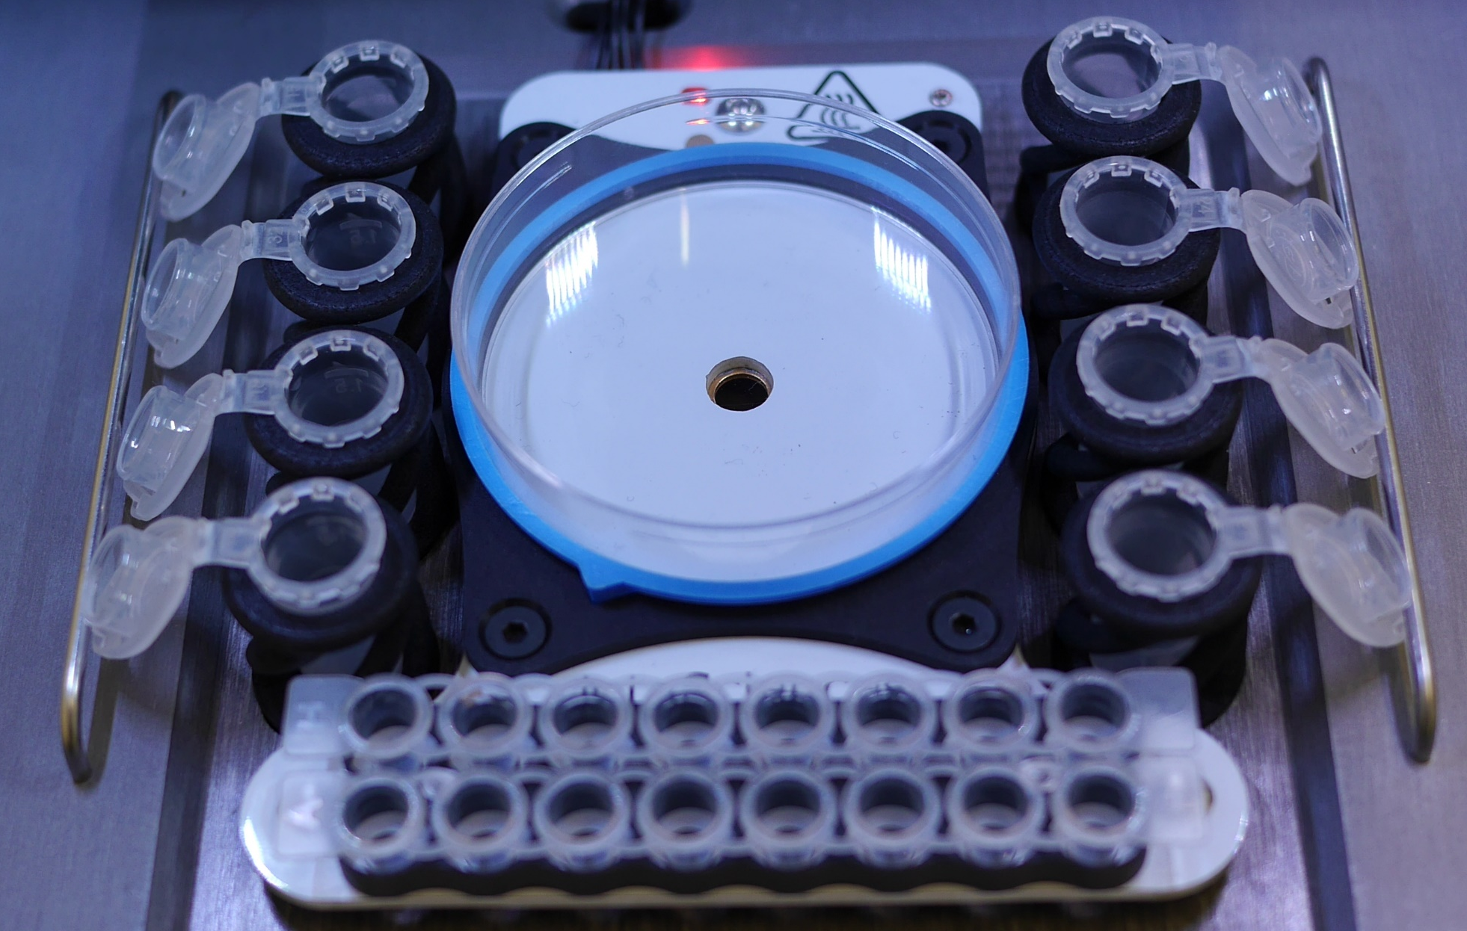
Dissociation reagent
60mm dish
FC40^{STAR} waste
PBS
Deionised water
Centrifuge tubes
70% ethanol
Centrifuge tubes
Media
Aqueous waste
Cells
Coloured locating ring
2x 8-tube PCR strip
(or 2x flat bottom 8-well strip)

Slide 5








