Slide 1
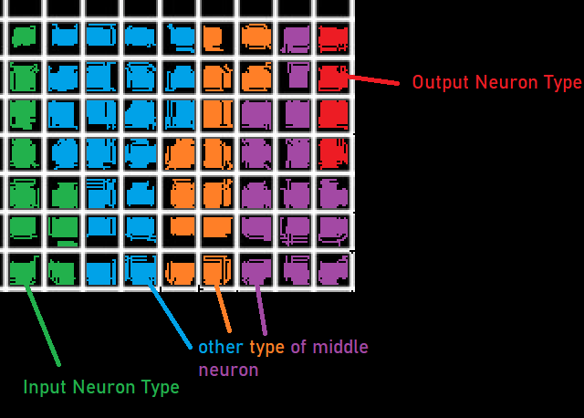
Model
Premise:
There exists a subset of these parameters that produce general intelligence.
Emergent Hebbian learning.
Neuron Attributes
potential
threshold
baseFreqOfModifyWeights
learninJuiceDissipationRate
Input Connection Attributes
Last10 <-percentage of last X received
Last100
Last1000
Last10000
DirectDischargeDeterminate
ConnectionWeightPortion
LearninJuice
Types of Processing Units:
1 input
|1-6|
1 output
*for each type of unit
Connections:
From Inputs to Hiddens
Within Hiddens
Hiddens to Outputs
*for each
function
StdNN
Usually just all the juices + whatever other parameters relevant
Neuron Functions Effect
receiveInput() modify
modifyThreshold() up/down threshold
modifyFreqOfModifyWeights() modify freq of learning
discharge() modify discharge
-> modifyAllInputWeights() up/down connection strength
-> releaseLearninJuice[]
Body:
Sleepiness
Insulin
Neuron Attributes (per type)
potential
neuronThresholdAve
neuronPortionVal

Slide 2
Neuron
Model
Connection Attributes
potential
in
Neuron Attributes (per type)
potential
neuronThresholdAve
neuronPortionVal
inputs (1-x)
soma (1)
outputs (1-x)
hidden
out
Model Attributes
hookupRandomOrFromInput: boolean
hookupNeuronDistance: number
hookupConnections: number: integer
neuronTypes: number: integer
neuronType: array
totalNeuronPortionSize : number

