Slide 1







Game Design Document
2022-01-05
Resources from Terrain
RTS with a destructible environment
Win Conditions:
(1) Defeat all enemy teams
(2) Win a generated treasure hunt
(3) Survive waves of enemies
Starting Pieces
Tier 1 blocks – metal
1x
3
Unit Control
Resources
Individual click and move units
Box select and move
Shift click to queue sequence of actions
Primarily used to build the tendies + eco upgrads
Primarily used for buildings and ships
Primarily used for advanced ships n buildngs
Used for advanced ships that do cool stuff
Ships
Utility
node
Tow Ship
80m 0c 0e
R-release line
Miner Ship
60m 0c 0e
R-redirect
particles

Slide 2
Base Unit Types
Damage Modifiers
Damage Modifiers
lazy ‘otiosum’
thorny ‘acanthus’
white ‘albiceps’
serpent ‘serpentis’
explosion ‘crepitus’
deep purple ‘atropurpureus’
spider ‘aranea’
heat ‘calor’
golden ‘aureus’
cliff dweller ‘rupes incola’
vibration ‘vibratio’
pale green ‘chloro’
eye ‘ommato’
Class Modifiers
african ‘africanus’
many ‘poly’
blue green ‘glaucus’
upright ‘erectus’
ordinary ‘trivialis’
many coloured ‘versicolor’
bulb ‘bulbus’
wild ‘ferus’
yellow ‘flavum’
guardian ‘custos’
greater ‘major’
tropical ‘tropicalis’
exalted ‘excelsus’
crowned ‘coronatus’
calamity ‘calamitas’
Attack Types
Collision (slow, ship)
Projectile explosive small (medium)
Projectile flak (medium)
Laser (instant)
Vibration (instant)
Lob (slow)
Homing projectile (medium)
Sticky Bomb (slow)
Particle gun (fast)
Fire sprayer (medium)

Slide 3
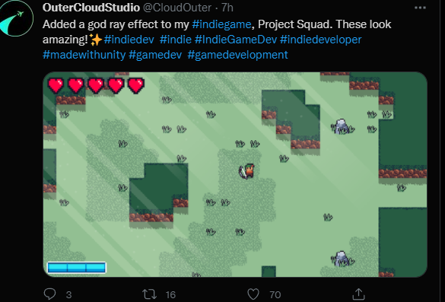
Supreme Final – END GAME Todo
2022-02-02
What is the aim:
The aim is to wipe out your opponent and survive the elements using war ships
-single UI - spawns from TC's
The quality and quantity of your army is determined by the resources you have
The resources come from
==unearthing the terrain using mining ships
==grabbing treasures using tow shps - and they ALLmust be brought back to TC
==waiting for farms to bring in food
==waiting for orb harvesters for energy (atracts ORB?!@)
U can build defence outposts that dont cost no food or nuthin
Defence strucutres include: walls (strengthen blocks next to it)
Turrets
Suckers, Repulsors, Gate walls (expensive)
-Repair boy (needs to be placed on terrain)
Entities (the sucker, the worm boY, trudeau black face)
Graphicals:
Ship thrusters
Mining debris
rent poly for mine beams
Only show one units waypoints at a time
Local only bouncy tcs? all buildings get pulld?
Ship has conditional polygon rendering
Gameplay TODOs:
Tow ship has max line tension before snap (only for holding enemies?)
Power Plant takes one orb at a time
R key for cons ships go home and drop off to TC
Technologies for buildings
Cons ship goes home after mine task complete
Cons ships bounce off each other
(3) entities
sucker
snake
lil fly bug
Tow rope has 5 joints?
Thick layers , more various treasures
Cloud, Vines(food), (nectar)(down), bomb plants(up)
New builder ui
****BUG water particles keep showing after their deletion because the watr particle is still listed in bogey radar of other ships which is where all the intel comes from
**Compartmentalized island areas for spawning
How ships are organized: Flex Ships
Metal Ships
Mirror Ships
General building :
min upgrade, max upgrades (tendie additions)
current tendie operation count
can build energy farms,
that act as attractors
-need builder beam back
ship team colours
cons ships can now build walls, gates, attractors, guard towers
Orb spawn and orb physics
(separate loop)
building that creates
TC grab and consume treasure functionality
tc pluck event
building upgrade additions
2022-01-14
unit upgrade additions
2022-01-14
TC queue edit ability and visual
2022-02-02
first game play through
2022-02-05
TC queue edit ability and visual
2022-02-15
floating builds
2022-01-24
implement buildings
2022-01-21
Release Date 1:
game finished
2022-03-09
sprint start
2022-01-09

Slide 4
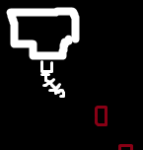
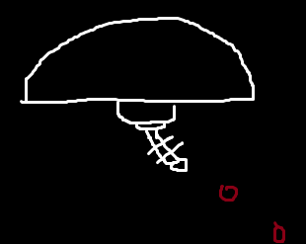
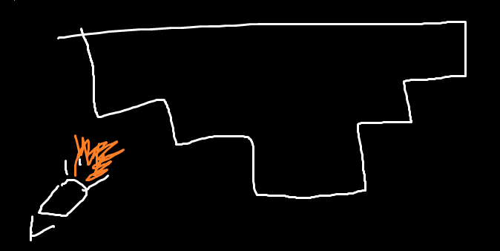
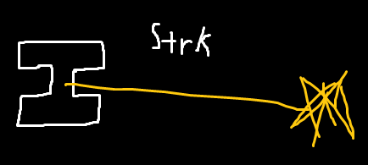
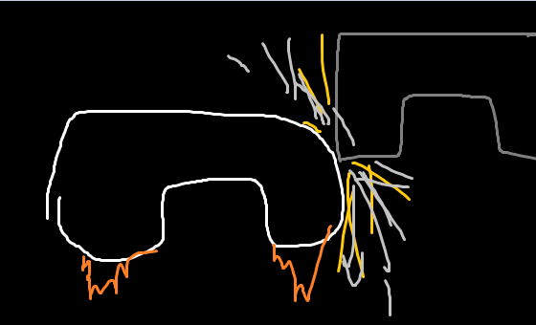
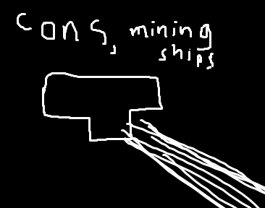
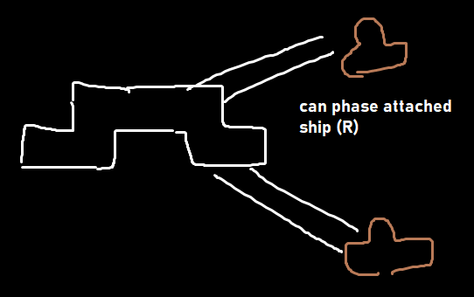
Buildings
Types of Orbs
Guard Tower
WIN
Central Processor
600m 100c 0e
+10 tendie
receives all
Farm
120m 0c 0e
+2 tendie
Continuously produces
Floating buildings:
Wall piece
Gate section 5x1 (orientation changeable)
Orb attractor (max limit b4 breking)
Guard Block (Gunndam, )
--
m=5 sun orbs
m=10
m=2
m=2
Radius that it can harvest orbs from
All buildings get upgraded through having more tendies spawn and inhabit them
Shields take all damage of full shots
Velocity (Impact)
Instant (Laser)
Payload (Unpropelled)
Payload (Propelled)
Weapon Movement
takes time to move through space
Instant effect
Dead Ass Bomb Drop,
Moves through space
target seeking missile
to deliver some destroy
Damage Type
Blast Damage
* tow ships use their ram ability
Good against mirror armor
*All blocks have a regenerative timer that resets when it takes one modicum of damage
healing = a*(x^1.01)
Vibration damage is the best way to clear away blocks, (constant stream of damage, and blocks have very weak defence to it)
Laser Damage
Good against against plate armor
Vibration Damage
Good against twig armor
Building Tools
TC
Stun Damage
Building Control UI
Effects shields,
Engine capability,
Weapon mobility
g+^
Wood: 18
Food: 6
Gold: 2
4/25
pop_
5 wood
2 food
1 food
AA+^
DD+^
o+^
w+^
f+^
3 iron
1 food
8 iron
4 food
15 wood
12 food
10 wood
9 food
10 wood
9 food

Slide 5



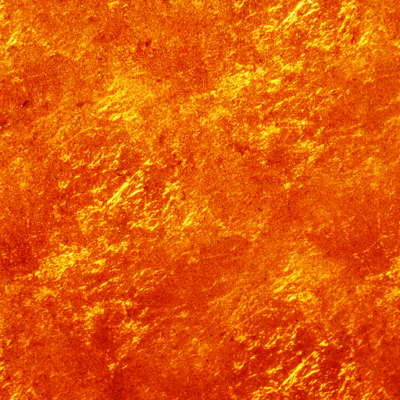
World and Gaia Composition
Resources
Primarily used for tendie creation
WIN
Primarily used for buildings and some starting ship units
Primarily used for ship units
Used for elite ship units, special upgrades
Building Tools
Mining Tools
Tier 1 buildings:
food farm (production)
barracks (unit production)
wood barricade (block)
wire gate (block-gate)
Tier 1 blocks – food
1x food production
5x food production
Tier 2 buildings:
metal forge (production)
1x metal production
7x metal production
Tier 2 blocks – metal production
Tier 3 blocks – crystal mines
1x crystal production
7x crystal production
*All blocks have a regenerative timer that resets when it takes one modicum of damage
healing = a*(x^1.01)
Vibration damage is the best way to clear away blocks, (constant stream of damage, and blocks have very weak defence to it)
Runner ships
-non controllable
-only carries resources from building to tc
World Generation always various versios of this “cake layered” format,
optionals:
-cavern generation
-treasure frequency
-islands (+size of)
-large base?.
-water bottom?
-gaia spawn rate? <- neutral players
-portals
Runner ships
-non controllable
-only carries resources from building to tc
THere is a case of gaia units that are aggressive and living in certain locations of the map?
TC

