Slide 1
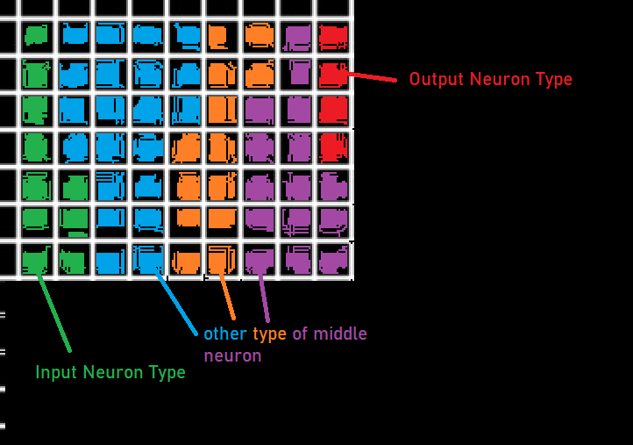
Model
Per-Processing Unit
Connection Attributes
potential
Neuron Attributes (per type)
potential
neuronThresholdAve
neuronPortionVal
inputs (1-x)
soma (1)
hidden
outputs (1-x)
in
Model Attributes
hookupRandomOrFromInput: boolean
hookupNeuronDistance: number
hookupConnections: number: integer
neuronTypes: number: integer
neuronType: array
totalNeuronPortionSize : number

Slide 2
Neuron
Model
Connection Attributes
potential
in
Neuron Attributes (per type)
potential
neuronThresholdAve
neuronPortionVal
inputs (1-x)
soma (1)
outputs (1-x)
hidden
out
Model Attributes
hookupRandomOrFromInput: boolean
hookupNeuronDistance: number
hookupConnections: number: integer
neuronTypes: number: integer
neuronType: array
totalNeuronPortionSize : number

