Slide 1
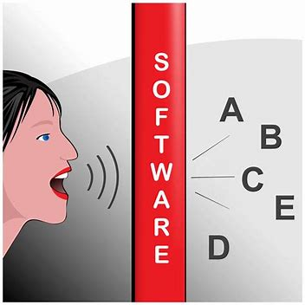
Improving Accessibility: Telephone-based Automatic Speech Recognition for Users with Disfluent Speech

Slide 2

Speech and Fluency
Fluent speech:
…has a consistent flow with which sounds, syllables, words phrases etc. are joined together to form utterances
Disfluent speech:
…characterized by repetitions and prolongations of sound as well as blockages to the flow of speech

Slide 3
ASR and Fluent Speech
ASR designed primarily to process fluent speech
Requires a consistent flow of speech
Threshold for pauses is typically short (e.g. 2-3 seconds)
Flow of speech represented as waveform
Matched to the most likely set of words

Slide 4
ASR and Disfluent Speech
ASR struggles to handle key characteristics of disfluent speech
Repetitions and prolongations
Modify the shape of target sound
E.g. “home” becomes "h-h-h-home” or “hhhhhhhh-ome”
Blockages
Cause lengthy pauses
With/without accompanying repetitions
E.g. ”I…[block]…am here”
E.g. ”I a-a-a-a-am here”

Slide 5
Survey: Attitudes towards ASR
Gathered general attitudes towards ASR
100+ people, fluent and disfluent
Of disfluent population, most common usages were
Using the telephone (customer service)
Using voice assistant (Siri etc.)
Overall, less positive view of ASR for disfluent population vs fluent
Requires level of fluency and speed of utterance unable to produce
Accuracy of recognition of stammered speech reduces effectiveness of system

Slide 6
Project Goals
Conduct research into challenges faced specifically by people with disfluent speech when using ASR
Iteratively build and test working prototypes of ASR systems which offer solutions to these challenges

Slide 7
Project Outline
Phase 1
Data Collection and Analysis
Reading exercise using phonetically balanced text
Manual analysis + survey feedback to identify problems
Phase 2
“Input” Problem
Multiple prototypes
Iterative user testing/feedback
Phase 3
“Output” Problem
Pre-ASR audio manipulation
Post-ASR word replacement

Slide 8
Accessibility Problem (1)
‘Input’ Problem
ASR pause-threshold usually very short, typically 2-3 seconds (e.g. Siri, Google, Alexa etc.)
Any blockages to the flow of speech causes recognition to timeout
Timeouts cause user to restart usage, often resulting in same problem

Slide 9
Accessibility Problem (2)
‘Output’ Problem
Stammered parts of speech often unrecognizable by ASR resulting in missing or incorrect recognitions
E.g. “My name is b-b-b-b-ben” most likely to be misrecognized due to the preceding repetition
Higher likelihood of misrecognitions

