Slide 1
Chkoba Game
Famous Tunisian Card Game

Slide 2
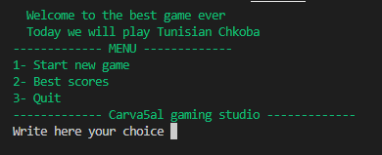
First menu
You can choose by numbers
1- Start new game or 2- best scores or 3- Quit the game

Slide 3
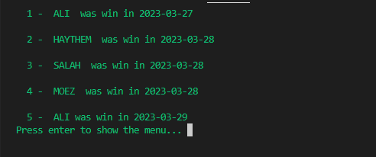
Best scores
When you choose 2 it will show gamers name that win the game with date that they win
You can return to the menu

Slide 4

Quit
When you choose 3 it will show that are you sure to quit the game or not if you write q the game will quit (close )

Slide 5
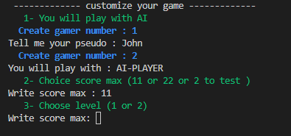
Start game
When you choose 1 it will show a menu to costmize the game
1- Name of the players
*John is the player
*AI-PLAYER is the second player
2- Score max:
the score when the player get it he will win
3- lavel can be
1 is random layer (idiot player haha )
2- is an algorithm that he will play with think and calculate cards available in the game

Slide 6

Chance card
Its the first card that you will get it and you had right to accept it or not - If you write yes accepted it will be one of your cards
- If you write no the cards will be in one of louta cards

Slide 7
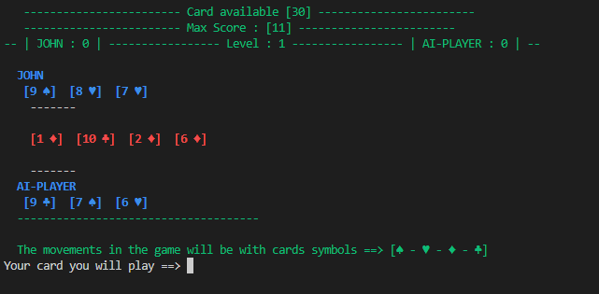
Game Table

Slide 8
John Movement Humain Play
Fine

Slide 9
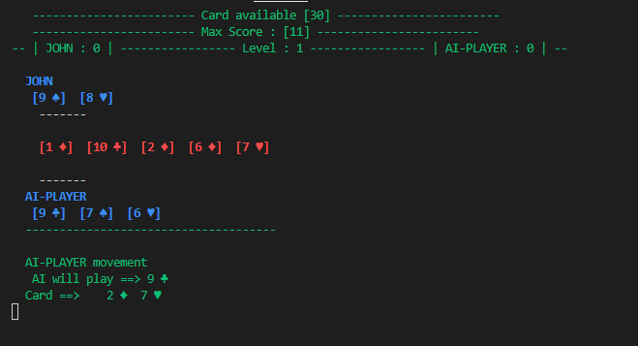
AI Movement with randomly way
This move is bad cause cause AI Can play 7 ♠ is better cause 7 add value in score better than this move

Slide 10
This games will Loop Until the available cards will be equals to zero
And the game will show marks that each player get it
If on of player get the max Score this player will win or the table will restart

Slide 11
How AI Player Think ???
AI Will Choose the movement based on 4 steps to verify
1- Chkoba ? It mean if he can play a card that can get all of louta cards ( will get automatically 1 point in score with all benifts of cards that he will get it )
2- EL 7aya ? Its mean that he will 7 ♦ from Louta cards ( will get automatically also 1 point in score )
3- Best Combination ? It mean he will get the best cominition to be more near to get points from bermila ( max 7 or 6) or dinari ( max ♦ ) or karta ( max cards )
4- random ? Its mean he will play random cards cause his cards are faild to get card from louta but it still check to make the other player lose and can’t get any card
JOHN Cards
Louta Cards
AI-Players Cards

Slide 12
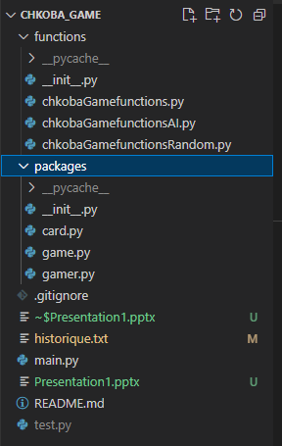
Project Architect
Package that get Python files for functions used in game
1- Principal functions for the game
2- Functions used for AI Algorithm to Play
3- Functions used for Random Algorithm to Play
1
2
3
Package that get Python files for functions used to define classes
1- card (value - symbol)
2- the game (list players – Level …)
3- gamer ( username , Score …)
Text File that had the history of winers
Main Program
Test File (test functions )

