Slide 1
Unit Lemmas for Detecting Requirement and Specification Flaws
ISSRE 2020
Ashlie (Ben) Hocking, Jonathan C. Rowanhill, Ben L. Di Vito
October 2020

Slide 2
Goal and Approach
Goal: Detect flaws in formal requirements and specifications early in the design process.
Approach:
Ask key questions about functions and lemmas in the formalization
Demonstrate that functions and lemmas have desired properties

Slide 3
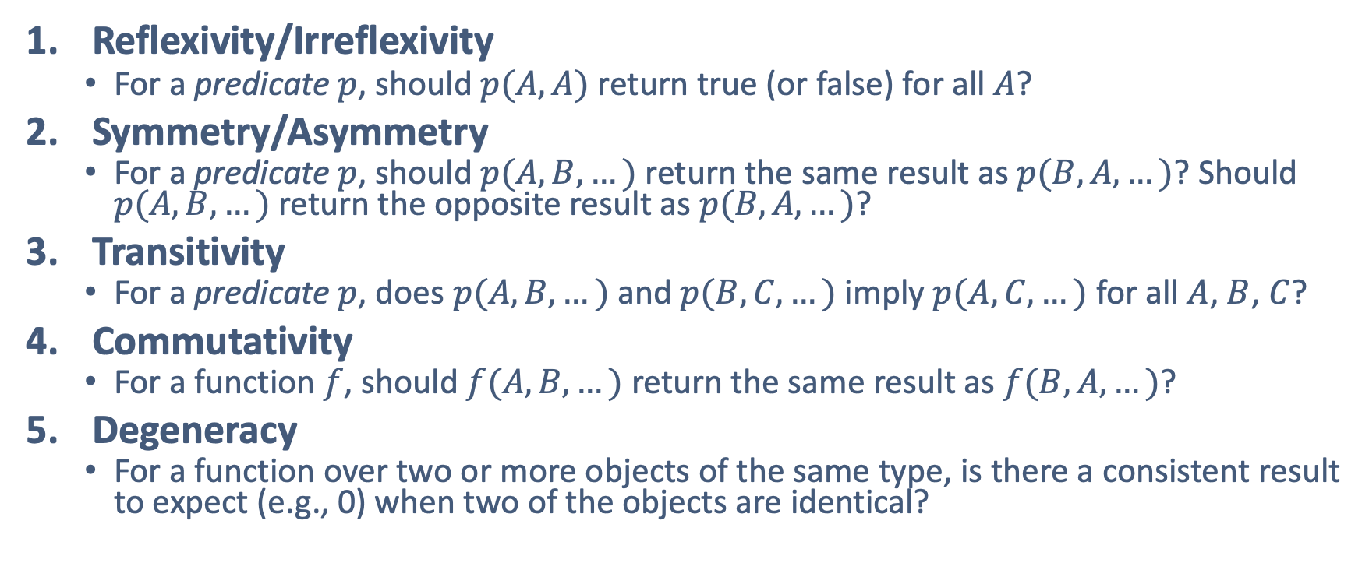
Common Categories of Unit Lemmas (1 of 3)
Reflexivity/Irreflexivity
For a predicate $p$, should $p(A, A)$ return true (or false) for all $A$?
Symmetry/Asymmetry
For a predicate $p$, should $p(A, B, …)$ return the same result as $p(B, A, …)$? Should $p(A, B, …)$return the opposite result as $p(B, A, …)$?
Transitivity
For a predicate $p$, does $p(A, B, …)$ and $p(B, C, …)$ imply $p(A, C, …)$ for all $A$, $B$, $C$?
Commutativity
For a function $f$, should $f(A, B, …)$ return the same result as $f(B, A, …)$?
Degeneracy
For a function over two or more objects of the same type, is there a consistent result to expect (e.g., 0) when two of the objects are identical?

Slide 4
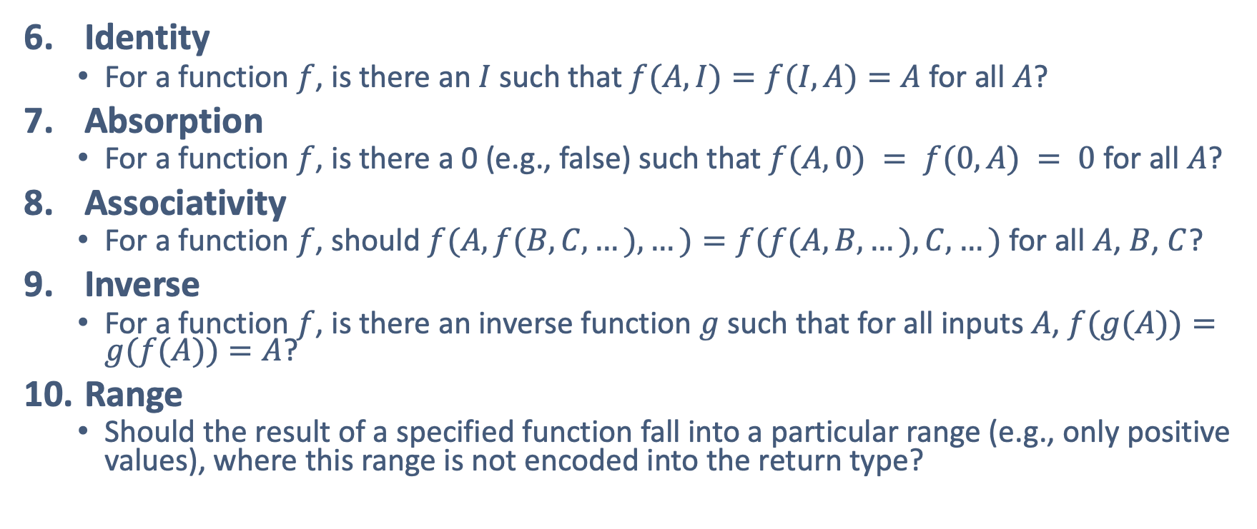
Common Categories of Unit Lemmas (2 of 3)
Identity
For a function $f$, is there an $I$ such that $f(A, I)=f(I, A)=A$for all $A$?
Absorption
For a function $f$, is there a 0 (e.g., false) such that $f(A, 0) = f(0, A) = 0$ for all $A$?
Associativity
For a function $f$, should $f(A, f(B, C, …), …)=f(f(A, B,…),C,…)$ for all $A$, $B$, $C$?
Inverse
For a function $f$, is there an inverse function $g$ such that for all inputs $A$, $f(g(A))=g(f(A))=A$?
Range
Should the result of a specified function fall into a particular range (e.g., only positive values), where this range is not encoded into the return type?

Slide 5
Common Categories of Unit Lemmas (3 of 3)
Composition: Should a predicate over two objects always be true (or always false) when one argument (e.g., point) is a component of the other (line)?
Alternate Formulation: Is there an alternate formulation of the specification component that is equally valid?
Logical Contradiction: Can the specification be used to prove false is true? If a specification can be used to prove false, then we know a flaw exists.

Slide 6


Example (Tri-Valued Logic)
tril: TYPE = {TRIKNOWNTRUE, TRIKNOWNFALSE, TRIUNKNOWN}; t?(t: tril): boolean = (t = TRIKNOWNTRUE); f?(t: tril): boolean = (t = TRIKNOWNFALSE); u?(t: tril): boolean = (t = TRIUNKNOWN);
eqt(a, b: tril): tril = IF t?(a) AND t?(b) THEN TRIKNOWNTRUE ELSIF f?(a) AND f?(b) THEN TRIKNOWNTRUE ELSIF u?(a) OR u?(b) THEN TRIUNKNOWN ELSE TRIKNOWNFALSE ENDIF; nott(a: tril): tril = IF t?(a) THEN TRIKNOWNFALSE ELSIF f?(a) THEN TRIKNOWNTRUE ELSE TRIUNKNOWN ENDIF; andt(a, b: tril): tril = IF f?(a) OR f?(b) THEN TRIKNOWNFALSE ELSEIF t?(a) AND t?(b) THEN TRIKNOWNTRUE ELSE TRIUNKNOWN ENDIF; ort(a, b: tril): tril = IF t?(a) OR t?(b) THEN TRIKNOWNTRUE ELSIF f?(a) AND f?(b) THEN TRIKNOWNFALSE ELSE TRIUNKNOWN ENDIF;
tril_equals_reflexive: LEMMA FORALL(a: tril): t?(eqt(a,a));
DeMorgan1: LEMMA FORALL(a, b: tril): nott(ort(a, b)) = andt(nott(a), nott(b));
DeMorgan2: LEMMA FORALL(a, b: tril): nott(andt(a, b)) = ort(nott(a), nott(b));
excluded_middle: LEMMA FORALL(a: tril): t?(ort(a, nott(a)));

Slide 7
Example (Parallel Lines)
% From the NASA library Vect2 : TYPE = [# x, y: real #]
cross(v1, v2: vector_2d): real = v1`x * v2`y - v1`y * v2`x;
are_vectors_collinear?(v1, v2: vector_2d): {b: bool | b = (abs(v1 * v2) = norm(v1) * norm(v2))} = cross(v1, v2) = 0;
are_vectors_collinear_reflexive: LEMMA FORALL(v: vector_2d): are_vectors_collinear?(v, v);
are_vectors_collinear_symmetric: LEMMA FORALL(v1, v2: vector_2d): are_vectors_collinear?(v1, v2) = are_vectors_collinear?(v2, v1);
are_vectors_collinear_transitive: LEMMA FORALL(v1, v2, v3: vector_2d): (are_vectors_collinear?(v1, v2) AND are_vectors_collinear?(v2, v3)) IMPLIES are_vectors_collinear?(v1, v3);

Slide 8
Fin

