Slide 1
Image Compression
Computer Vision, Spring 2017, Seoul National University
Horner Benjamin, Steiner Patric, Penas Pastilla Francisco Javier

Slide 2
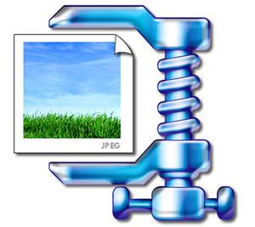
Goal
Invent our own image compression algorithm
Compare compression size to common image compression techniques

Slide 3
Image and Pixel representation
Matrix of pixels → H x W x 3
each pixel has 3 values between 0 and 255 (for RGB)
0 0 1 1 0 0 3 3 0 0 0 0 0 0 0 0 0 0
0 0 1 1 0 0 3 3 0 0 0 0 0 0 0 0 0 0
5 5 1 1 5 5 0 0 3 3 0 0 3 3 3 3 3 3
5 5 1 1 5 5 0 0 3 3 0 0 3 3 3 3 3 3
0 0 1 1 0 0 0 0 0 0 3 3 4 4 4 4 4 4
0 0 1 1 0 0 0 0 0 0 3 3 4 4 4 4 4 4

Slide 4
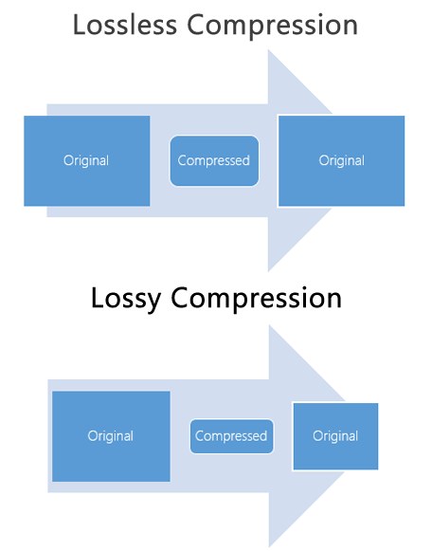
Common compression algorithms

Slide 5
Idea for Algorithm
Lossless compression
Find pixelgroups that occur more than once in the image (repeating patterns)
Replace pixelgroup with a placeholder (key)
Store original value associated with the key in a dictionary
→ Save dictionary and the compressed image
→ Less storage than Bitmap

Slide 6
0 0 0 0 0 0
0 0 1 2 0 0
1 2 1 2 1 2
0 0 0 0 0 0 0 0 1 2 0 0 1 2 1 2 1 2
A A A A B A B B
Dict:
A: 0 0
B: 1 2
C C B A B B
Dict:
A: 0 0
B: 1 2
C: A A

Slide 7
Problem: Finding repeating patterns
Naive solution: compare each pair of pixels to each other pair of pixels
replace the found pairs
repeat until there are no more pairs
Works, but really slow→ O(n^3)
Better solution: Use a hashtable to count that pairs occur more than once
Still a problem: Hashtable is way too big!
→ Solution: Use matlab sparse matrix function (only store non-zeros)
a lot faster! → worst case O(n^2), best case O(n * log(n))

Slide 8
Problem: Described algorithm only works for single value pixels (grayscale images)
We want RGB!
Naive solution: Just run algorithm 3x (once for R, G, B)
Better solution: Treat image as single vector!
Advantage: pairs with same value, even from different colors can use the same dictionary entry
→ Better compression (only 1 dictionary instead of 3)
0 0 2 1 2 1 3 3 2 3 3 3 2 4 5 7 3 3 2 1 0 0 1 2 3 3 2 2 2 1 2 3 3 2 2 1 1

Slide 9

Results – Initial Reduction
100 x 100

Slide 10

Results – Initial Reduction
160 x 230

Slide 11

Results – Initial Reduction
*White Pixels*
648 x 1152

Slide 12
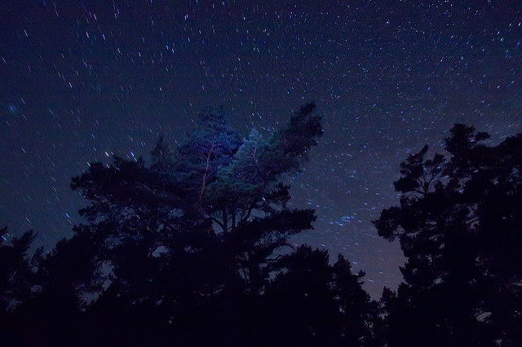
Results – Initial Reduction
426 x 640

Slide 13
Results – Dictionary Reduction
 | SNU Paint | Cat | White | Night
Reduced | 1 | 1 | 15 | 0
Only occasionally useful

Slide 14
Results – Huffman Encoding
Only considering smaller size reduction often meant a larger dictionary and more unique values. This is bad for Huffman encoding
Using a threshold of 25 produced the best results when including encoding.

Slide 15
Results – Final Size (using Huffman Encoding)
 | Huffman on Raw Image | Our Size | PNG Size
SNU Paint | 9.12 KB | 4.25 KB | 3 KB
Cat | 113 KB | 104 KB | 72.9 KB
Night | 637 KB | 538 KB | 79.0 KB
White | 279.94 KB | 39.38 B | 3.52 KB

Slide 16
Demo

Slide 17
Improving the Algorithm
Goal: better compression
→ Make it lossy (Trade-off: sacrifice image quality to find more patterns)
Idea: Smooth image before compressing to reduce noise
→ Did not work, because gradients alongside edges
So: Do the opposite, sharpen the image:
→ Only worked for certain images (not for simple images like perfect checkerboard)
Best (and easiest) solution: reduce the colors of the image
Consider options to optimise encoding for our particular problem

Slide 18
Conlusion
Our algorithm works extremely well for simple images
Even better than PNG for certain cases!
Works ok for normal images, but PNG is better
It is too slow to consider pixels in image compression, should rather consider the whole matrix

Slide 19
Q & A

