Slide 1
News for IOI Trainees
The materials of last week until end of this semester
WILL NOT appear in the actual IOI
  Outside of the syllabus
  But too bad (or good?), you will have to learn them in advance ☺
NOI 2012 results are out
  I have updated IOI workshop page with your achievement
    Congratulations once again
  New entrants: Haikal (NUSH), Yao Zexi (RI), Lee Zhi Wei, Louise
  & Wu Xin Yu (Raffles Girls’ School)
Reminder: Shen Chuanqi’s extra training this Saturday
  17 March 2012, 10am-end, PL6
CS3233 - Competitive Programming,
Steven Halim, SoC, NUS

Slide 2


JOIN THIS
CS3233 - Competitive Programming,
Steven Halim, SoC, NUS

Slide 3
Be A Problem Author HW
Generally well done
  (I am left with a few more submissions to grade)
Only problem description/writeup/solution idea are checked at this stage
  Test data will be checked in the near future
Some of the better ones will appear in future contests ☺, full credits to the original problem author
CS3233 - Competitive Programming,
Steven Halim, SoC, NUS

Slide 4
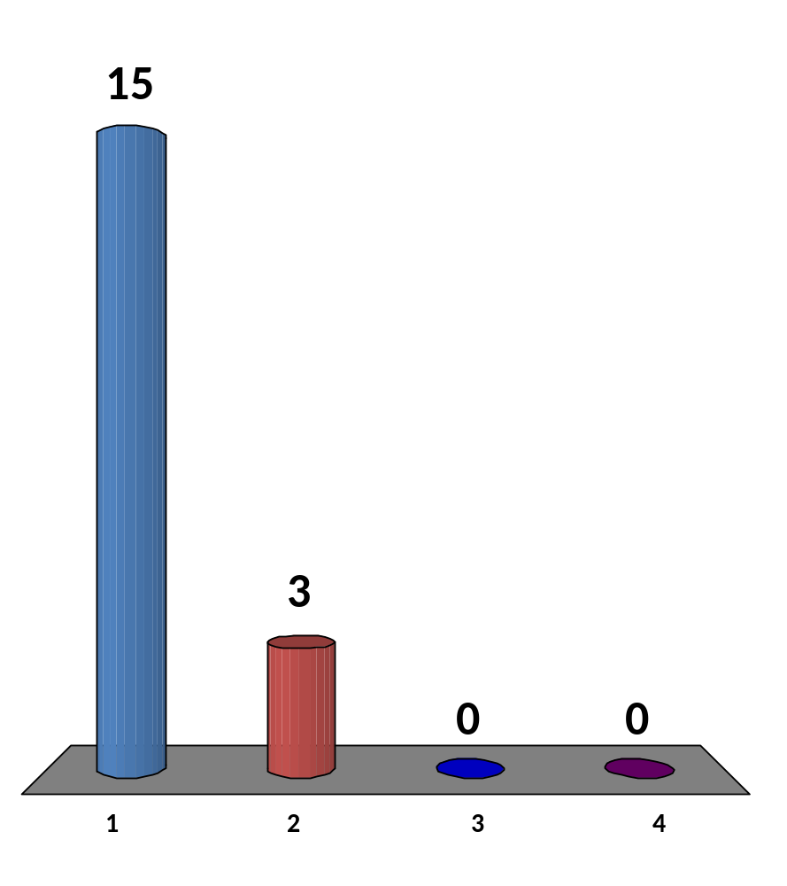
CS3233 so far…
Amount of new knowledge gained
I have learned a lot of stuffs ☺
I have learned some stuffs
I learned a few new stuffs, the rest are just revisions
I learned no new stuffs ☹
Steven post lecture commentary:
I realized that the same slide last year gave me different results (with some ~2-3 students gave me answer 3 or 4)
18 of 120
CS3233 - Competitive Programming,
Steven Halim, SoC, NUS
Notes:
2012
Almost everyone say 1
3 say 2
No one say 3 or 4
2011
Majority 1-2
Few say 4

Slide 5
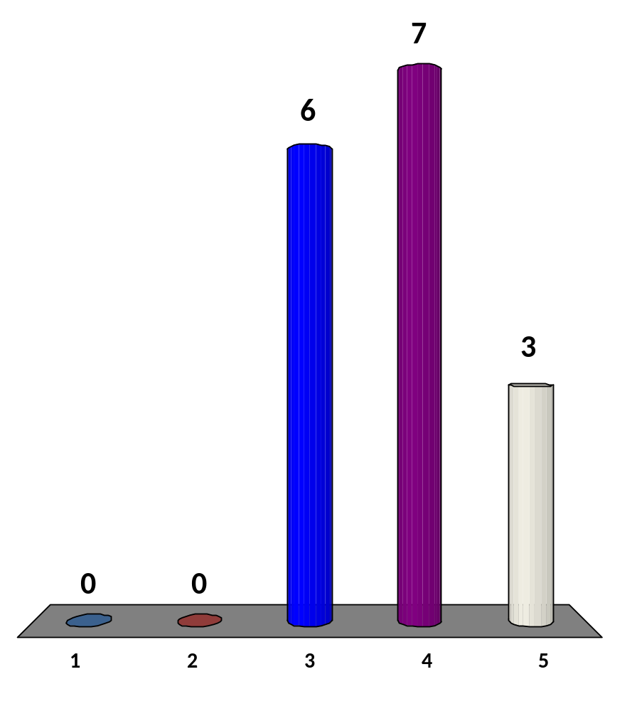
CS3233 so far…
Level of difficulty (focus on mini contests)
Too easy :O
Easy
Just right, A very easy, B medium, and C really test our creativity/ problem solving skills
Difficult, even A/B are sometimes tricky (and have D/E)
Too difficult ☹
Steven post lecture commentary:
Answer 3-4 is OK
15 of 120
CS3233 - Competitive Programming,
Steven Halim, SoC, NUS
Notes:
2012
Majority 3-4
2011
Majority no 3, but the rest 4/5

Slide 6
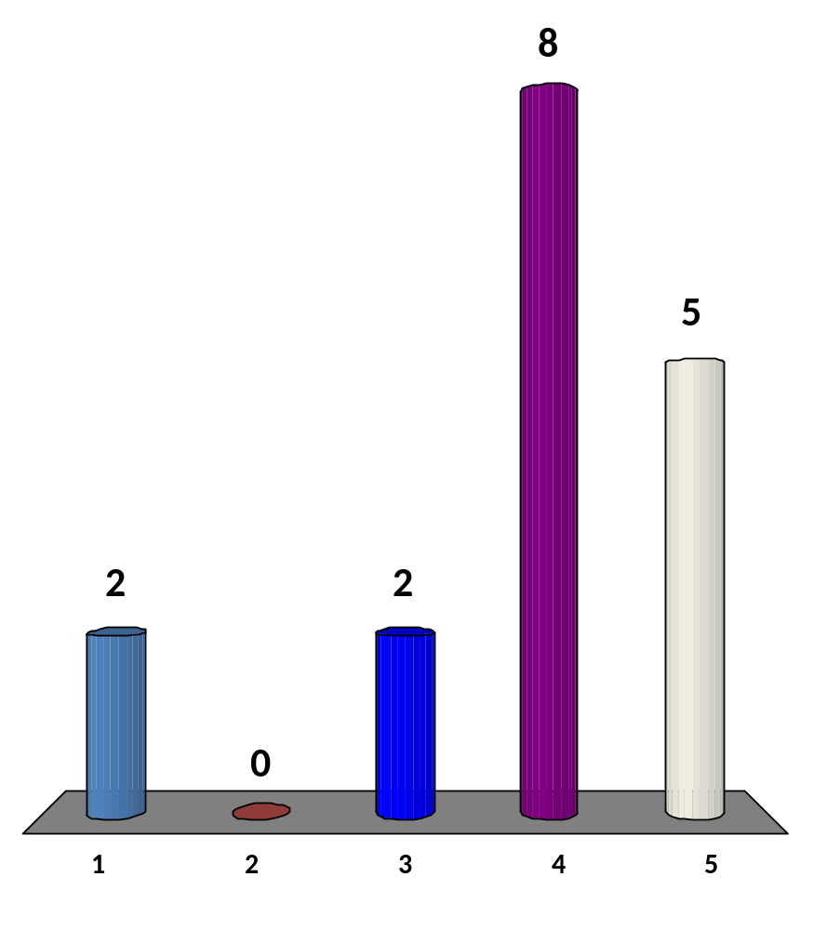
CS3233 so far…
Amount of workload (weekly HW: UVa/Book Review/C)
Too light :O
Light
OK
Heavy
Too heavy, I almost have no time for other modules ☹
Steven post lecture commentary:
To those who answer 5, use the strategy that I said yesterday, use “end of exam – Sat 5 May” to catch up
16 of 120
CS3233 - Competitive Programming,
Steven Halim, SoC, NUS

Slide 7
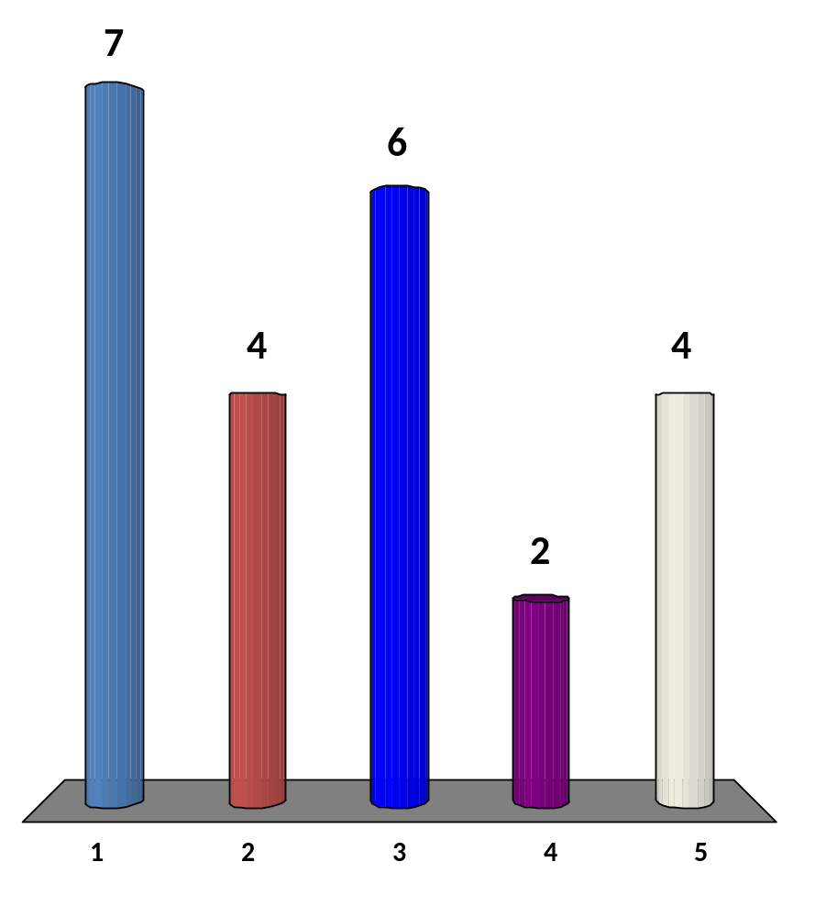
CS3233 so far…
Likely grade… (Cutoff: 55% for B+)
Will definitely pass 55% and get A+ as I am quite far above the rest ☺☺
Will definitely pass 55% but not sure if B+, A-, or A ☺
Likely just pass 55% (or B+)
May or may not pass 55%, so either B or B+ ☹
Likely cannot reach 55%, maybe B, don’t give me B- or lower please ☹☹
20 of 120
CS3233 - Competitive Programming,
Steven Halim, SoC, NUS
Notes:
2012
7 students say 1 :O
4 students say 5 ☹
2011
Seems majority will select 2-3-4

Slide 8
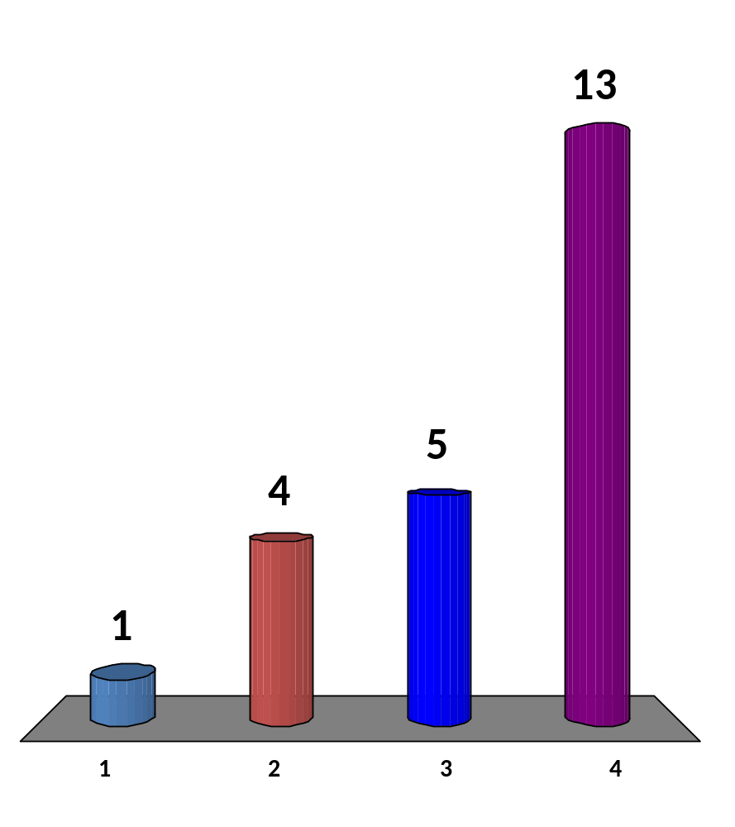
After I finish CS3233
(in 1 more month), I will…
Apply to be CS3233 TA next AY :D
Continue solving programming problems, perhaps solving
≥ 1420 UVa problems ☺
Likely join IOI selection test (Jun 2012) or NUS ICPC selection test this (Sep 2012)
That’s enough, I am not planning to do programming in competitive style
Steven post lecture commentary:
Again, this is a different profile from last year (where less people say answer no 4)
Maybe because last year we have several ICPC/ex IOI students
21 of 120
CS3233 - Competitive Programming,
Steven Halim, SoC, NUS
Notes:
2012
Wow, significant number say 4
2011
Majority no 2,
The rest no 3
One-two number 1

Slide 9
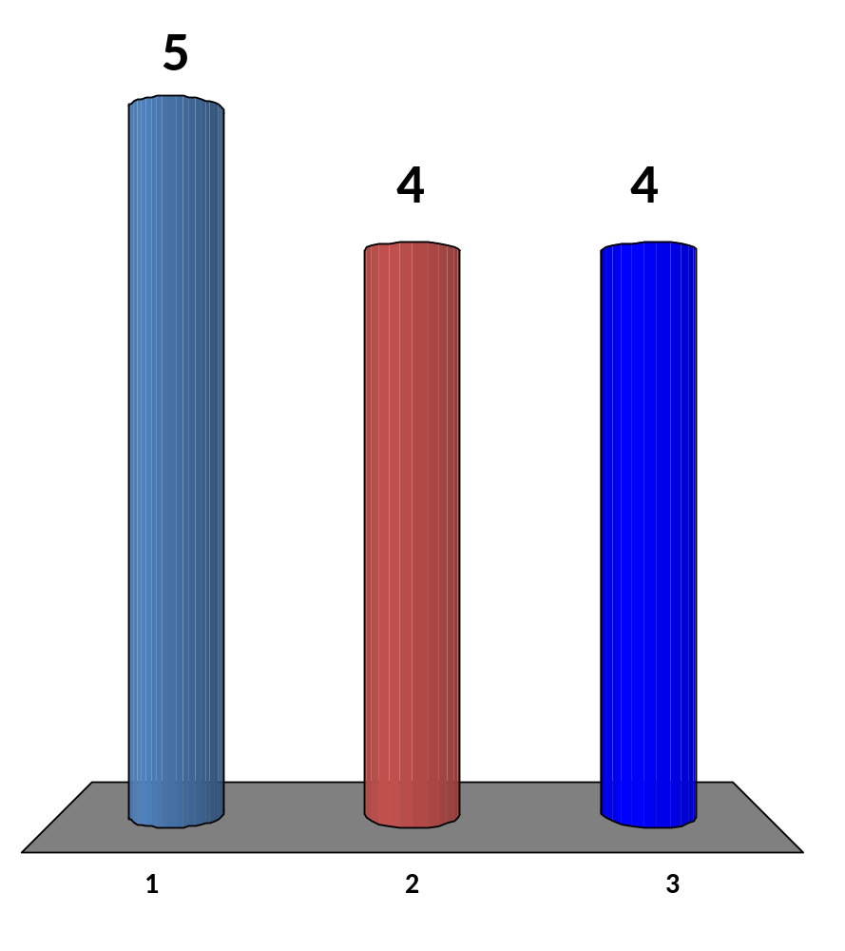

If N ≤ 100, then f91(N) = f91(f91(N+11))
If N ≥ 101, then f91(N) = N-10
Simplify this formula! N is an integer (UVa 10696)
N <= 101 ? 91 : N - 10
N <= 100 ? 91 : N – 10
Hey..., I have not finished thinking yet ☹
13 of 120
CS3233 - Competitive Programming,
Steven Halim, SoC, NUS
Notes:
The first one bug with N = 100, correct answer is 91, but option 1 gives 90

Slide 10
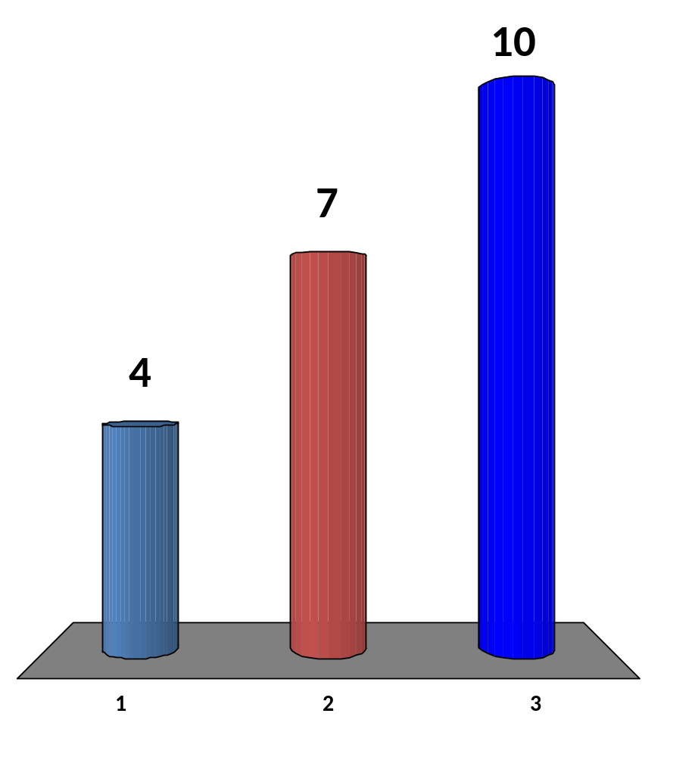
What does this code snippet do?
(int)floor(1 + log10((double)a))
I don’t know ☹
Count the log10 of a, plus 1, rounded down? What else?
I know, it is for ______
Counting the number of digits of a in decimal (base 10)
CS3233 - Competitive Programming,
Steven Halim, SoC, NUS

Slide 11
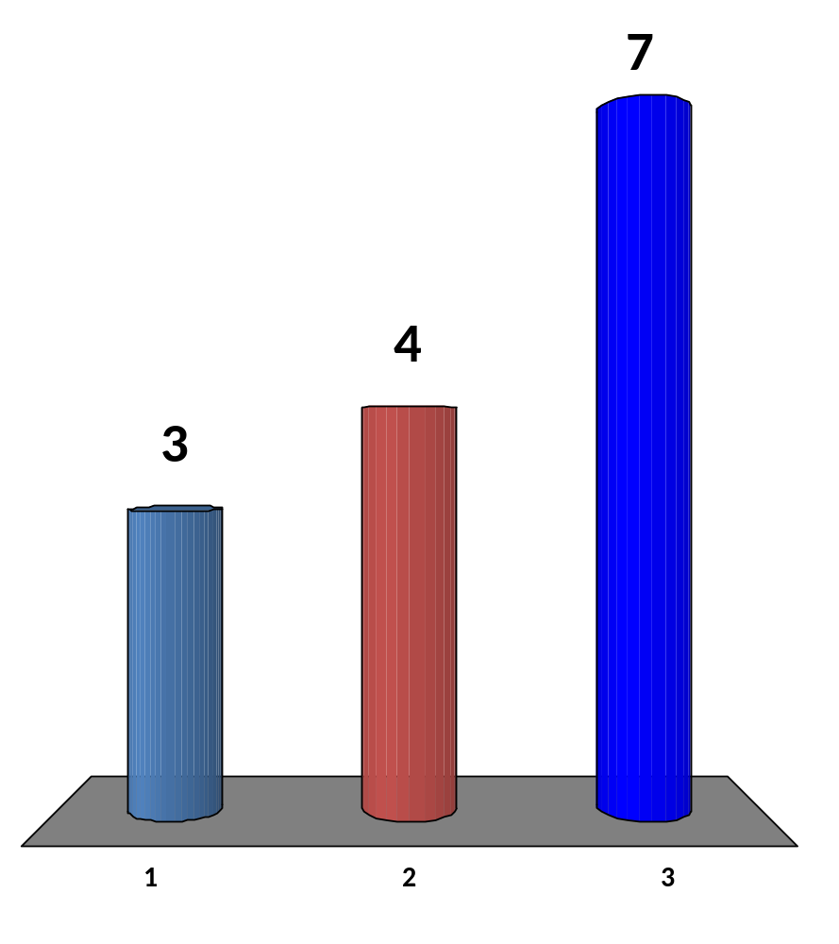
How to compute the n-th root of a?
√(a)
n
I don’t know ☹
Use pow
This way: ______
Use exp or log
This way: ______
pow((double a, 1.0/(double) n)
exp(log((double)a) * 1.0 / (double) n)
CS3233 - Competitive Programming,
Steven Halim, SoC, NUS
Notes:
#include <cmath>
#include <cstdio>
using namespace std;
int main() {
printf("%lf\n", pow(8.0, 1.0/3)); // ans = 2.000000
printf("%lf\n", exp(log(8.0) * 1.0/3)); // ans = 2.000000, because e^(ln (a^(1/n))) = a^(1/n)
return 0;
}

Slide 12
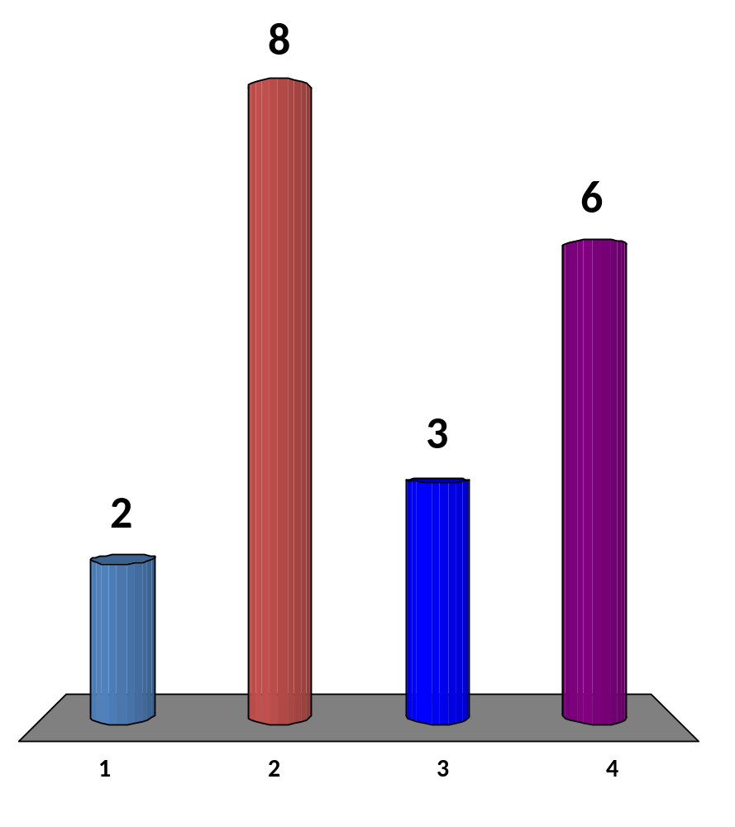
Java BigInteger…
Steven post lecture commentary:
It is better to move yourself from no 1-2 to 3-4
I am a Java user but I have never used it before
I am a (pure) C++ user so
I never used it before
I am a Java user and I have used it before ☺
I am bilingual (Java/C++) and I have used it before ☺
18 of 120
CS3233 - Competitive Programming,
Steven Halim, SoC, NUS
Notes:
5 never
7 have used it, now I will make this known to all

Slide 13
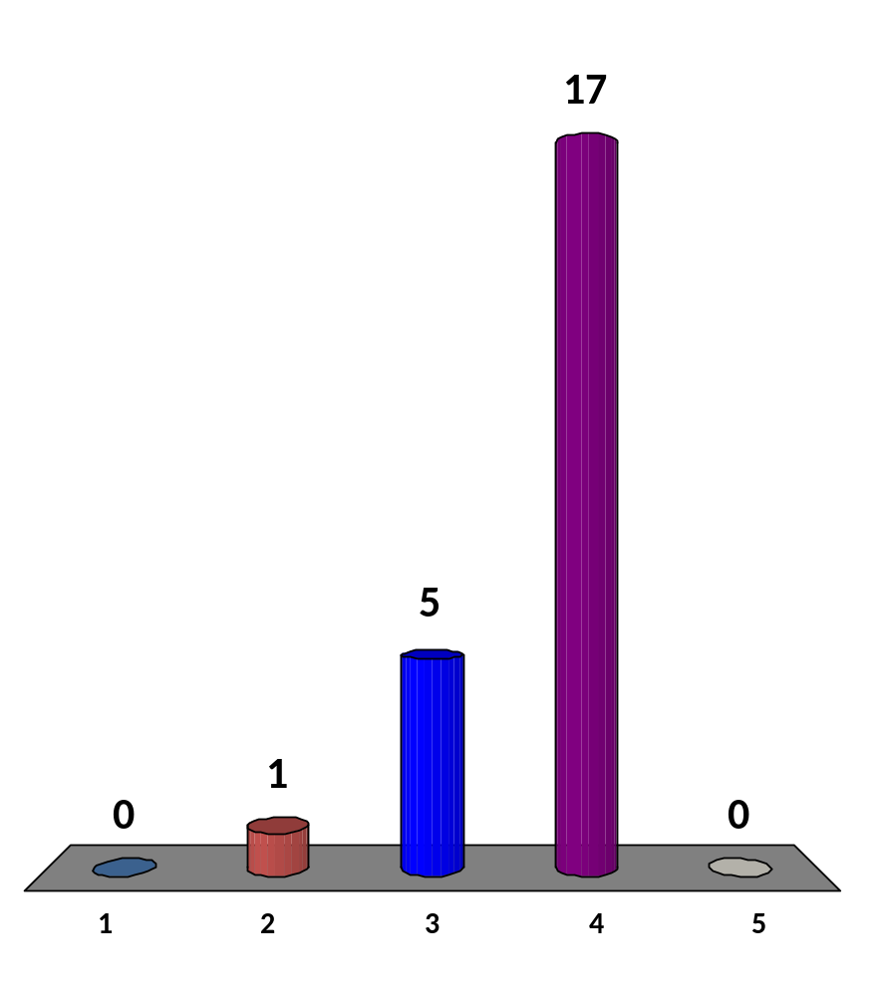
1, 2, 6, 24, 120, 720, 5040, …, the next number is:
5041
10080
25200
40320
I don’t know ☹
CS3233 - Competitive Programming,
Steven Halim, SoC, NUS
Notes:
Factorial (number of permutation)

Slide 14
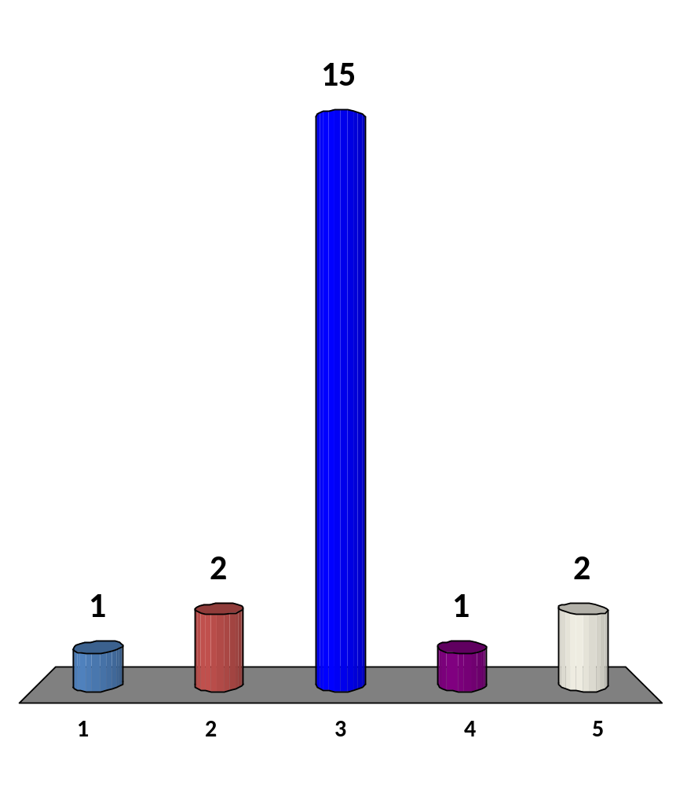
1, 0, 1, 2, 9, 44, 265, …, the next number is:
266
486
1854
1972
I don’t know ☹
Hints 1: Similar to previous slide
Hints 2: Derangement
Hints 3: Try OEIS
CS3233 - Competitive Programming,
Steven Halim, SoC, NUS
Notes:
Derangement

Slide 15
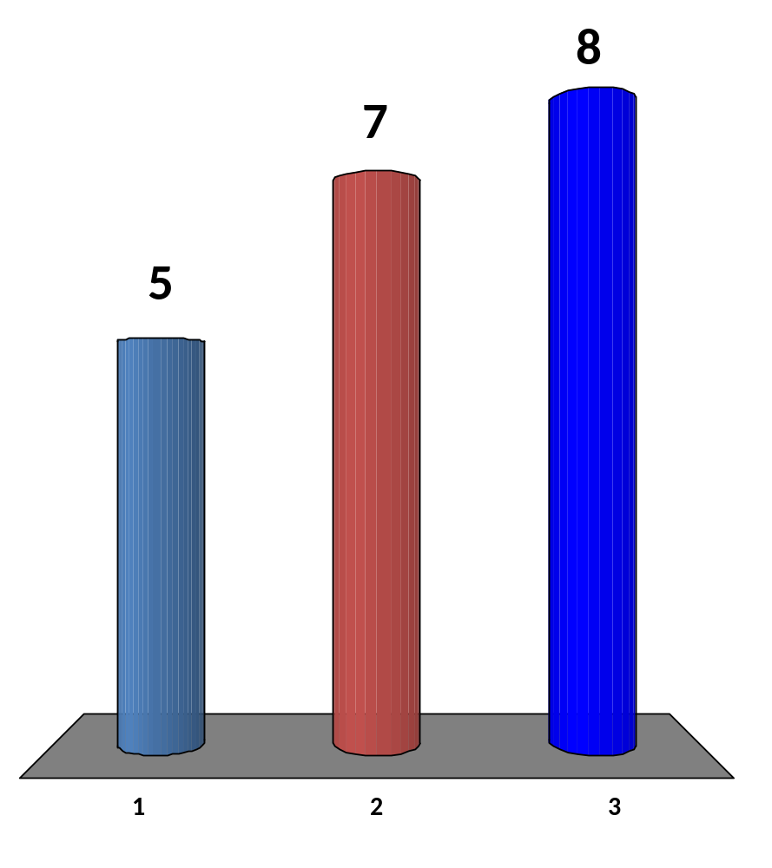
The Pace of this Lecture
Too slow, I already know all these…
I want to know more
Fine; we are used to it now ☺
Crazy as always… and we still have lots of reading material at home
20 of 120
CS3233 - Competitive Programming,
Steven Halim, SoC, NUS

Slide 16
HW8 (due next Wed 11.59am!)
  Go to: http://uhunt.felix-halim.net/id/32900
  Solve UVa 11889 – Benefit by working with prime factors of the two input numbers (A and C)
  If you have solved these problems in the past, fine, we will count it as “homework part A done”
Solve problem C (Sabotage) from today
  EMAIL to Phuong directly: u0906808@nus.edu.sg
Write a report on Chapter 5 (all… you will need some time to read it :O)
  Upload to IVLE Workbin, “CP2 Review”
Potential Achievements
  Chapter 4 diversity: Solve eight problems from different category in chapter 4 by the end of Week09
  Chapter 5 diversity: Solve four starred problems from different category in chapter 5 by the end of Week10
  Still on track: Solve at least 10 weeks*4/week = 40 UVa problems by the end of Week 10 and also obtain Chapter 1-2-3-4-5 diversity

