Slide 1
CS2102-Lab2
Queries, duplicates, referential integrity, multiple relations and conditions and complex conditions, UNION

Slide 2
Introduction (I)
Zhou Jingbo
Email: jzhou@nus.edu.sg
g0900477@nus.edu.sg
Lab: DB Research Lab-1
Notes:
Lab1=>lab2=>lab3 what different?
Hard=>harder=>hardest
Every note is important, but
* is very important
** is very very important (always test)
*** is very very very important (test every time)
NOTE: they are only my understanding, Prof Stephane may not agree!!!

Slide 3
Introduction (II)
Objective of Lab 2
Queries, duplicates, referential integrity, multiple relations and conditions and complex conditions, UNION
multiple relations, referential integrity,* conditions and complex conditions* UNION*, Duplicates***
Two volunteers
Upload your solutions to forum of IVLE
GroupXXlabXX.sql
Send your solution to my email
jzhou@nus.edu.sg

Slide 4
correction
Question 1.
Original: Find the different emails of students
Correction: Find the emails of students
Question 9
Original: Find the different names of students who owned a copy of book other that ‘978-0262033848’.
Correction (Disambiguate): Find the different names of students who own book(s), but a copy of book is not ‘978-0262033848’.
Question 14
Original: Delete all the data in table copy
Correction: Delete all the data in table loan

Slide 5
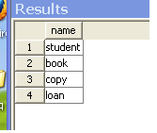
Warm up (I)
http://www.comp.nus.edu.sg/~tang1987/lab.htm
SELECT name FROM sysobjects WHERE type = 'U' AND uid = user_id('put_your_login_here');

Slide 6
Warm Up(II)
Create the tables using the file NUNStASchema.sql.
Remember: Rearrange the statements
Populate the database using the files NUMNStAStudent.sql , NUMNStABook.sql, NUMNStACopy.sql, NUMNStALoan.sql and.
Check the foreign key constraints to decide in which order to insert the data.
You can clean up data and tables anytime using the file NUNStAClean.sql.

Slide 7
Question 1
Find the different emails of students
Correct:
Find the emails of students
SELECT s.email
FROM student s

Slide 8
Question 2
Find the different emails of students
SELECT s.email
FROM student
s
SELECT DISTINCT s.email FROM student s
DISTINCT is not needed * * *
Only use DISTINCT when strictly necessary * * *

Slide 9
Question 2: When to use “Distinct”
DISTINCT can only be used when it is strictly necessary
The DISTINCT should be used when two rules are satisfied:
1) Your are required to find different elements of a column i.e.
When it is “find the different names…”, you may consider to use DISTINCT
When it is “find the names”, DISTINCT is not necessary…
AND
2) There are duplicates in this column.
When are there duplicates in column?
Most of columns may have duplicates
However, 1) column of primary key does not have duplicates 1) column with unique does not have duplicates

Slide 10
Question 3
Print the names of students in descending alphabetical order
SELECT s.name
FROM student s
ORDER BY name DESC
Notes:
Descending [diˈsendiŋ]
Alphabetical [ˌælfəˈbɛtɪkəl]

Slide 11
Question 4
Are there students with the same name?
SELECT *
FROM student s1, student s2
WHERE s1.name=s2.name AND s1.email <> s2.email

Slide 12
Options:
SELECT *
FROM student s1, student s2
WHERE s1.name=s2.name AND s1.email > s2.email
SELECT *
FROM student s1, student s2
WHERE s1.name=s2.name AND s1.email <> s2.email
select s.name,count(*) from student s group by s.name having count(*)>1

Slide 13
Question 5
Find the different names of students. Is the result sorted?
SELECT DISTINCT s.name
FROM student s
NO! You may be luck that result may be sorted, but it is not guaranteed.

Slide 14
Question 6
Find the names of students who owned a copy of book ‘978-0262033848’.
SELECT s.name
FROM student s, copy c
WHERE c.owner=s.email AND c.book='978-0262033848'
Do not use table book as it is guaranteed by referential integrity that there is such a book if it appears in table copy.
“It is possible that the database records books that are not owned by any students (because the owners of a copy graduated or because the book was advised by a
lecturer for a course but not yet purchased by any student.)”
--Student guide, page 4

Slide 15
select s.name
from student s, copy c
where c.book='978-0262033848'
SELECT name FROM student WHERE email = ANY(SELECT owner FROM copy WHERE book = '978-0262033848')

Slide 16
Question 7
Find the names of students who owned a copy of book whose title contains ‘computer’ with more than 100 pages.
SELECT s.name
FROM student s, copy c, book b
WHERE c.owner=s.email AND c.book=b.ISBN13 AND LOWER(b.title) LIKE '%computer%' AND b.pages > 100

Slide 17
Question 8
Find the number of A4 pages needed to photocopy the two books with ISBN-13 '978-0262033848' and '978-0321295354' (if you own the books and for personal use only!)
SELECT b1.pages + b2.pages
FROM book b1, book b2 WHERE b1.ISBN13 = '978-0262033848' AND b2.ISBN13='978-0321295354'

Slide 18
SELECT SUM(pages) FROM book WHERE book.ISBN13 = '978-0262033848' OR ISBN13 = '978-0321295354'
SELECT (b1.pages + b2.pages)/2
FROM book b1, book b2 WHERE b1.ISBN13 = '978-0262033848' AND b2.ISBN13='978-0321295354'
select count(b1.pages) + count(b2.pages) from book b1, book b2 where b1.ISBN13 = '978-0262033848' and b2.ISBN13= '978-0321295354'

Slide 19
Question 9
Find the different names of students who owned a copy of book other that ‘978-0262033848’.
Disambiguate:
Find the different names of students who own book(s), but a copy of book is not ‘978-0262033848’.
SELECT DISTINCT s.name
FROM student s, copy c
WHERE c.owner=s.email AND c.book <> '978-0262033848'
This is not “Print the names of the different students …” why?
Notes:
Disambiguate [ˌdɪsæmˈbɪɡjuˌet]

Slide 20
Question 9 (Cont.)
This is not “Print the names of the different students …” why?
Name is not primary key (duplicates) ***

Slide 21
Question 10
What is the meaning of the following query? SELECT DISTINCT s.name FROM student s, copy c WHERE NOT(c.owner=s.email AND c.book <> ‘978-0262033848’)
Note: not( A and B)=> not A OR not B**
SELECT DISTINCT s.name
FROM student s, copy c
WHERE c.owner<>s.email OR c.book = ‘978-0262033848’
Print all the different names in the table

Slide 22
Question 10 (Cont.)
Table student s
Table copy c
Email | name
jim@nus.edu.sg | Jim
anny@nus.edu.sg | Anny
owner | ISBN
jim@nus.edu.sg | 978-0262033848
… | …
S ×C ( i.e. from student s, copy c)
Email | name | owner | ISBN
jim@nus.edu.sg | Jim | jim@nus.edu.sg | 978-0262033848
anny@nus.edu.sg | Anny | jim@nus.edu.sg | 978-0262033848
WHERE c.owner<>s.email OR c.book = ‘978-0262033848’
Select Distinct s.name
name
Jim
Anny
Notes:
Cartesian [kɑrˈtiʒən] product

Slide 23
Question 11
Find the names of students who borrowed a copy of book ‘978-0262033848’.
SELECT s.name
FROM student s, loan l
WHERE l.borrower=s.email AND l.book=‘978-0262033848’

Slide 24
Question 12
Find the names of students who owned or borrowed a copy of book ‘978-0262033848’. Use UNION.
SELECT s.name
FROM student s, copy c
WHERE c.owner=s.email AND c.book=‘978-0262033848’
UNION
SELECT s.name
FROM student s, loan l
WHERE l.borrower=s.email AND l.book=‘978-0262033848’

Slide 25
Question 13
Find the names of students who owned or borrowed a copy of book ‘978-0262033848’. USE OR.
SELECT s.name
FROM student s, copy c, loan l
WHERE (c.owner=s.email AND c.book=‘978-0262033848’)
OR (l.borrower=s.email AND l.book=‘978-0262033848’)

Slide 26
Question 14
Delete all the data in table copy
Correct:
Delete all the data in table loan
DELETE FROM loan

Slide 27
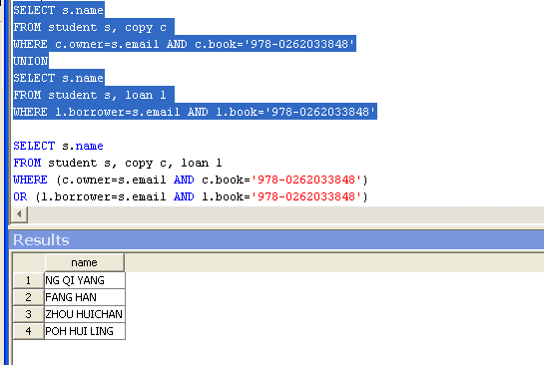
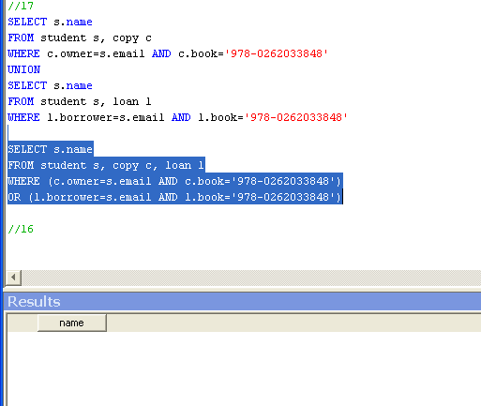
Question 15*
Try again queries (12) and (13)
(12)
(13)

Slide 28
Question 15*(Cont.)
If load is empty (null)
SELECT s.name
FROM student s, copy c, loan l
=> empty
We see that the query with OR returns no results. This is wrong. That means that the query was not correct. It happens because the Cartesian product in the FROM clause is empty*. When is it correct to use OR? “OR”should be used among conditions on the exactly same tables.*

Slide 29
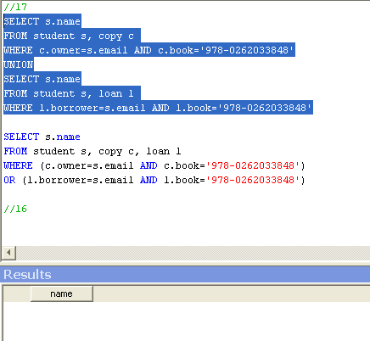
Question 15*(Cont.)
However, if
DELETE FROM copy
Referential Integrity, e.g. Delete cascade, if records in copy are deleted, records in loan are also deleted*

