Slide 1
EEC 130A Introductory Electromagnetics I
Lecture 2
Winter 2012
Dr. Xiaoguang “Leo” Liu
Electrical and Computer Engineering
UC Davis

Slide 2
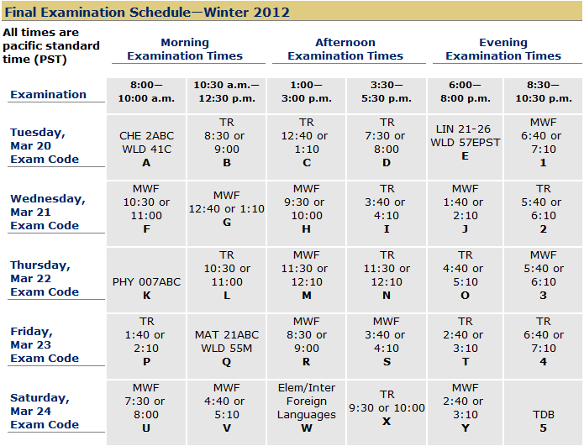
Exam Schedule

Slide 3
Example 1-1
An acoustic wave traveling in the x-direction in a fluid (liquid or gas) is characterized by a differential pressure p(x,t). The unit for pressure is newton per square meter (N/m²). Find an expression for p(x,t) for a sinusoidal sound wave traveling in the positive x-direction in water, given that the frequency is 1 kHz, the velocity of sound in water is 1.5 km/s, the wave amplitude is 10 N/m², and p(x, t) was observed to be at its maximum value at t = 0 and x = 0.25 m.
Treat water as a lossless medium.

Slide 4
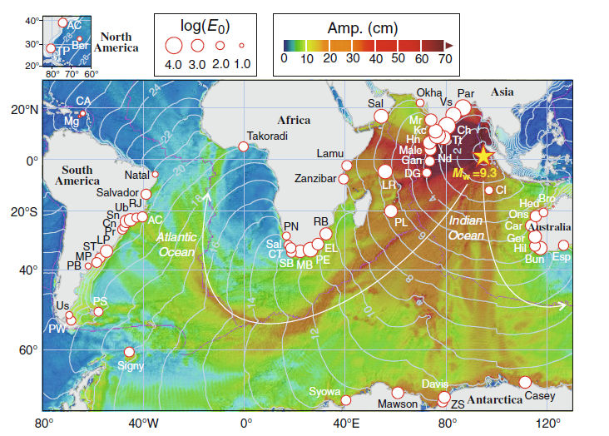
Energy Decay of the 2004 Sumatra Tsunami in the World Oceans
http://www.pac.dfo-mpo.gc.ca/science/oceans/tsunamis/documents/PAG-2011_Rabinovich_et_al.pdf

Slide 5
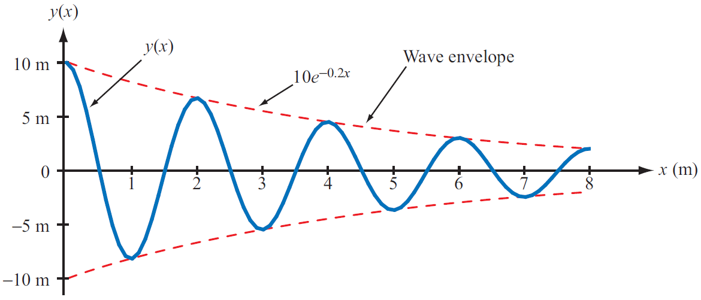
Waves in Lossy Media
Attenuation factor

Slide 6
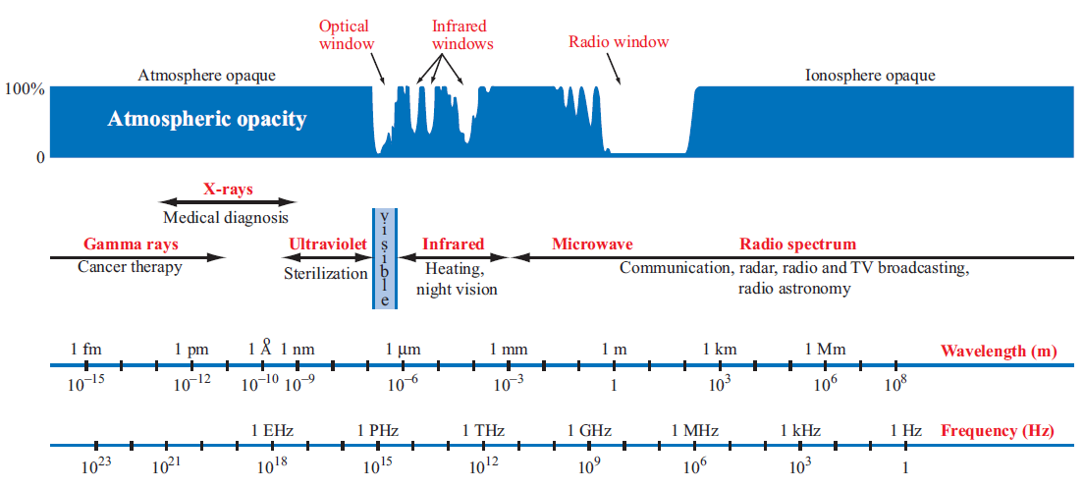
Electromagnetic Spectrum

Slide 7
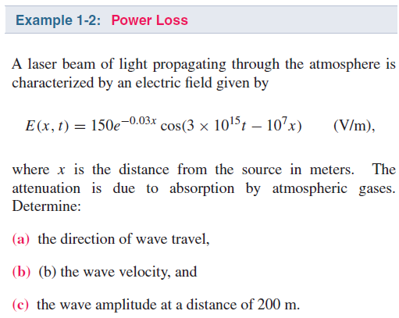
Example 1-2

