Slide 1
EEC 130A Introductory Electromagnetics I
Lecture 10
Winter 2012
Dr. Xiaoguang “Leo” Liu
Electrical and Computer Engineering
UC Davis

Slide 2
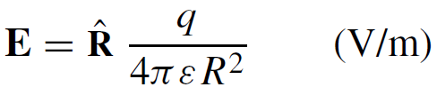
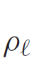
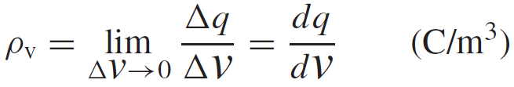

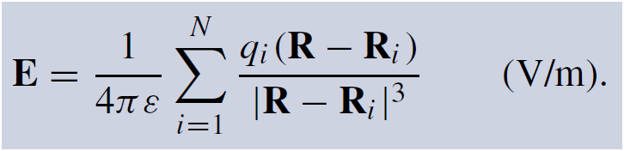
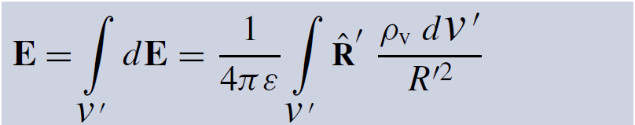
Review
Electrostatics
Coulomb’s Law
Charge Distribution
Electric field due to multiple charges
Electric field due to charge distributions

Slide 3
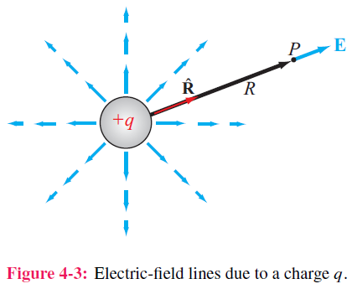
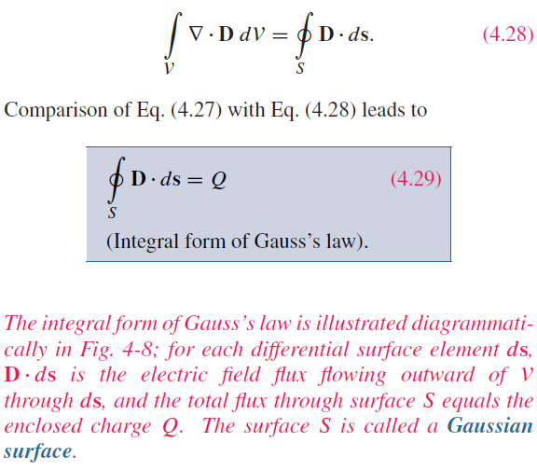

Slide 4
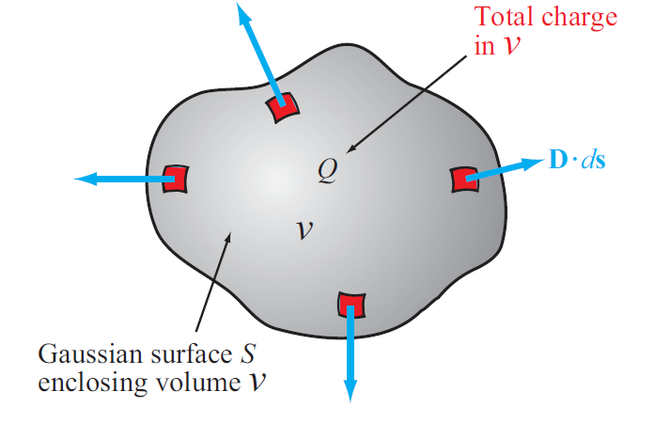
Gauss’s Law

Slide 5

Gauss’s Law

Slide 6
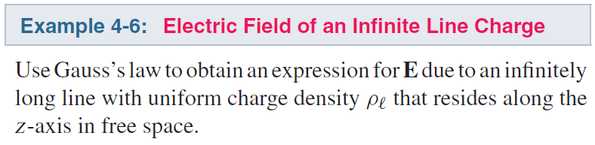
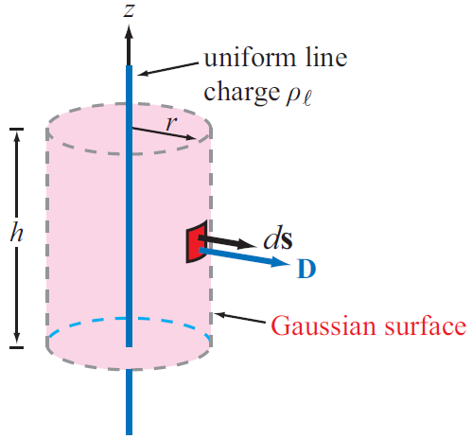
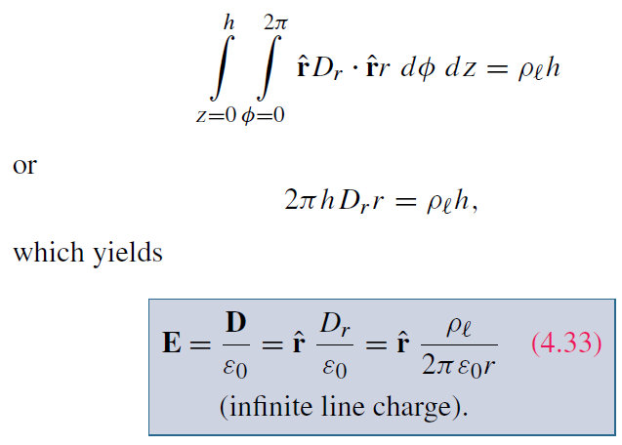
Using Gauss’s Law

Slide 7
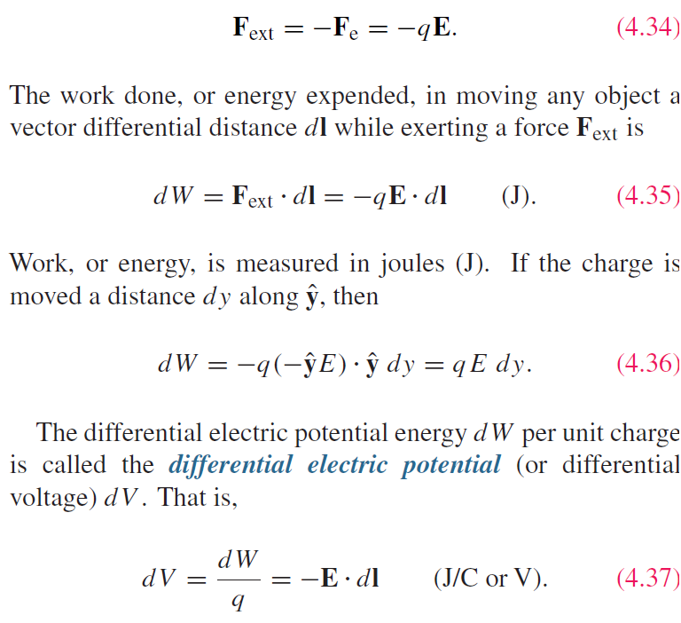
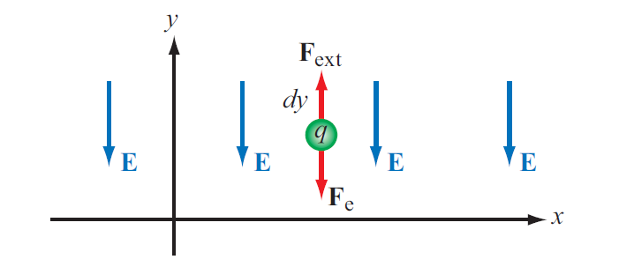
Electric Scalar Potential
Work needed to move a charge q
differential electric potential

Slide 8
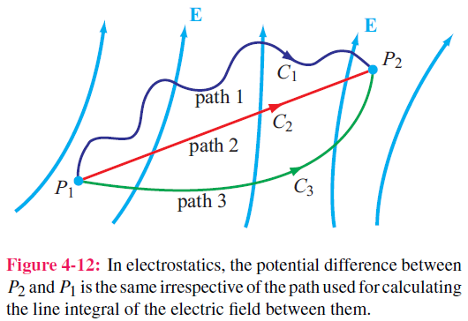
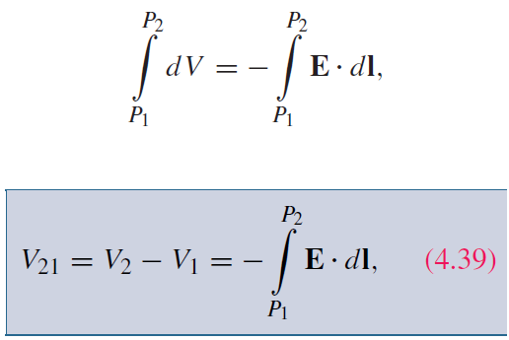
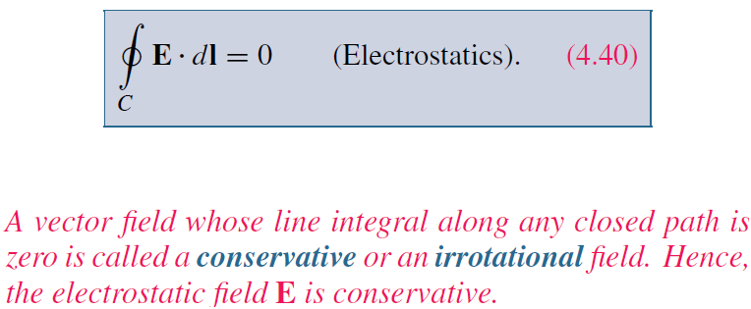
Electric Scalar Potential

Slide 9
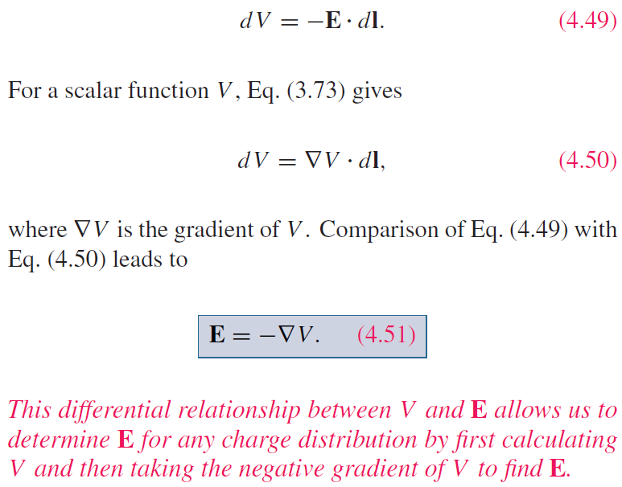
Relating E to V

Slide 10
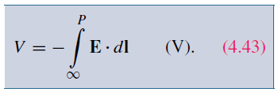

Electric Potential Due to Charges
In electric circuits, we usually select a convenient node that we call ground and assign it zero reference voltage. In free space and material media, we choose infinity as reference with V = 0. Hence, at a point P
For a point charge, V at range R is:

Slide 11
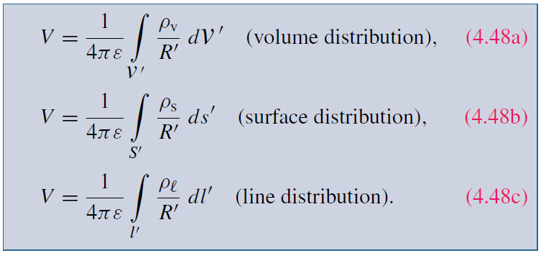
Electric Scalar Potential due to Charges
Multiple Charges
Charges distributions

Slide 12
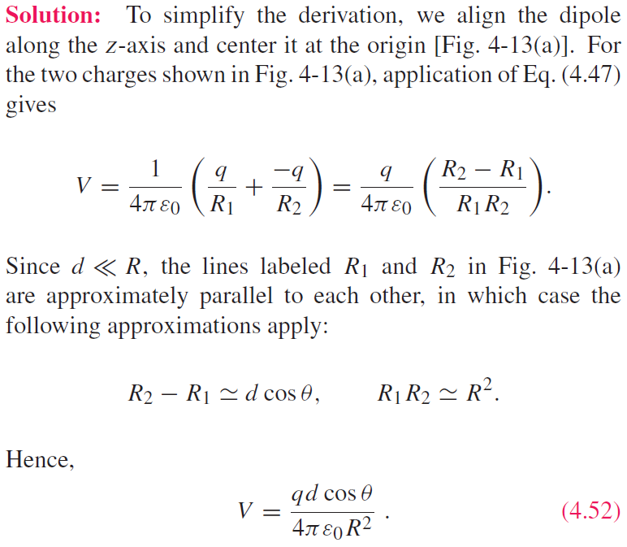
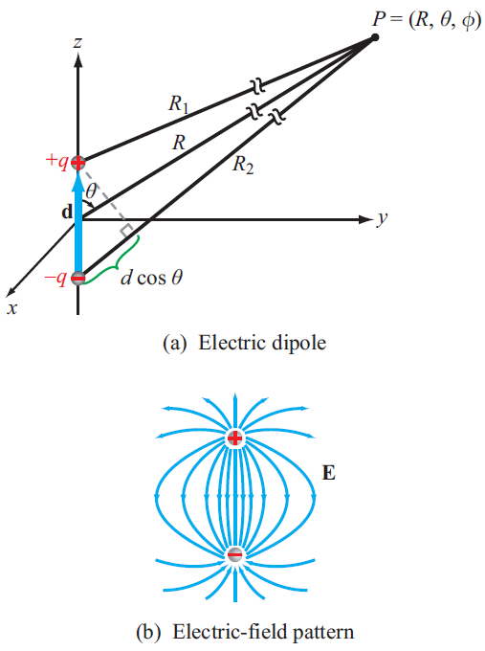
Example 4-7

Slide 13

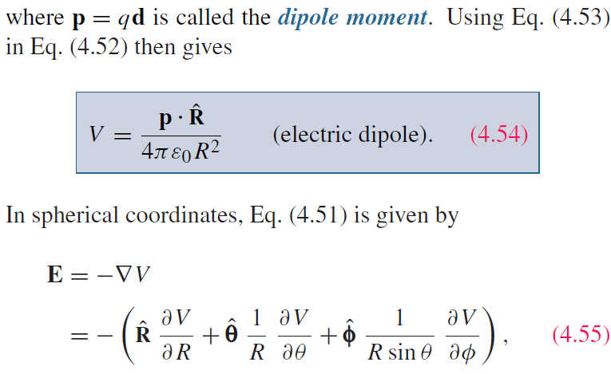
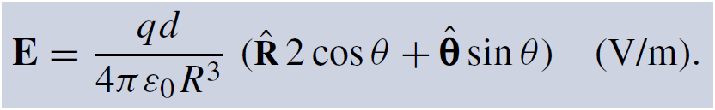

Slide 14
Poisson’s Equation
Laplacian
Poisson’s Equation

