Slide 1
EEC 130A Introductory Electromagnetics I
Lecture 11
Winter 2012
Dr. Xiaoguang “Leo” Liu
Electrical and Computer Engineering
UC Davis

Slide 2
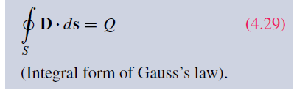

Review
Gauss’s Law
Integral form
Differential form

Slide 3
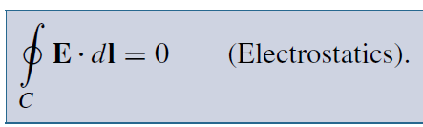
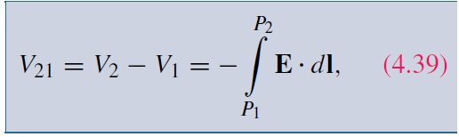
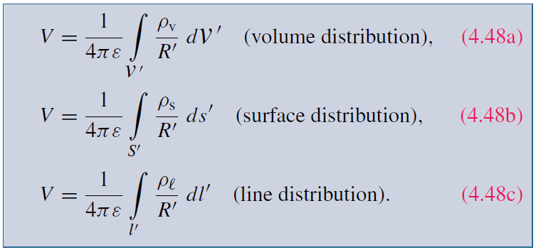
Review
Electric scalar potential

Slide 4
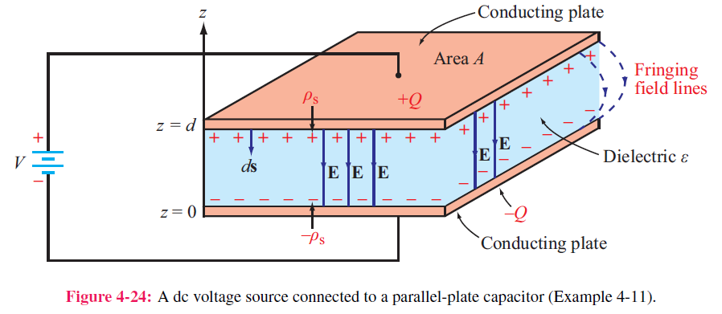
Examples
Infinite sheet of charge
Parallel plate

Slide 5
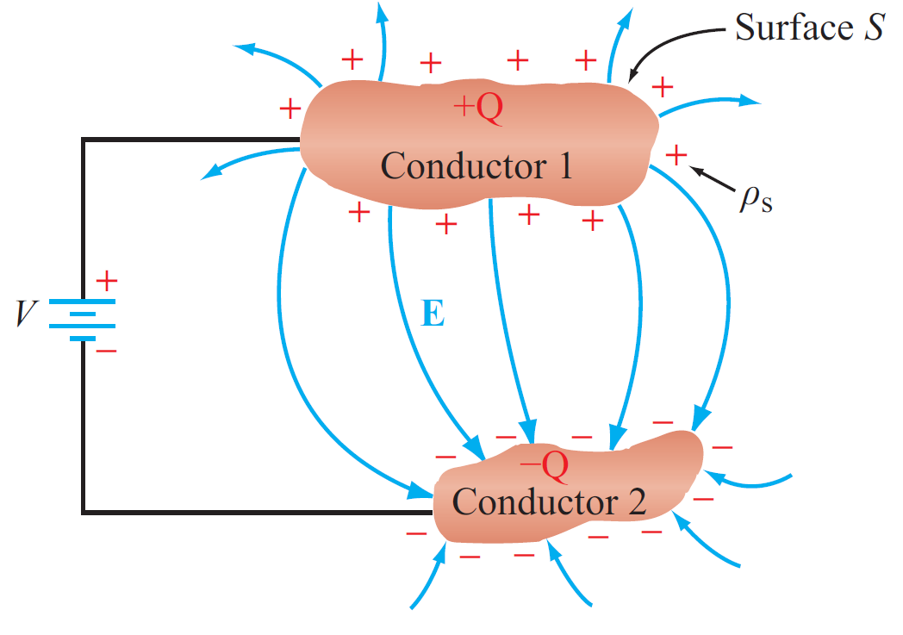
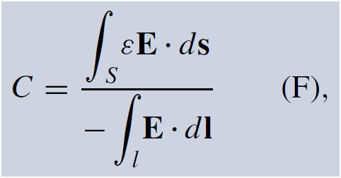
Capacitance

Slide 6
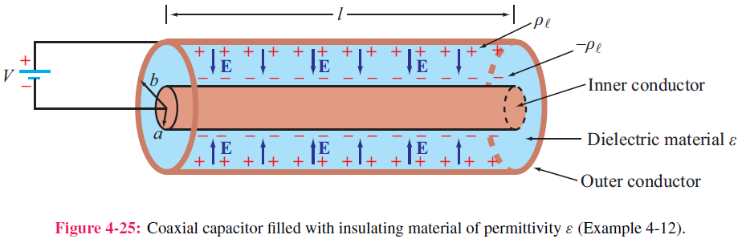
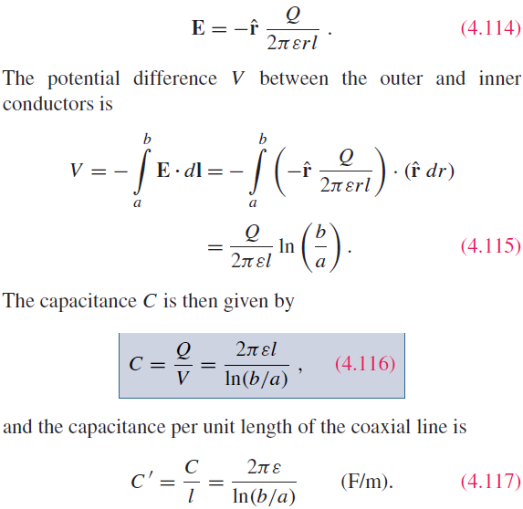
Capacitance of Coaxial Cable

Slide 7
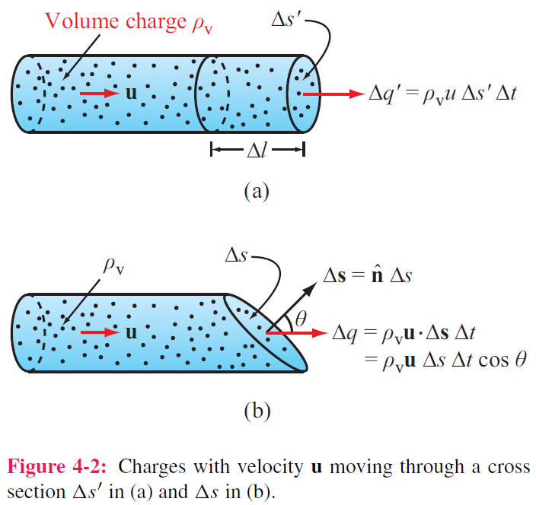
Current

Slide 8
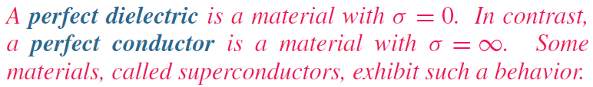
Current
Drift
velocity
Current
density
Charge
density
Mobility
(A/m²)
Condutivity

Slide 9
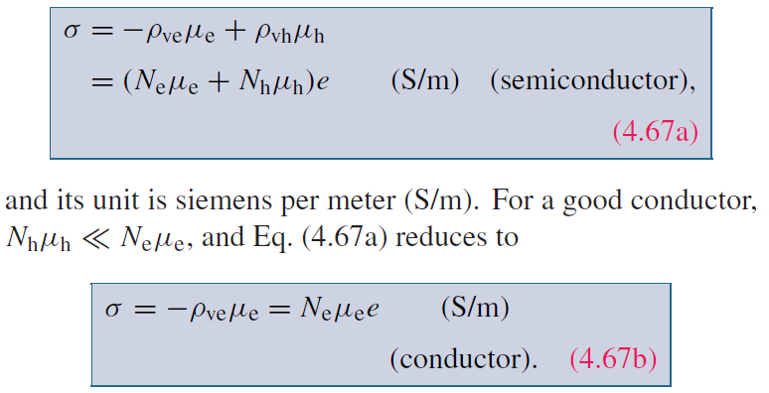
Semiconductors

Slide 10
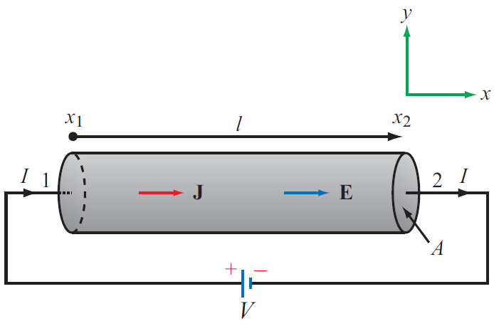
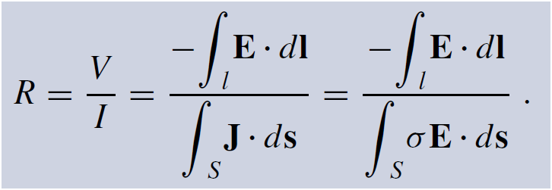
Resistance

Slide 11
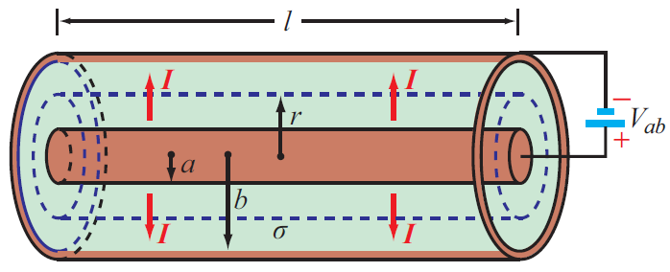
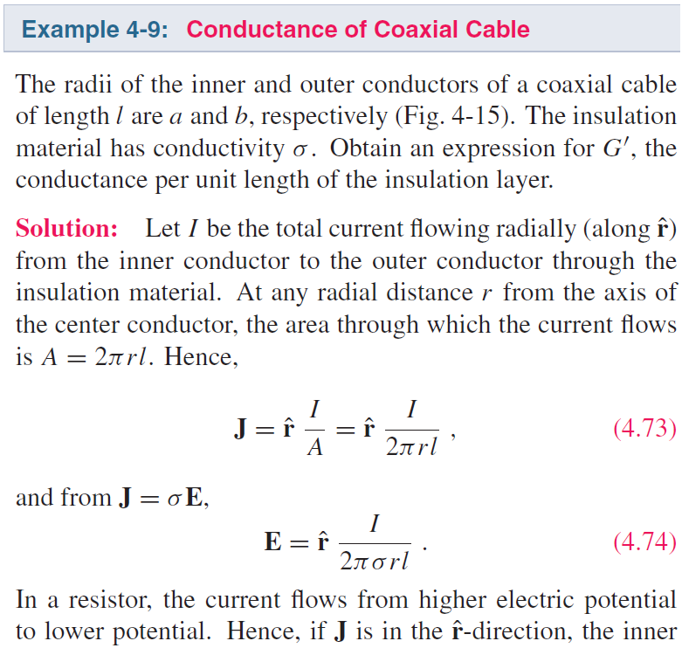
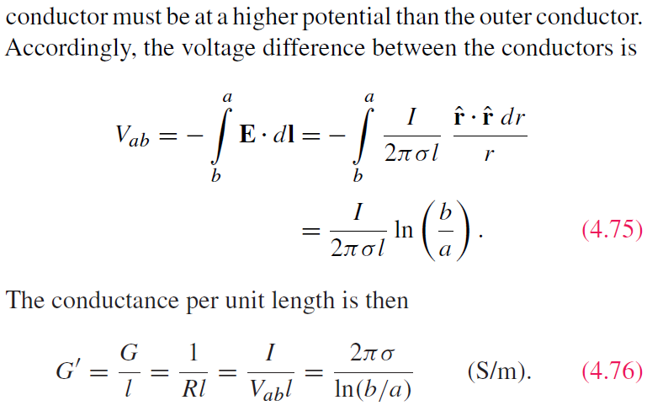
Coaxial Cable Conductance

Slide 12
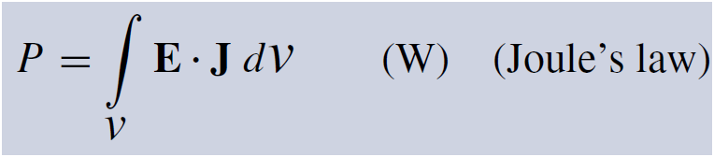
Joule’s Law
The power dissipated in a volume containing electric field E and current density J is:
For a conductor:

