Slide 1
EEC 130A Introductory Electromagnetics I
Lecture 12
Winter 2012
Dr. Xiaoguang “Leo” Liu
Electrical and Computer Engineering
UC Davis

Slide 2
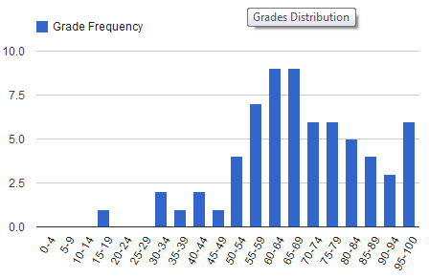
Statistics
Mid-term 1
Mean: 68.5 Std. Dev.: 17.6
Extra Credit: Mean: 7.96 Std.Dev.: 5.13
Adjustment options…
Top Four: 100, 100, 98, 98
Free lunch
Below 55
Come and talk with me, I’ll buy you coffee
Total cumulative point
Mean: 76.6 Std.Dev.: 14.5

Slide 3
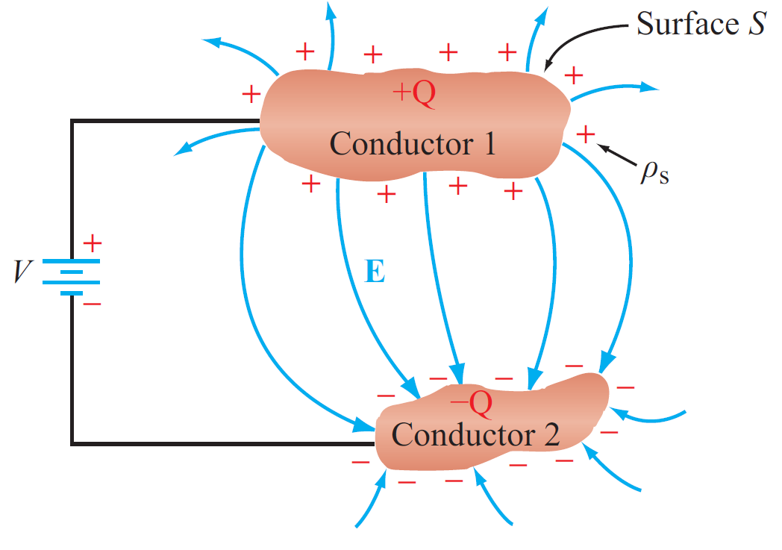
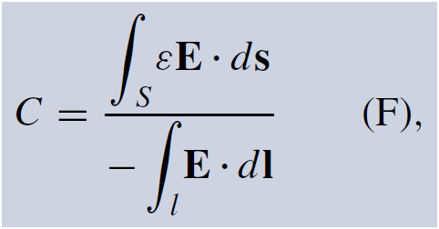
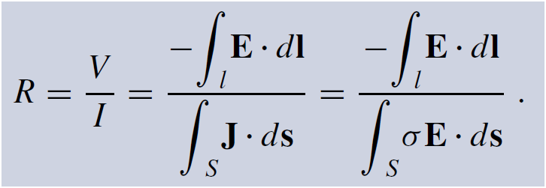
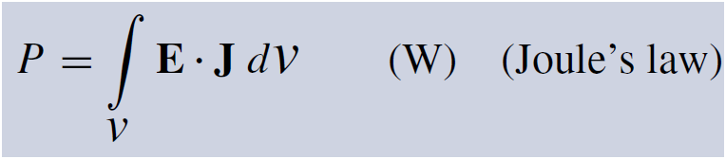
Review
Capacitance
Resistance
Current density
Resistance
Joule’s law

Slide 4
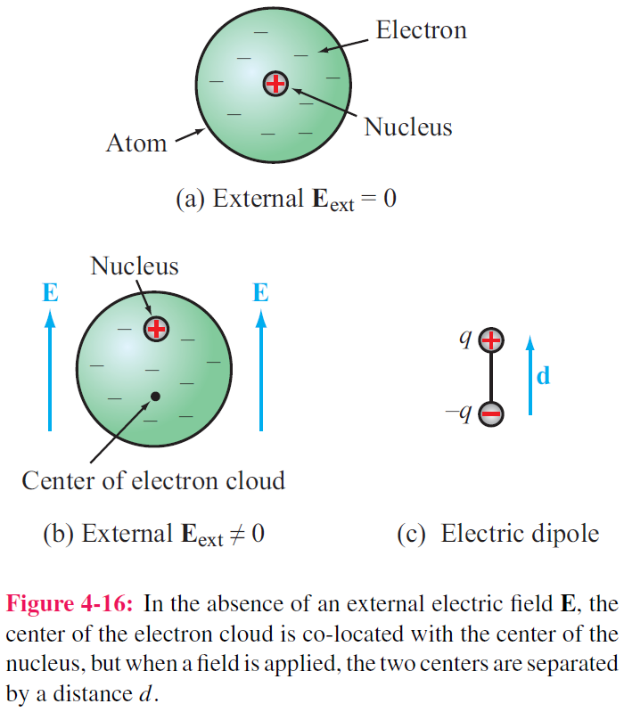
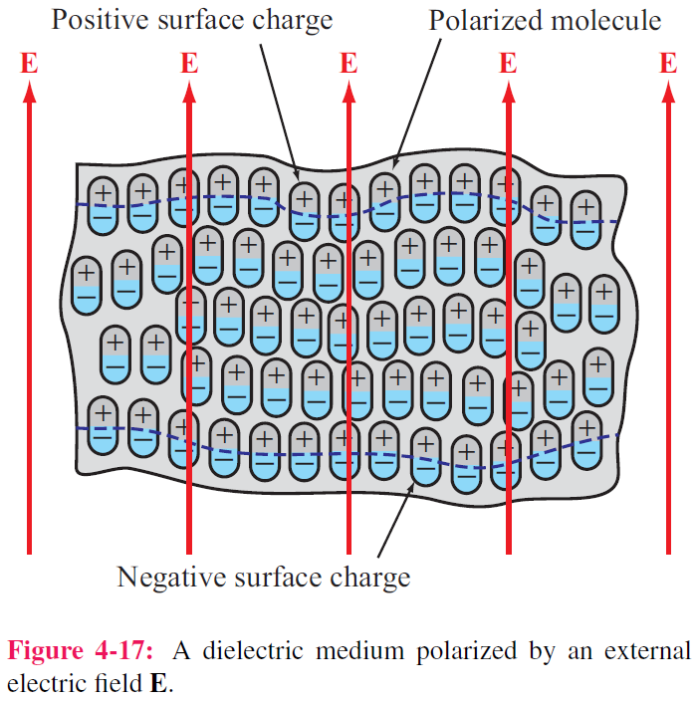
Dielectric Materials
No free electrons

Slide 5

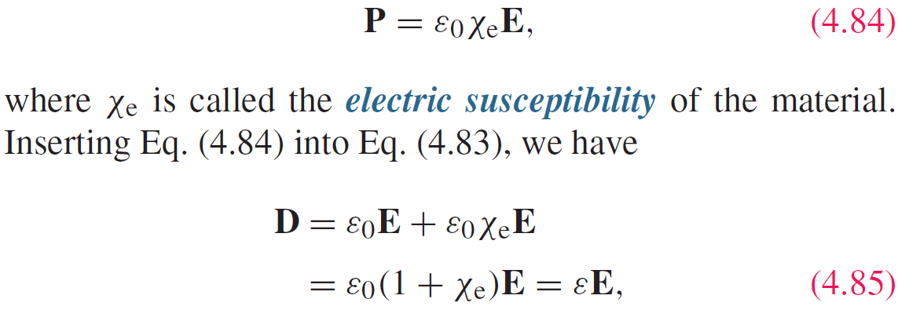
Polarization Field
P = electric flux density induced by E

Slide 6
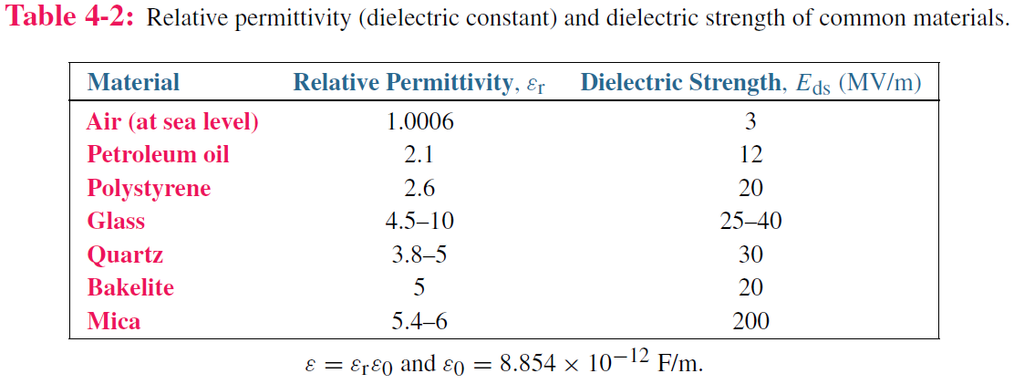
Electric Breakdown

Slide 7
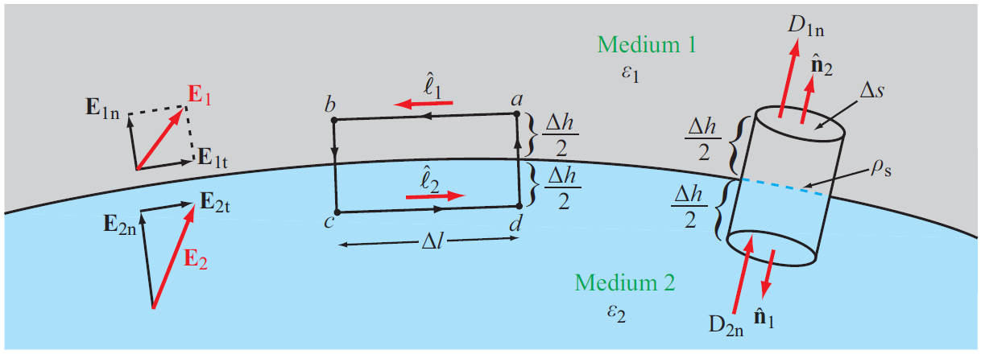


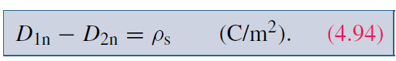
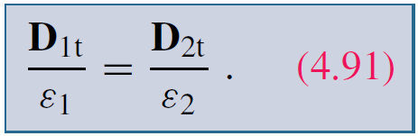
Boundary Conditions
Tangential Component
Normal Component

Slide 8
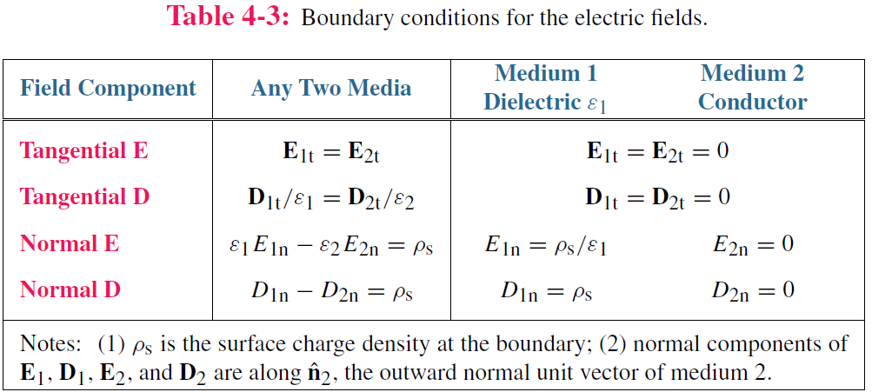
Summary of Boundary Conditions
Electric field inside a perfect conductor is 0 !

Slide 9
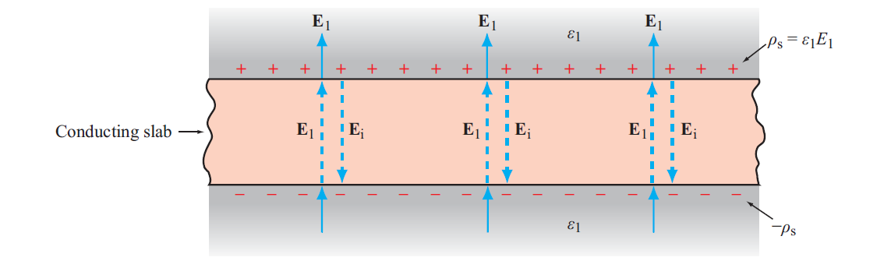
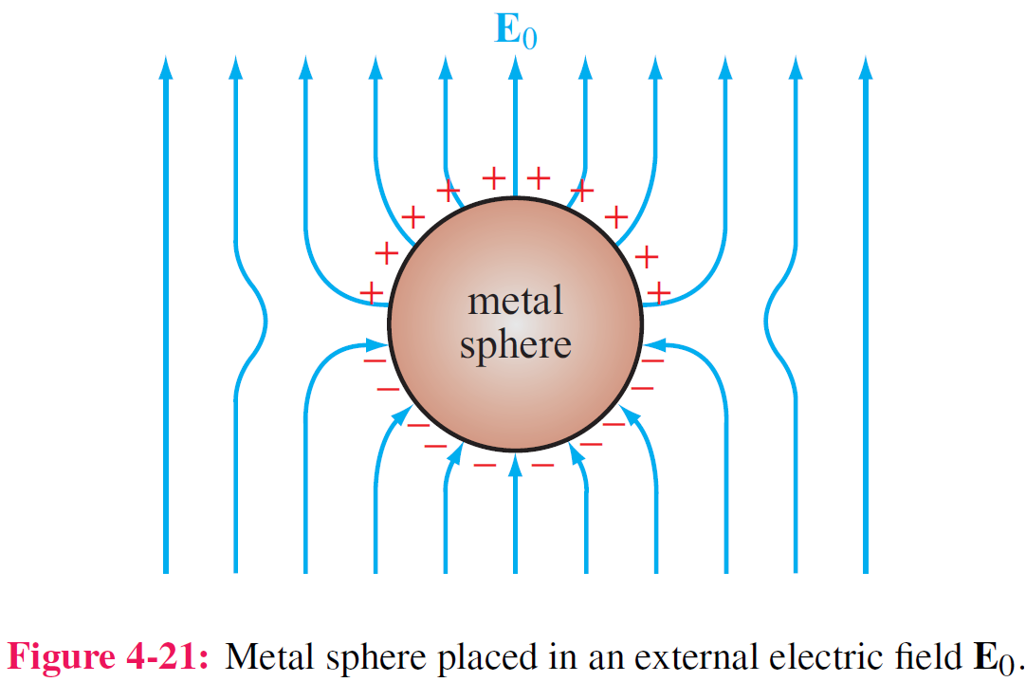
Conductors
Net electric field inside a conductor is zero

Slide 10
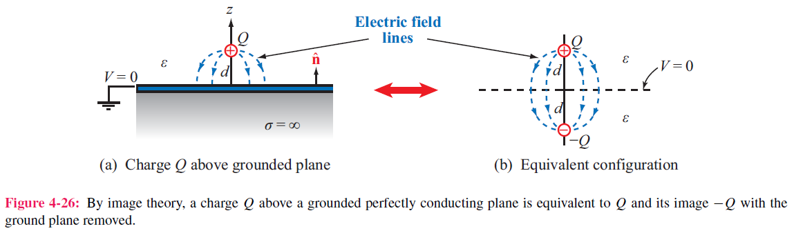
Image Method
Image method simplifies calculation for E and V due to charges near conducting planes.
For each charge Q, add an image charge –Q
Remove conducting plane
Calculate field due to all charges

Slide 11
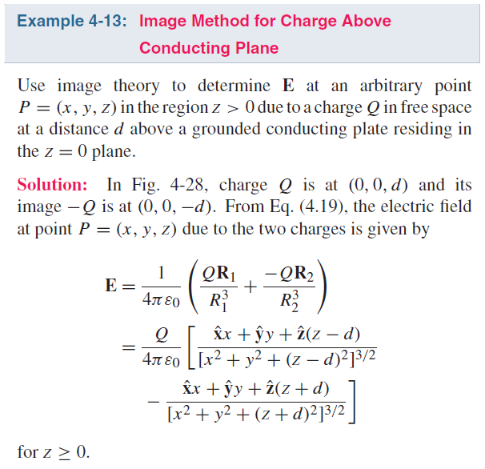
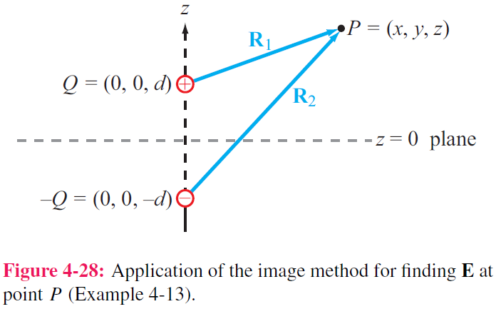
Example

Slide 12

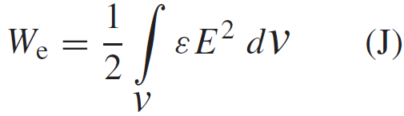

Electrostatic Potential Energy
Electrostatic potential energy density (Joules/volume)
Total electrostatic energy stored in a volume
Energy stored in a capacitor

Slide 13
Poisson’s Equation/ Laplace’s Equation
Gauss’s Law
Poisson’s Equation
Laplace’s Equation

