Slide 1
EEC 130A Introductory Electromagnetics I
Lecture 13
Winter 2012
Dr. Xiaoguang “Leo” Liu
Electrical and Computer Engineering
UC Davis

Slide 2
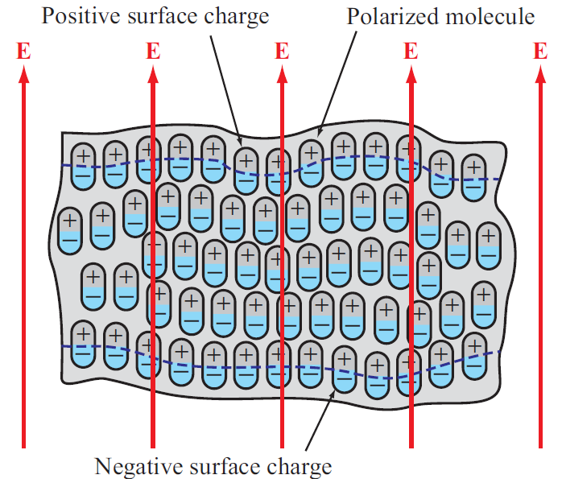

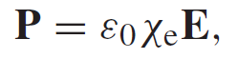


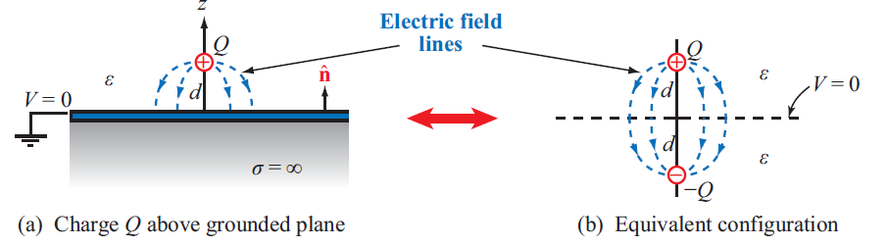
Review
Dielectrics
Boundary Conditions
Image Method

Slide 3
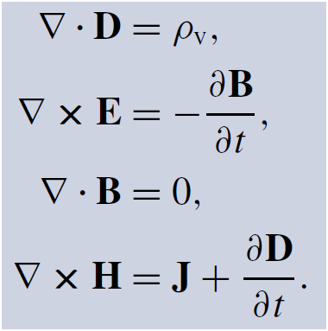
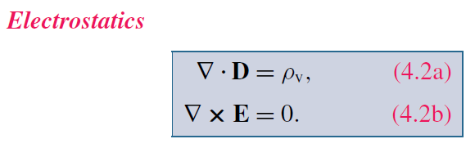
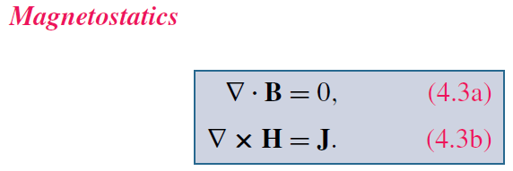
Magnetostatics
God said:
If we take out the time dependence
And there was light!

Slide 4
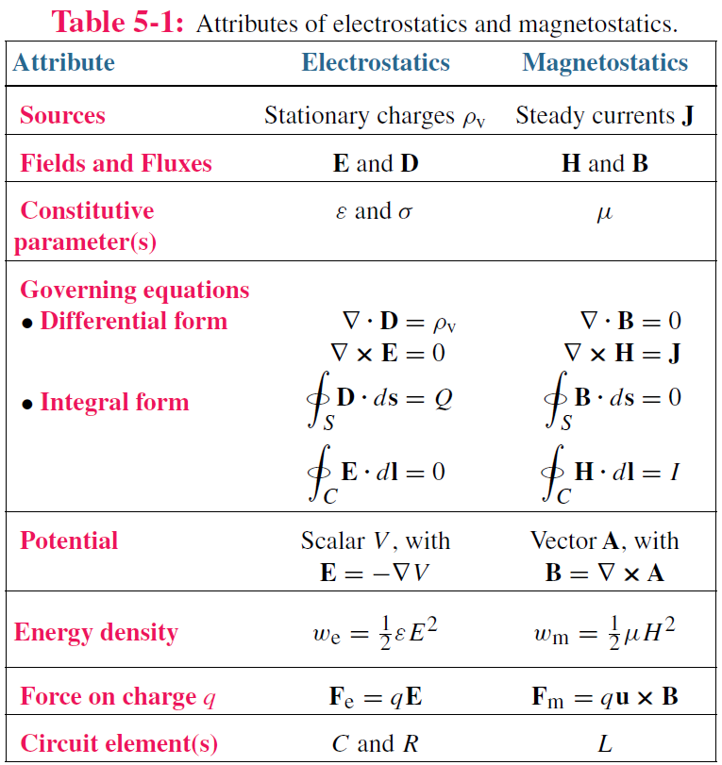
Comparison

Slide 5

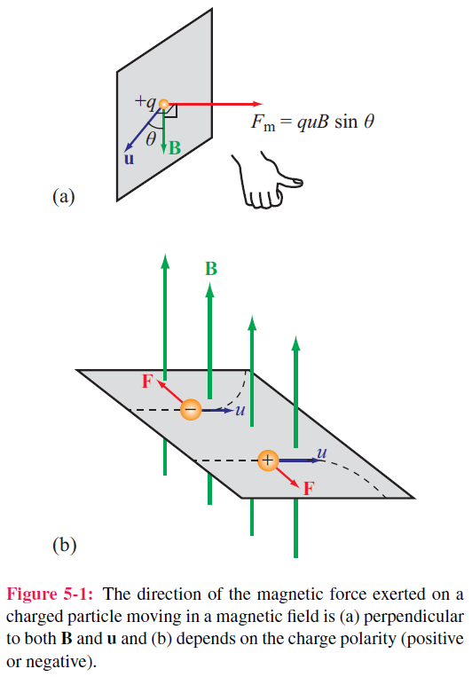

Force and Torque
Magnetic force
Right-hand Rule
Electromagnetic (Lorentz) force
Moving charges → Current
Differential force dF_{m}
on a differential current I dl:

Slide 6
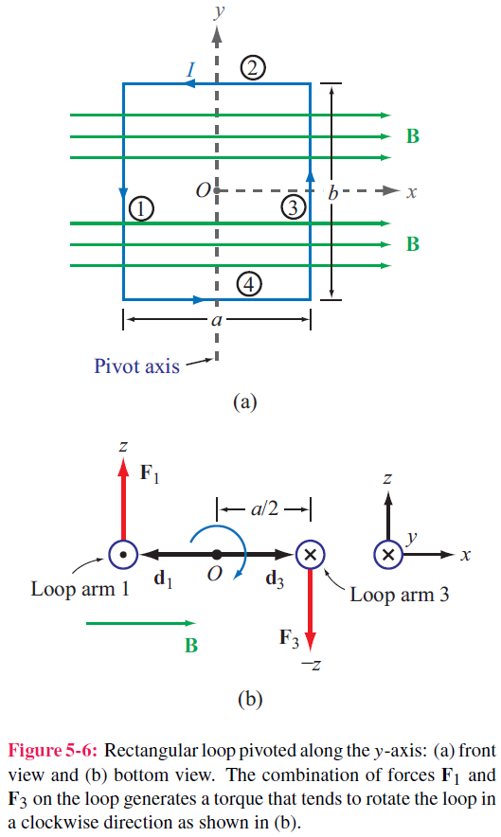
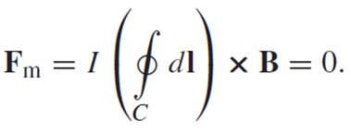
Force on Current
Differential force dF_{m}
on a differential current I dl:
Total force on a segment of current
For closed contour:

Slide 7
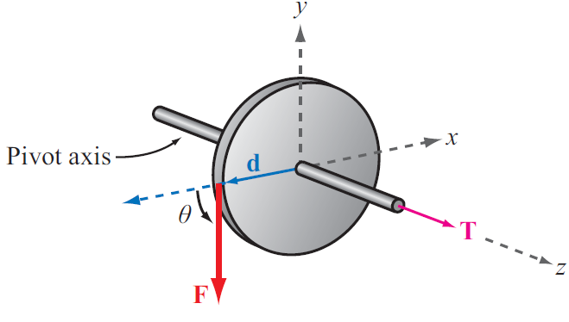

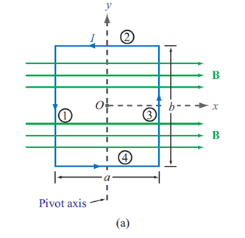
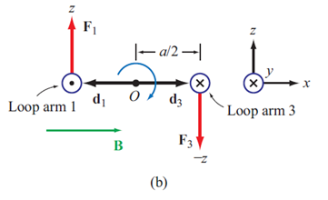
Torque
Torque
T = torque, d = moment arm F = force

Slide 8
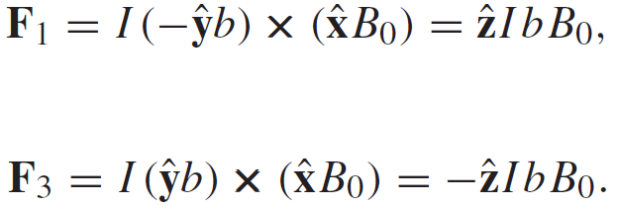
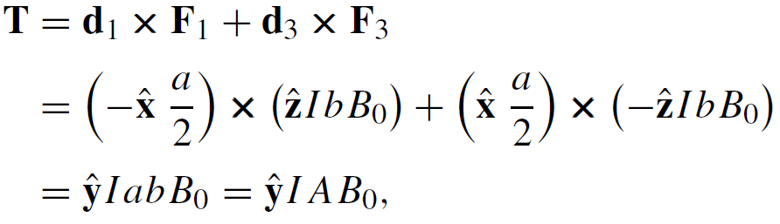
Magnetic Torque on Current Loop
No forces on arms 2 and 4 (I and B are parallel, or anti-parallel)
Magnetic torque:
Area of Loop

Slide 9
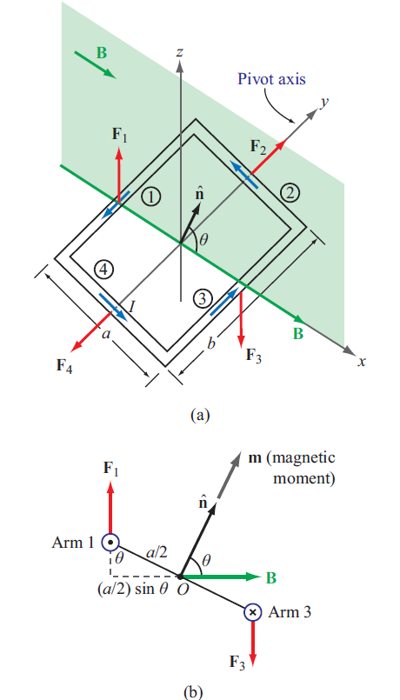



Inclined Loop
For a loop with N turns and whose surface normal is at angle θ relative to B direction:
Magnetic Moment

Slide 10
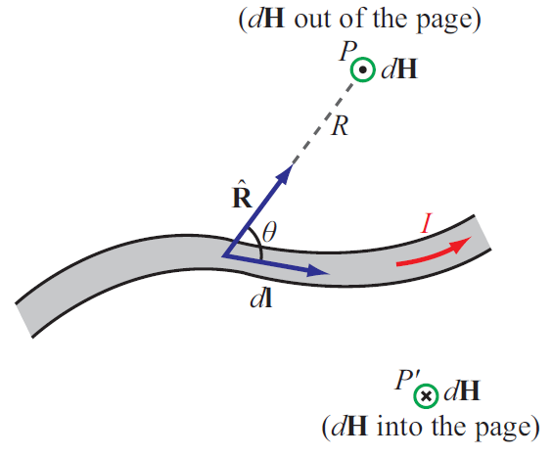

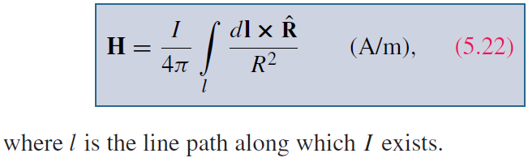
Biot-Savart Law
Magnetic field induced by
a differential current:
For the entire length:

Slide 11
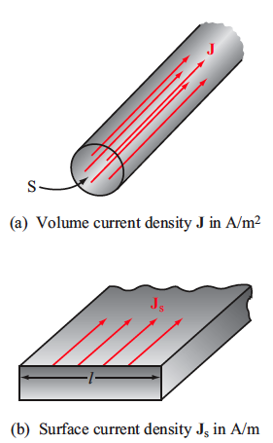
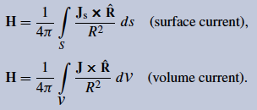
Magnetic Field due to Current Densities
I dl
J_{s} ds
J dV

Slide 12
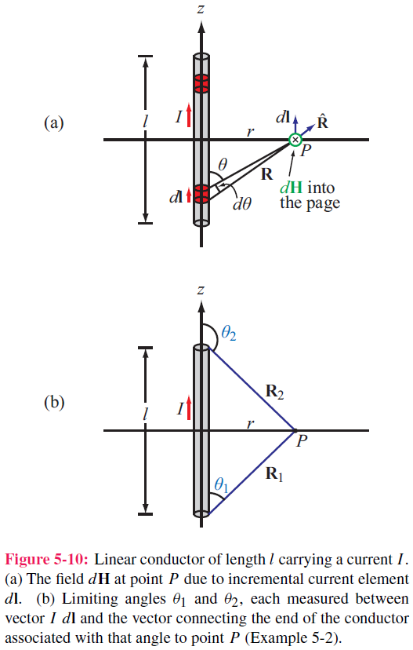
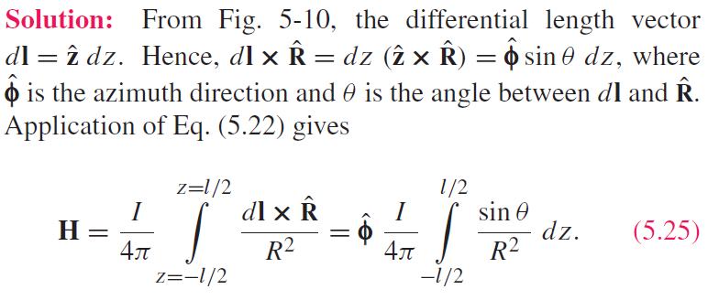
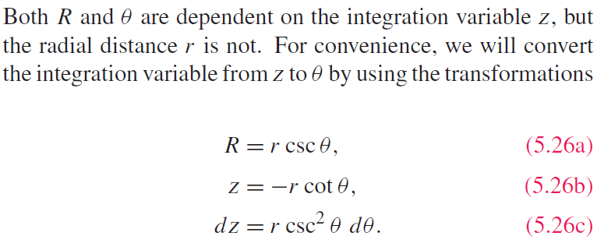
Example 5-2:
Magnetic Field of Linear Conductor
Cont.

Slide 13
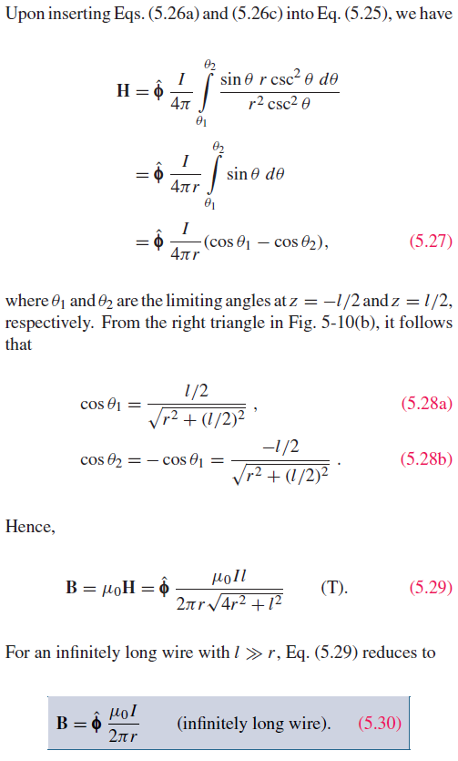
Example 5-2:

Slide 14
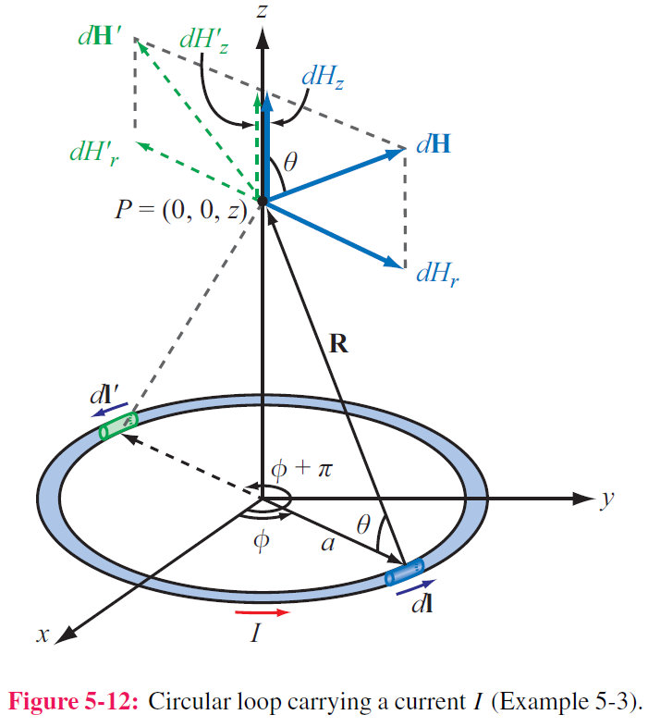
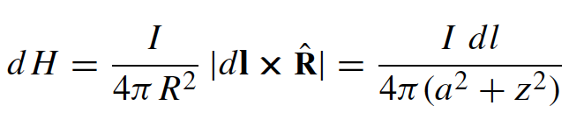
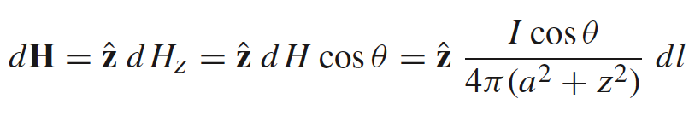
Example 5-3
Magnetic Field of a Loop
Magnitude of field due to dl is
dH is in the r–z plane , and therefore it has components dH_{r} and dH_{z}
z-components of the magnetic fields due to dl and dl’ add because they are in the same direction, but their r-components cancel
Hence for element dl:
Cont.

Slide 15
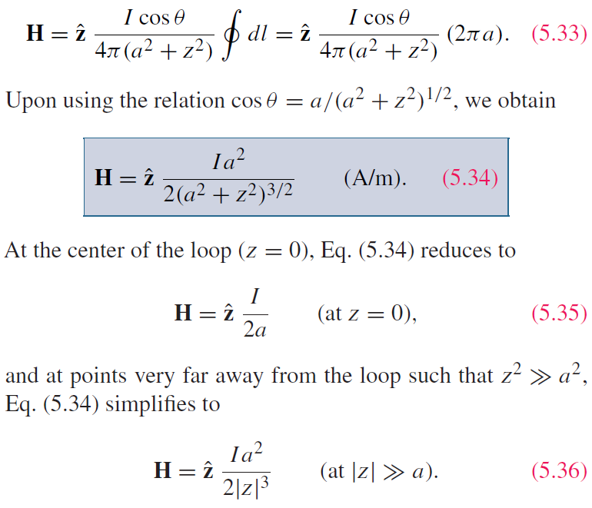
Example: (cont.)
For the entire loop:

Slide 16
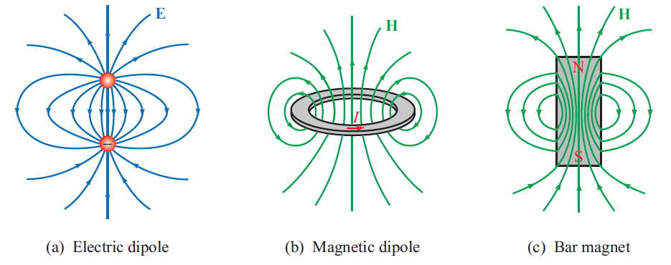
Magnetic Dipole
Because a circular loop exhibits a magnetic field pattern similar to the electric field of an electric dipole, it is called a magnetic dipole

Slide 17
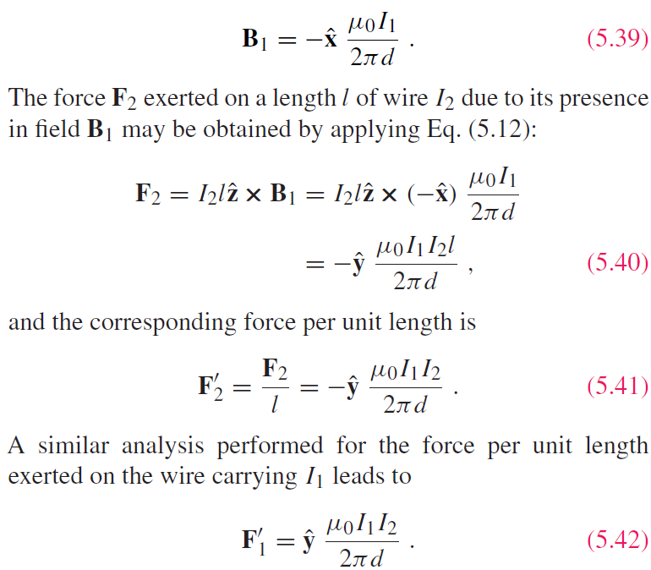
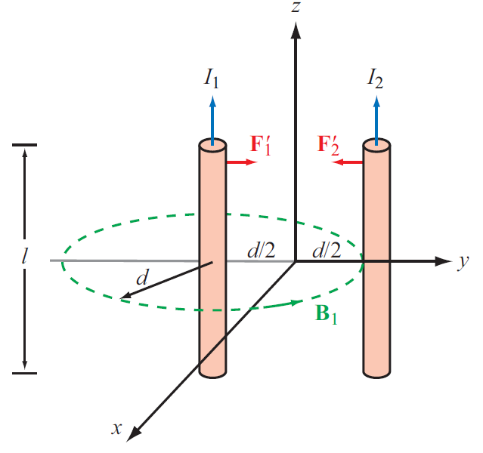
Forces on Parallel Conductors
Parallel wires attract if their currents are in the same direction, and repel if currents are in opposite directions

