Slide 1
EEC 130A Introductory Electromagnetics I
Lecture 14
Winter 2012
Dr. Xiaoguang “Leo” Liu
Electrical and Computer Engineering
UC Davis

Slide 2
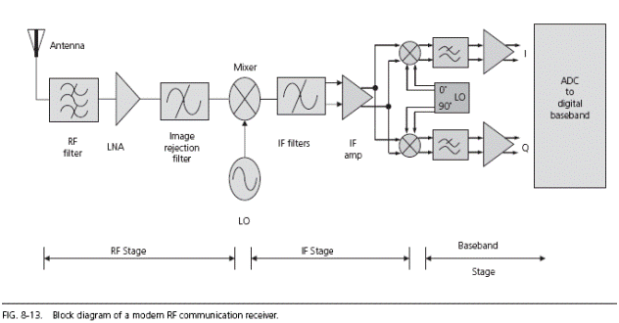
What to do after 130A?
A few options if you are interested in RF/Microwave Engineering
Courses
130B, taught by Prof. Branner next quarter
132ABC: RF / Microwave circuits
133: Principles and applications of antenna
http://rfengineer.net/1511/radio-architectures-pt-5-adcs-and-receivers/

Slide 3
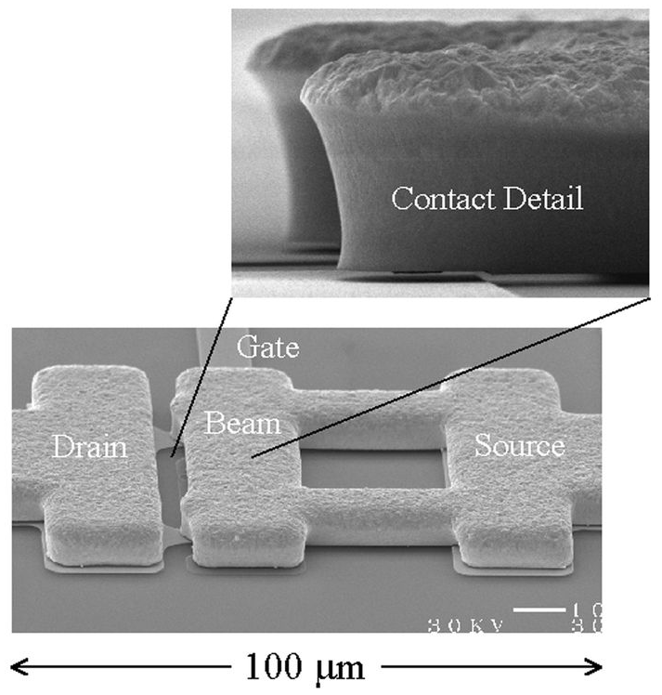
Courses
289N: RF-MEMS and Adaptive Wireless Communication Systems
Radio Frequency Micro-Elelctromechanical Systems
Thick cantilever
Radant MEMS Switch
Signal
Bias Electrode
Signal
ON State (contact)
OFF State (no contact)

Slide 4
Why RF-MEMS?
So, can’t you do this with transistors? After all they are …
Really small (~nm)
CAUTION = may be much larger for RF
Really fast (~100ps)
Yes, but…
They are non-linear devices (semiconductor junctions)
Constant biasing current in the on state
They have quite high loss for high frequencies (several GHz)
They leak in the off state at high frequencies

Slide 5
Why RF-MEMS
RF-MEMS switches are:
Low loss (0.1 dB up to 120 GHz)
Low power consumption (µW for electrostatic actuation)
High Isolation (> 30 dB up to 100 GHz)
High linearity (Very low intermodulationproducts > 60 dBm)
Very high Q possible with varactors(and large capacitance range)
Potential for low cost fabrication (no epilayers, no 0.15 um litho.)

Slide 6

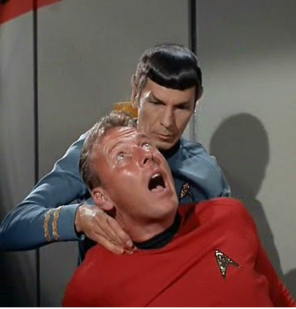
Applications of RF-MEMS
Cellphone “Death Grip” problems

Slide 7

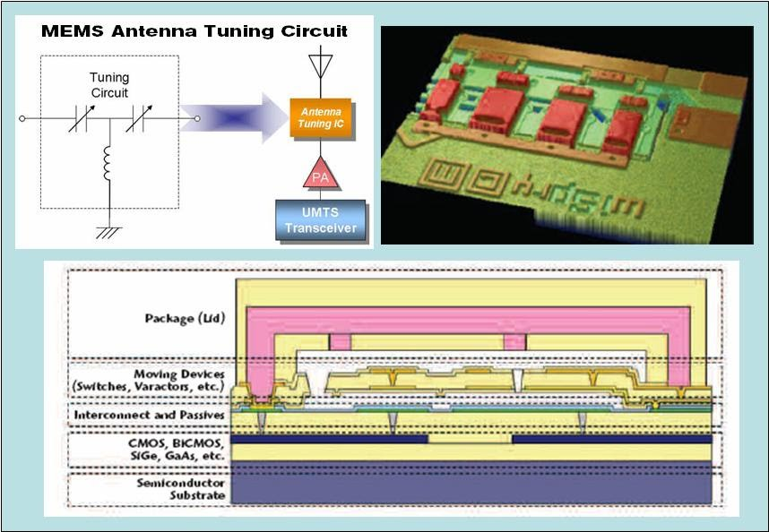
RF-MEMS Comes to the Rescue
RF-MEMS based antenna impedance tuner

Slide 8
289N RF-MEMS
A general introduction on the modeling, design, fabrication, and characterization of RF-MEMS
Prerequisite: 130A & B
Expected outcome:
Understand the advantages and limitations of RF-MEMS technology
Understand the working principles of the state-of-the-art RF-MEMS devices
Evaluate the merits and drawbacks of an RF-MEMS design
Quickly read and understand a paper on RF-MEMS and judge its quality
Complete a design of an RF-MEMS device or circuit with the help of CAD packages
Deliver a report and a presentation on a topic in RF-MEMS

Slide 9
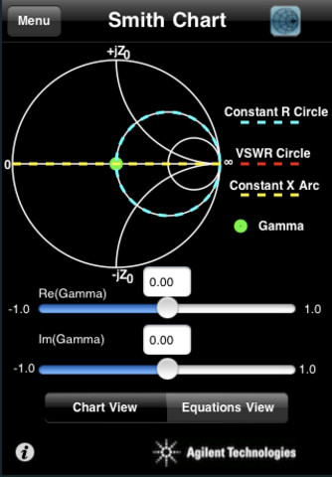
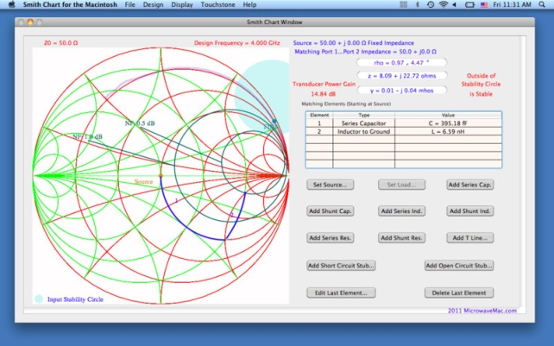
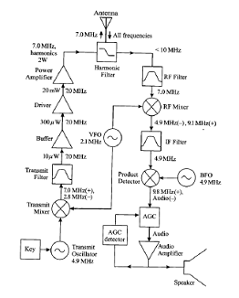

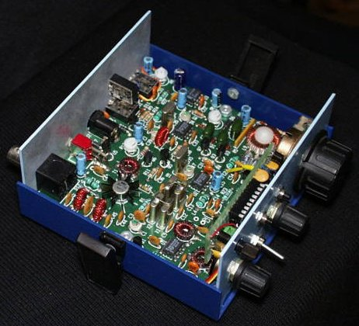
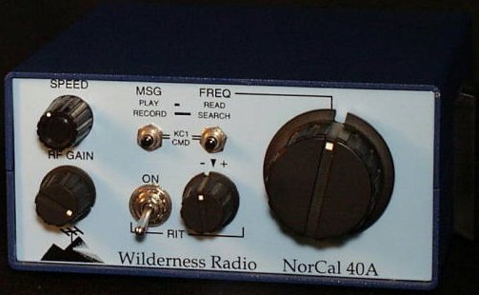
Projects for Fun
Smith chart iPhone app
Building a HAM radio and getting a license
Sucks
$14.99
NorCal 40A
Come Up with
Your Own Idea

Slide 10
Senior Design
Senior design project in RF/Microwave systems
Department requires at least 3 students to form a team
Some examples from other schools:
Purdue: Microwave
Powered Helicopter
TAMU: Phase Based
RF Direction Tracking

Slide 11
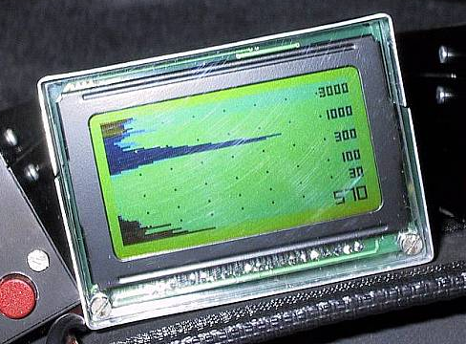
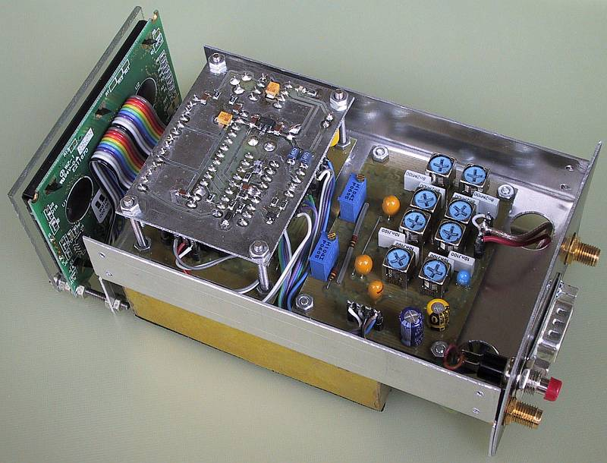
Senior Design
Some more ideas (from the almighty Internet)
Vertical Navigation Radar (http://lea.hamradio.si/~s53mv/vnr/assembly.html)
Microwave Handy Scanner (http://www.youtube.com/watch?v=vDyo_OQFdAc)
Speed Radar (http://www.youtube.com/watch?v=Dhp21FxttWM)

Slide 12
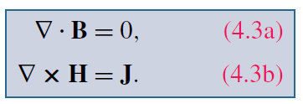
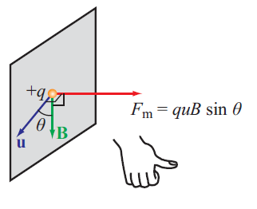


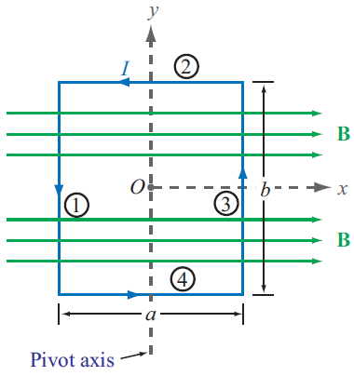


Review
Magnetostatics
Magnetic force & torque

Slide 13
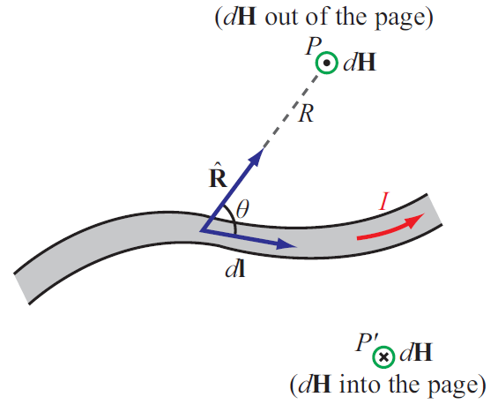

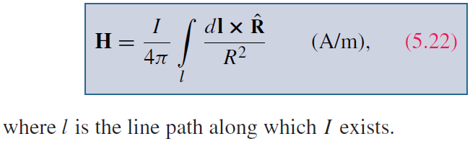
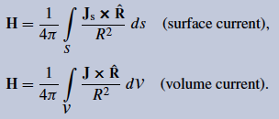
Review
Biot-Savart Law

Slide 14

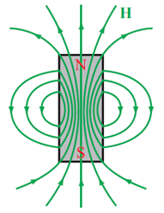
Maxwell’s Magnetostatic Equations
Gauss’s Law for Magnetism
There is no magnetic charge (or magnetic monopole)

Slide 15
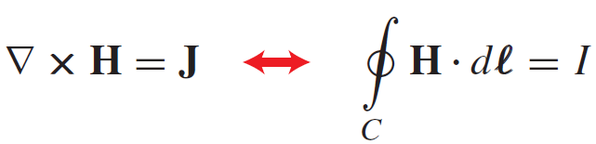
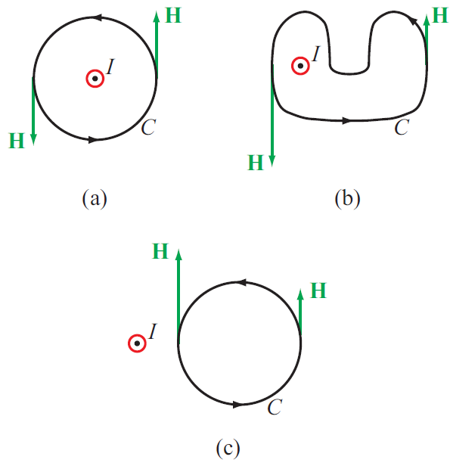
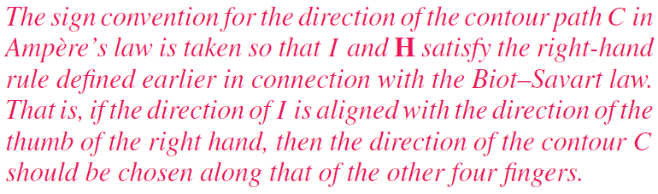
Ampere’s Law

Slide 16
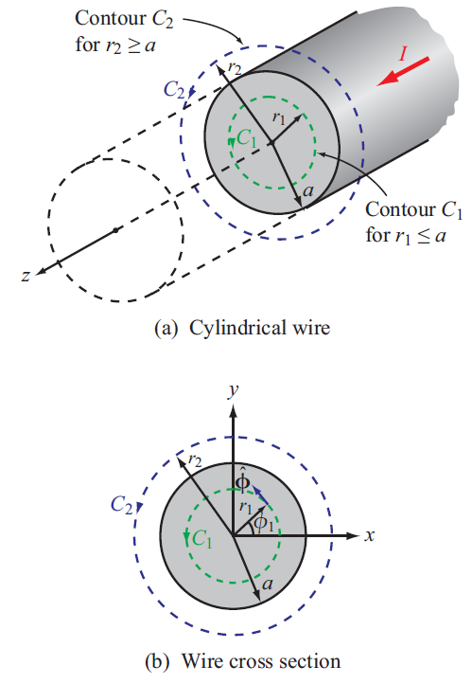
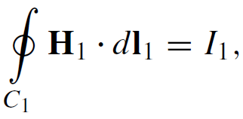
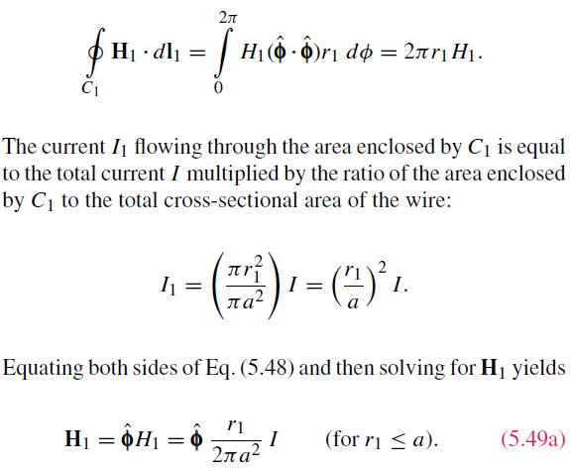
Example: Internal Magnetic Field
For r < a

Slide 17
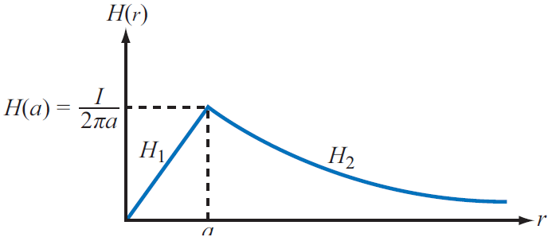
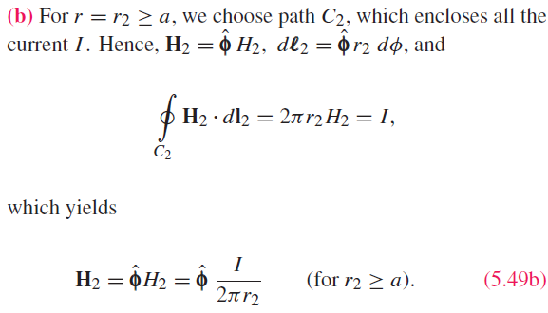
Example: Internal Magnetic Field
For r > a

Slide 18
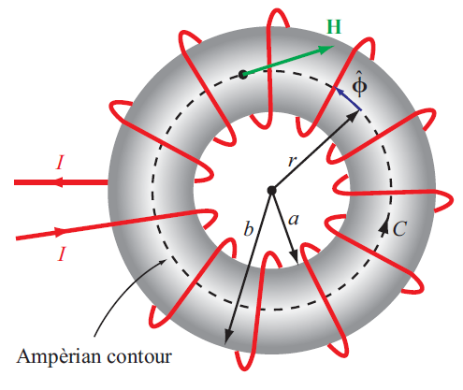
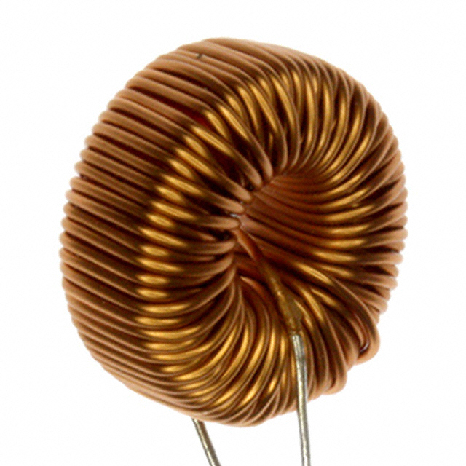
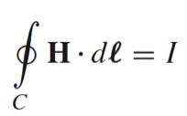
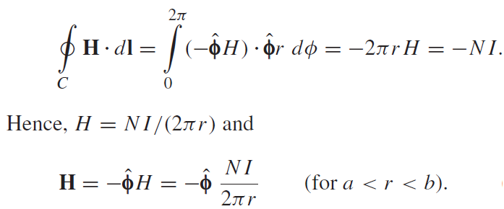
Magnetic Field of Toroid
Applying Ampere’s law over contour C
Ampere’s law states that the line integral of H around a closed contour C is equal to the current traversing the surface bounded by the contour.
The magnetic field outside the toroid is zero. Why?

