Slide 1
EEC 130A Introductory Electromagnetics I
Lecture 15
Winter 2012
Dr. Xiaoguang “Leo” Liu
Electrical and Computer Engineering
UC Davis

Slide 2
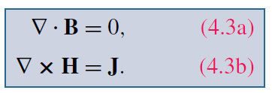

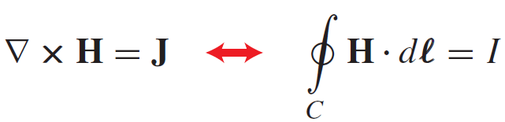
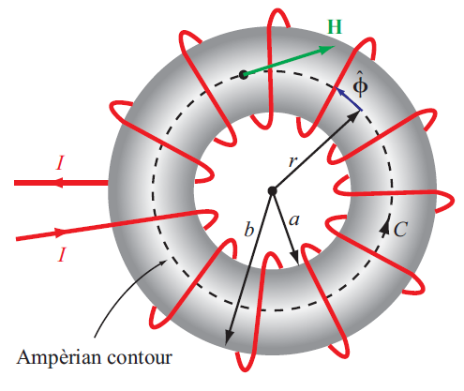
Review
Magnetostatics
Gauss’s Law for Magnetism
Ampere’s Law
Take advantage of symmetry
Toroid
Coaxial?

Slide 3
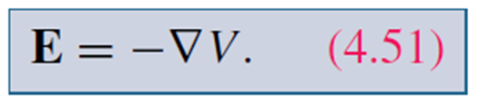

Vector Magnetic Potential
Recall electric scalar potential V
We wish to define a magnetic potential for B.
Note that
Vector Identity
Define vector potential A

Slide 4
Ampere’s Law
Coulomb gauge
Vector Poisson’s
Equation

Slide 5



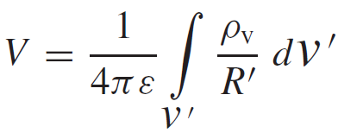
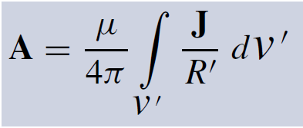
Electrostatics
Magnetostatics
Solution

Slide 6
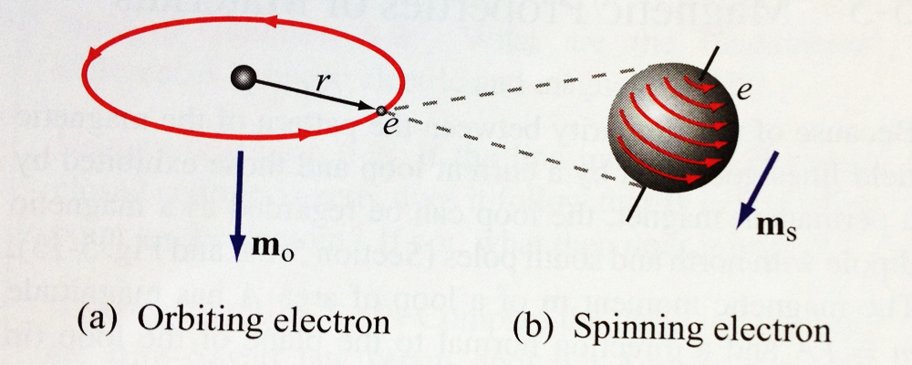
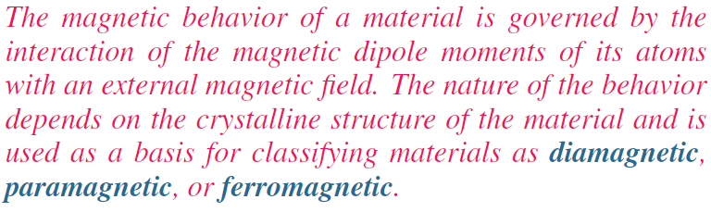


Magnetic Properties of Materials

Slide 7
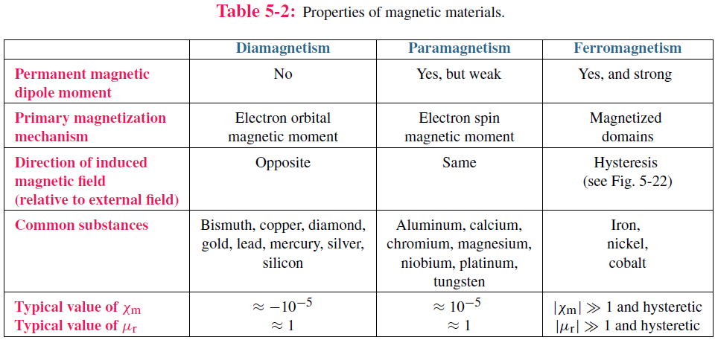
Comparison

Slide 8
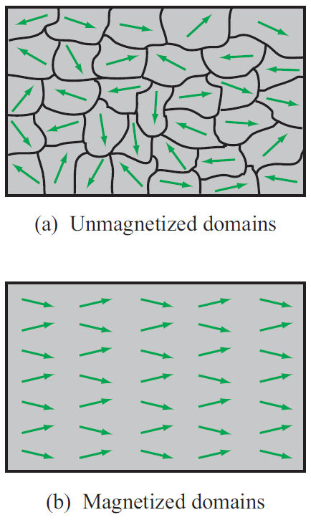
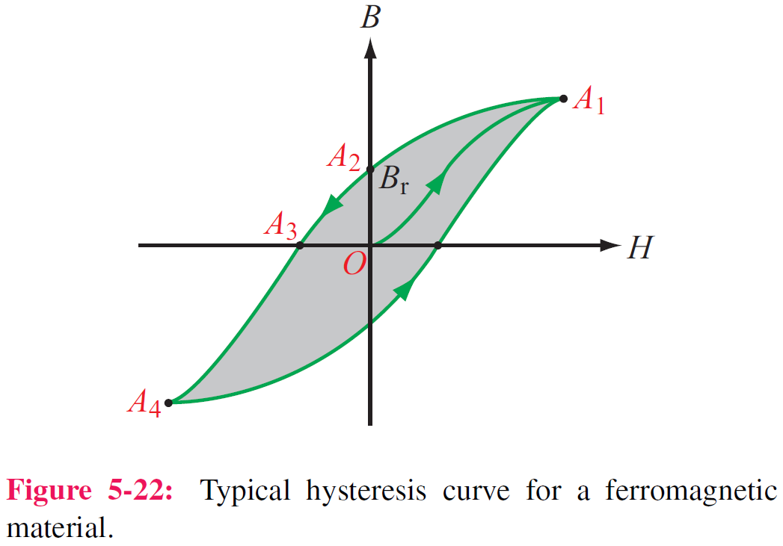
Magnetic Hysteresis

Slide 9
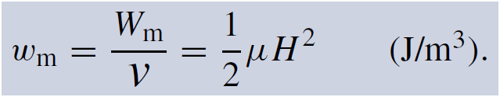
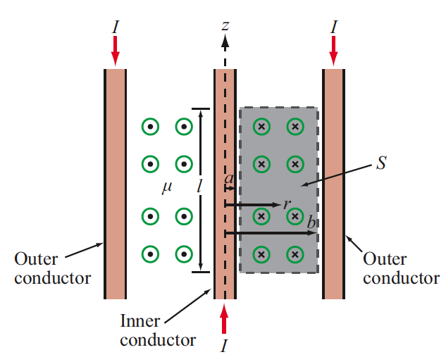
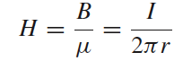
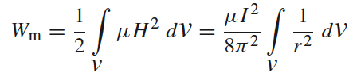
Magnetic Energy
Magnetic energy density
Magnetic field in the insulating material is
The magnetic energy stored in the
coaxial cable is

Slide 10
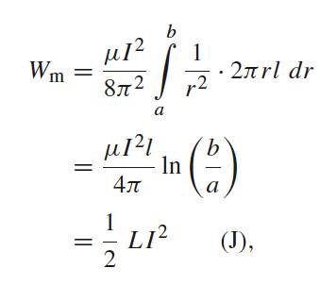
The magnetic energy stored in the
coaxial cable is

Slide 11
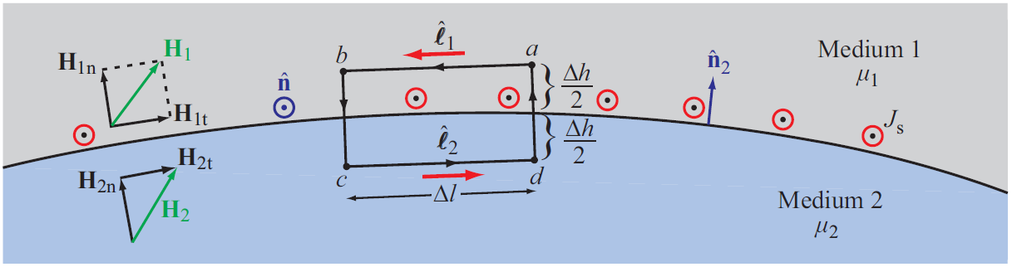
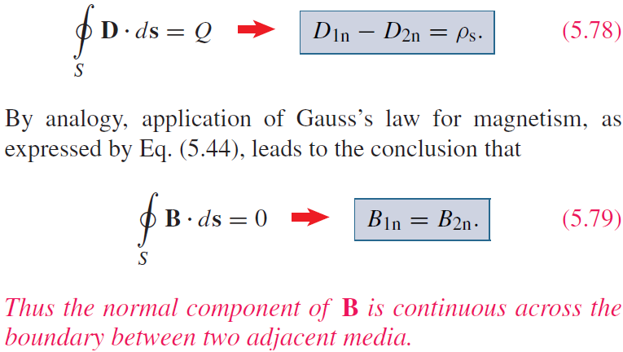

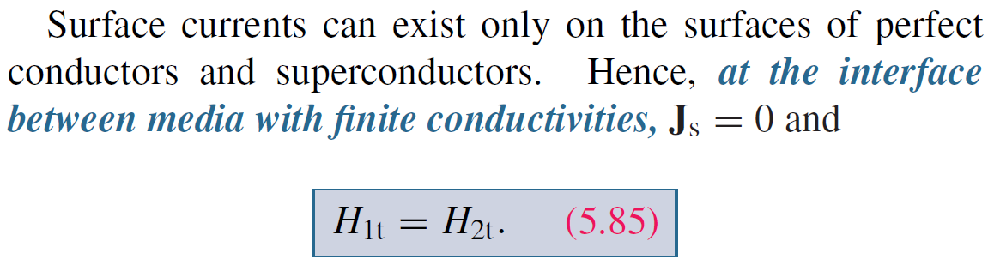
Boundary Conditions

