Slide 1
EEC 130A Introductory Electromagnetics I
Lecture 16
Winter 2012
Dr. Xiaoguang “Leo” Liu
Electrical and Computer Engineering
UC Davis

Slide 2





Review
Magnetic vector potential
Magnetic materials
Magnetic boundary conditions

Slide 3
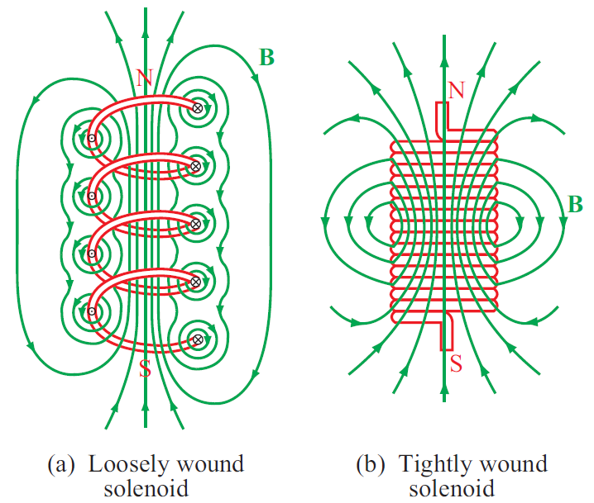





Inductance
Magnetic Flux
Flux Linkage
Inductance

Slide 4
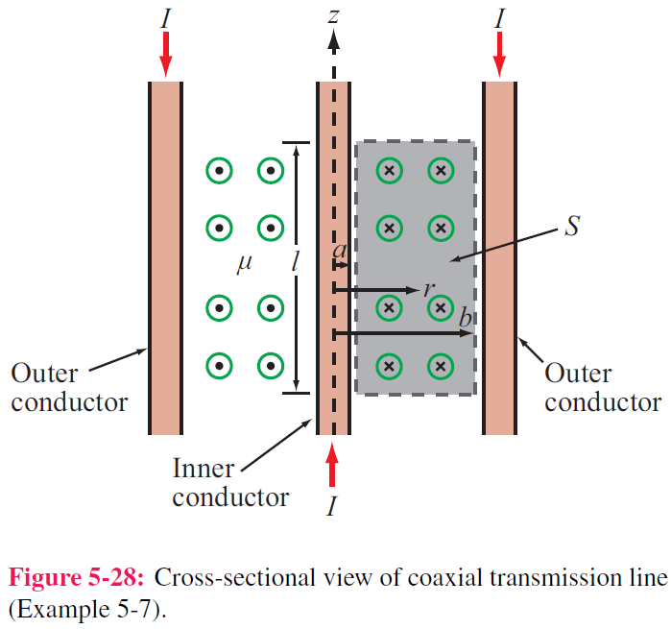
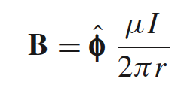


Inductance of Coaxial Cable
The magnetic field in the region S between the two conductors is approximately
Total magnetic flux:
Inductance per unit length:

Slide 5
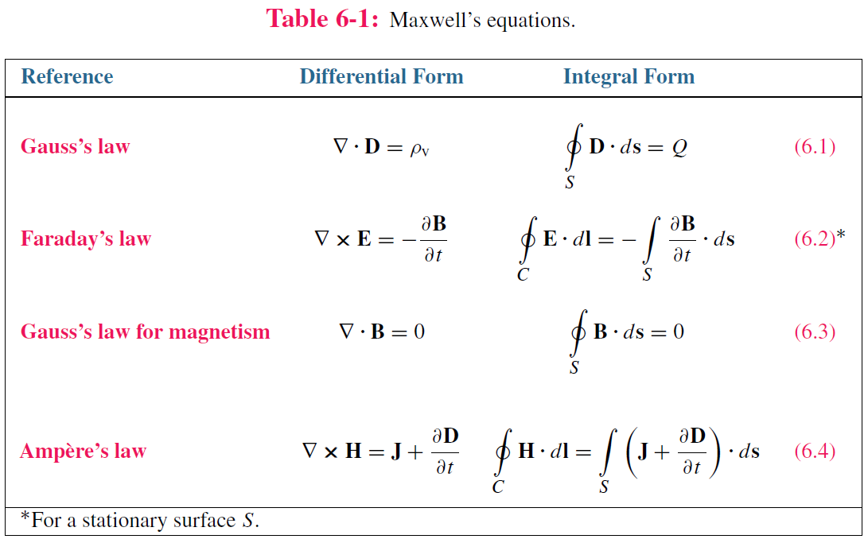
Maxwell’s Equations
From statics to dynamics

Slide 6
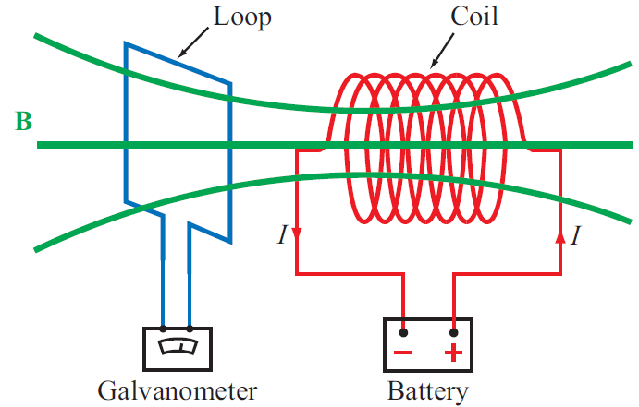


Faraday’s Law
Electromotive force (voltage) induced by time-varying magnetic flux:

Slide 7
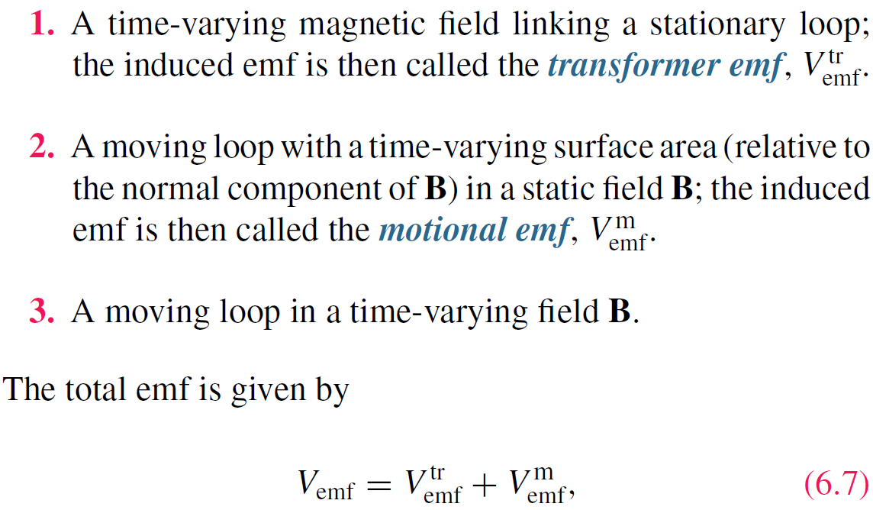
Keyword is CHANGE

Slide 8

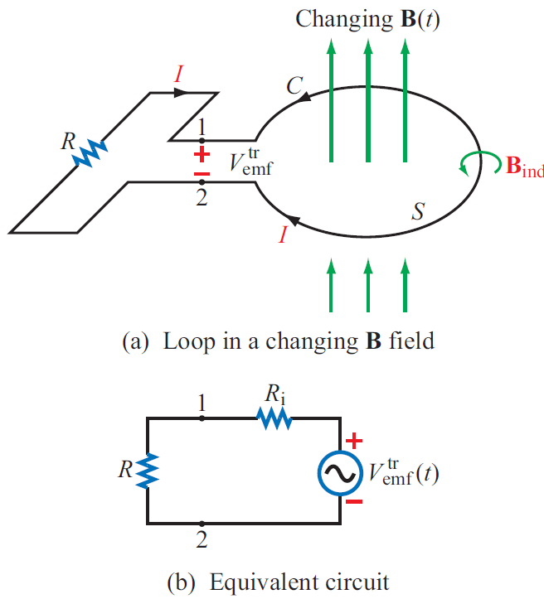

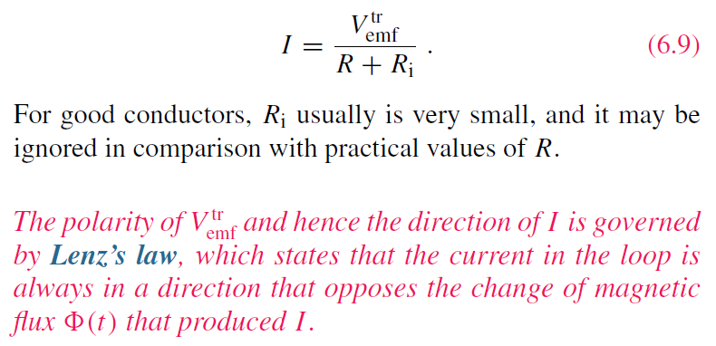

Stationary Loop in Time-Varying B

Slide 9
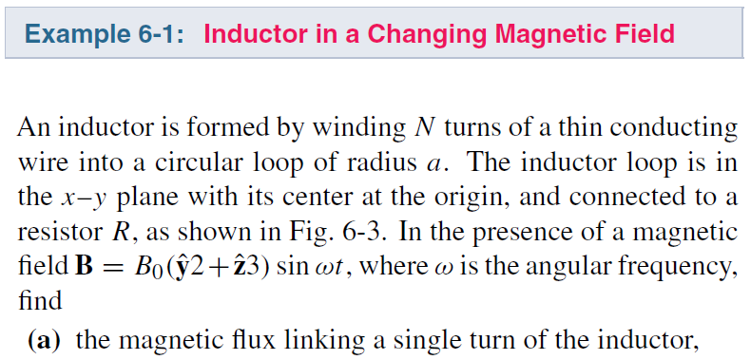

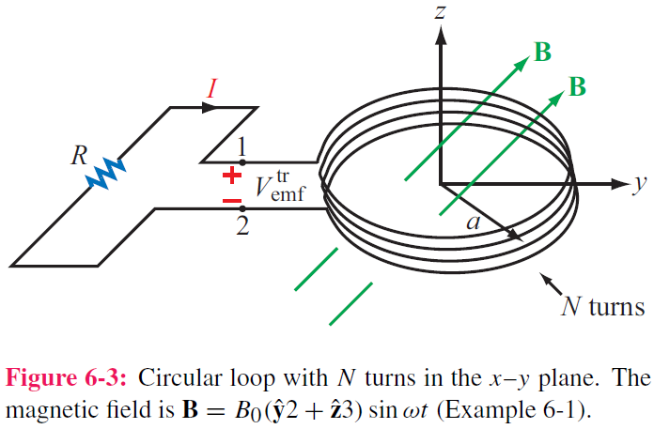
Example 6-1
cont.

Slide 10
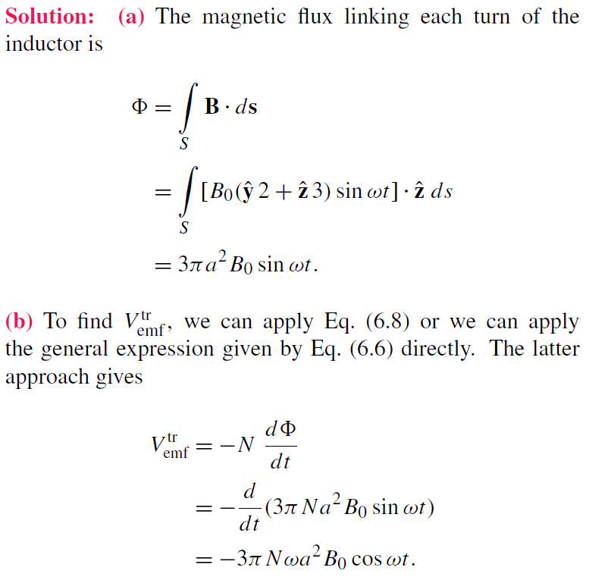
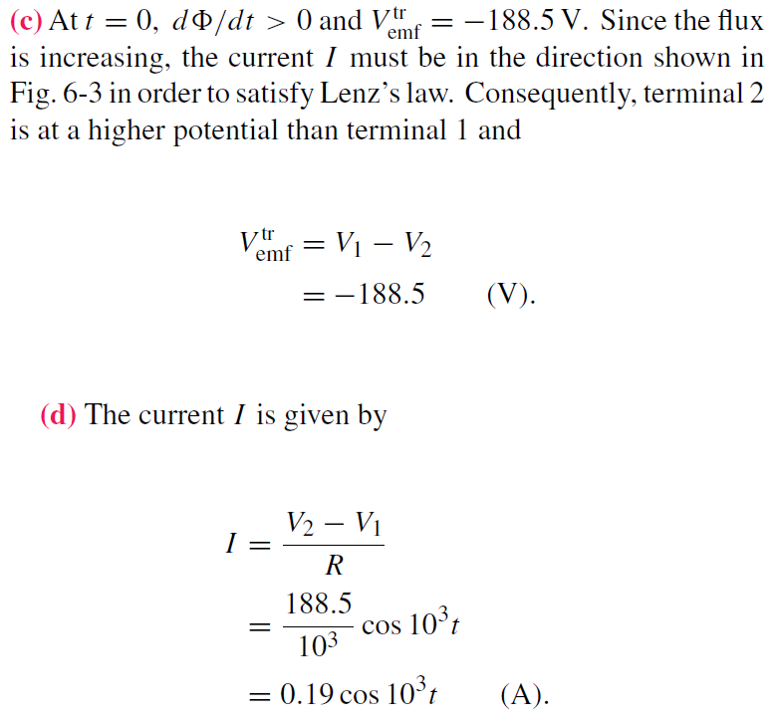


Slide 11
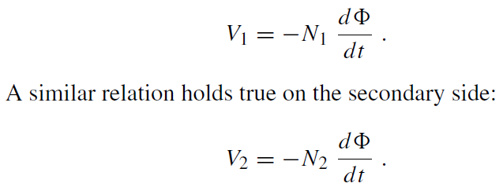
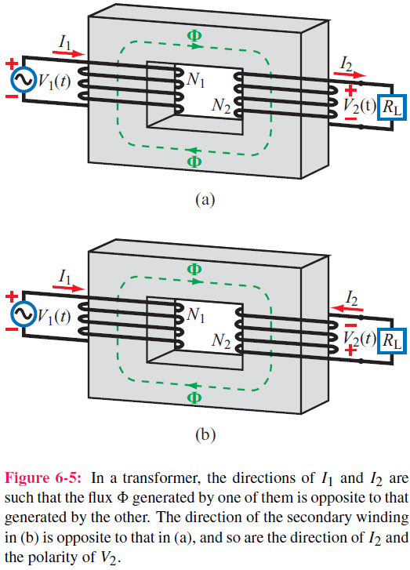
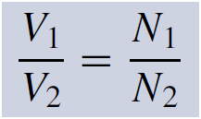
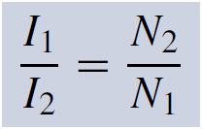
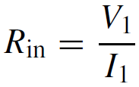
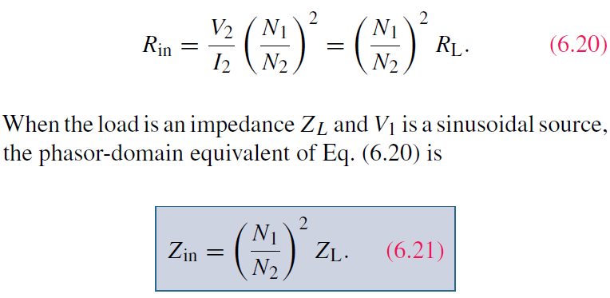
Ideal Transformer

Slide 12
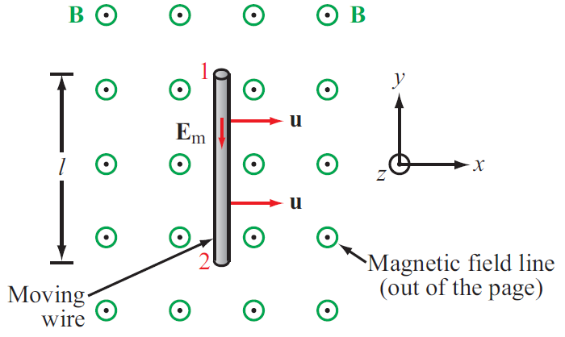

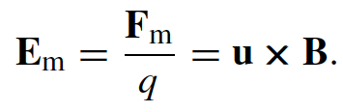

Motional EMF
Magnetic force on charge q moving with velocity u in a magnetic field B:
This magnetic force is equivalent to the electrical force that would be exerted on the particle by the electric field Em given by
This, in turn, induces a voltage difference between ends 1 and 2, with end 2 being at the higher potential. The induced voltage is called a motional emf

Slide 13
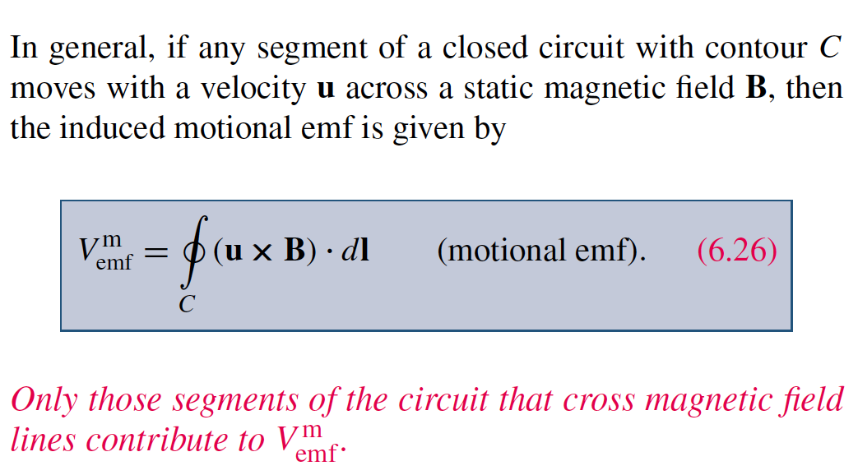
Motional EMF

Slide 14
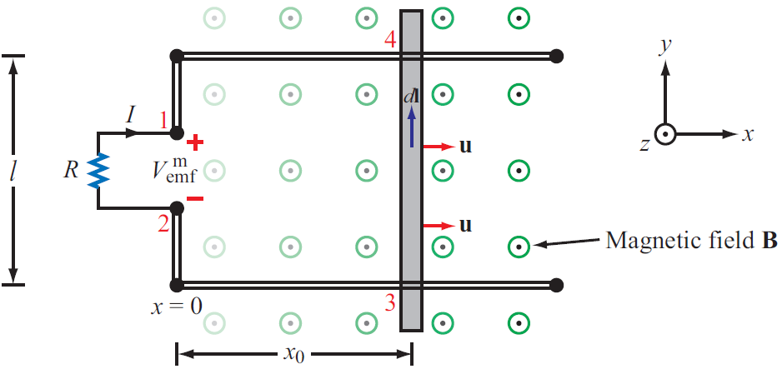
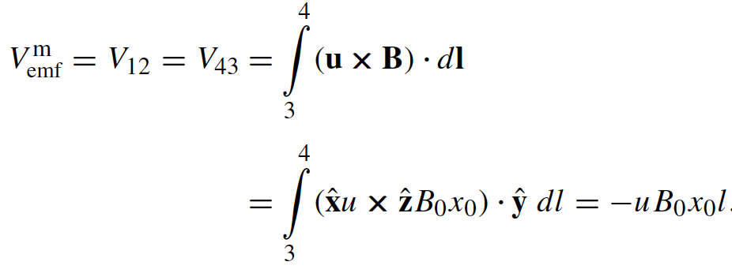

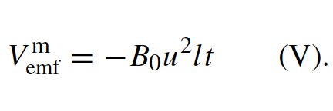
Example 6-3: Sliding Bar
Note that B increases with x
The length of the loop is related to u by x0 = ut. Hence

Slide 15

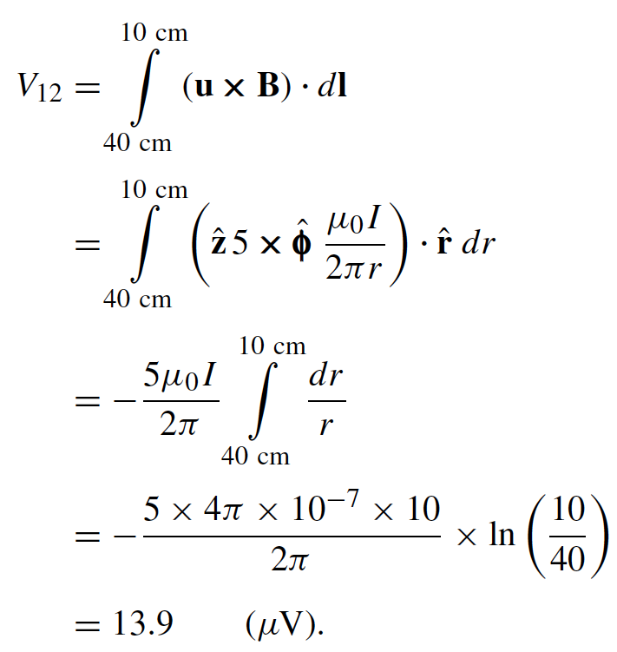
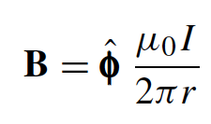
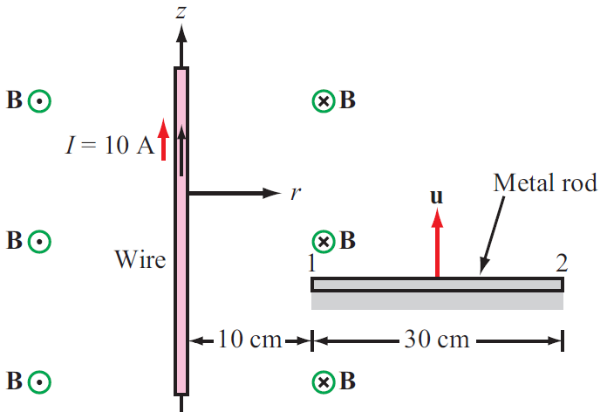

Slide 16
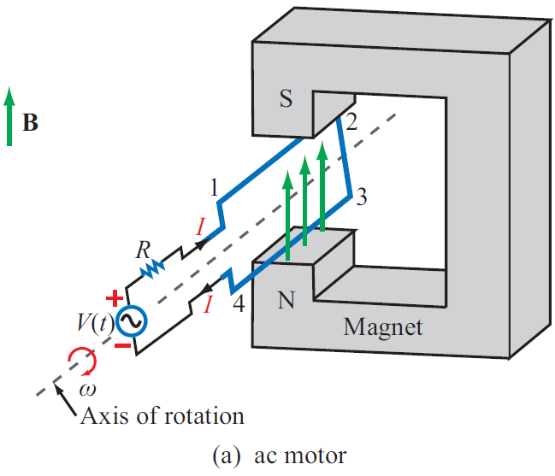
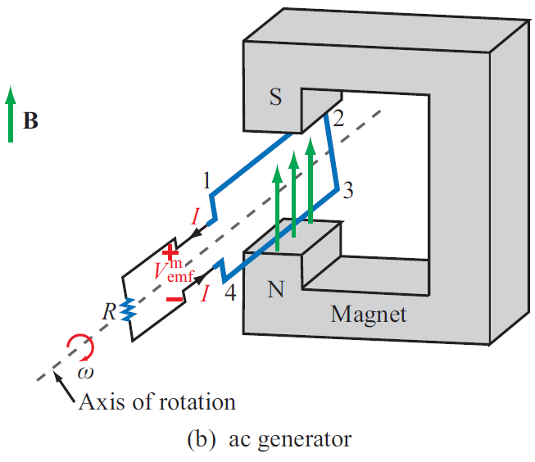
EM Motor/ Generator Reciprocity
Motor: Electrical to mechanical energy conversion
Generator: Mechanical to electrical energy conversion

