Slide 1
EEC 130A Introductory Electromagnetics I
Lecture 17
Winter 2012
Dr. Xiaoguang “Leo” Liu
Electrical and Computer Engineering
UC Davis

Slide 2
Announcements
Final exam schedule
Friday afternoon?
Homework 9 will not be returned; solution will be posted Friday
Practice problems pool
All homework problems
Practice problem sets 1 & 2
Additional office hours?
Check your scores in SmartSite

Slide 3
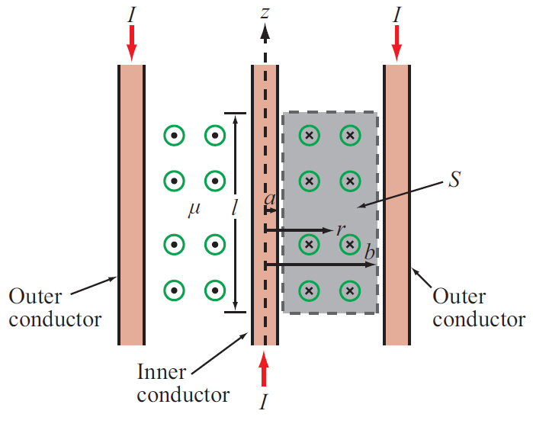
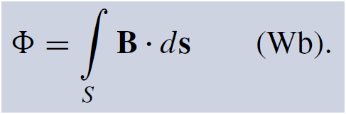
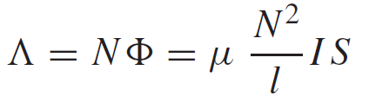
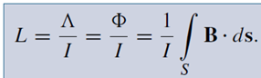
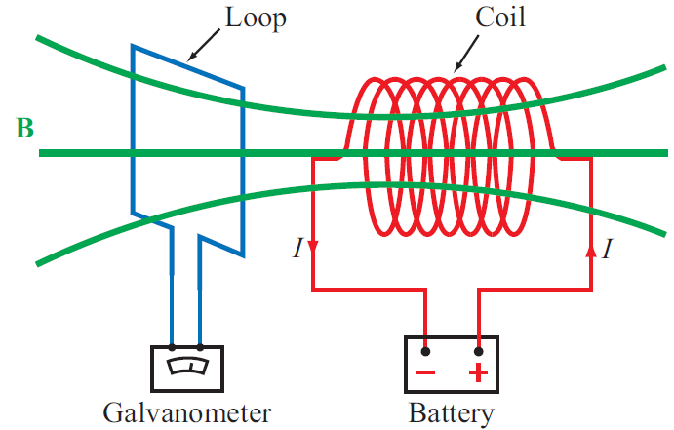
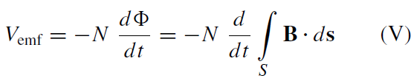
Review
Inductance
Magnetic flux
Flux linkage
Inductance
Maxwell’s equations – Dynamics
Faraday’s law
Keyword is CHANGE
Lenz law

Slide 4
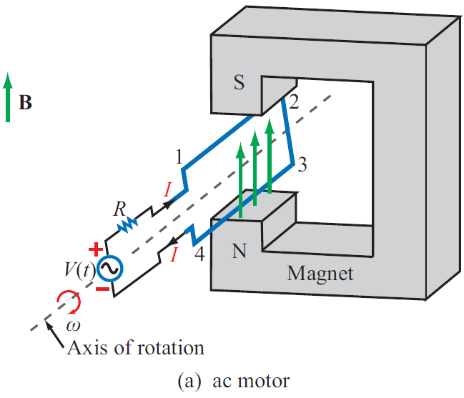
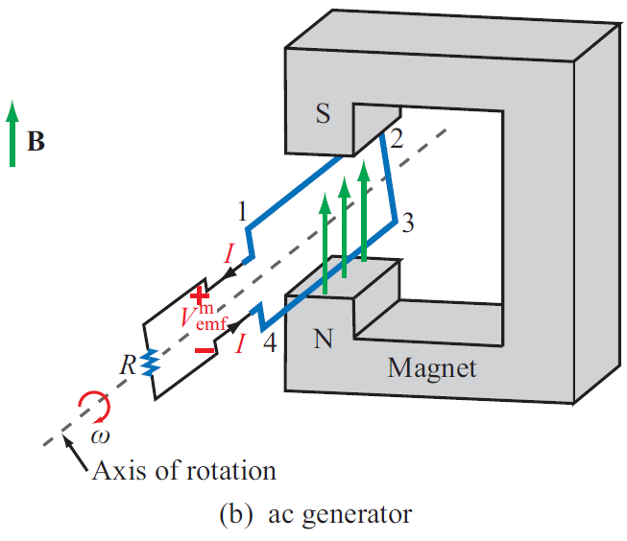
EM Motor/ Generator Reciprocity
Motor: Electrical to mechanical energy conversion
Generator: Mechanical to electrical energy conversion

Slide 5
Example
H
u
I
b
a
r = ut

Slide 6
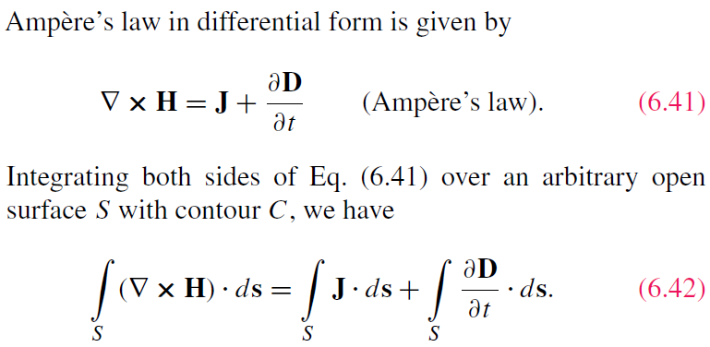
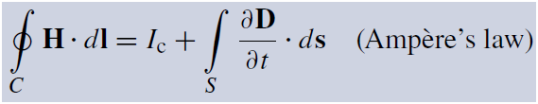
Displacement Current
This term is conduction current I_{C}
Application of Stokes’s theorem gives:
This term must represent a current

Slide 7
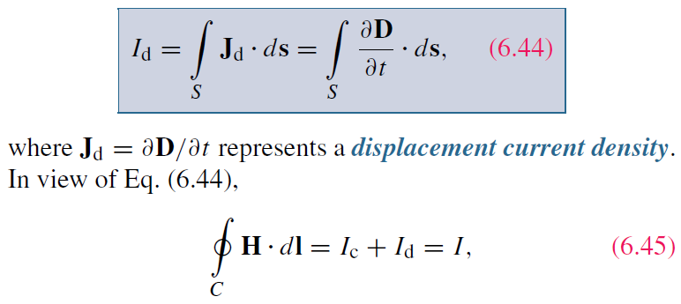

Displacement Current
Define the displacement current as:
The displacement current does not involve real charges;
it is an equivalent current that depends on

Slide 8
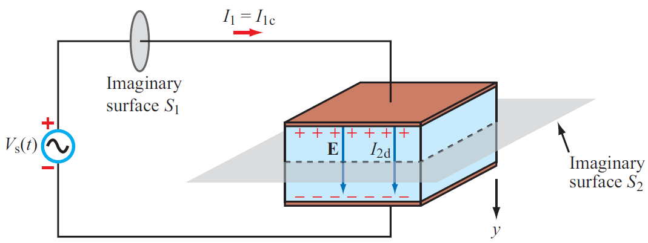
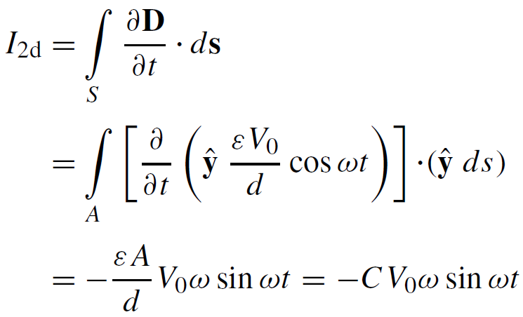
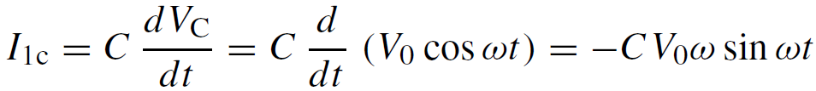
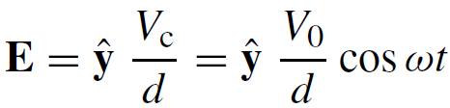

Capacitor Circuit
Given: Wires are perfect conductors and capacitor insulator material is perfect dielectric.
For Surface S₁:
I₁ = I_{1c} + I_{1d}
For Surface S₂:
I₂ = I_{2c} + I_{2d}
I_{2c} = 0 (perfect dielectric)
(D = 0 in perfect conductor)
Conclusion: I₁ = I₂

Slide 9
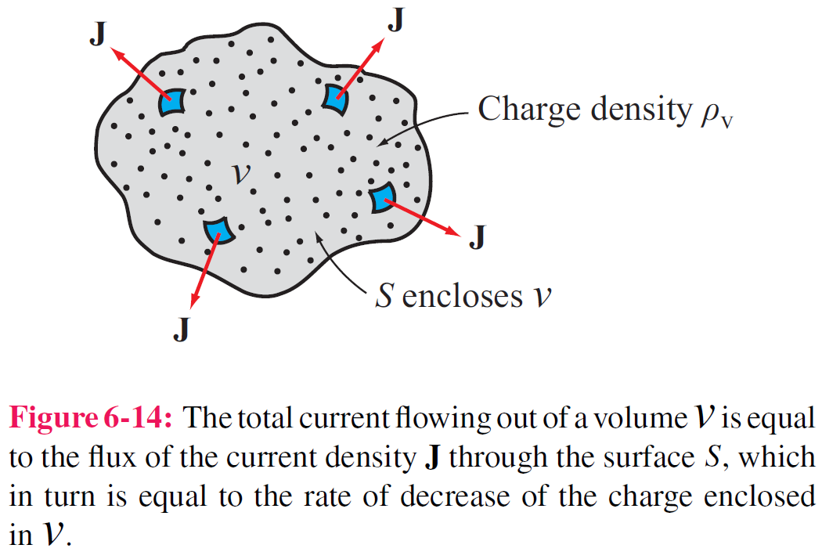
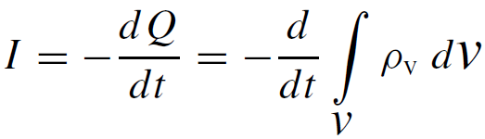
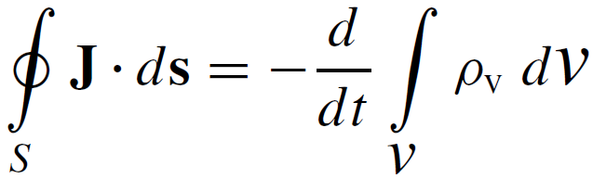
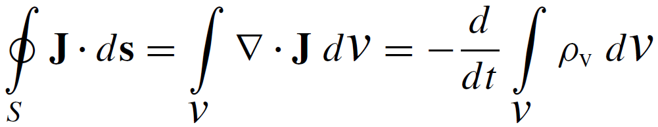
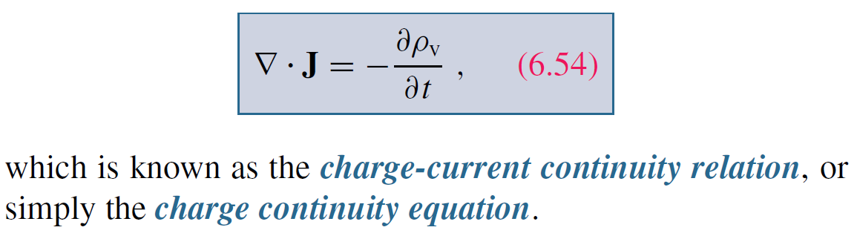
Charge Current Continuity Equation
Current I out of a volume is equal to rate of decrease of charge Q contained in that volume:
Used Divergence Theorem

Slide 10
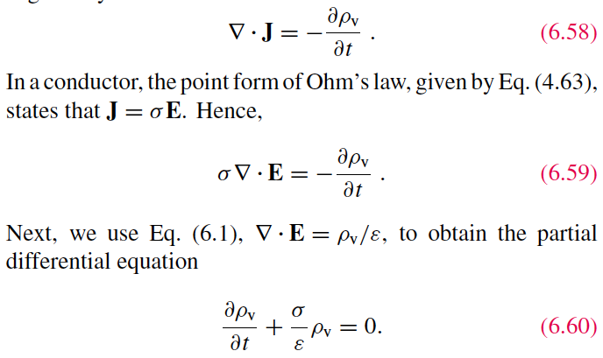

Charge Dissipation
Question 1: What happens if you place a certain amount of free charge inside of a material?
Answer: The charge will move to the surface of the material, thereby returning its interior to a neutral state.
Question 2: How fast will this happen?
Answer: It depends on the material; in a good conductor, the charge dissipates in less than a femtosecond, whereas in a good dielectric, the process may take several hours.
Derivation of charge density equation:
Cont.

Slide 11
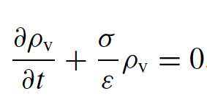
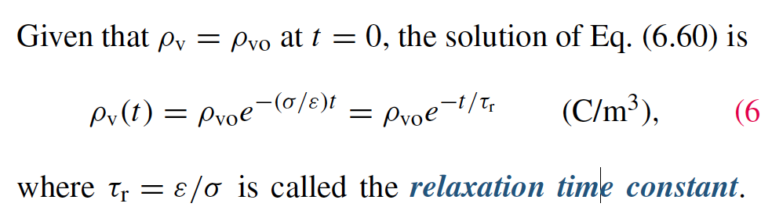


Solution of Charge Dissipation Equation
For copper:
For mica:
= 15 hours

