Slide 1
EEC 130A Introductory Electromagnetics I
Winter 2012
Dr. Xiaoguang “Leo” Liu
Electrical and Computer Engineering
UC Davis

Slide 2
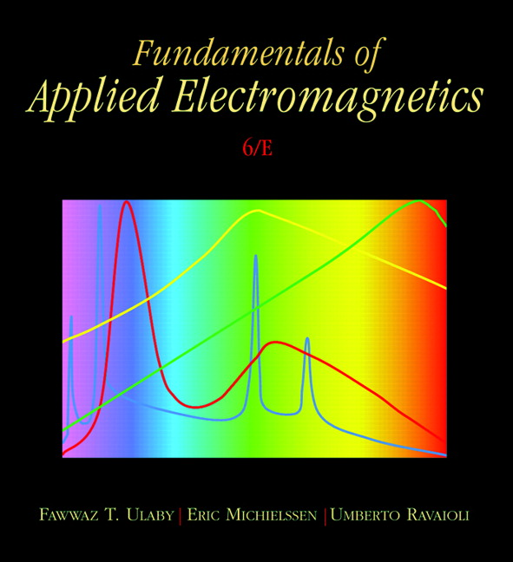
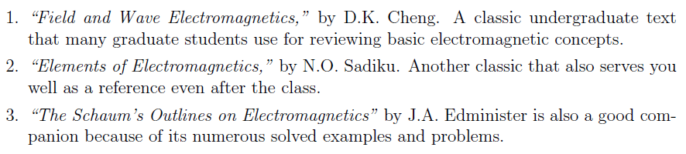
Textbooks
Textbook
“Fundamentals of Applied Electromagnetics,”
6th Ed., by F. T. Ulaby, E. Michielssen, U. Ravaioli, Pearson Prentice Hall, 2010.
Optional References

Slide 3
Homework
Homework assignments are designed to help you progress through the course
10 %
Assigned weekly
Due 2131 Kemper by 12pm on Tuesday
Working in groups is encouraged, BUT
Make sure the solution you submit is your own!
Write the names of all individuals with whom you worked at the top of your assignment.
Limit the group size less than 4.
Late homework will NOT be accepted.

Slide 4
Exams
2 mid-terms and 1 final
Time and location TBA
No textbooks, no notes, no calculators
A formula sheet will be provide
30 %
each
Make-up exams will be provided, BUT
With a 15% penalty
Problems will be different
Will cover additional materials between the original and the make-up exam

Slide 5
Regrade
Must be filed with the instructor within one week after the homework/exam is returned.
3 days for the final.
Do not mark on the original homework/exam. Make a photocopy.
We will keep a photocopy of all exams.

Slide 6
No Cheating Please
Following actions are considered cheating:
Submitting homework solutions which are not your own. While we encourage you to work together, your work should not be a copy of your partner's.
Sharing results or notes during exams.
Using notes (hardcopy or electronic) during exams.
Continuing work on your exam after we have called for papers.
Requesting a regrade on an exam that has been altered.
You will receive ZERO for the homework/exam and may receive F for the course if found cheating.

Slide 7
Getting Help – Office Hours
Xiaoguang “Leo” Liu | Tuesday: 8-10 pm in 3169 Kemper Wednesday: 4-5 pm in 3169 Kemper By appointment
Stevan Djordjevic | Monday: 6-7:30 pm in 1127 Kemper
Runxiang Yu | Friday: 4-5:30 pm in 1127 Kemper
Don’t let yourself fall behind!

Slide 8
Misc
Student with disability need to register with the Student Disability Center (http://sdc.ucdavis.edu/)
Talk with the instructor within the first week of class
Course Website:
SmartSite
Alternative website: http://ucdart.net/Teaching
Questions?

Slide 9
Introduction
What does Electromagnetics study?
Electric charges
Magnetic field
Electric field
Electromagnetic wave
Current
Radiation
… and many more
Can you think of some examples in which electromagnetics is involved?

Slide 10
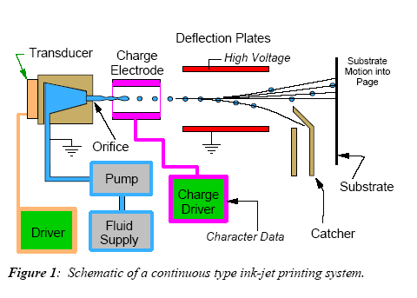
Electromagnetics in a Ink-jetPrinter
Courtesy of EE311 (Purdue University) Prof. Chappell

Slide 11

Electromagnetics in a Satellite
8.4 billion miles or 13.5 billion kilometers away and still communicating. A signal traveling at the speed of light towards Voyager-1, takes about 12 hours and 39 minutes, to reach Voyager-1's receiver (and vice versa). Yet electrons moving on the face of the dish antenna are detected on earth.
For a full description of the Voyager mission: http://nssdc.gsfc.nasa.gov/nmc/spacecraftDisplay.do?id=1977-084A
Courtesy of EE311 (Purdue University) Prof. Chappell

Slide 12
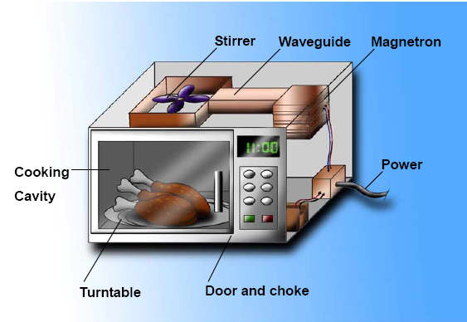
Electromagnetics in Microwave Oven
http://www.todayifoundout.com/index.php/2010/08/why-you-generally-shouldnt-put-metals-in-the-microwave/

Slide 13
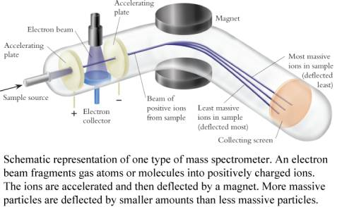
Electromagnetics in Mass Spectrometer
http://martine.people.cofc.edu/111LectWeek2.htm

Slide 14




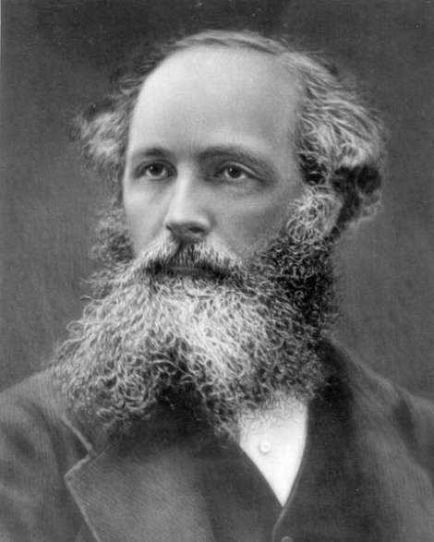
Maxwell’s Equation
Gauss’ law for electricity
Gauss’ law for magnetism
Faraday’s law of induction
Ampere’s law
Note:
1. the time dependence
2. electric field and magnetic field are coupled

Slide 15
Course Outline
In this course, we will study 4 main topics:
Waves and transmission lines
6
Electrostatics
5
Magnetostatics
4
Maxwell equations and
electromagnetic waves
5

