Slide 1
EEC 130A Introductory Electromagnetics I
Winter 2012
Lecture 4
Dr. Xiaoguang “Leo” Liu
Electrical and Computer Engineering
UC Davis

Slide 2
Announcement
Mid-term exam: Tuesday, Feb. 7th
Lecture notes, homework solutions and practice problems will be available by Jan. 31
A tentative formula sheet will be distributed by next lecture
Final exam schedule ?
Feedback

Slide 3
Today’s Topics
Review
General considerations for transmission lines
Typical transmission line examples
Reflection coefficient and standing wave

Slide 4
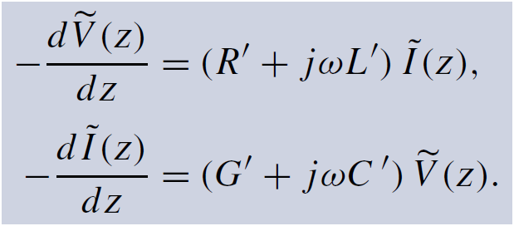
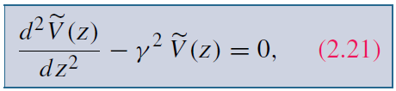

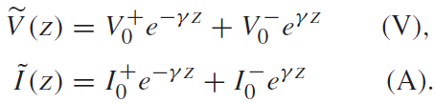
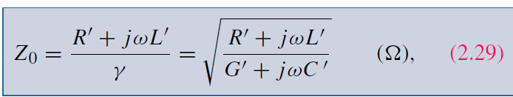
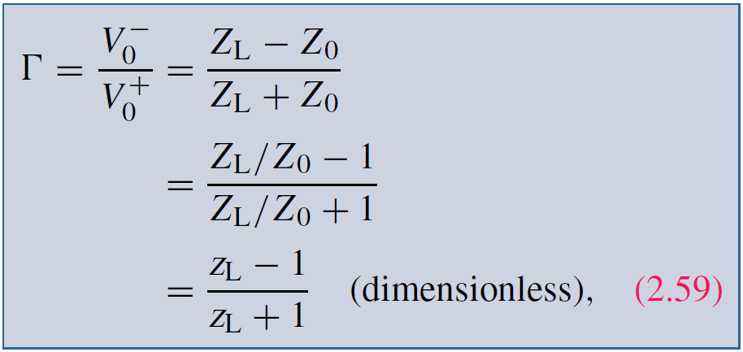
Review
Telegrapher’s Equations
Wave Equation
Characteristic Impedance
Reflections coefficient

Slide 5



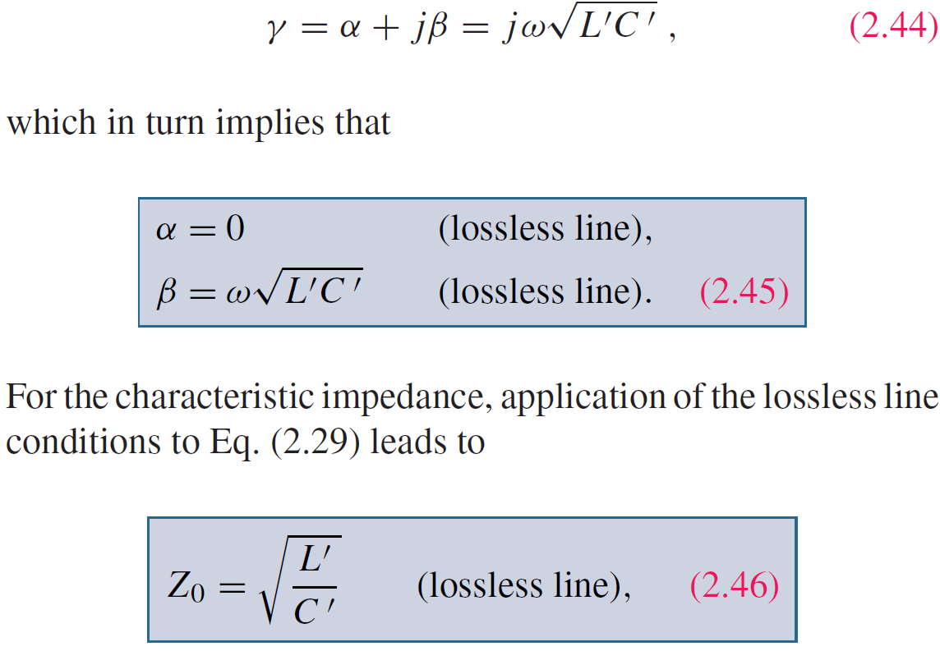
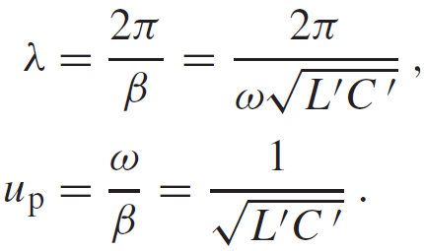
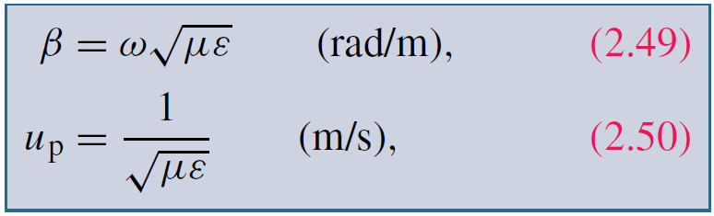
Lossless Transmission Lines
Complex Propagation Constant
Attenuation Constant
Propagation Constant
If
Then:
Wavelength
Phase velocity
Characteristic Impedance

Slide 6
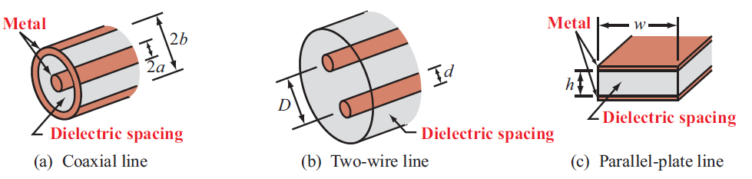
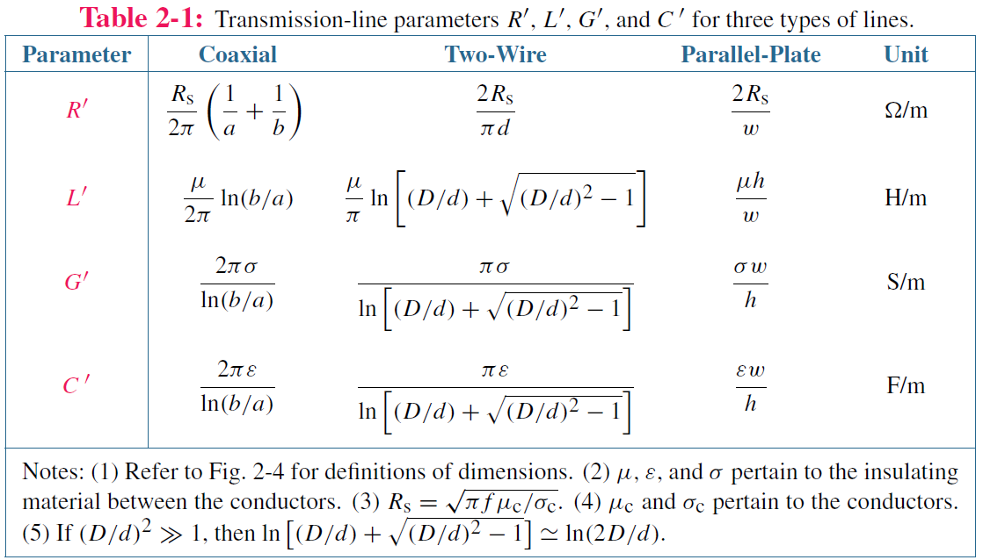
Typical Transmission Lines

Slide 7
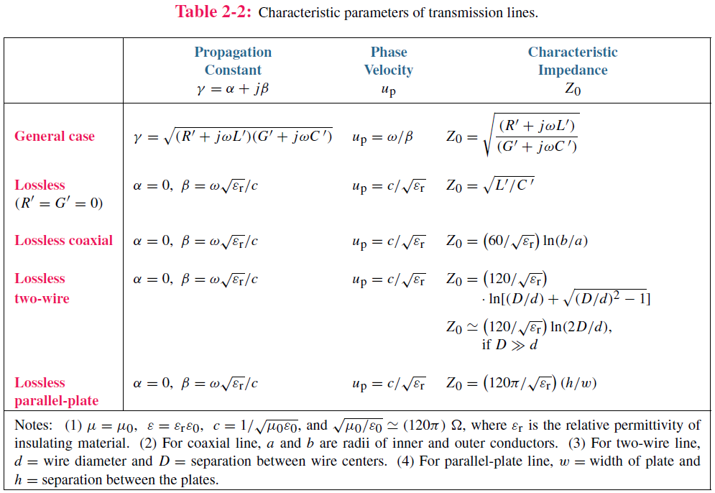
Continued.

Slide 8

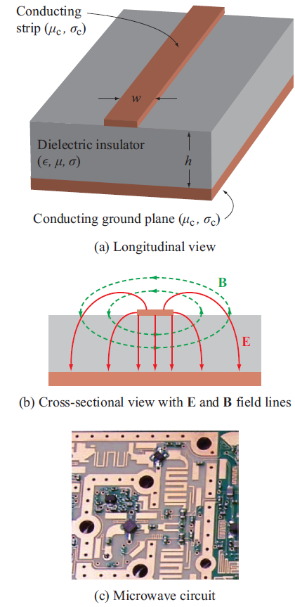

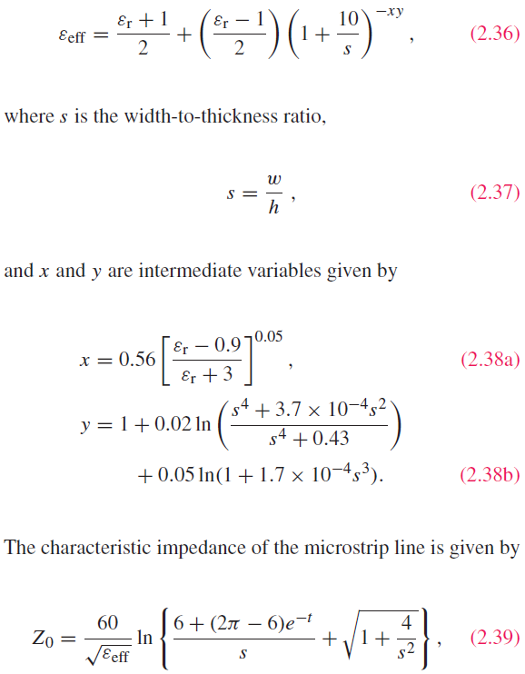
Microstrip Line
Phase velocity
in dielectric:
microstrip:

Slide 9
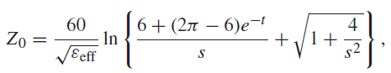
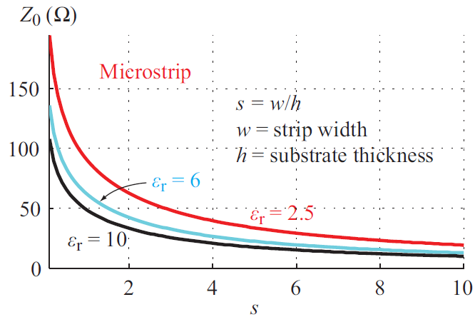

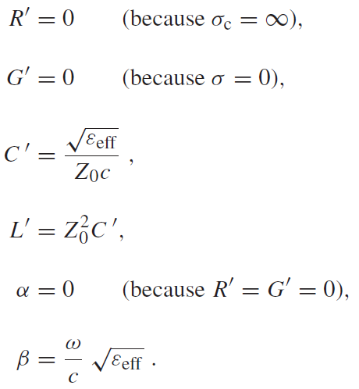
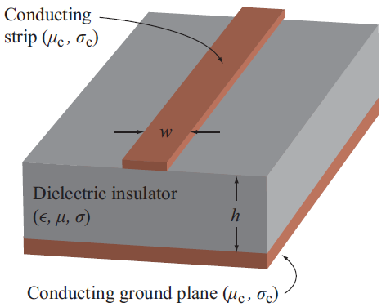
Characteristic Impedance (Lossless)

Slide 10
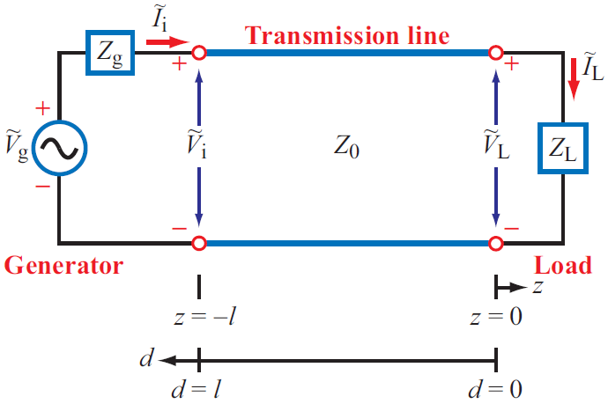
Reflection Coefficient
Is Γ real or complex?

Slide 11
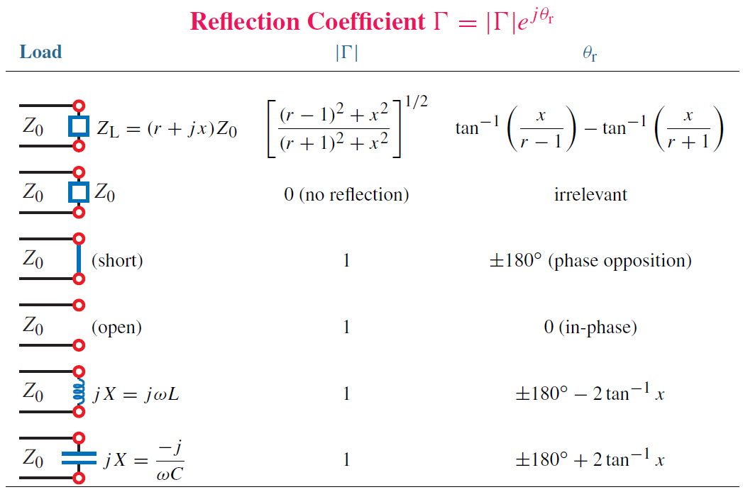
A Few Examples
Notes:
Note:
For reactive loads, the magnitude of the reflection coefficient is always 1.

Slide 12
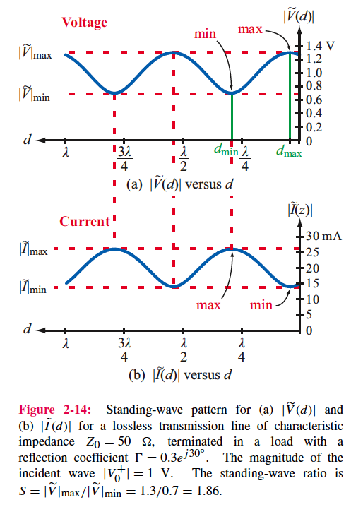
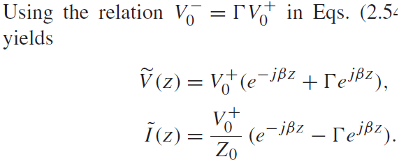

Standing Wave
Voltage Standing Wave Ratio
(VSWR)

Slide 13
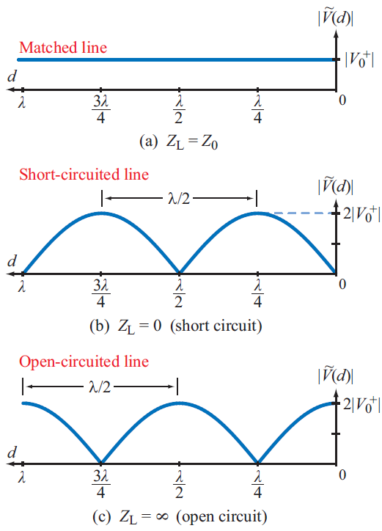
Some Special Cases
VSWR =1
VSWR =∞
VSWR = ∞
VSWR is a measure of matching

Slide 14
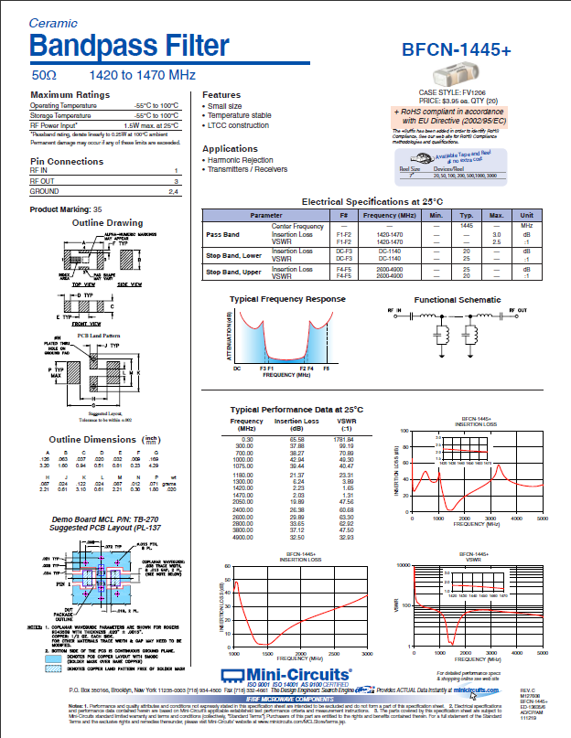
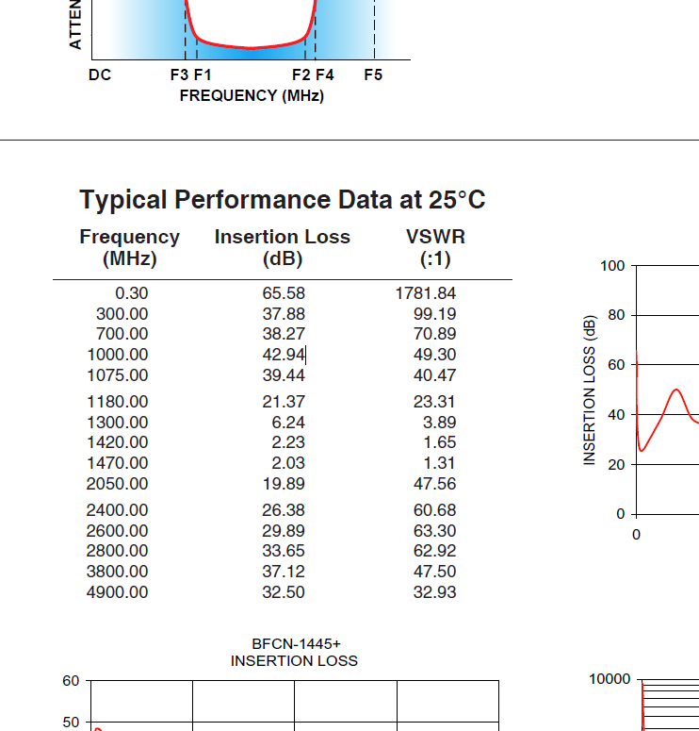
A Real Datasheet
http://www.minicircuits.com/pdfs/BFCN-1445+.pdf

Slide 15
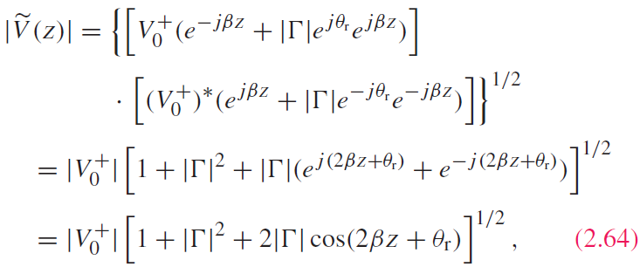
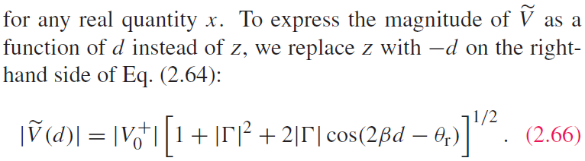
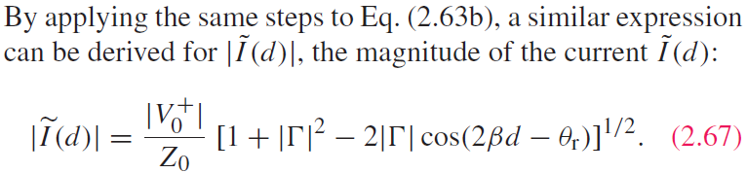
VSWR -- Mathematics
Notes:
Notes:
1. For complex number z, |z|^2=z x z*

Slide 16

Continued
Voltage magnitude is maximum
When voltage is a maximum, current is a minimum, and vice versa

