Slide 1
EEC 130A Introductory Electromagnetics I
Lecture 5
Winter 2012
Dr. Xiaoguang “Leo” Liu
Electrical and Computer Engineering
UC Davis

Slide 2

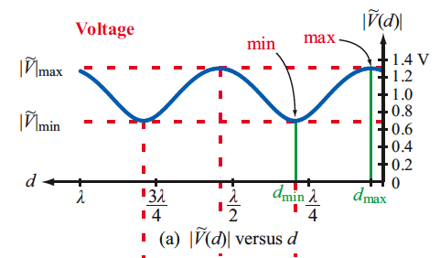

Review of Last Lecture
Standing wave ratio (SWR)
Sometimes voltage standing wave ratio (VSWR)
A measure of the matching

Slide 3
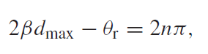

Maximum and Minimum Voltage
Voltage maxima
Voltage minima

Slide 4
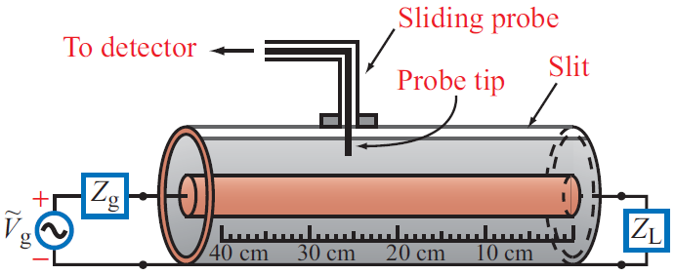
Slotted Line
Example 2-16

Slide 5
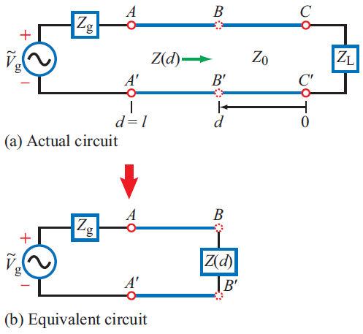
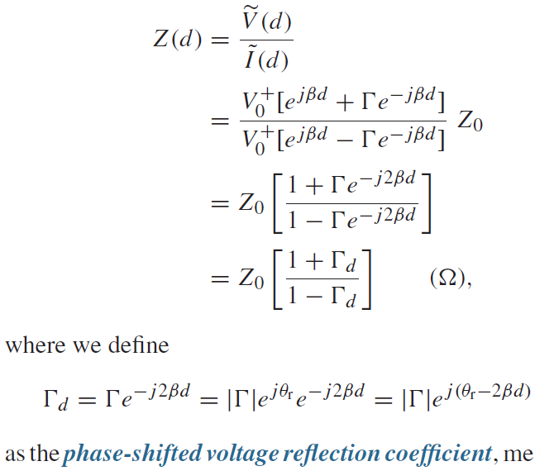
Wave Impedance
At a distance d from the load:

Slide 6
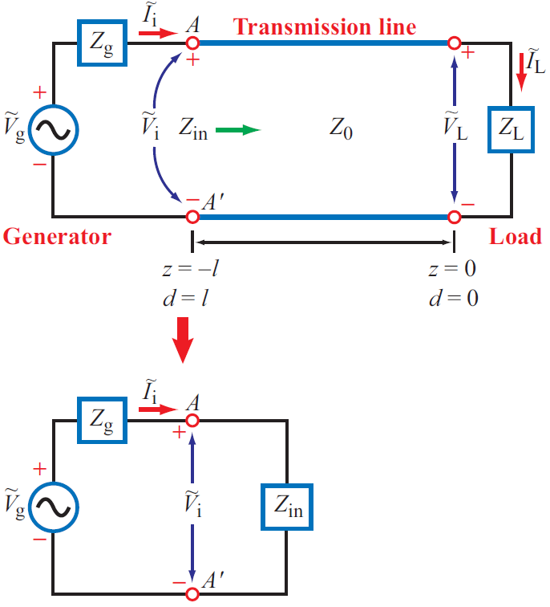
Input Impedance
Some interesting (and useful) examples
Short
Open
Match
λ/2
λ/4

Slide 7
Appendix: Derivation of Input Impedance Expression

Slide 8
Appendix: Derivation of Input Impedance Expression
This is where I stuck in the lecture

