Slide 1
EEC 130A Introductory Electromagnetics I
Lecture 5
Winter 2013
Dr. Xiaoguang “Leo” Liu
Electrical and Computer Engineering
UC Davis

Slide 2
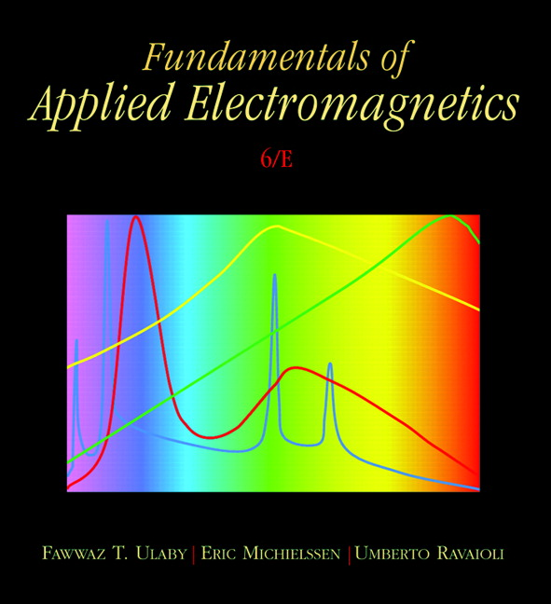
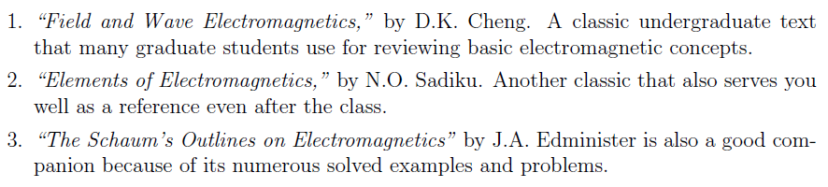
Textbooks
Textbook
“Fundamentals of Applied Electromagnetics,”
6th Ed., by F. T. Ulaby, E. Michielssen, U. Ravaioli, Pearson Prentice Hall, 2010.
Optional References

Slide 3
Homework
Homework assignments are designed to help you progress through the course
20 %
Assigned weekly
Due 2131 Kemper by 3:30 pm on Tuesday
Working in groups is encouraged, BUT
Make sure the solution you submit is your own!
Write the names of all individuals with whom you worked at the top of your assignment.
Limit the group size less than 4.
Late homework will NOT be accepted.

Slide 4
Exams
2 mid-terms and 1 final
Time and location TBA
No textbooks, no notes, no calculators
A formula sheet will be provide
30 % + 20%
Make-up exams will be provided, BUT
With a 15% penalty
Problems will be different
Will cover additional materials between the original and the make-up exam

Slide 5
Regrade
Must be filed with the instructor within one week after the homework/exam is returned.
3 days for the final.
Do not mark on the original homework/exam. Make a photocopy.
We will keep a photocopy of all exams.

Slide 6
No Cheating Please
Following actions are considered cheating:
Submitting homework solutions which are not your own. While we encourage you to work together, your work should not be a copy of your partner's.
Sharing results or notes during exams.
Using notes (hardcopy or electronic) during exams.
Continuing work on your exam after we have called for papers.
Requesting a regrade on an exam that has been altered.
You will receive ZERO for the homework/exam and may receive F for the course if found cheating.

Slide 7
Getting Help – Office Hours
Xiaoguang “Leo” Liu | Tuesday: 8-10 pm in 3169 Kemper Wednesday: 4-5 pm in 3169 Kemper By appointment
Yuhao Liu | Monday: 10am -- 12 pm in 1127 Kemper
Fengqi Hu | Tuesday: 2 – 4 pm in TB207 120
Don’t let yourself fall behind!

Slide 8
Misc
Student with disability need to register with the Student Disability Center (http://sdc.ucdavis.edu/)
Talk with the instructor within the first week of class
Course Website:
SmartSite
Questions?

Slide 9

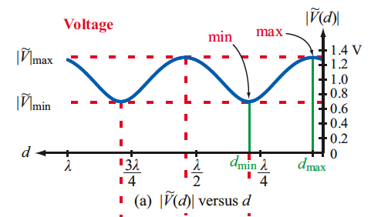

Review of Last Lecture
Standing wave ratio (SWR)
Sometimes voltage standing wave ratio (VSWR)
A measure of the matching

Slide 10
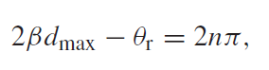

Maximum and Minimum Voltage
Voltage maxima
Voltage minima

Slide 11
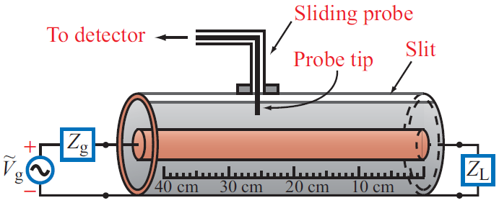
Slotted Line
Example 2-16

Slide 12
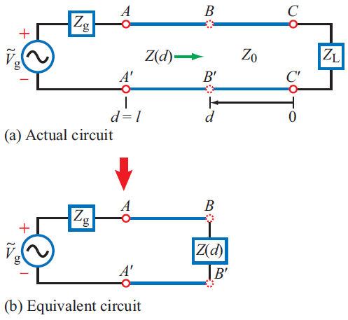
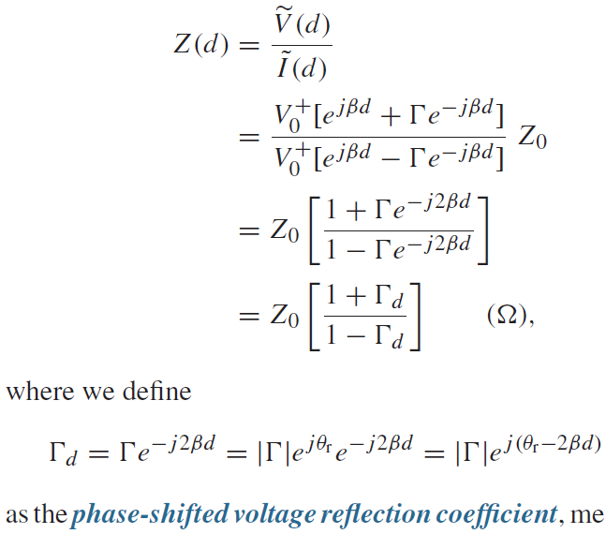
Wave Impedance
At a distance d from the load:

Slide 13
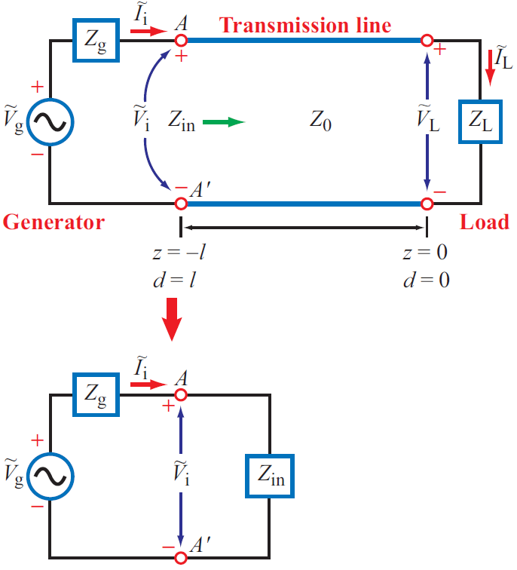
Input Impedance
Some interesting (and useful) examples
Short
Open
Match
λ/2
λ/4

Slide 14
Smith Chart
Let
and
Notice that these two equations represent circles on the Γ plane

Slide 15
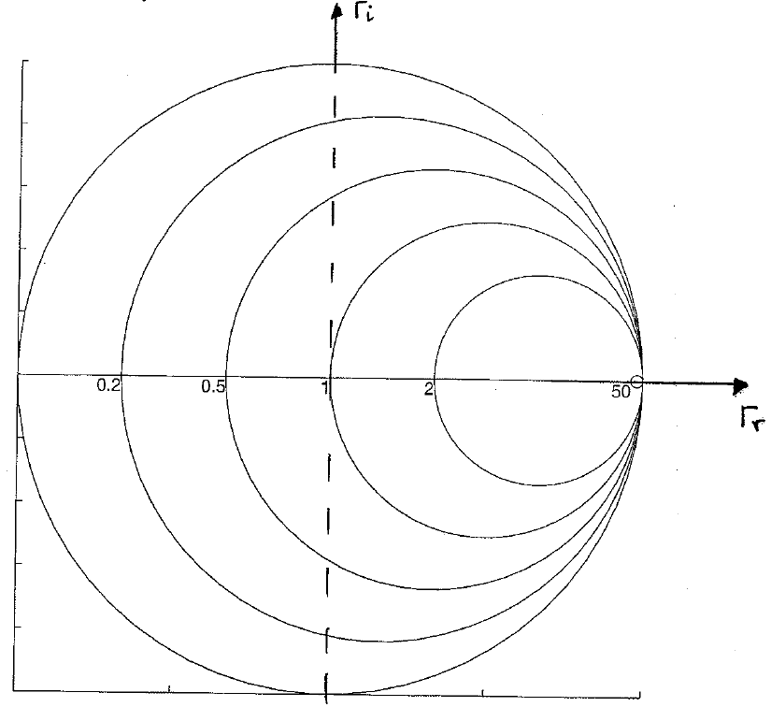
Constant-r Circles
r_{L} = 0 --> Z_{L}=jX_{L}
r_{L} = ∞
r_{L} = 1
--> Z_{L}=1+jX_{L}

Slide 16
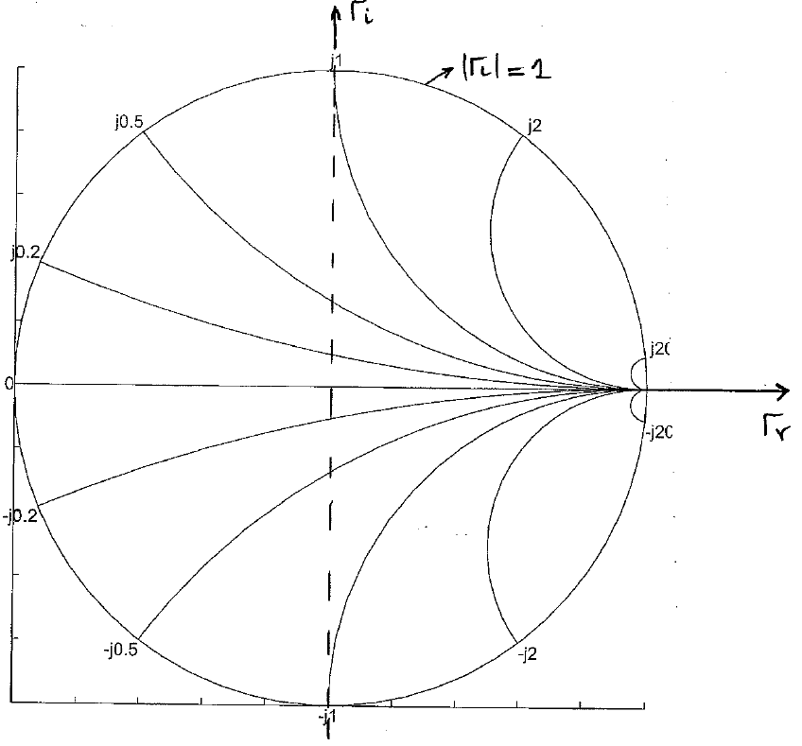
Constant-x Circles
x_{L} = 1
x_{L} = -0.5

Slide 17
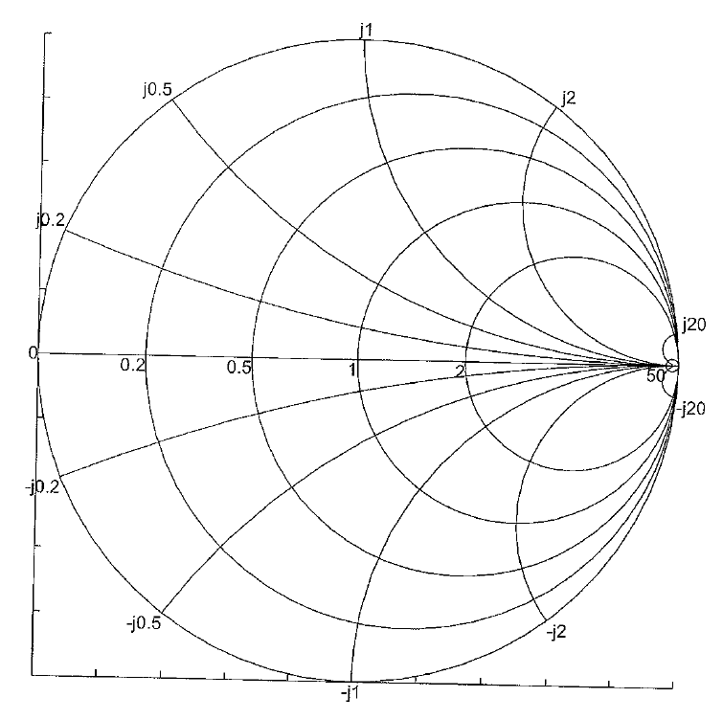
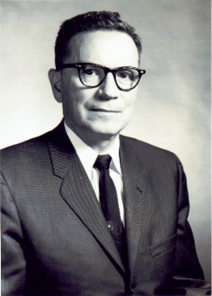
Complete Smith Chart
Constant-r circles
Constant-x circles
Phillip Smith
Read a brief biography of Philip Smith: http://sss-mag.com/smith01.html

Slide 18
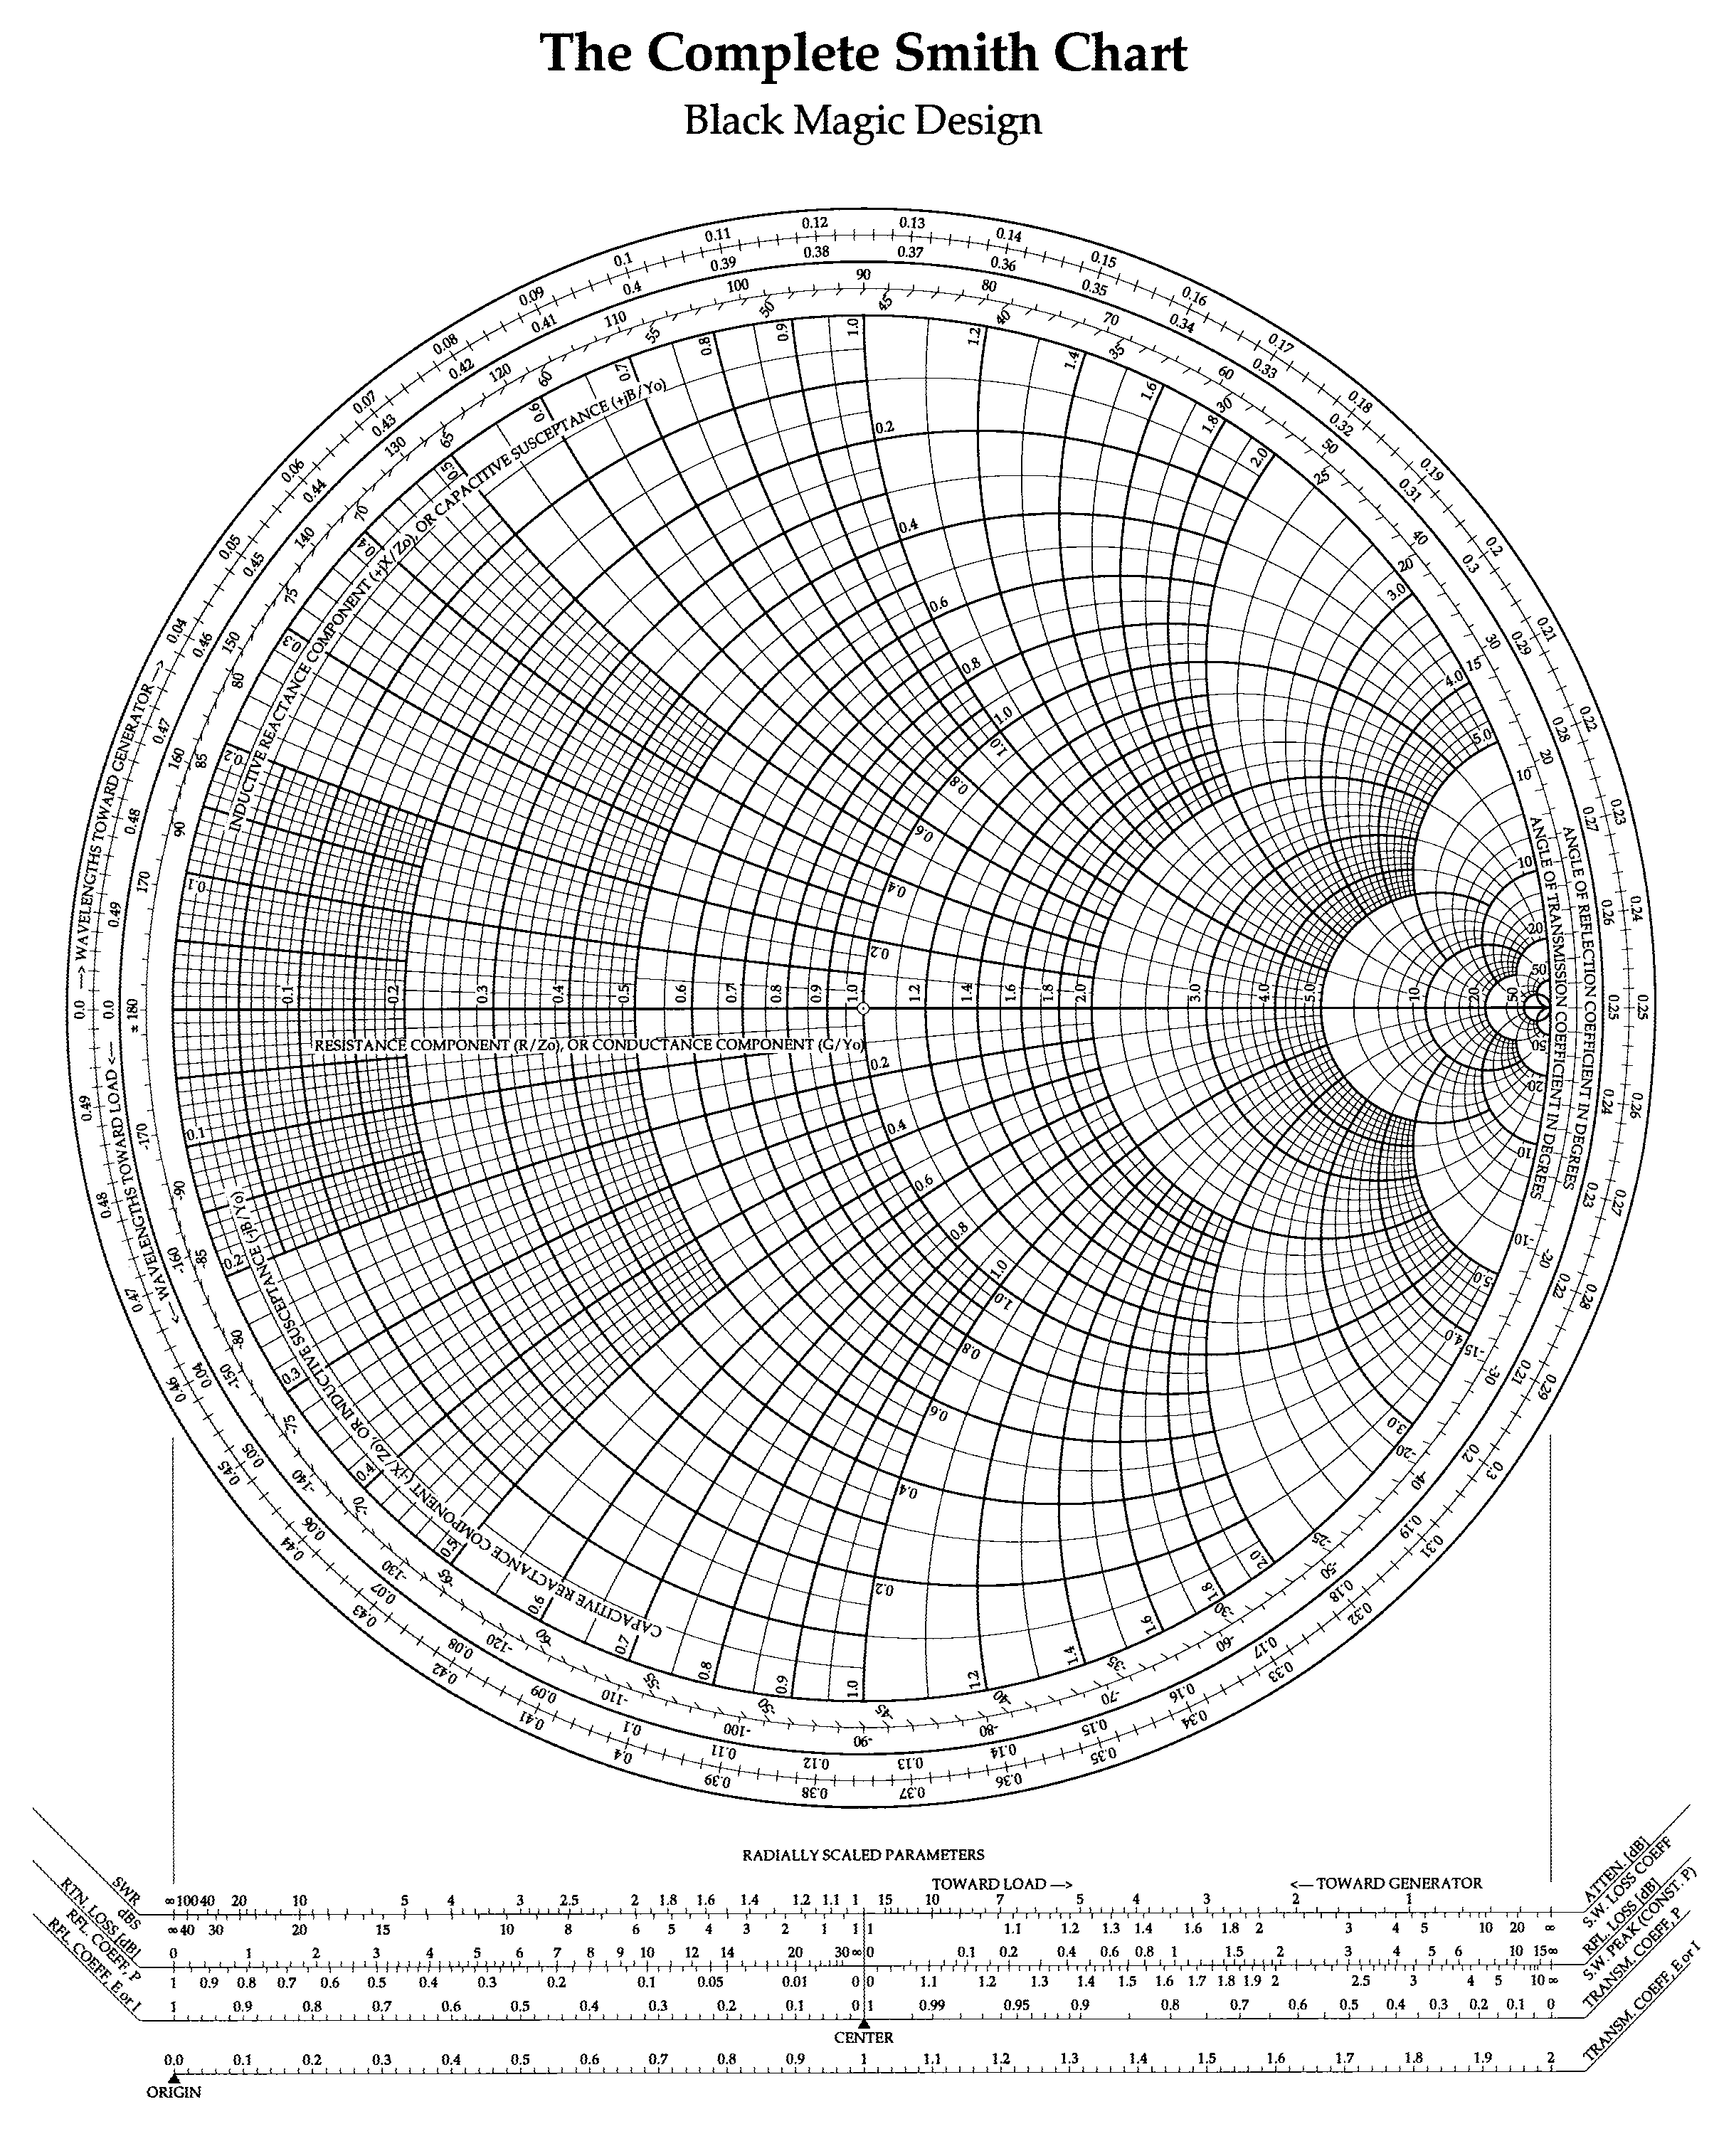
Black Magic Design

Slide 19
What Can We Do with the Smith Chart
Reading Reflection Coefficient, Impedance/admittance, SWR(VSWR), Return Loss, …
Locating the load on the chart
Impedance Matching
Moving around on the chart

Slide 20
Reading Reflection Coefficient
Z_{L} = 10+j25 Ω
z_{L} = 0.2+j0.5
125°
Γ_{L} = 0.725/125°
0.725
Open?
Short?
Matched Load?

