Slide 1
Input Reflection Coefficient
Let
and

Slide 2
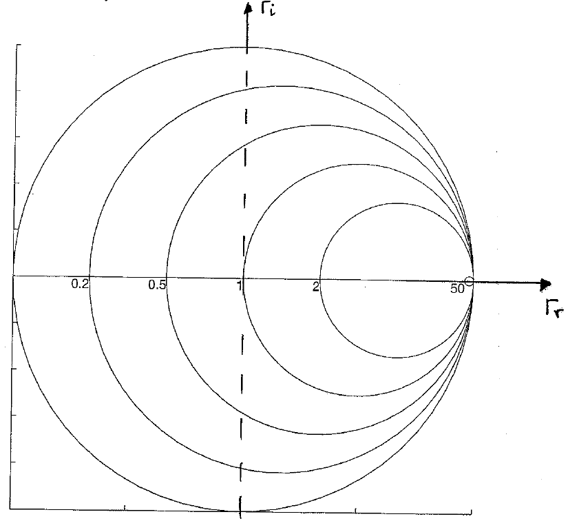
r_{L} = 0 --> Z_{L}=jX_{L}
r_{L} = ∞
r_{L} = 1
--> Z_{L}=1+jX_{L}

Slide 3
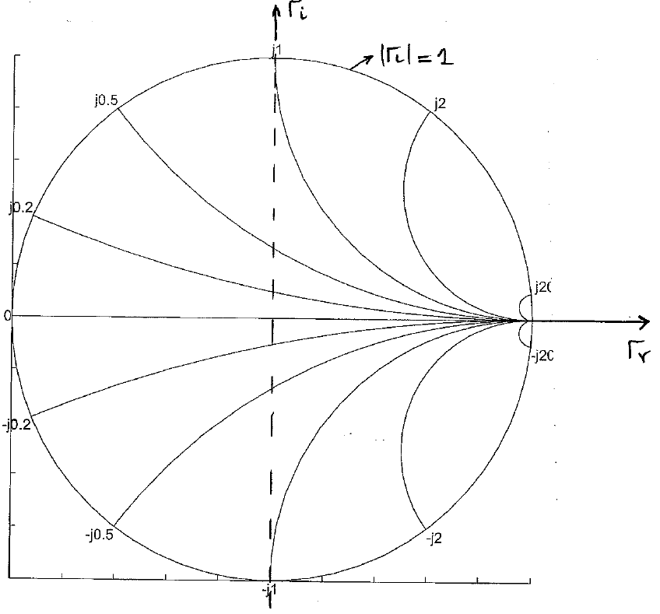
x_{L} = 1
x_{L} = -0.5

Slide 4
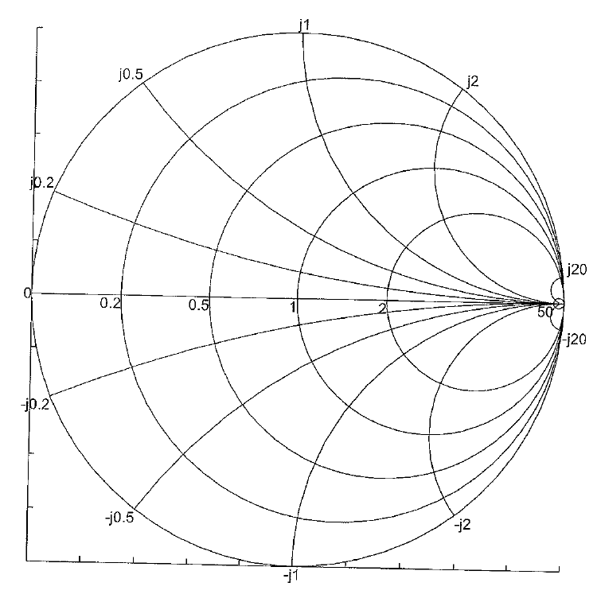
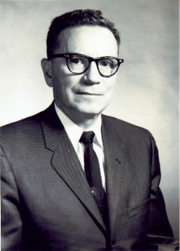
Complete Chart
Constant-r circles
Constant-x circles
Phillip Smith
Read a brief biography of Philip Smith: http://sss-mag.com/smith01.html

Slide 5
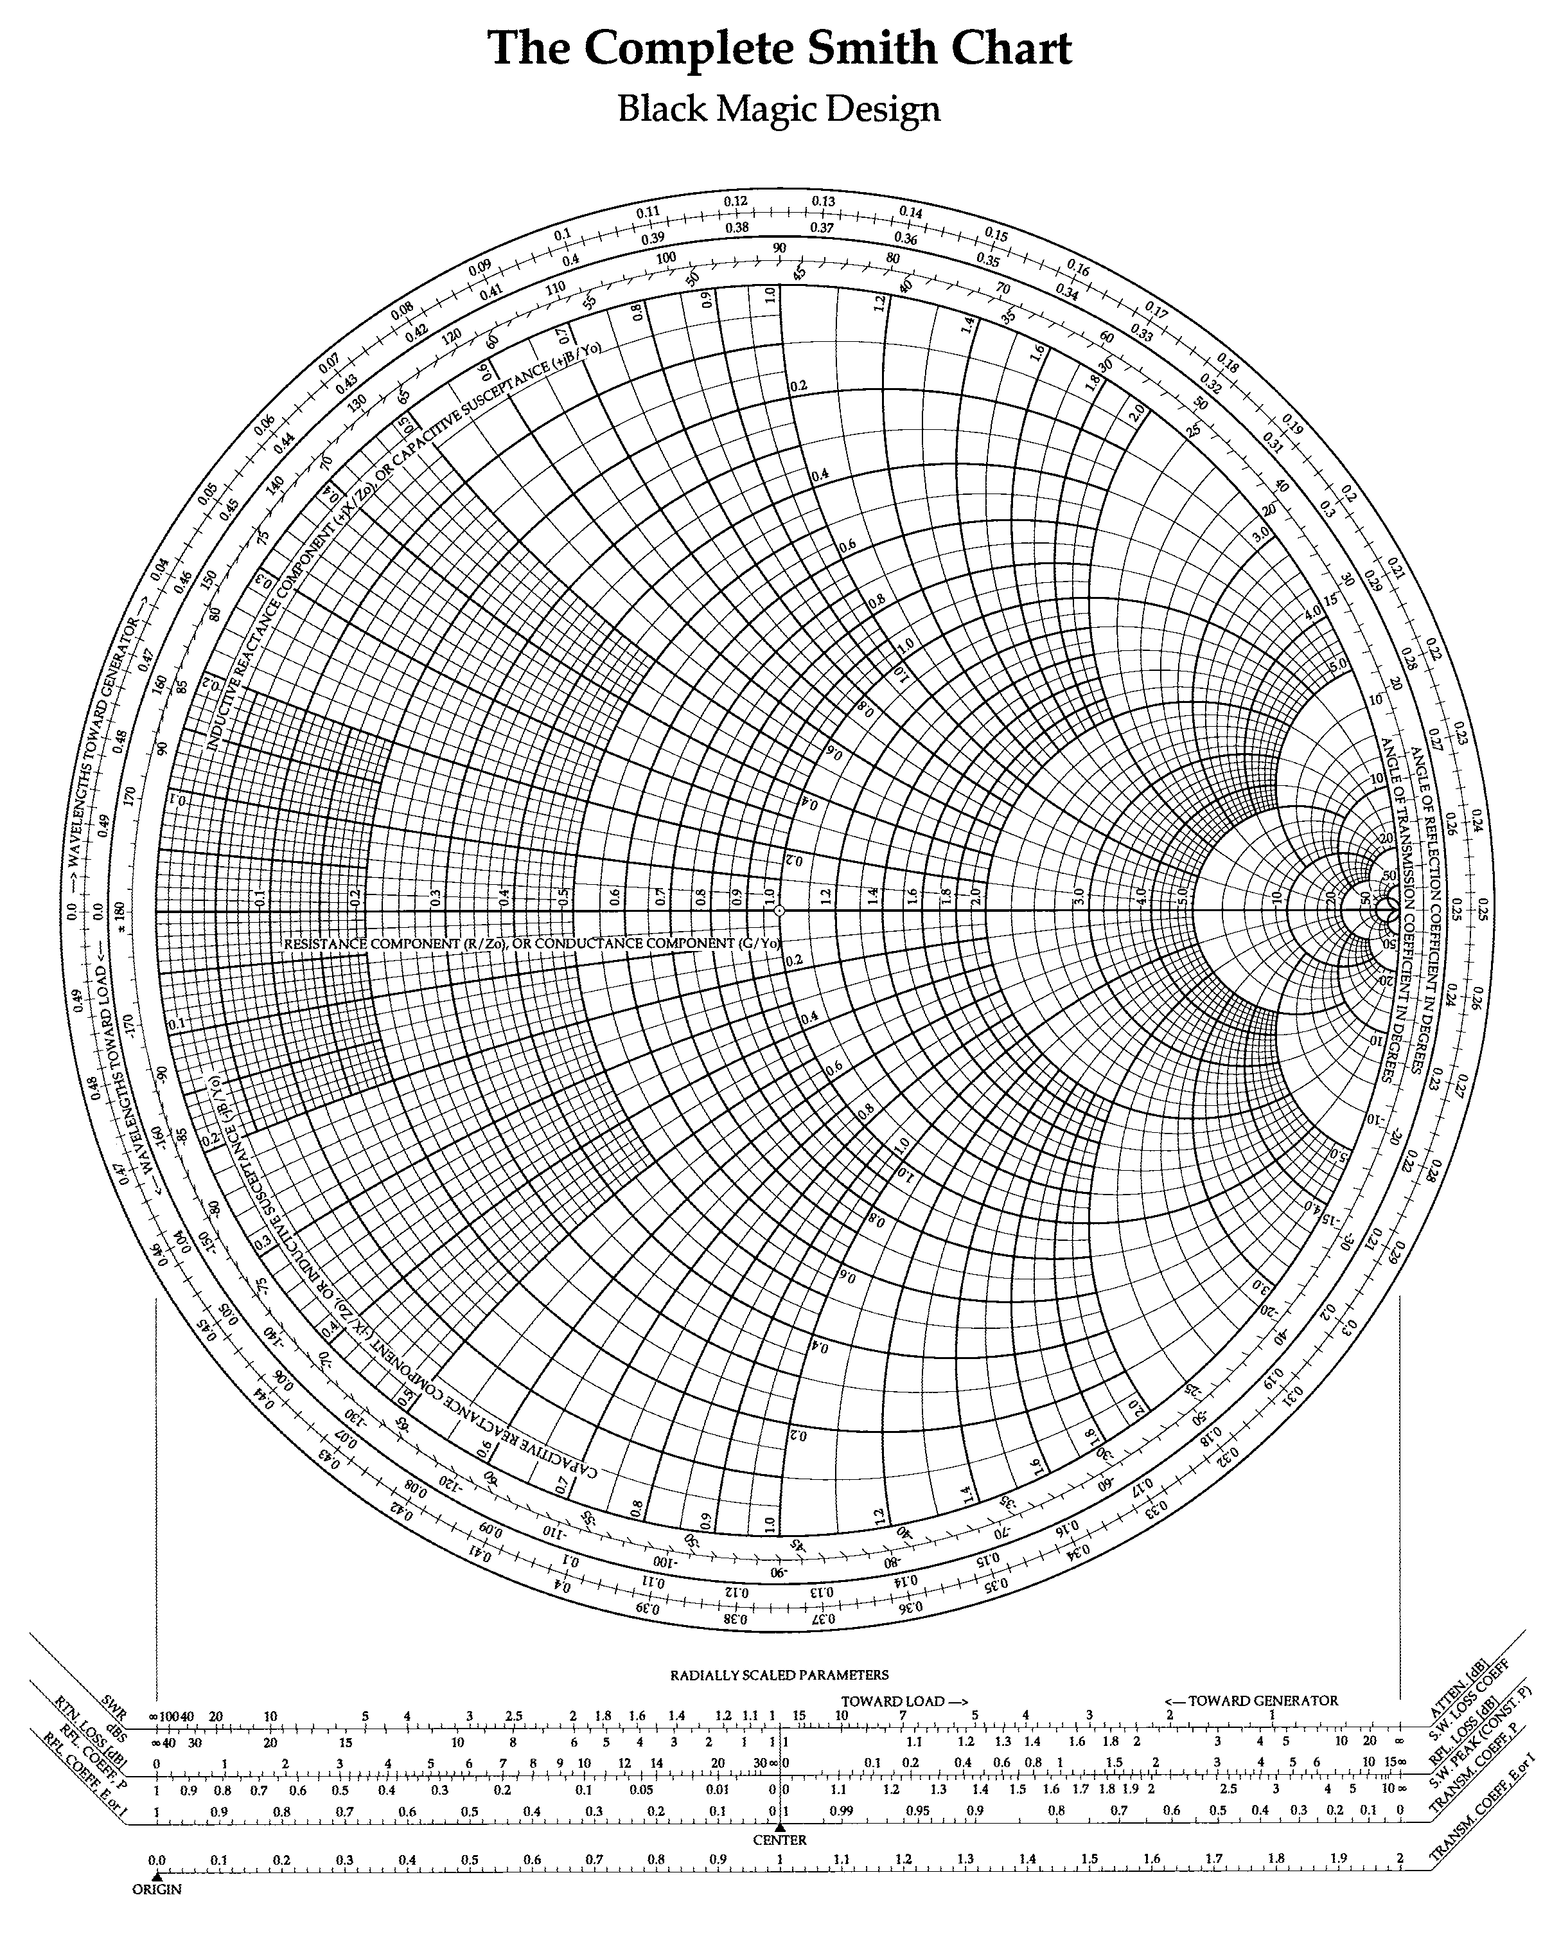
Black Magic Design

Slide 6
What Can We Do with the Smith Chart?
Reading Reflection Coefficient, Impedance/admittance, SWR(VSWR), Return Loss, …
Locating the load on the chart
Impedance Matching
Moving around on the chart

Slide 7
Reading Reflection Coefficient
Z_{L} = 10+j25 Ω
z_{L} = 0.2+j0.5
125°
Γ_{L} = 0.725/125°
0.725
Open?
Short?
Matched Load?

Slide 8
And more …

Slide 9
Reading Load Impedance
Γ_{L} = 0.5/-90°
z_{L} = 0.6-j0.8
If Z₀ = 50 Ω
Z_{L} = 30-j40 Ω

