Slide 1
EEC 130A Introductory Electromagnetics I
Lecture 6
Winter 2012
Dr. Xiaoguang “Leo” Liu
Electrical and Computer Engineering
UC Davis

Slide 2
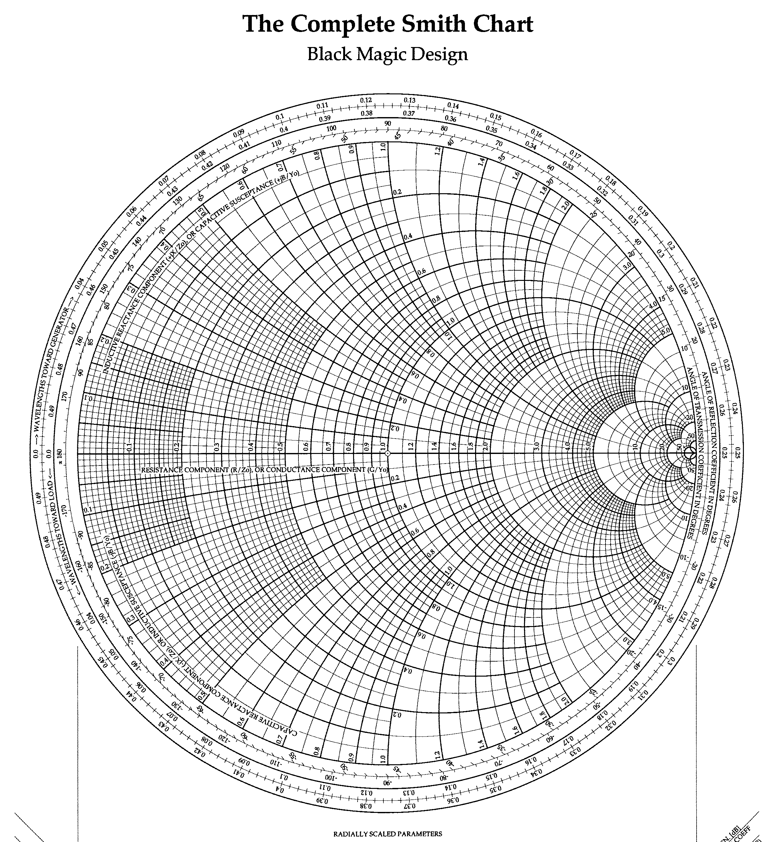
Review of Last Lecture
Input impedance
Smith chart
Normalized Load
Impedance

Slide 3
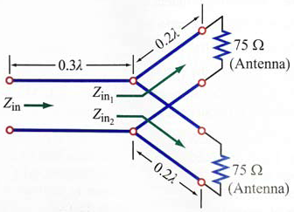
Example (P2.33)
Find Z_{in}
Z_{P}

Slide 4
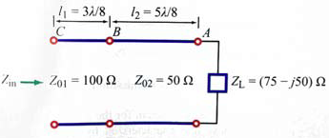
Example (P2.50)
Find Z_{in}
Z_{B}

Slide 5
Smith Chart
[Very Important] Smith chart is a plotted in the Γ plane.
Γ_{i}
Γ= -0.4+j0.4
= 0.56/135°
0.37
(-0.4 , 0.4 )
0.32
Γ_{r}
z_{L}= 0.32+j0.37

Slide 6
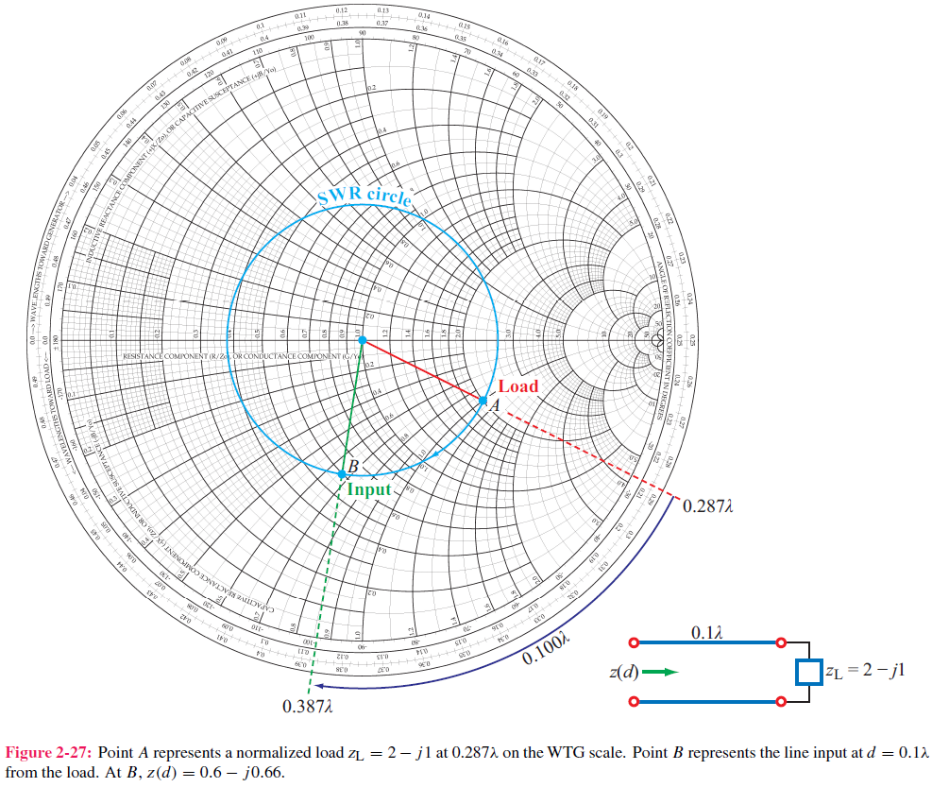
Input Impedance and VSWR
360° is λ/2
Clockwise is “Moving towards the generator”

Slide 7
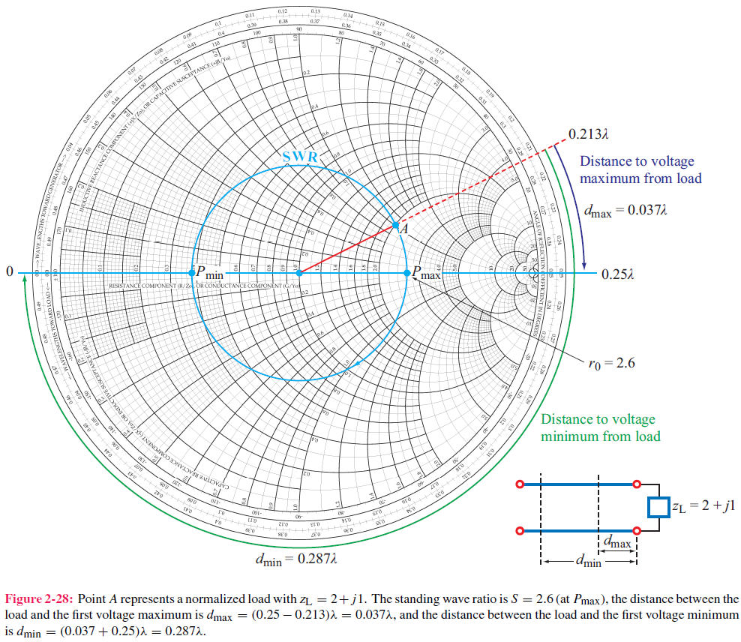
Maxima and Minima

Slide 8
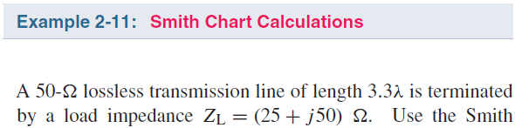
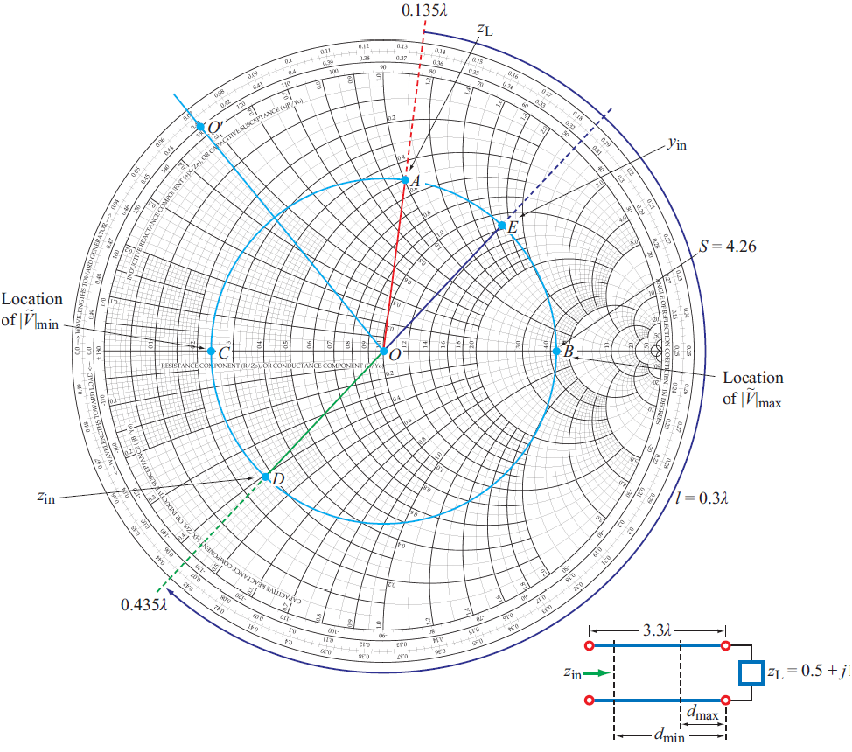


Example (2-11)
(a)
(b)

Slide 9
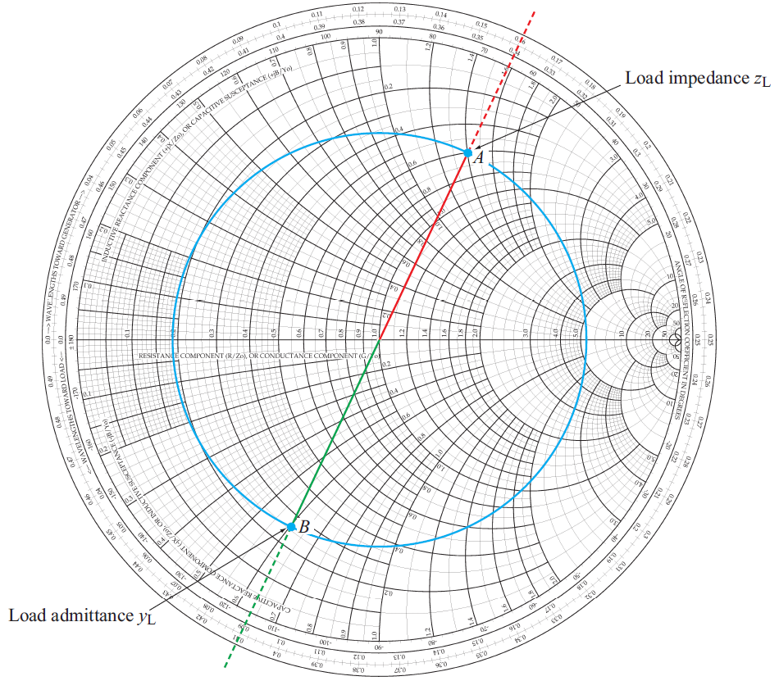
Impedance ←→ Admittance
λ/4 Impedance Transformer

Slide 10
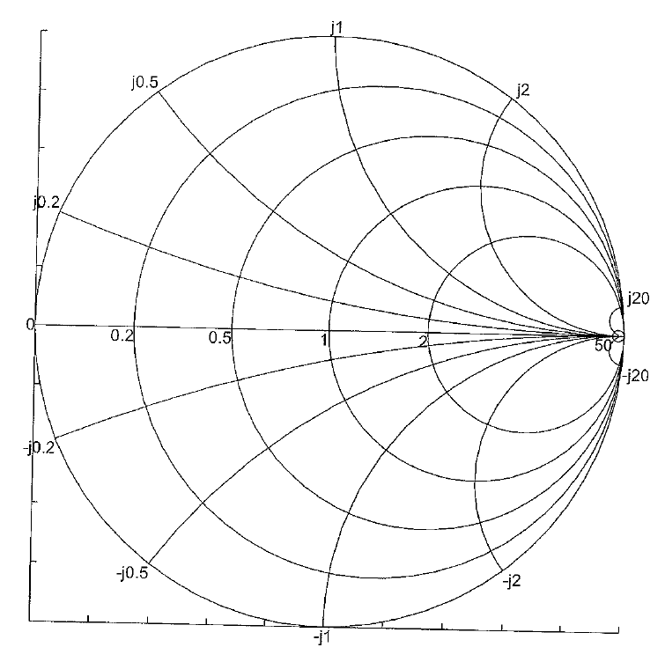
Adding Lumped Elements
z_{L}
z_{L}
+
-
r
_{jx}
Y_{L}
Y_{L}

Slide 11
Example
L
Given: Z_{L}= 10 + j 25, Z0=50 Ω,
L presents an 0.4 nH inductor
Find: Input impedance at 10 GHz
Z_{L}
Z_{in}
(1)
(2) Find z_{L} on Smith Chart
(3)
Normalized to be j0.5
(4) Move along constant-x circle by 0.5

Slide 12
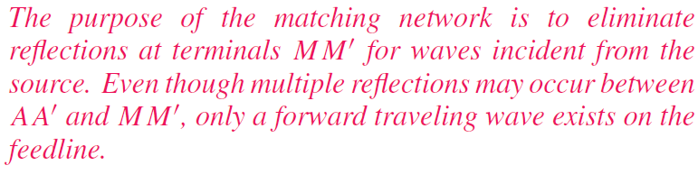
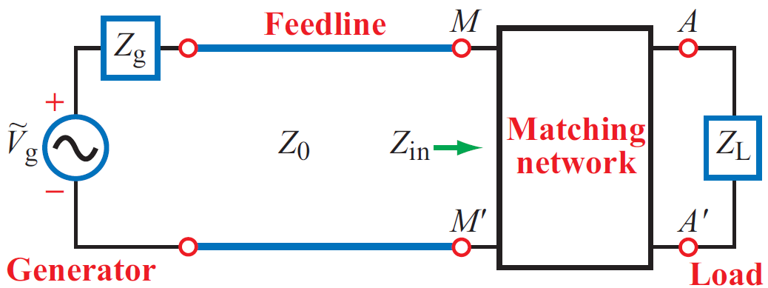
Matching Network

Slide 13
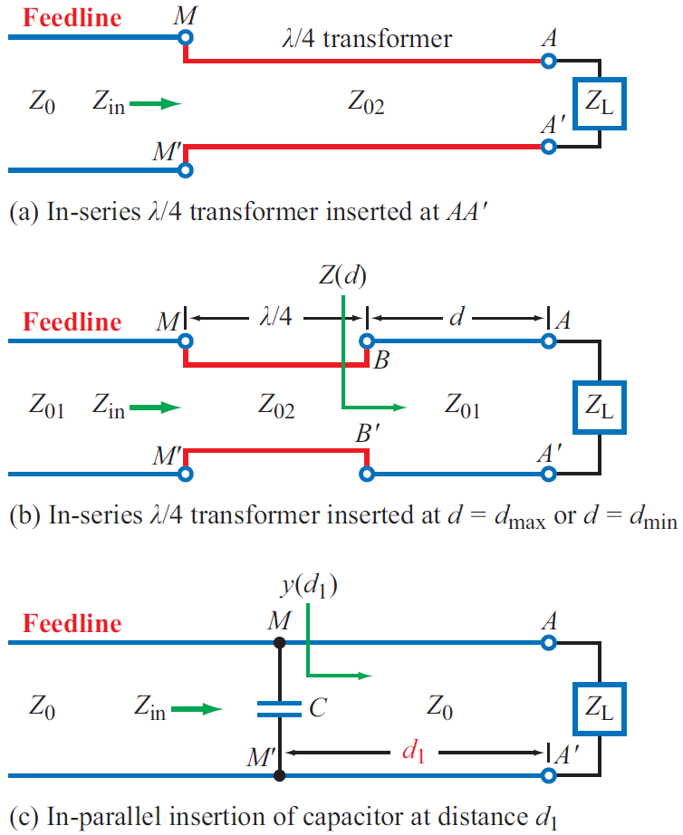
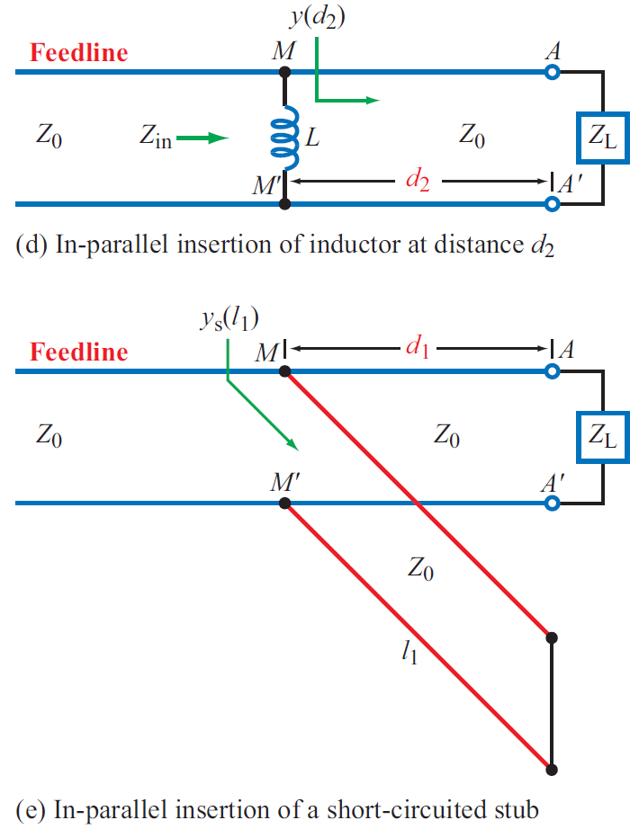
Examples of Matching Networks

Slide 14
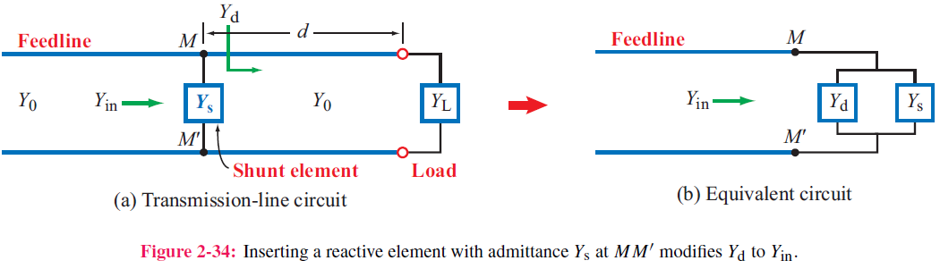
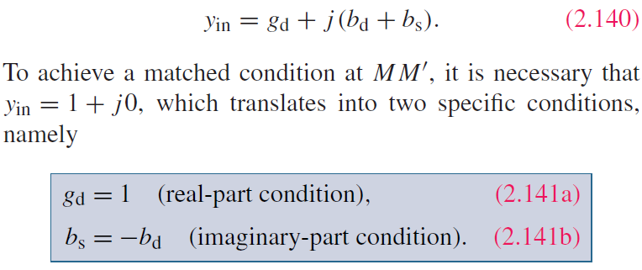

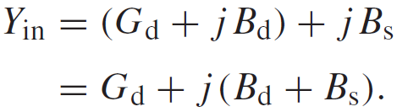
Lumped Element Matching

Slide 15
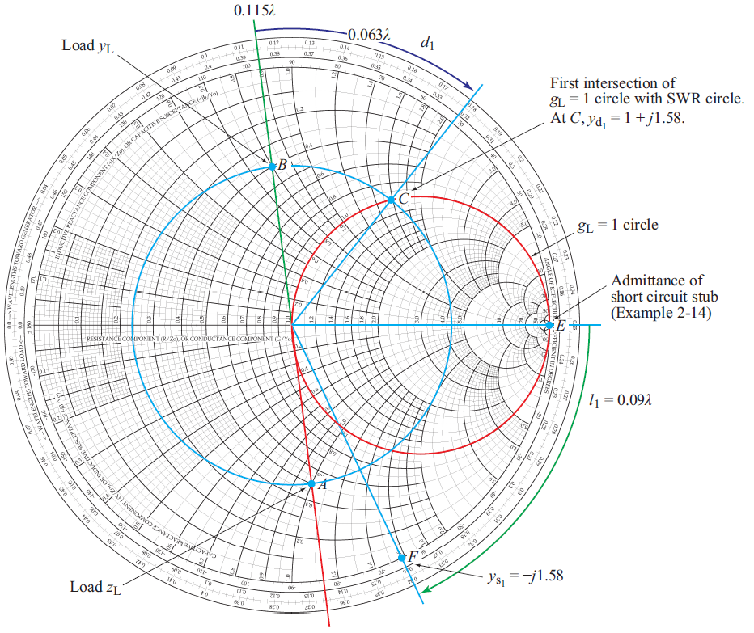
Lumped Element Matching
Step 1: Find y_{L}
Step 2: Move along const-SWR circle to intersect with r_{L}=1 circle
(1)
(2)
Step 3: Move along const-r_{L} circle to reach origin (Match!)
(3)

Slide 16
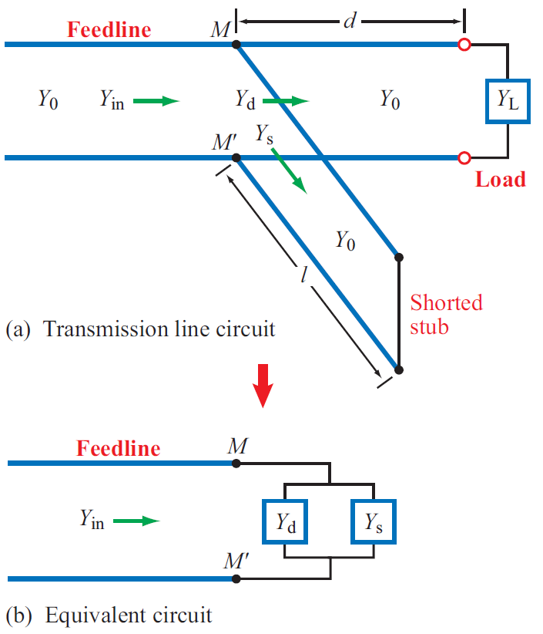
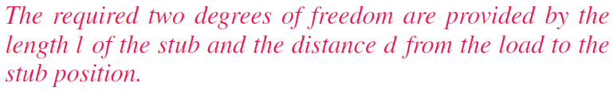
Single-stub matching
Very similar to lumped element matching
--- replace the shunt reactance with a shorted stub

