Slide 1
EEC 130A Introductory Electromagnetics I
Lecture 7
Winter 2012
Dr. Xiaoguang “Leo” Liu
Electrical and Computer Engineering
UC Davis

Slide 2
Mid-term 1
4:10 – 6:00 pm, Tuesday, Feb 7th
5 problems for 100 points, 1 additional problem for 20 extra credit points
Covers all of Chapter 1&2, except for 2-9 and 2-12
Allowed: your pen/pencil, 1 non-graphing calculator
Practice problems have been posted online
15 homework problems, 9 additional problems from the textbook and 18 problems from other references
Additional office hours and a help session
Available Saturday and Sunday afternoon
A 1.5 hour help session?

Slide 3
Review
Moving around the Smith chart
Add transmission line of length l
Impedance to admittance
Add series resistance and/or reactance
Add shunt resistance (conductance) and/or shunt reactance (suseptance)
Impedance matching
λ/4 impedance transformer
Transmission line + lumped element
Transmission line + shunt shorted stub

Slide 4
Example (P2.68)
(P2.66) A 200-Ω transmission line is to be matched to a computer terminal with ZL=(50-j25) Ω by inserting an appropriate reactance in parallel with the line. If f=800 MHz and εr=4, determine the location nearest to the load at which inserting
(a) A capacitor can achieve the required matching, and the value of the capacitor
(b) An inductor can achieve the required matching, and the value of the inductor

Slide 5
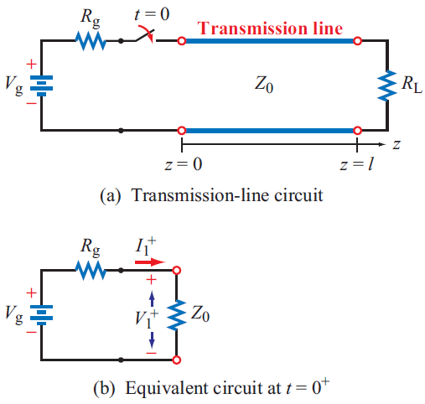
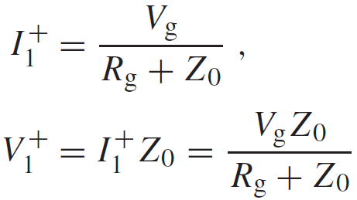
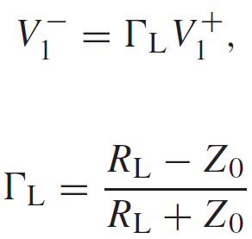
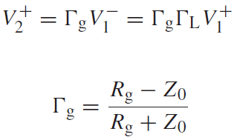
Transient Response
Initial current and voltage
Reflection at the load
Load reflection
coefficient
Second transient
Generator reflection coefficient

Slide 6
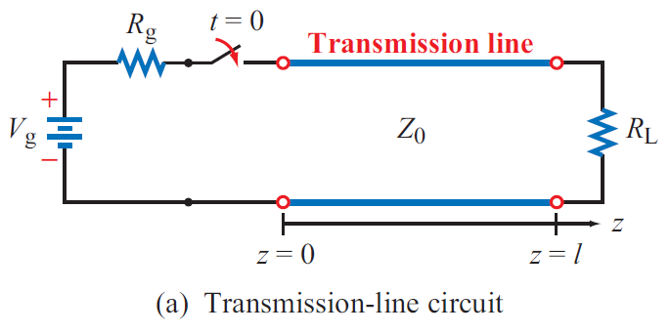
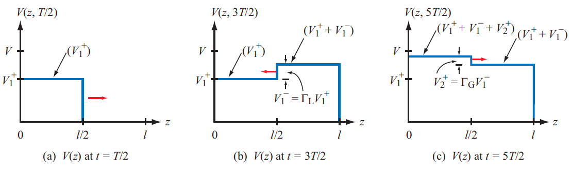
Voltage
T = l/u_{p} is the time it takes the wave to travel the full length of the line

Slide 7
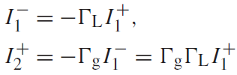
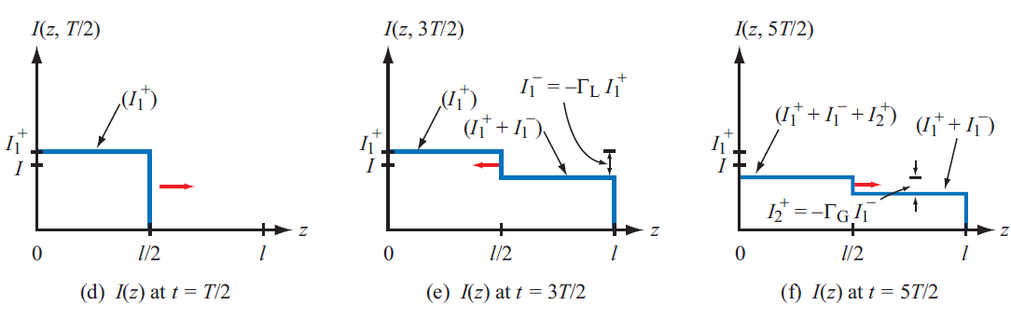
Current
Reflection coefficient for current is the negative of that for voltage

Slide 8
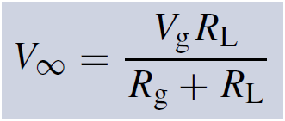
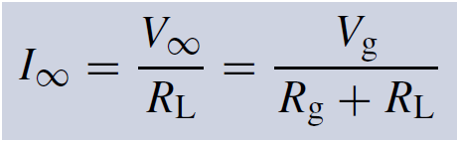
Steady State Response
Since
, for

Slide 9
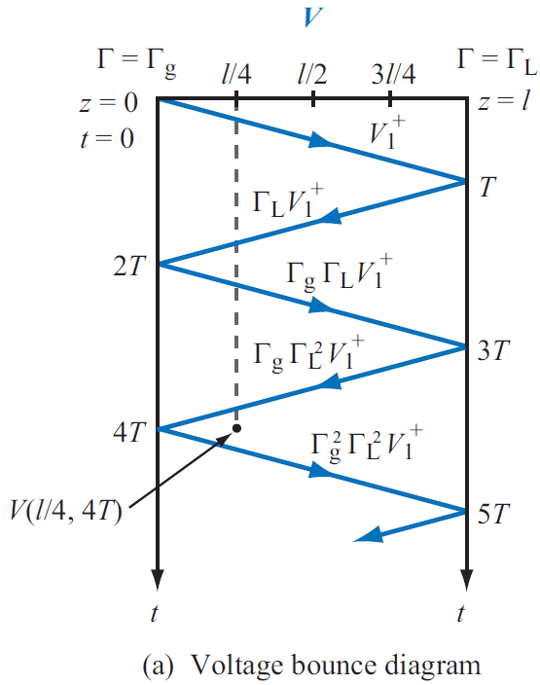
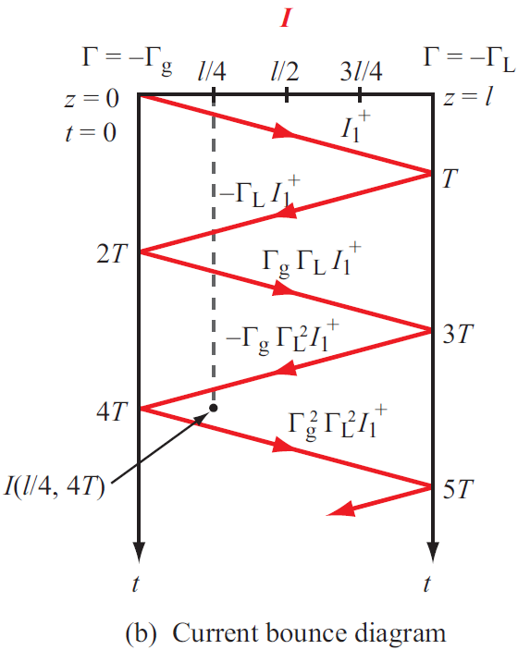
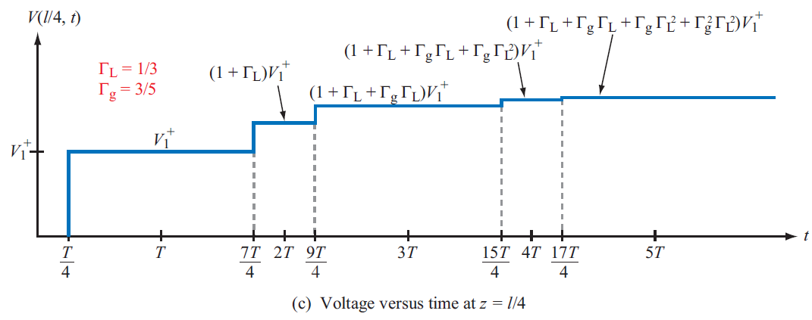
Bounce Diagram

Slide 10
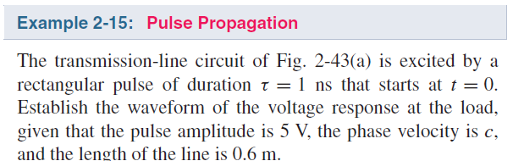
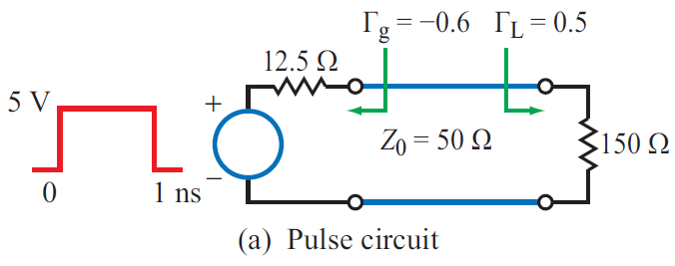
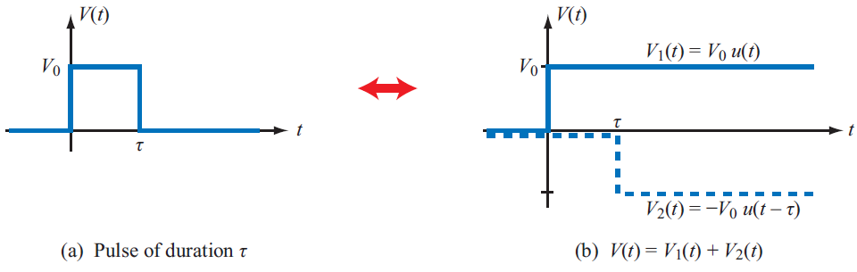
Example 2-15

Slide 11
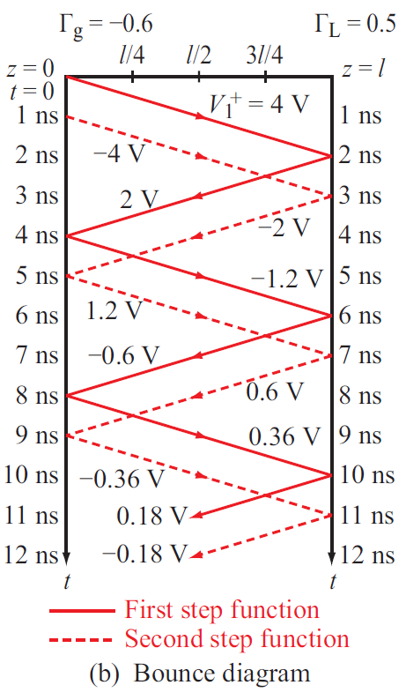
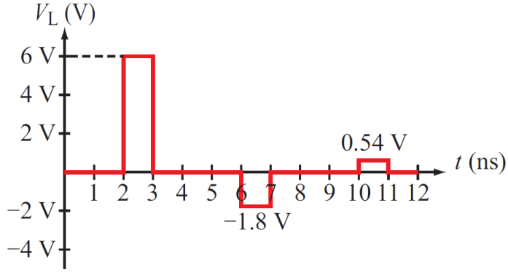
Example 2-15

Slide 12

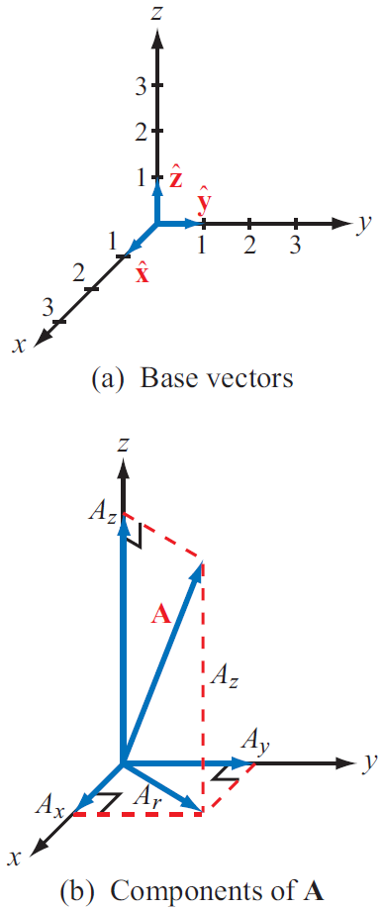


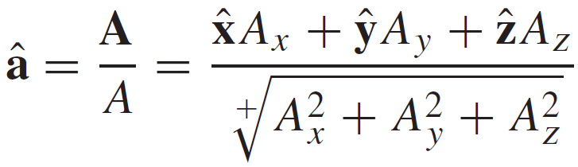
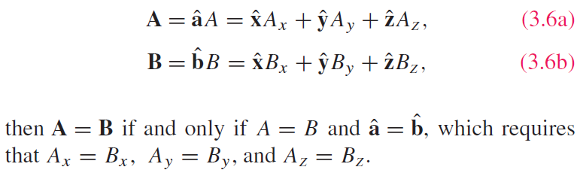
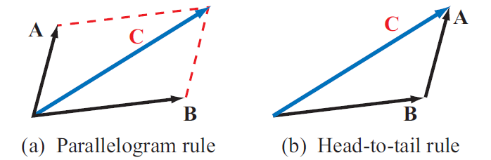
Vectors Analysis

Slide 13
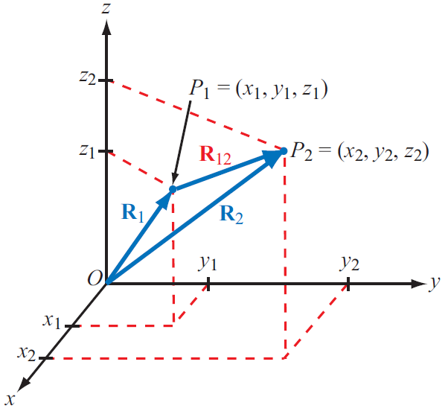
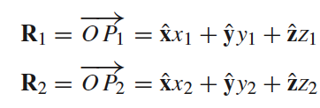
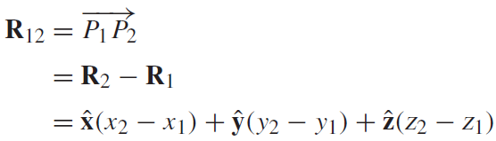
Position and Distance
Position Vector:
From origin to point P
Distance Vector:
Between two points

Slide 14


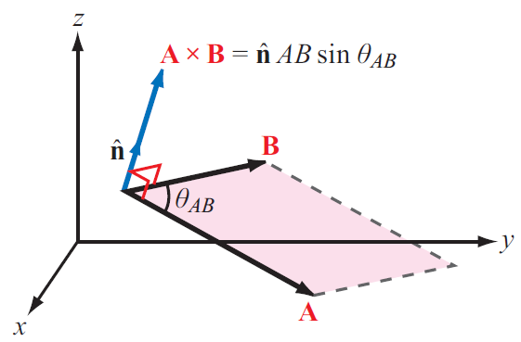
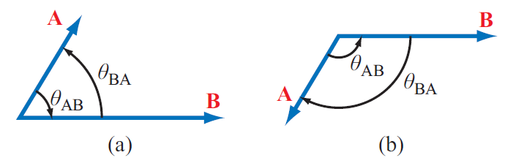

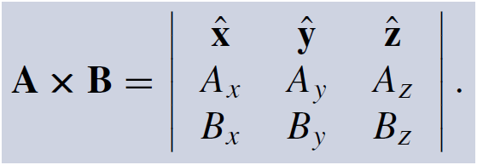

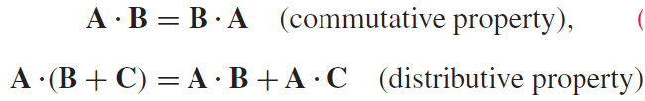

Multiplication
Dot Product
Cross Product

Slide 15
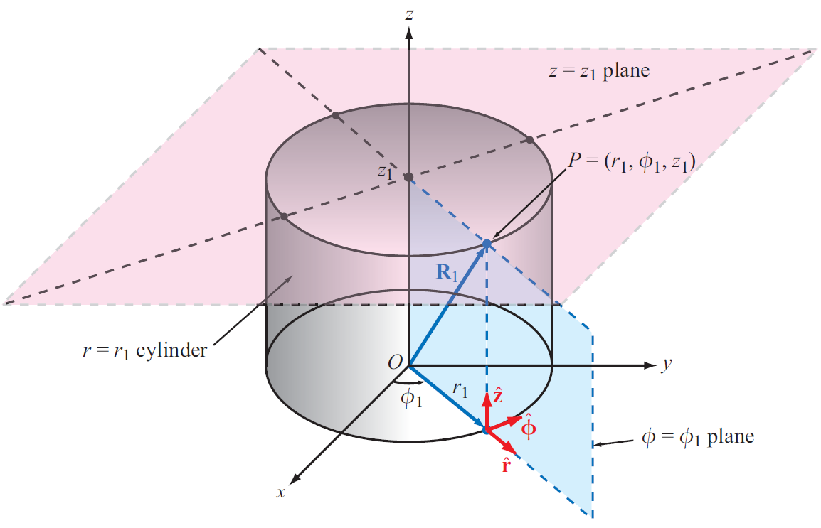
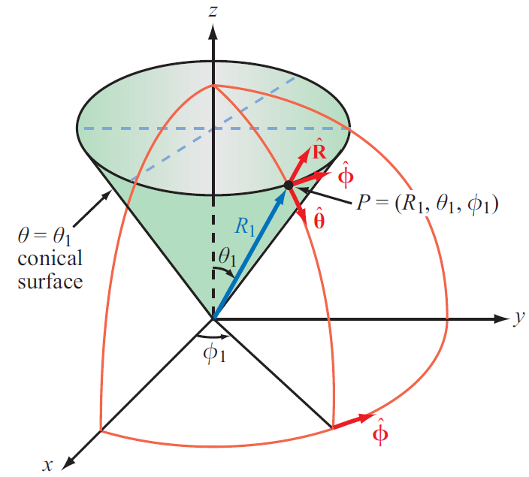
Coordinate Systems
Cartesian
Cylindrical
Spherical

Slide 16
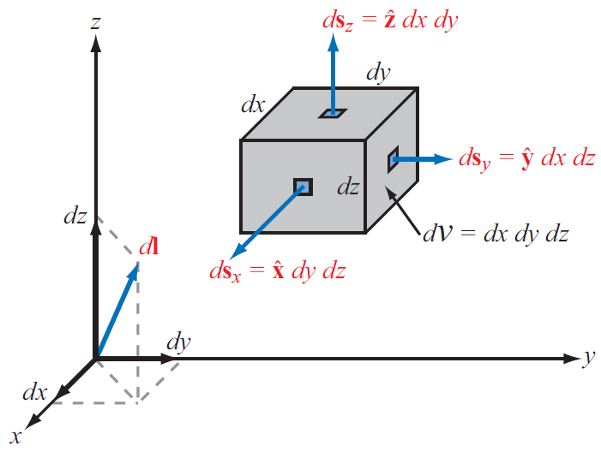
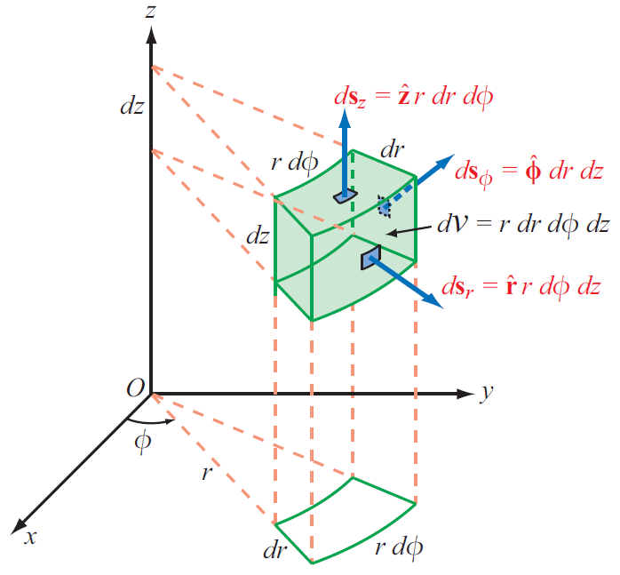
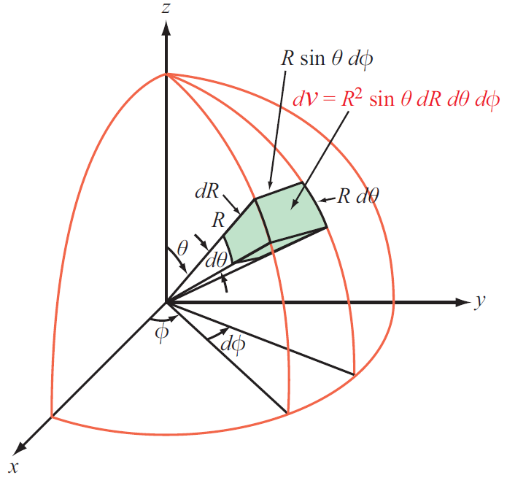
Differential Length, Area, and Volume

Slide 17
