Slide 1
EEC 130A Introductory Electromagnetics I
Lecture 8
Winter 2012
Dr. Xiaoguang “Leo” Liu
Electrical and Computer Engineering
UC Davis

Slide 2

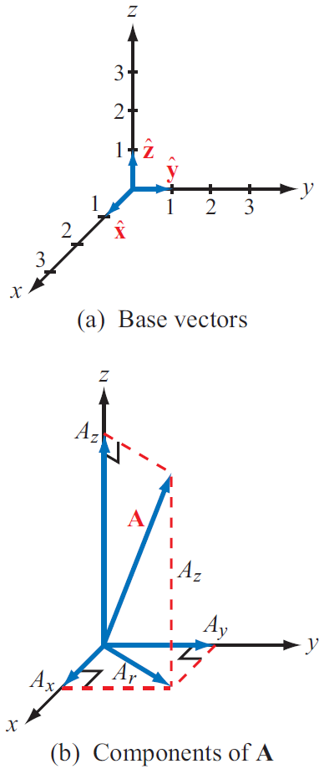


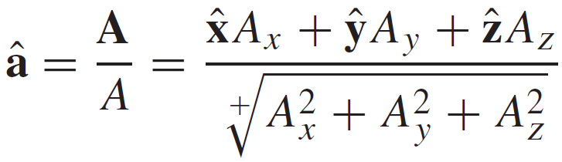
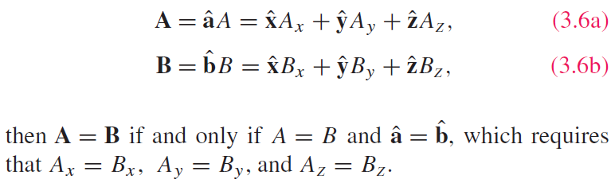
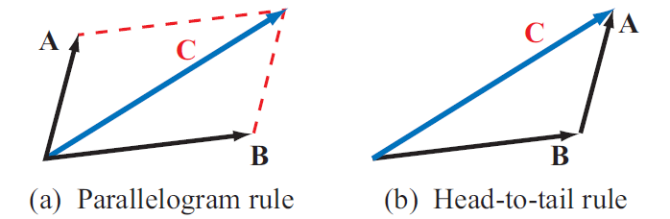
Vectors Analysis

Slide 3
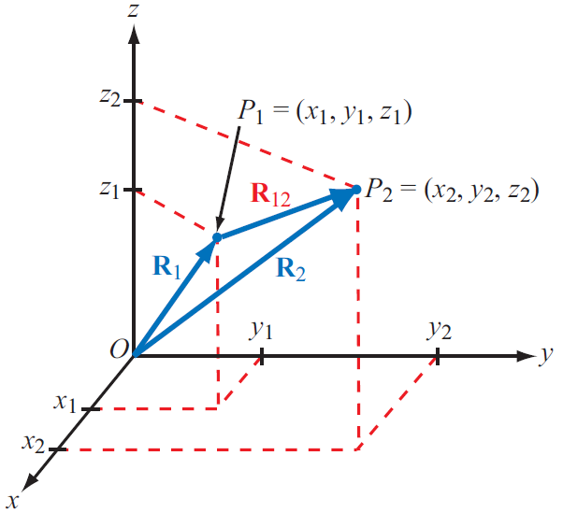
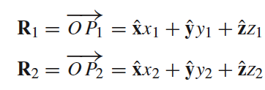
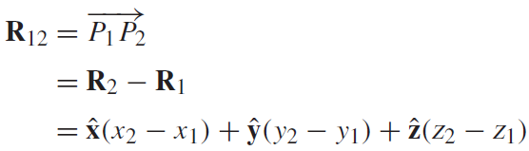
Position and Distance
Position Vector:
From origin to point P
Distance Vector:
Between two points

Slide 4


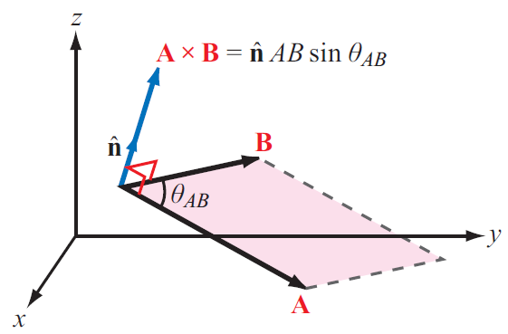
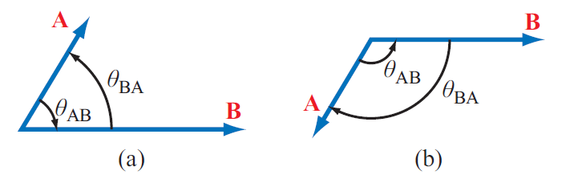

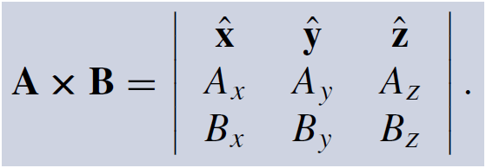

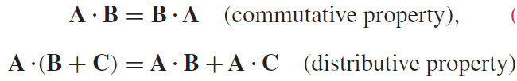

Multiplication
Dot Product -> Scalar
Cross Product -> Vector

Slide 5
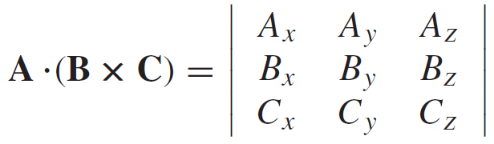
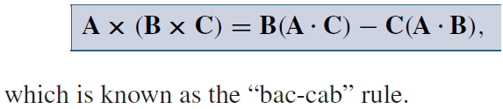
Triple Product
Scalar Triple Product
Vector Triple Product

Slide 6
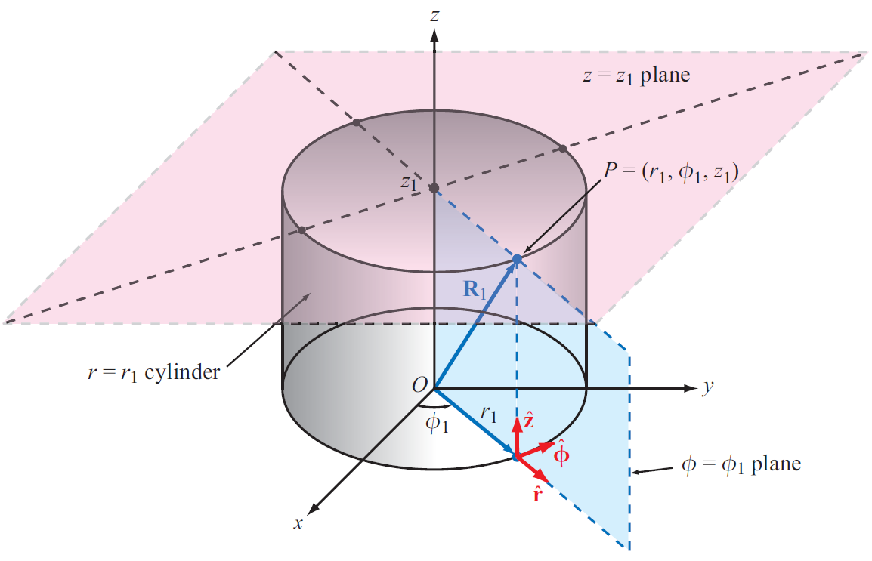
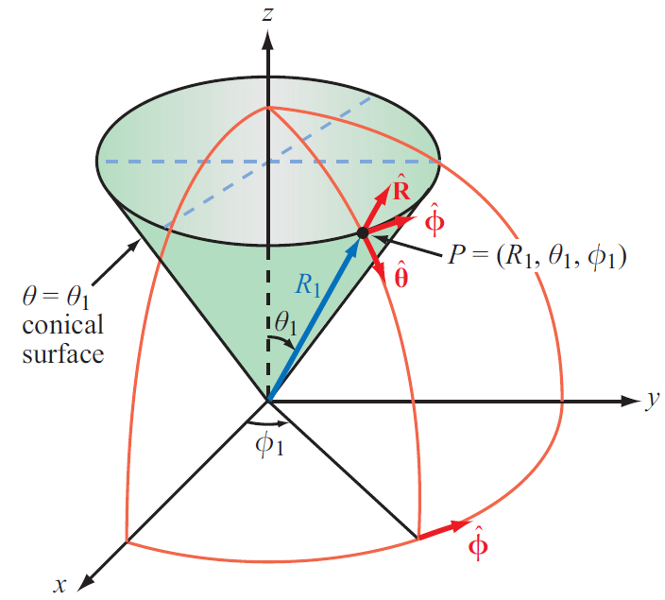
Coordinate Systems
Cartesian
Cylindrical
Spherical

Slide 7
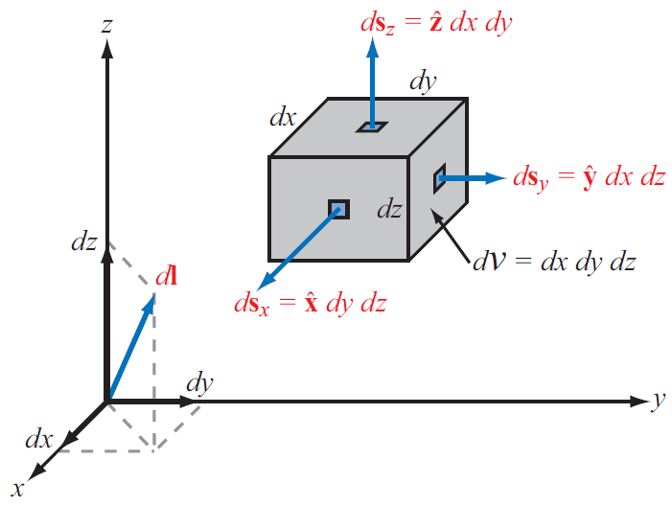
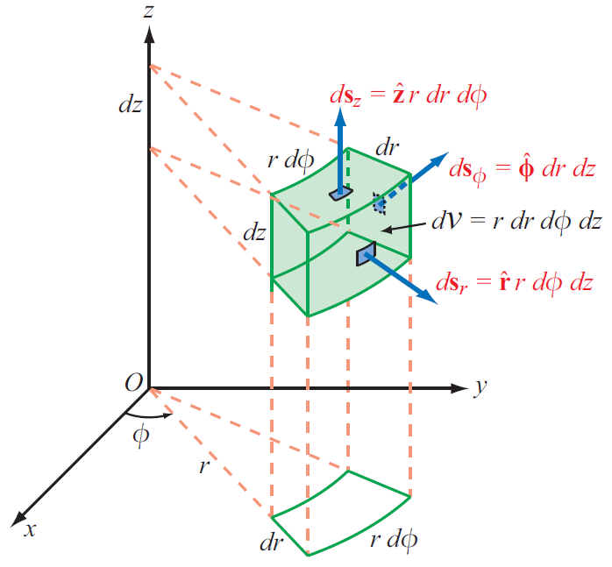
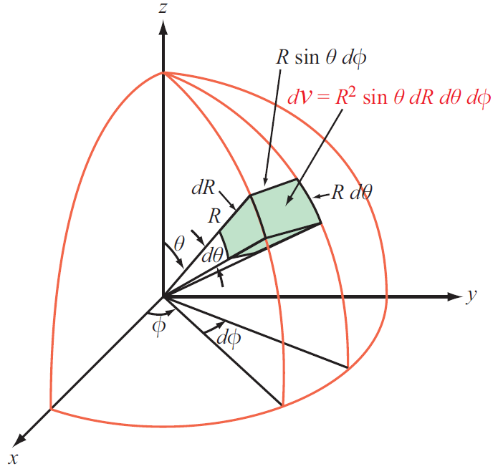
Differential Length, Area, and Volume

Slide 8
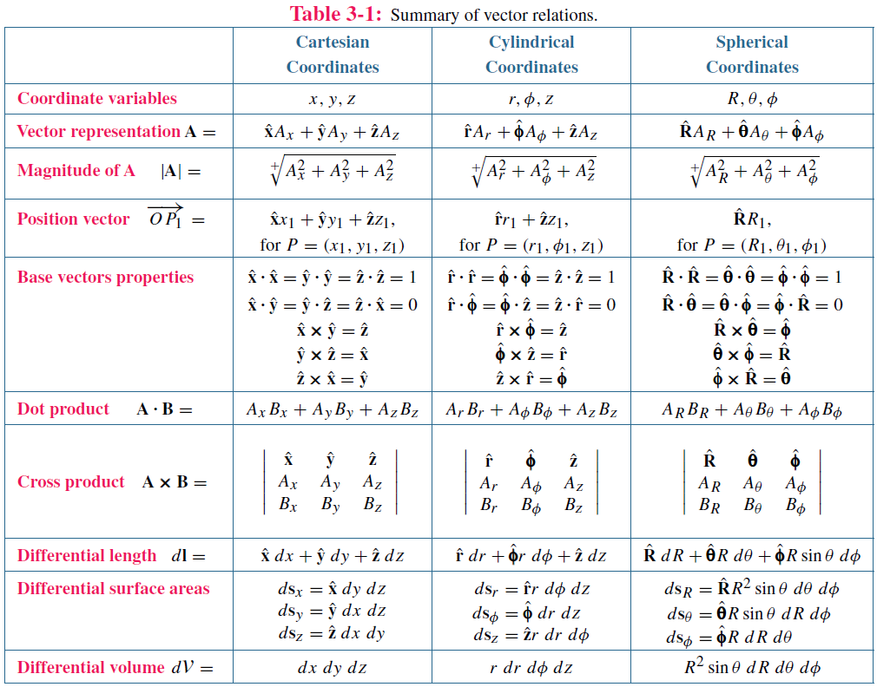

Slide 9
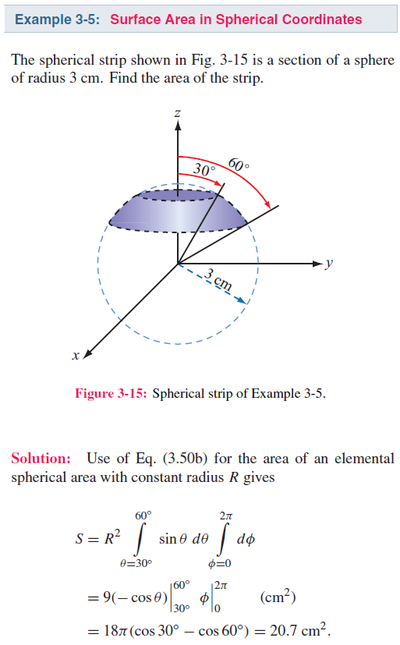
Example 3-5

Slide 10
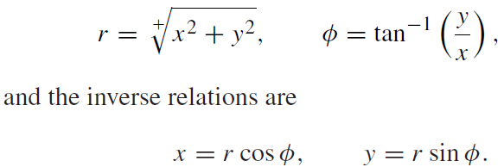
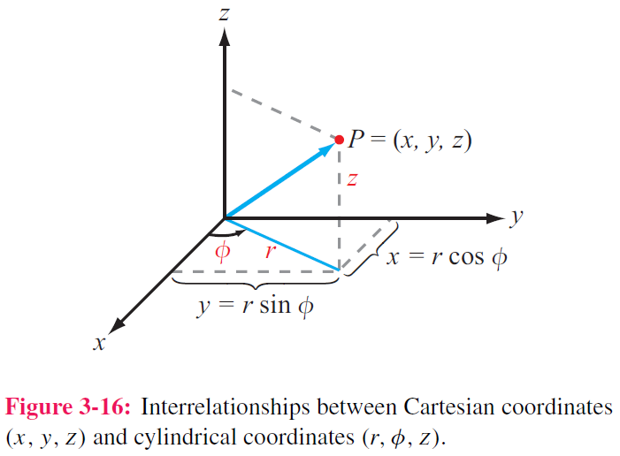
Transformation Between Coordinate Systems
To solve a problem, we select the coordinate system that best fits its geometry

Slide 11
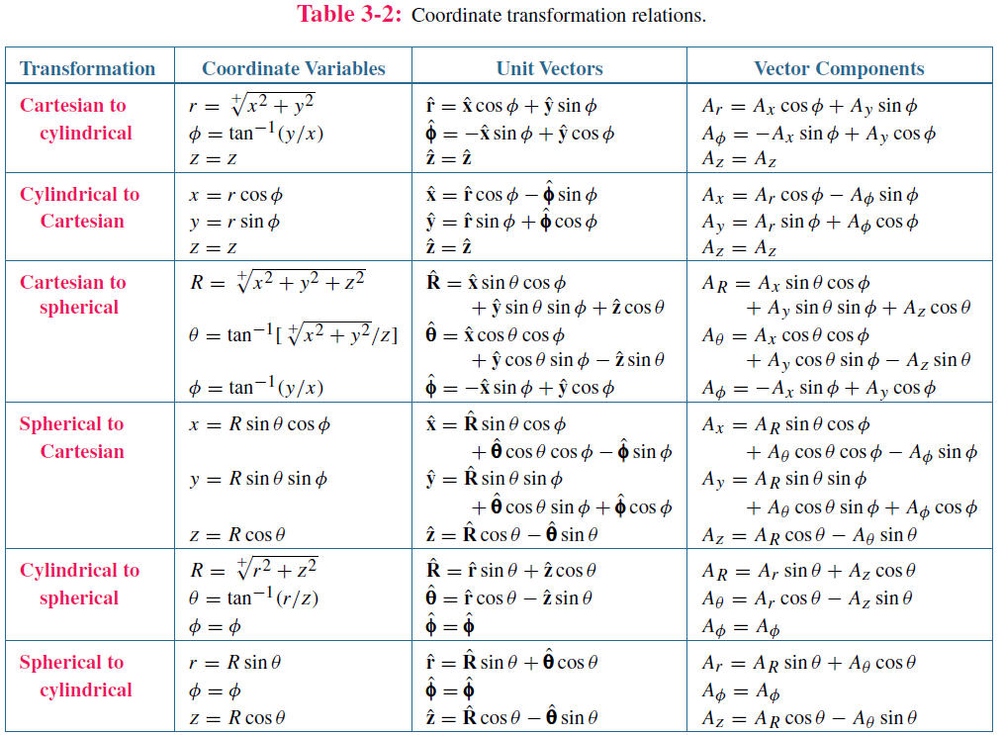

Slide 12
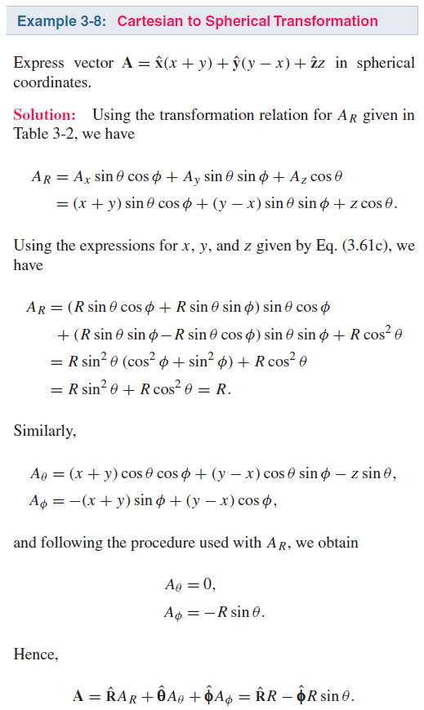
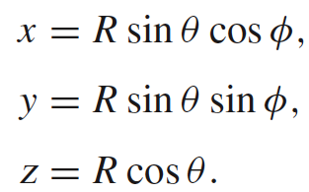
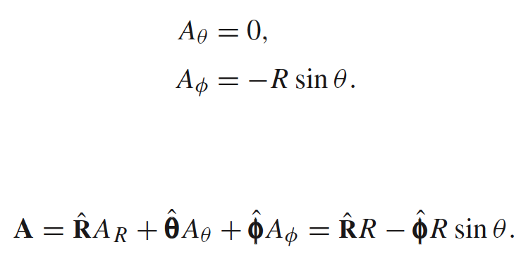
Example 3-8
Solution
Using the relations:
leads to:

Slide 14
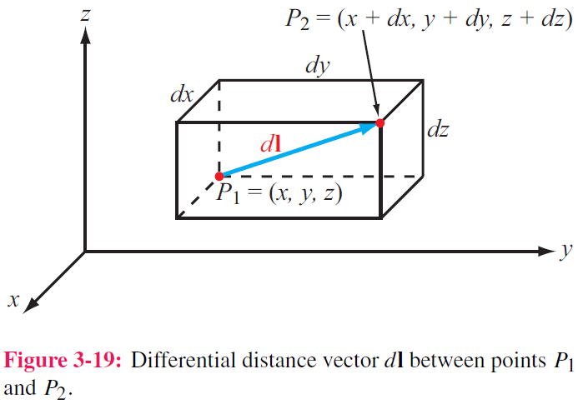
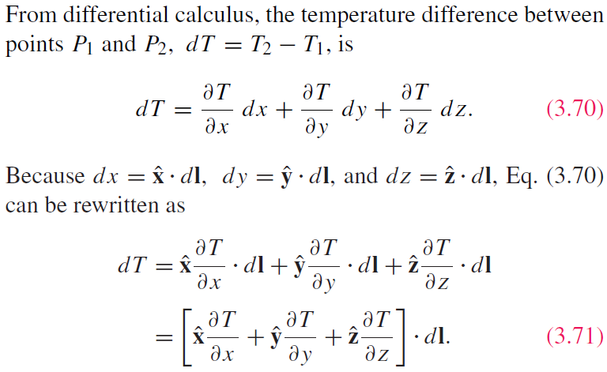
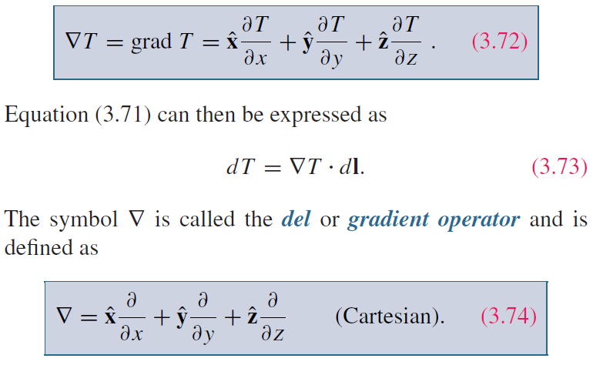
Gradient of A Scalar Field
Example :Temperature Distribution T(x,y,z)

Slide 15
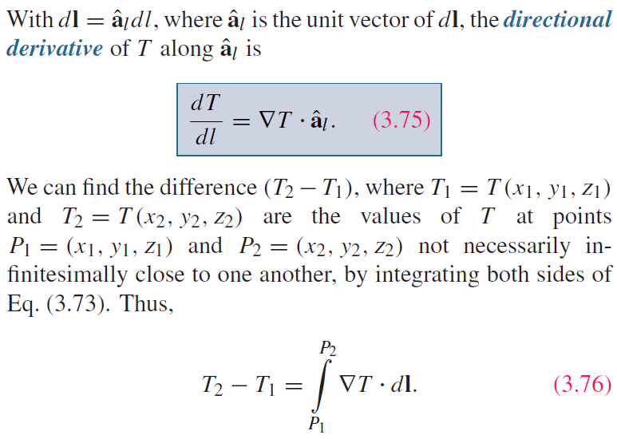
Directional Derivative

Slide 16
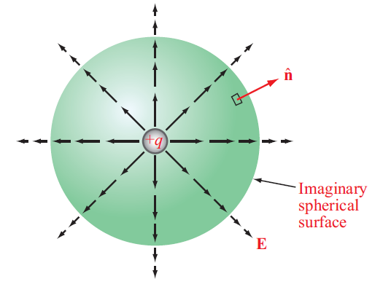
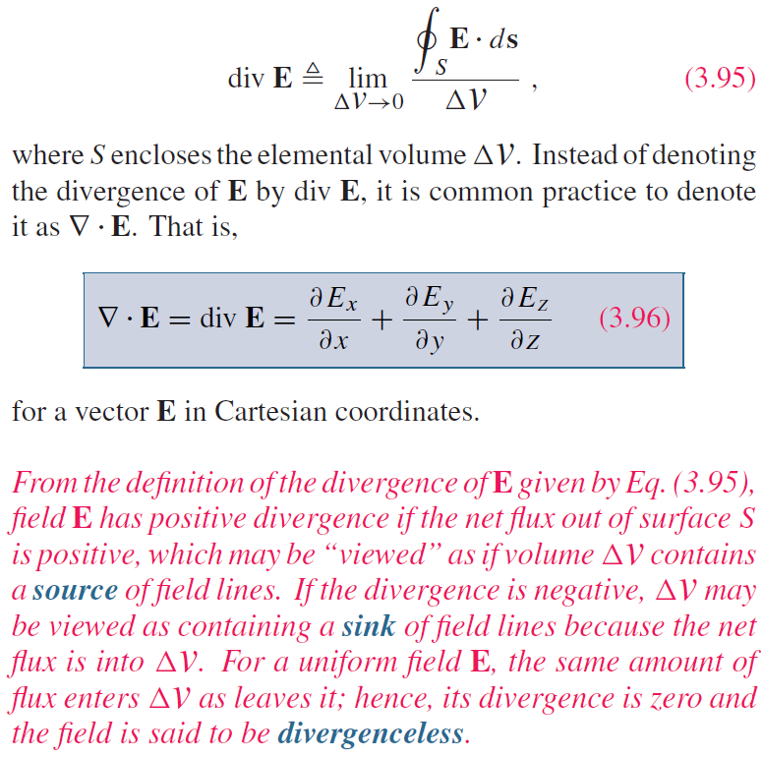
Divergence of a Vector Field
Total flux out of an enclosed volume
Scalar -> Vector

Slide 17
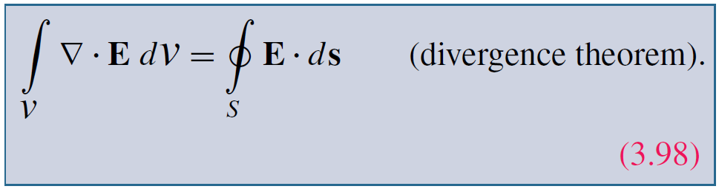
Divergence Theorem
Useful tool for converting integration over a volume to one over the surface enclosing that volume, and vice versa

Slide 18
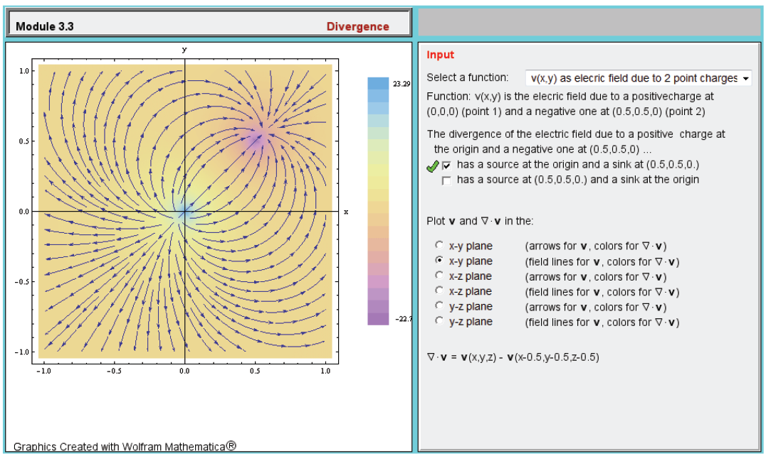

Slide 19
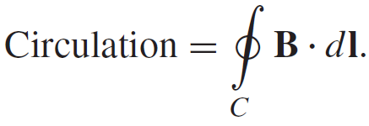
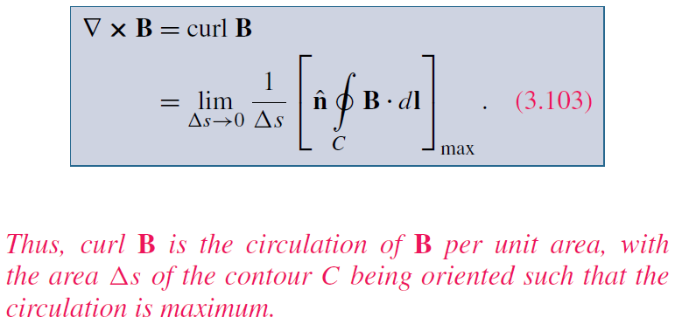
Curl of a Vector Field

Slide 20
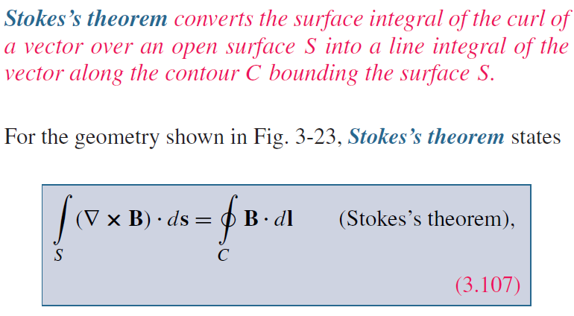
Stokes’s Theorem

Slide 21
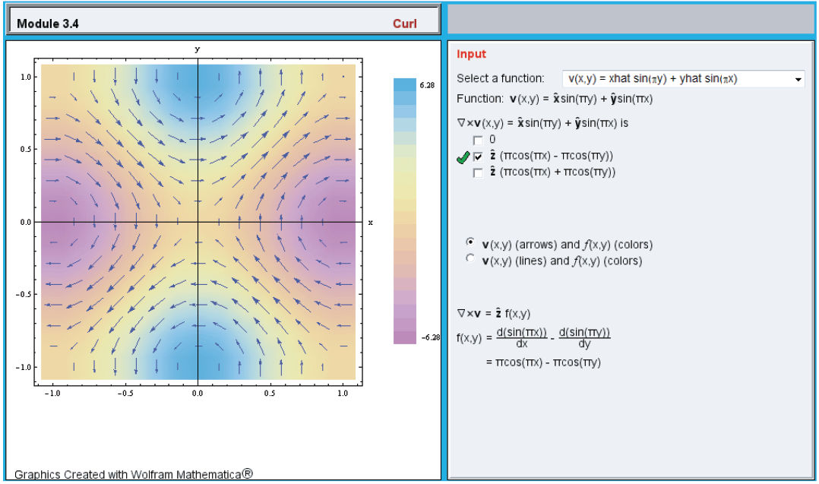

Slide 22
We didn’t have enough time to complete the last two slides

Slide 23
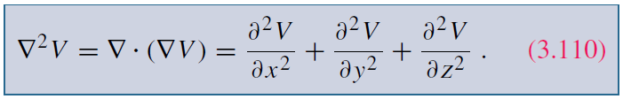
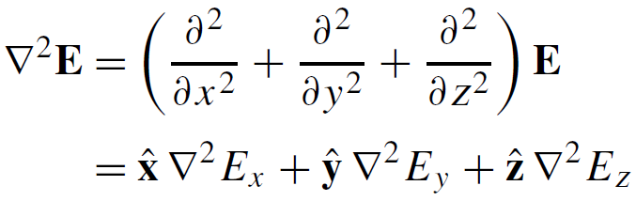

Laplacian Operator
Laplacian of a Scalar Field
Laplacian of a Vector Field
Useful Relation

Slide 24
Quick Review
Coordinate Systems
Unit vector
Differential length, surface, volume
Transformation between coordinate systems
Gradient
Divergence
Divergence theorem
Curl
Stokes theorem
Lapacian

