Slide 1
EEC 130A Introductory Electromagnetics I
Lecture 9
Winter 2012
Dr. Xiaoguang “Leo” Liu
Electrical and Computer Engineering
UC Davis

Slide 2
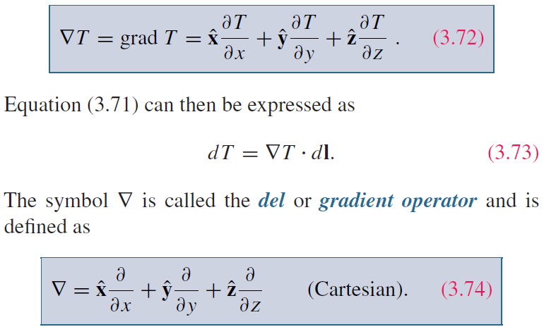
Review
Vectors
Dot and Cross product
Coordinate systems
Cartesian, cylindrical, spherical
Transformation between coordinate systems
Gradient
Divergence
Curl
Table 3-2
del operator ∇

Slide 3
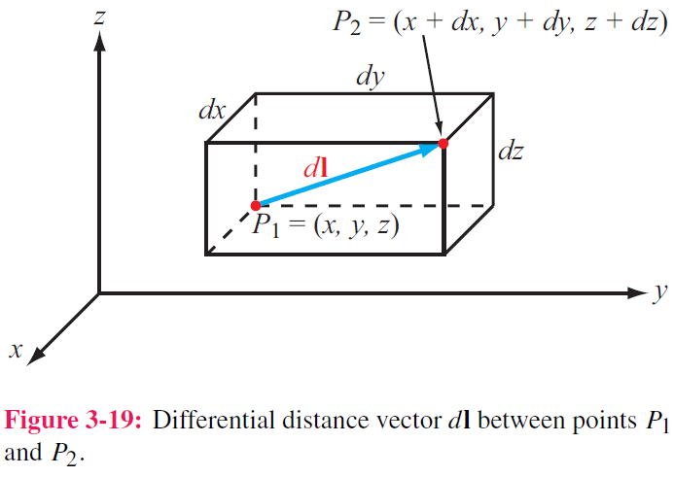
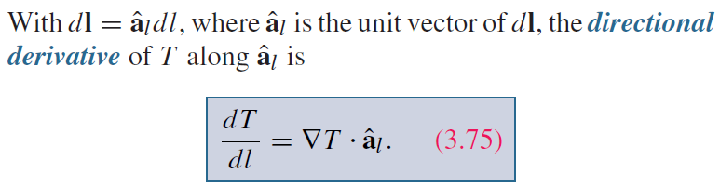
Gradient of a Scalar Field

Slide 4
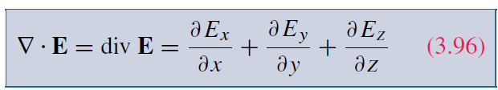
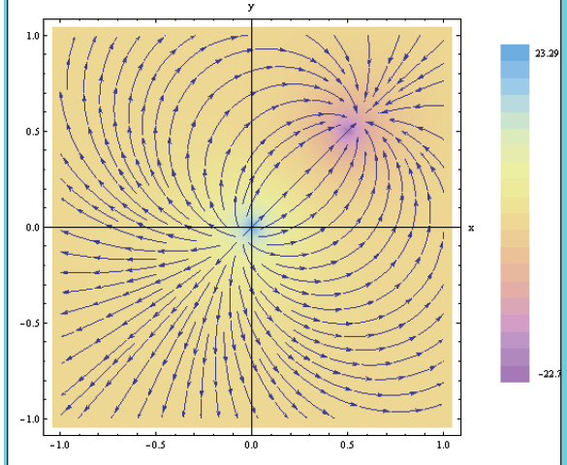

Divergence of a Vector Field

Slide 5
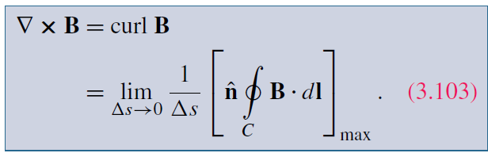
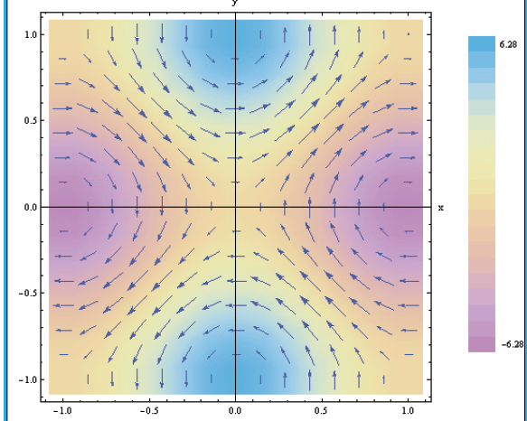
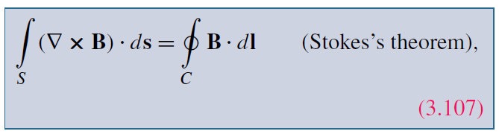
Curl and Stokes’s Theorem

Slide 6



Laplacian Operator
Laplacian of a Scalar Field
Laplacian of a Vector Field
Useful Relation

Slide 7
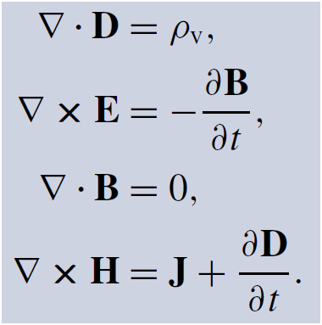
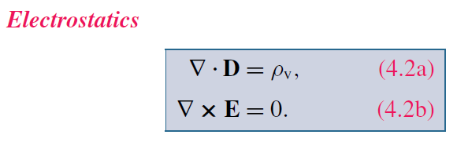
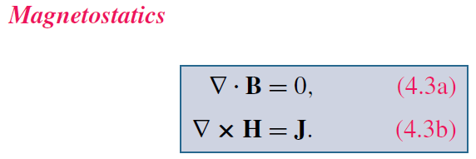
Maxwell’s Equations
God said:
If we take out the time dependence
And there was light!

Slide 8

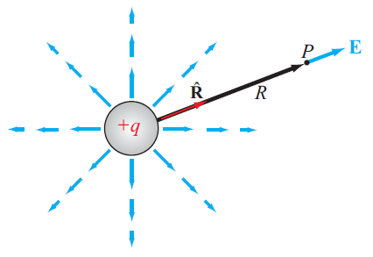

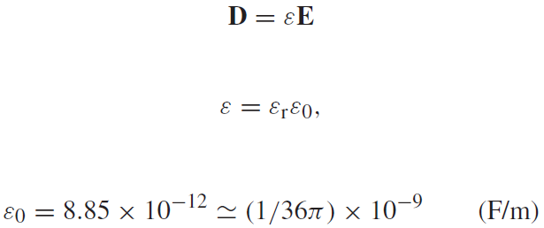
Coulomb’s Law
Electric field at point P due to single charge
Electric force on a test charge placed at P
Electric flux density D

Slide 9
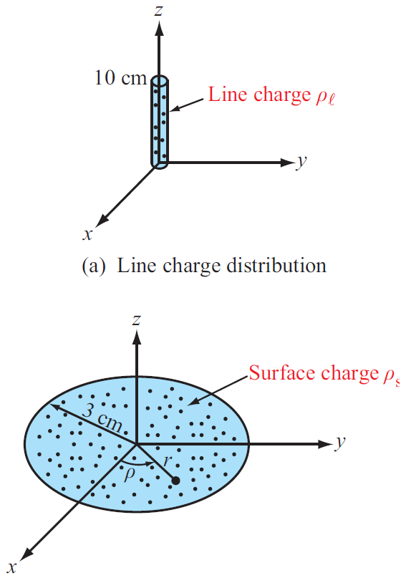

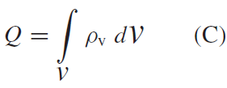


Charge Distribution
Volume charge density:
Total Charge in a Volume
Surface and Line Charge Densities

Slide 10

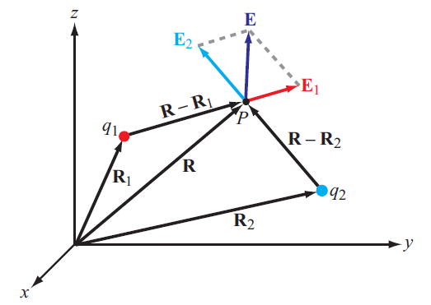
Electric Field Due to Multiple Charges

Slide 11

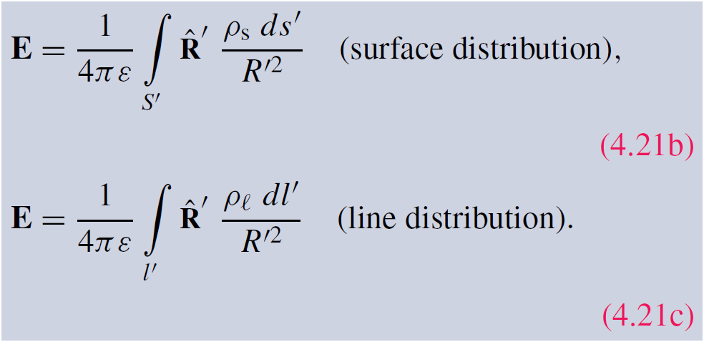
Electric Field Due to Charge Distributions

Slide 12
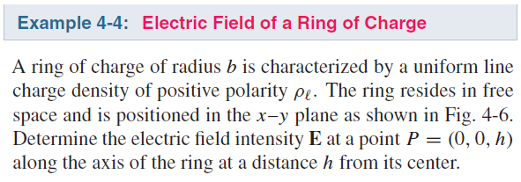
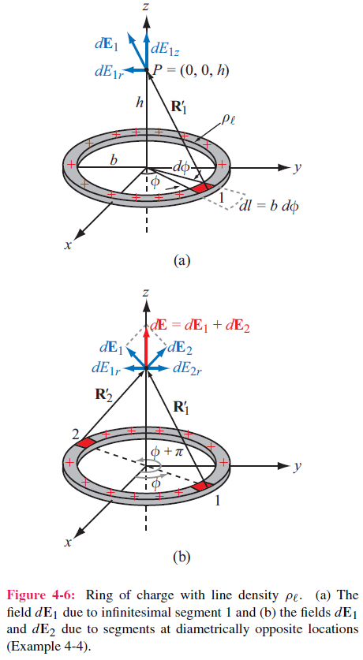
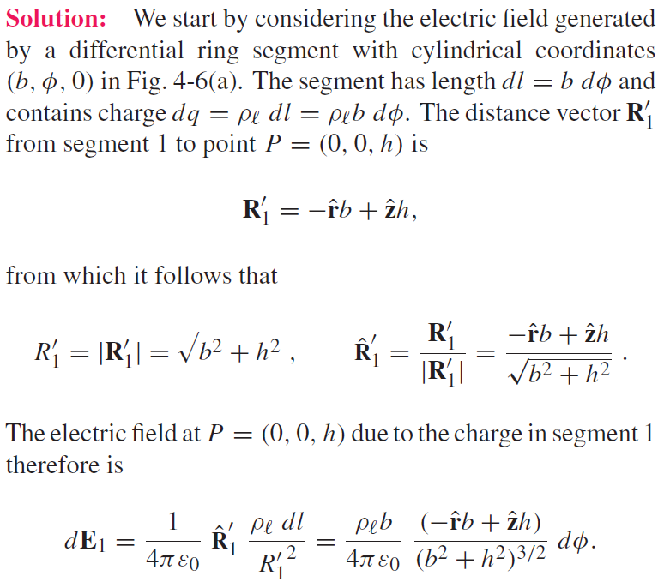

Slide 13
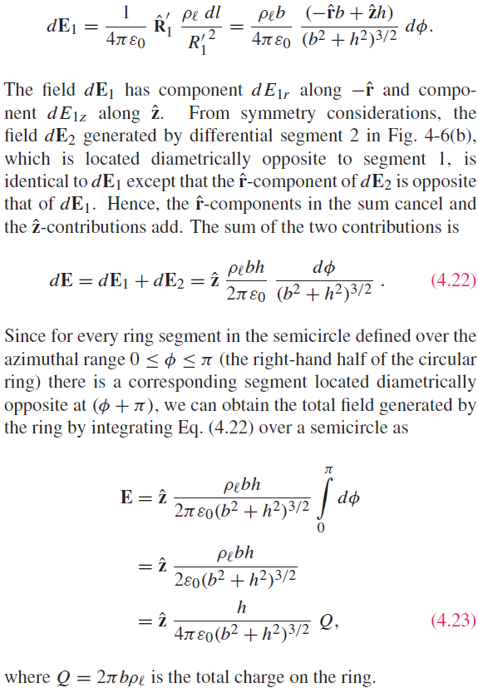

Slide 14
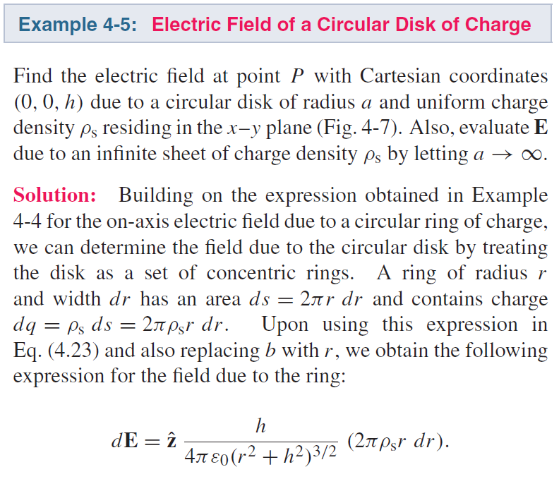
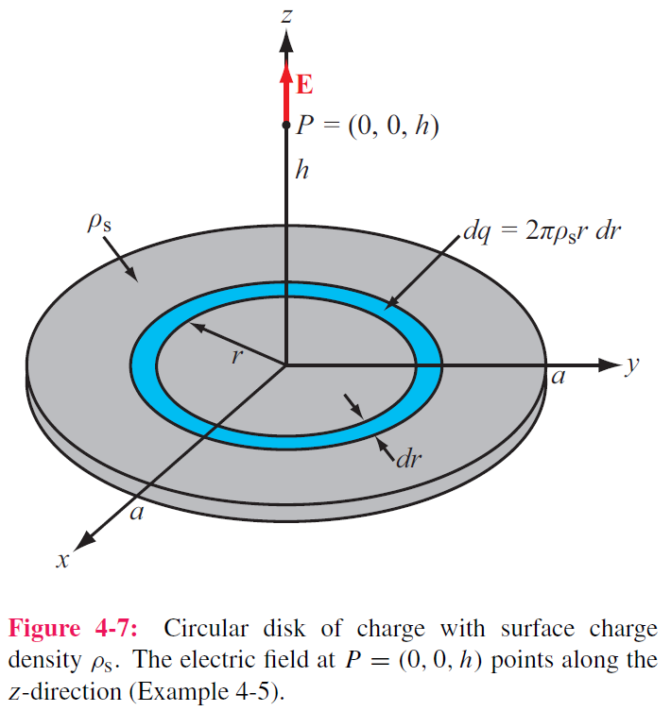

Slide 15
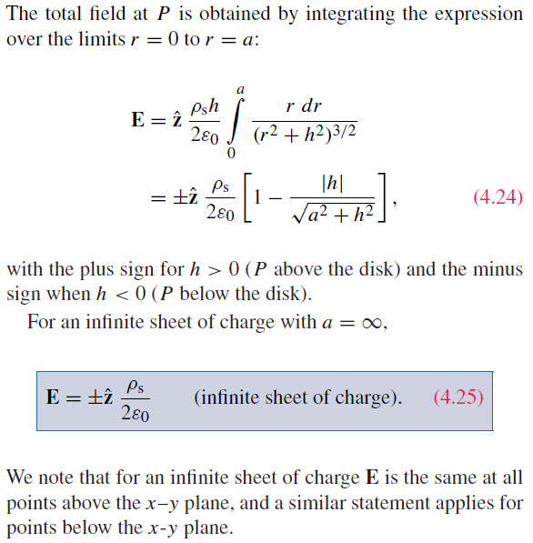

Slide 16
