Slide 1
EEC 130A Introductory Electromagnetics I
Lecture 11
Winter 2013
Dr. Xiaoguang “Leo” Liu
Electrical and Computer Engineering
UC Davis

Slide 2
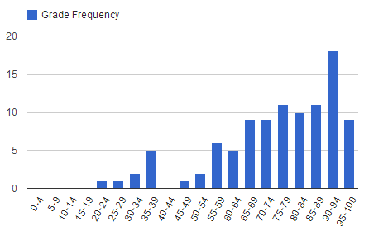
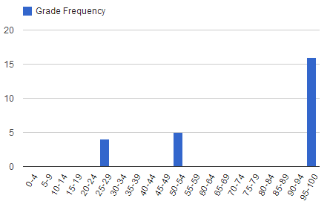
Midterm 1
Regular problems
Average: 75.2 ;
Std Deviation: 18.08;
Median: 79
Extra credit problem
Average: 15.6;
Stdd Deviation: 6.05;
Median: 20

Slide 3
Midterm 1
If your final score is 20 points higher than any of your midterms (regular problems only), then you may drop that midterm with low grade.
Example:
You get 50 in the first mid-term (30%)
You get 60 in the second mid-term (20%)
You get 75 in the final (30%)
You may drop the first mid-term. Now your final is worth 30%+30%=60%

Slide 4
Review
Vectors
Dot and Cross product
Coordinate systems
Cartesian, cylindrical, spherical
Transformation between coordinate systems
Table 3-2

Slide 5
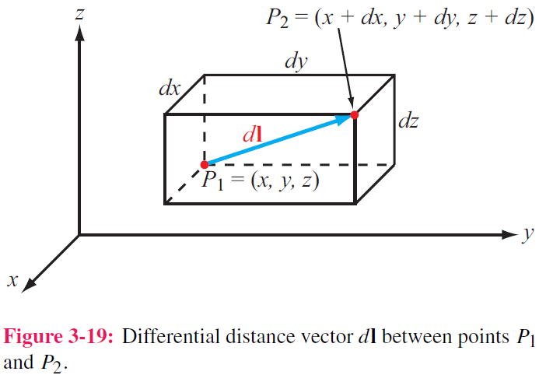
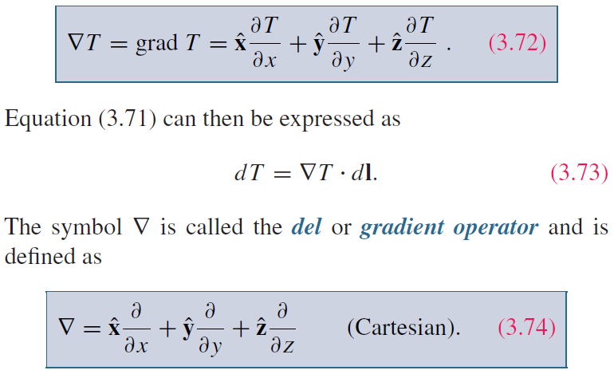
Gradient of a Scalar Field
del operator ∇

Slide 6
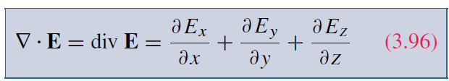
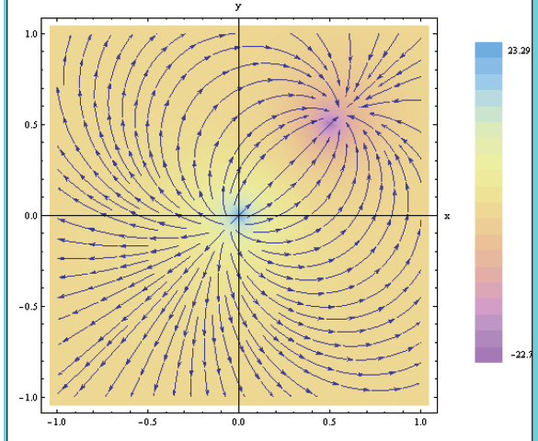
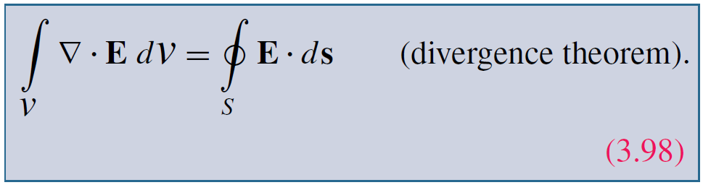
Divergence of a Vector Field

Slide 7
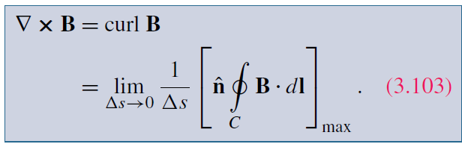
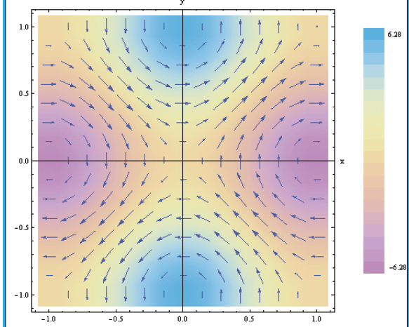
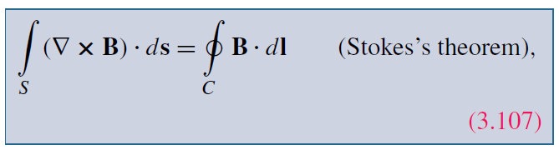
Curl and Stokes’s Theorem

Slide 8
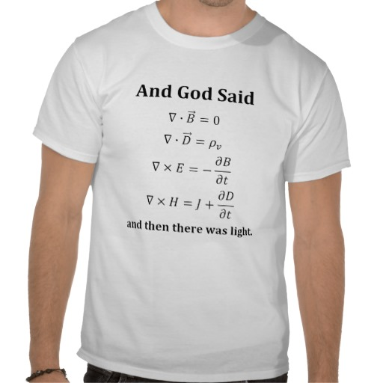
Maxwell’s Equations

Slide 9
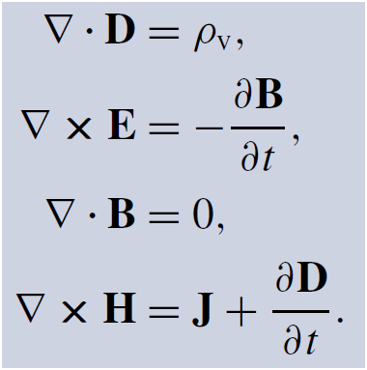
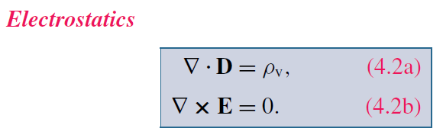
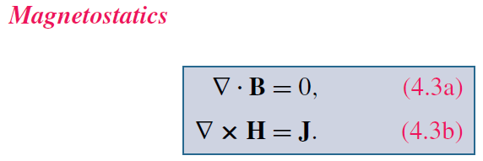
Maxwell’s Equations
If we take out the time dependence

Slide 10
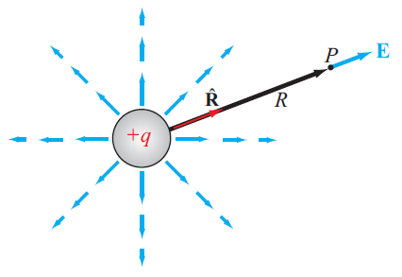

Charge and Electric Field Intensity
Electric Field Intensity
Electric flux density

Slide 11
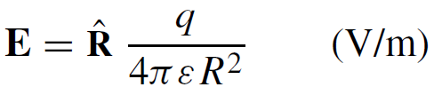
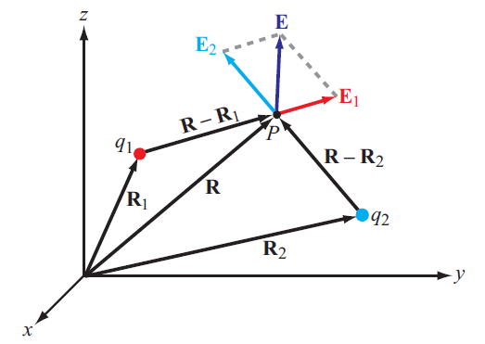
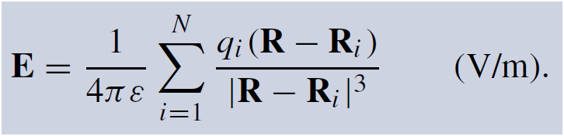
Coulomb’s Law
Electric field at point P due to single charge

Slide 12
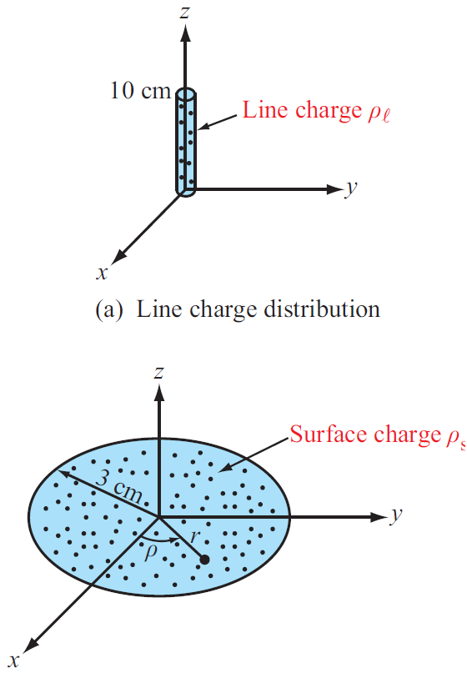
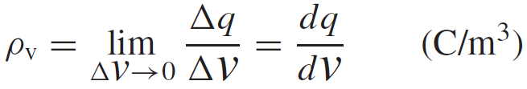
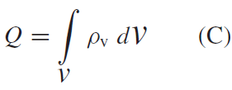

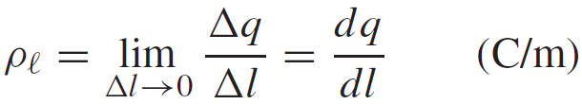
Charge Distribution
Volume charge density:
Total Charge in a Volume
Surface and Line Charge Densities

Slide 13
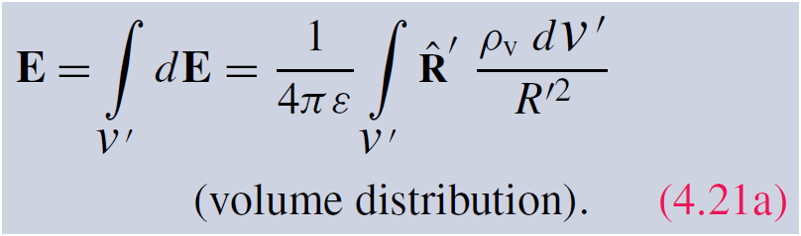
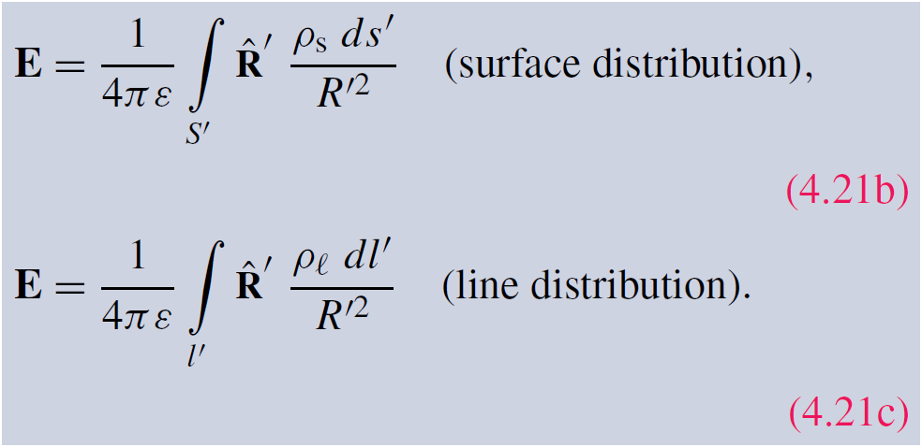
Electric Field Due to Charge Distributions

Slide 14
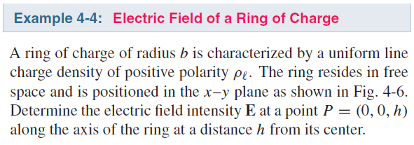
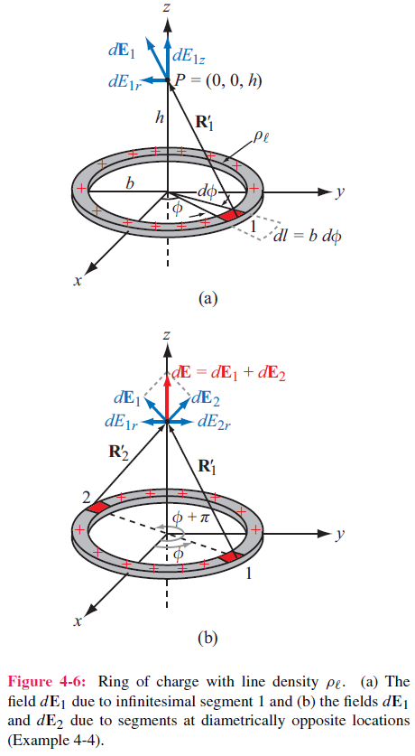
Example

Slide 15
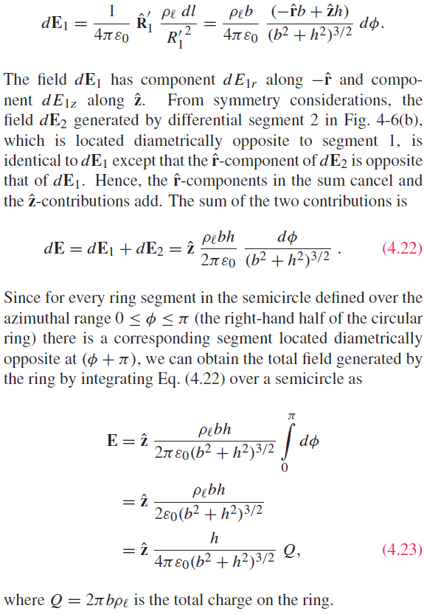

Slide 16
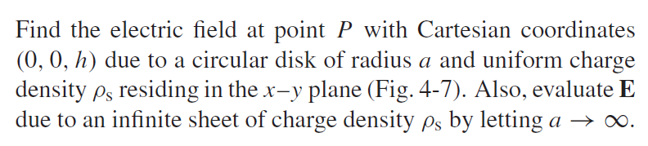
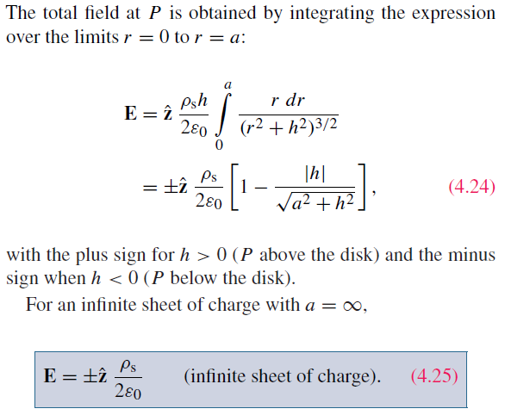
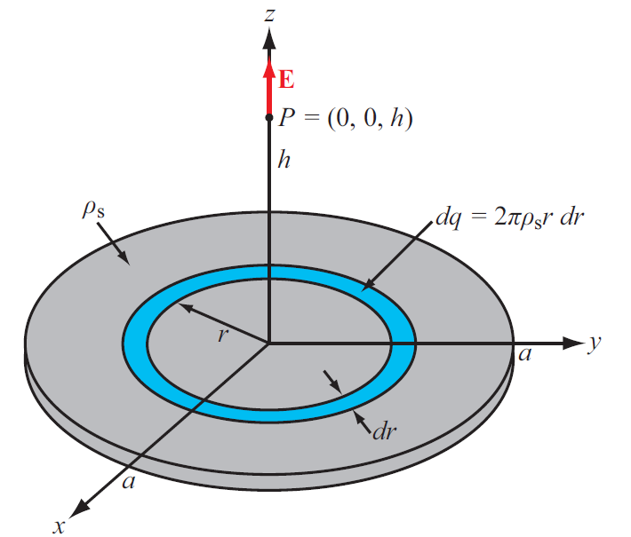
Example

Slide 17
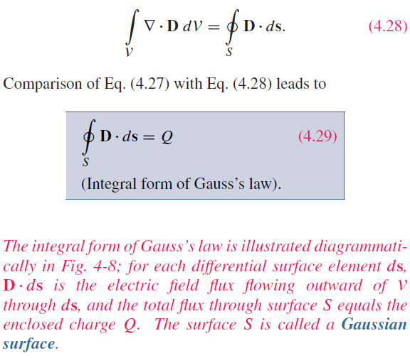
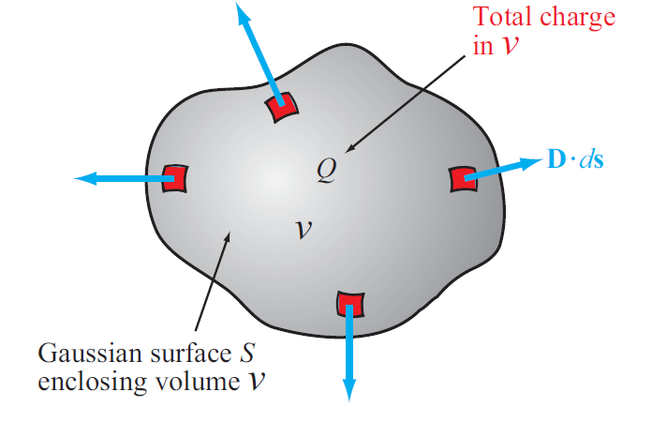
Gauss’s Law

Slide 18

Gauss’s Law

Slide 19
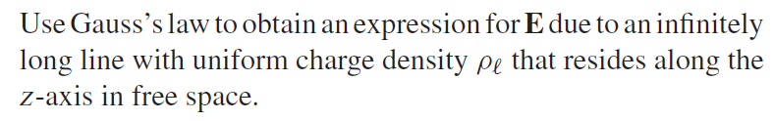
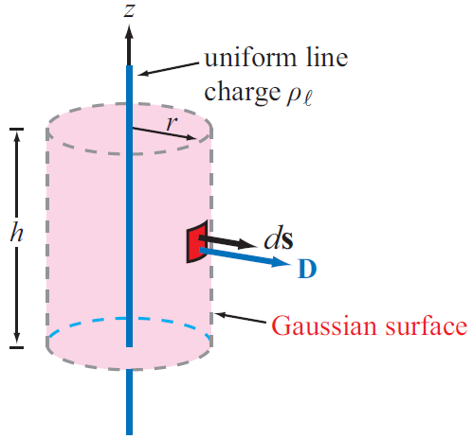
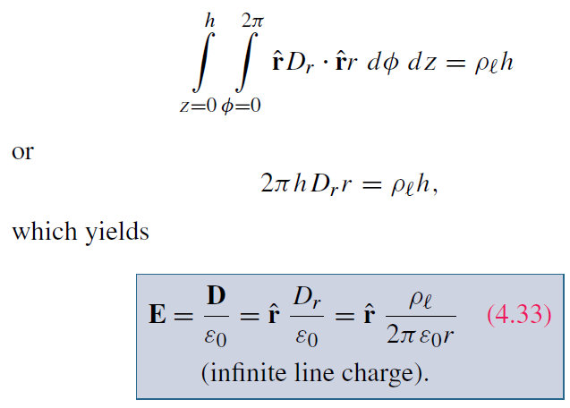
Using Gauss’s Law
Take advantage of symmetry and uniform Gaussian surfaces

