Slide 1
EEC 130A Introductory Electromagnetics I
Lecture 12
Winter 2013
Dr. Xiaoguang “Leo” Liu
Electrical and Computer Engineering
UC Davis

Slide 2
Feedback
What do you appreciate least about the course?
Need a more clear reading schedule
The use of Powerpoint slides
Pace a bit slow
Class not curved
Has a lot of trouble with the text
Too much time spent on Smith chart
Didn’t quite understand the transmission line part

Slide 3
Feedback
Suggestions to improve the class
More writing on the whiteboard to show derivations
More examples in class, if not possible, have more help sessions
More real-world examples
More online notes
Fewer Powerpoint
Do demos in class
Upload lectures earlier
Provide an outline at the beginning of a lecture
List critical concepts and topics before exam

Slide 4
Announcement
Midterm 2
March 7 (Thursday)
1.5 hour long
20% of total grade
Covers Chapter 3, 4, and 5
Office Hour
Tuesday evening hours -> Thursday evening 8 – 10 pm, starting from this week
Wednesday afternoon 3 – 5 pm
Make up class
Class on next Tuesday (Feb. 26) is cancelled because of a business trip
Make up class or a video lecture?

Slide 5
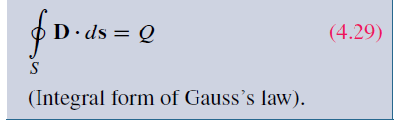

Review
Gauss’s Law
Integral form
Differential form

Slide 6
Overview of Today’s Lecture
Electric scalar potential
Concept
How it relates to electric field intensity
How to calculate it
Current, conductivity and resistivity

Slide 7
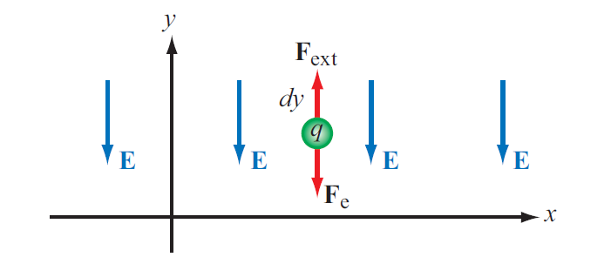
Electric Scalar Potential
Work needed to move a charge q
differential electric potential

Slide 8
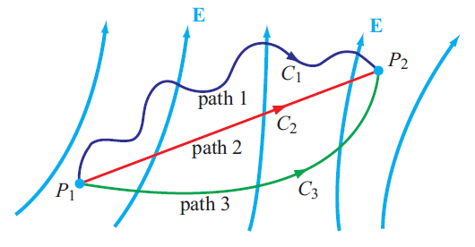
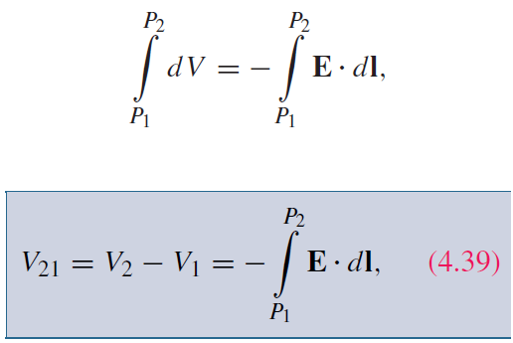
Electric Scalar Potential
Irrotational (conservative)

Slide 9
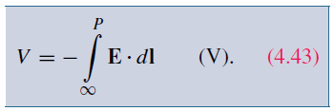

Electric Potential Due to Charges
In electric circuits, we usually select a convenient node that we call ground and assign it zero reference voltage. In free space and material media, we choose infinity as reference with V = 0. Hence, at a point P
For a point charge, V at range R is:

Slide 10
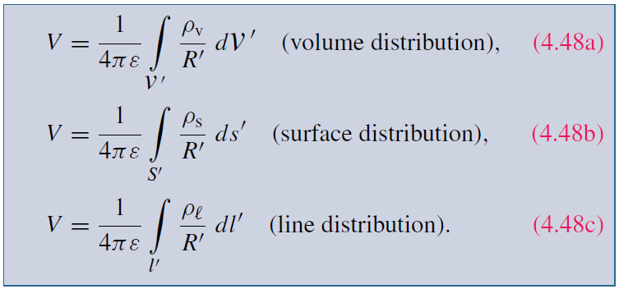
Electric Scalar Potential due to Charges
Multiple Charges
Charges distributions

Slide 11
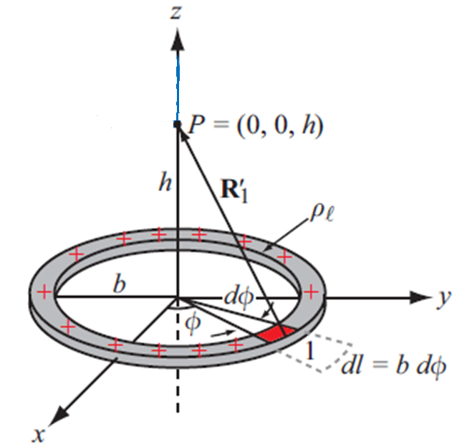
Example 4-4
Find V at Point P

Slide 12
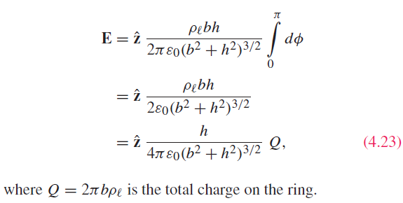

Slide 13
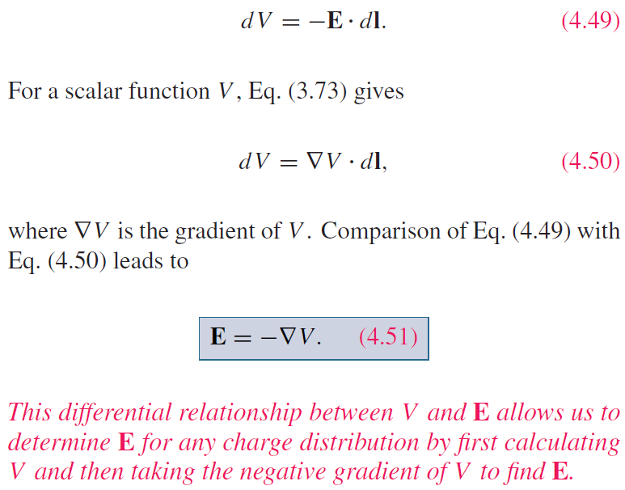
Relating E to V

Slide 14
Poisson’s Equation
Laplacian
Poisson’s Equation

Slide 15
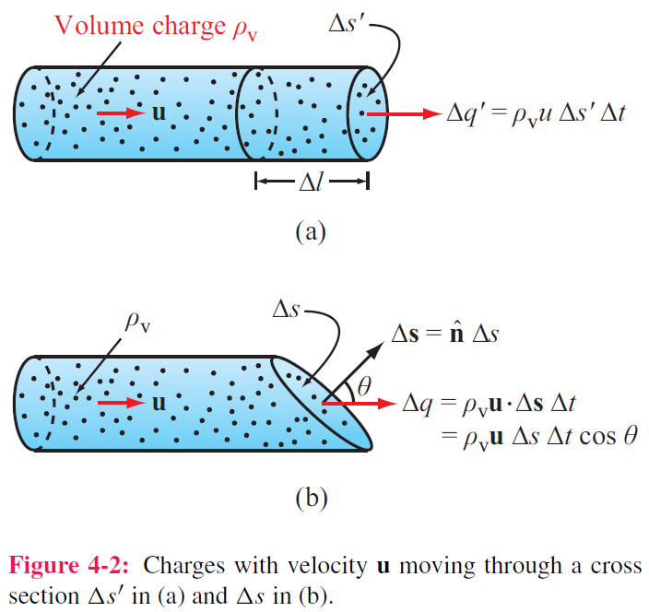
Current

Slide 16
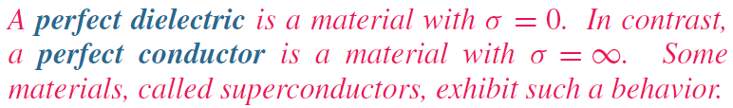
Current
Drift
velocity
Current
density
Charge
density
Mobility
(A/m²)
Condutivity

Slide 17
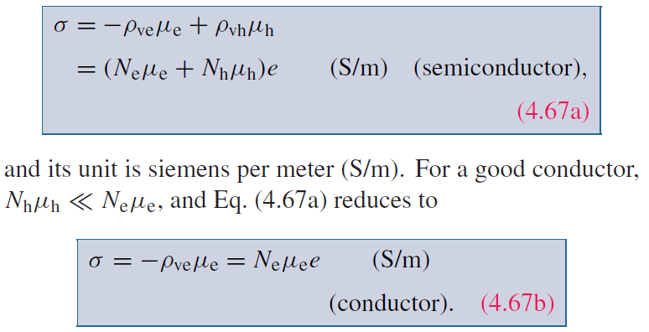
Semiconductors

Slide 18
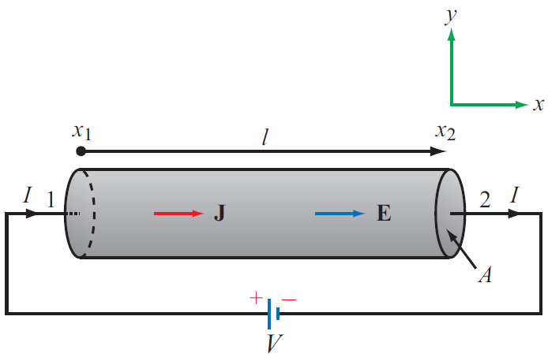
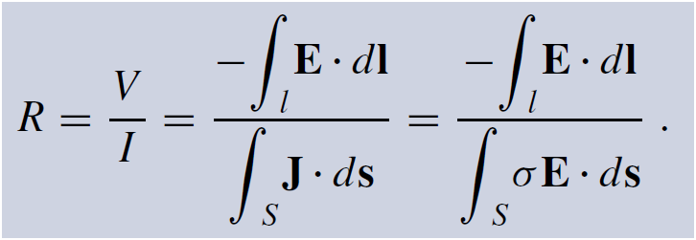
Resistance

Slide 19
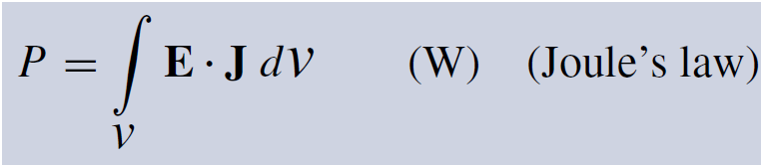
Joule’s Law
The power dissipated in a volume containing electric field E and current density J is:
For a conductor:

Slide 20
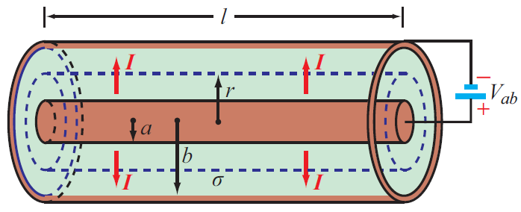
Coaxial Cable Conductance

Slide 21
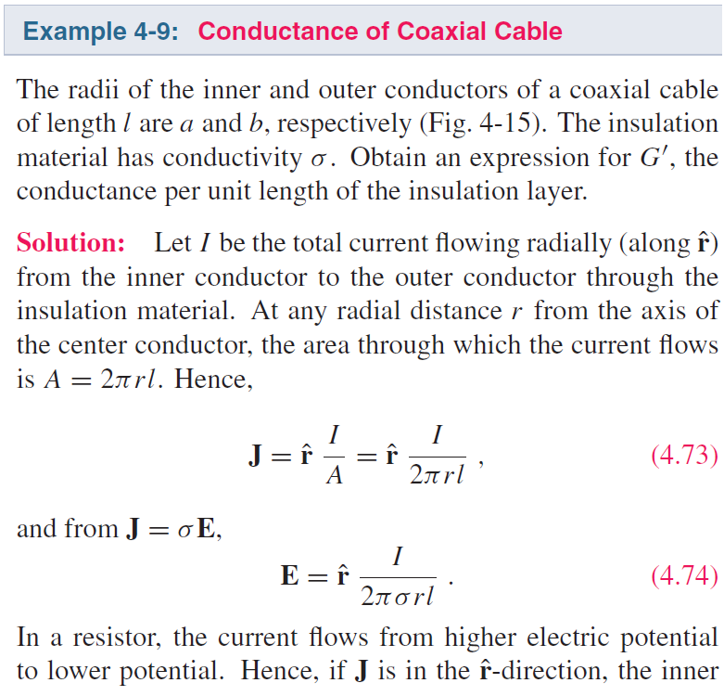
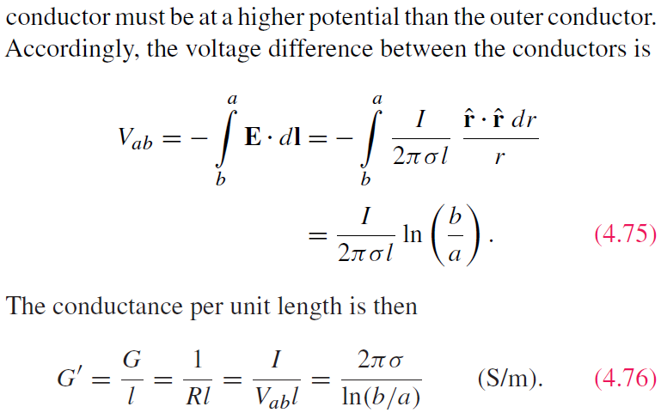
Coaxial Cable Conductance

