Slide 1
EEC 130A Introductory Electromagnetics I
Lecture 13
Winter 2013
Dr. Xiaoguang “Leo” Liu
Electrical and Computer Engineering
UC Davis

Slide 2
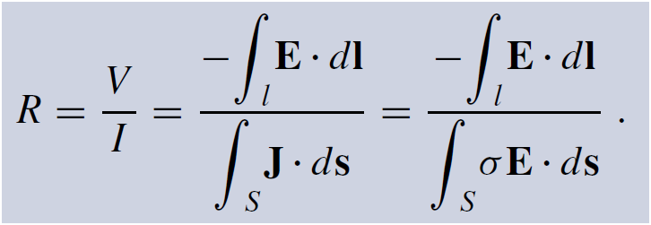
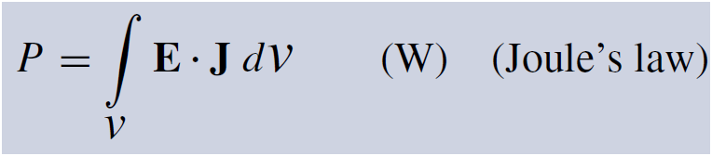
Review
Resistance
Current density
Resistance
Joule’s law

Slide 3
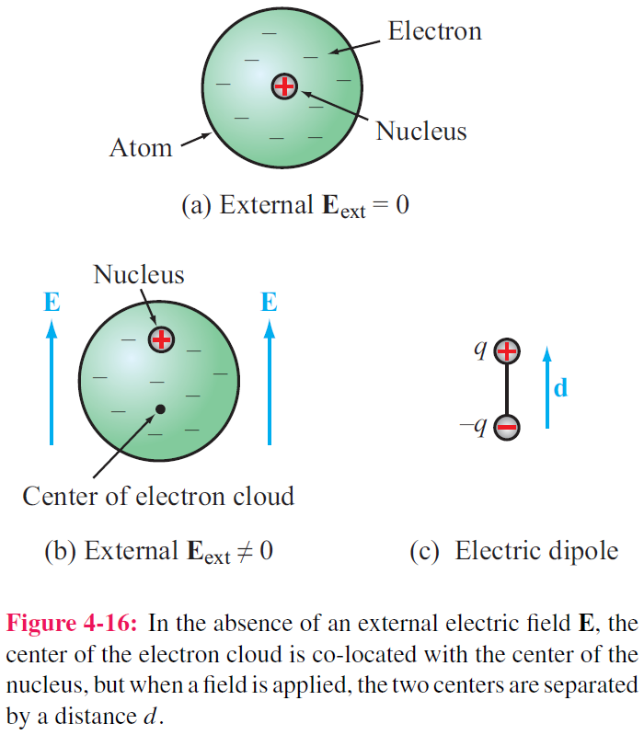
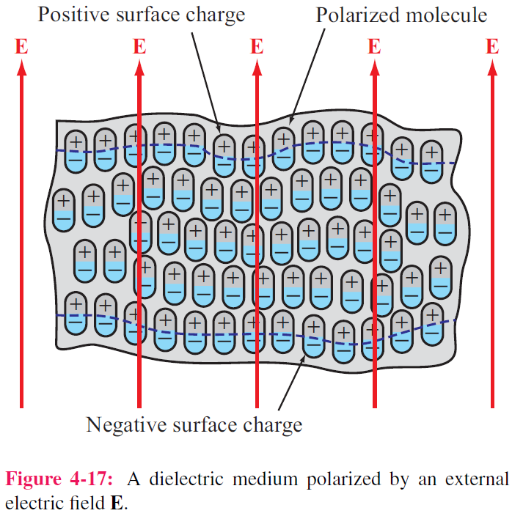
Dielectric Materials
No free electrons

Slide 4

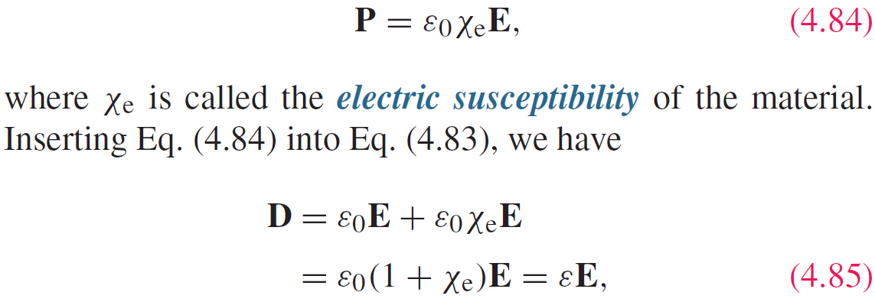
Polarization Field
P = electric flux density induced by E

Slide 5
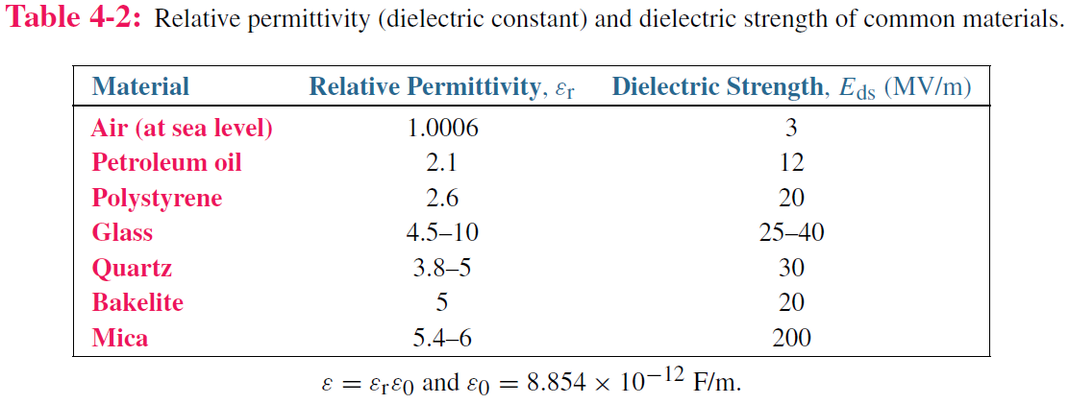
Electric Breakdown

Slide 6
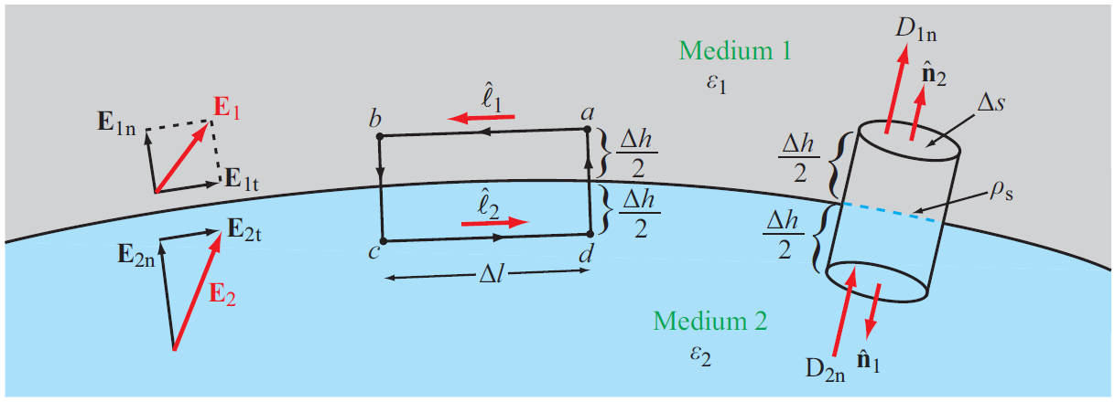


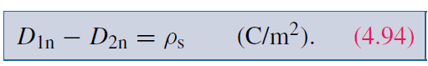
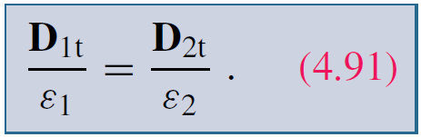
Boundary Conditions
Tangential Component
Normal Component

Slide 7
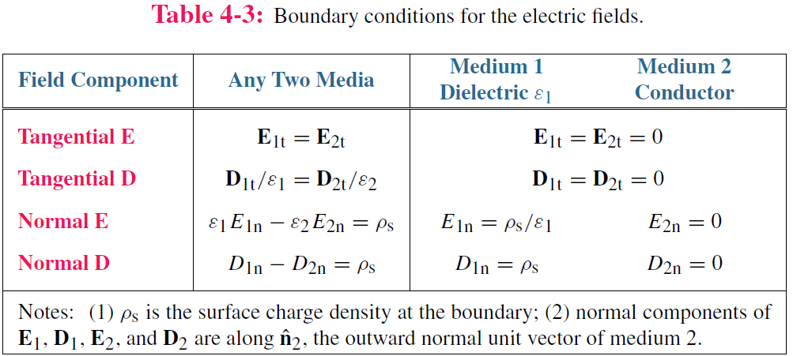
Summary of Boundary Conditions
Electric field inside a perfect conductor is 0 !

Slide 8
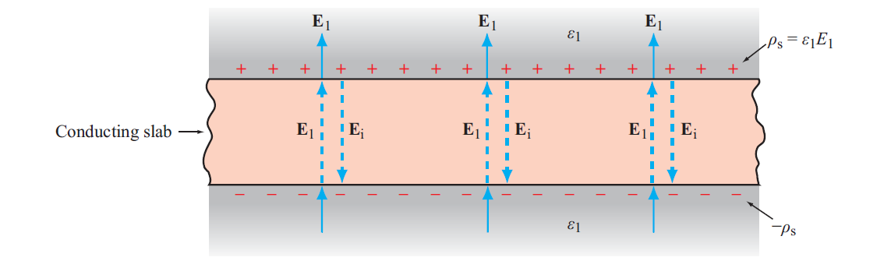
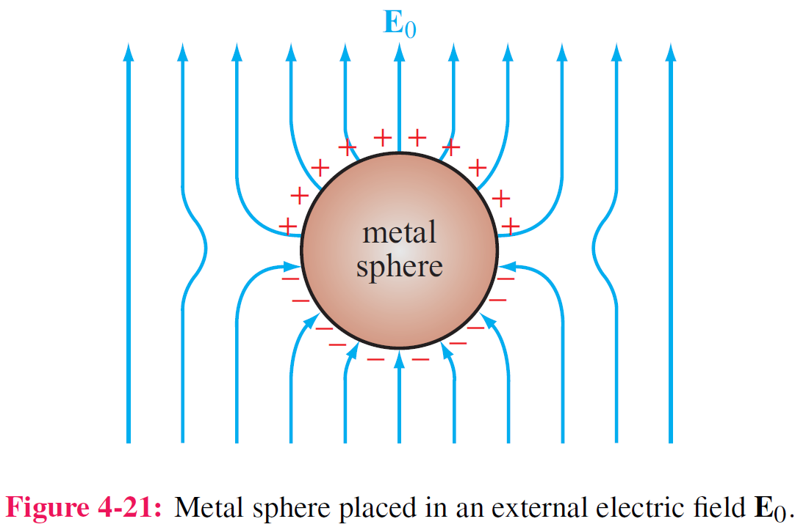
Conductors
Net electric field inside a conductor is zero

Slide 9
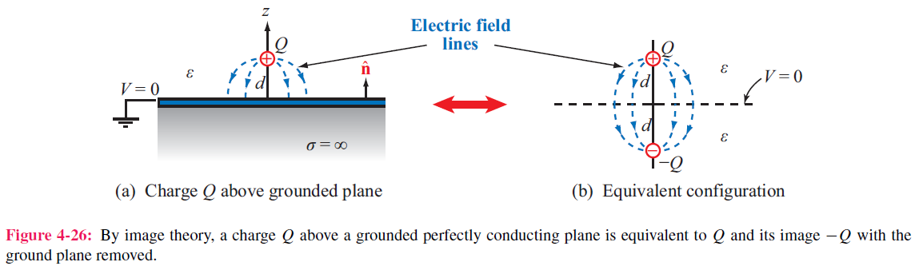
Image Method
Image method simplifies calculation for E and V due to charges near conducting planes.
For each charge Q, add an image charge –Q
Remove conducting plane
Calculate field due to all charges

Slide 10
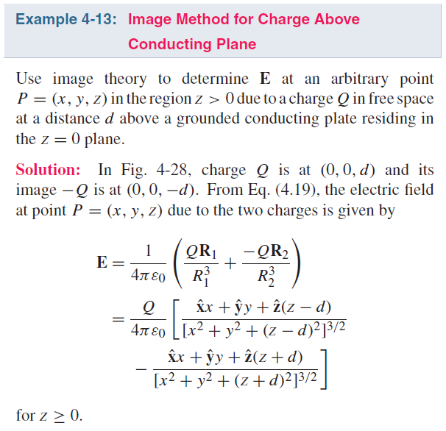
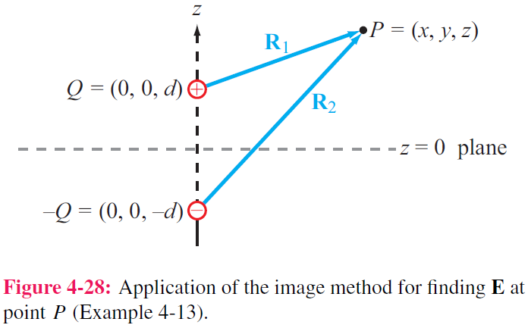
Example

Slide 11

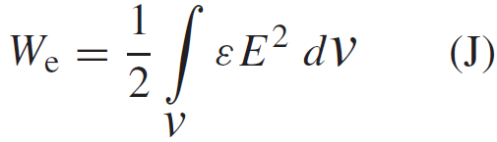

Electrostatic Potential Energy
Electrostatic potential energy density (Joules/volume)
Total electrostatic energy stored in a volume
Energy stored in a capacitor

Slide 12
Poisson’s Equation/ Laplace’s Equation
Gauss’s Law
Poisson’s Equation
Laplace’s Equation

