Slide 1
EEC 130A Introductory Electromagnetics I
Lecture 9
Winter 2013
Dr. Xiaoguang “Leo” Liu
Electrical and Computer Engineering
UC Davis

Slide 2
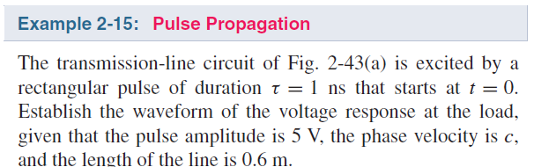
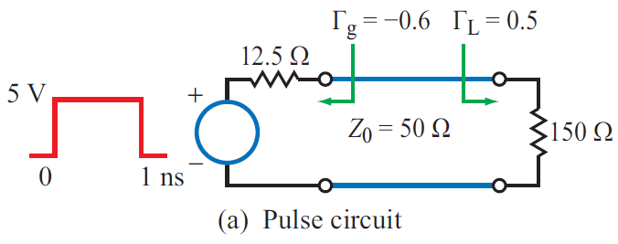
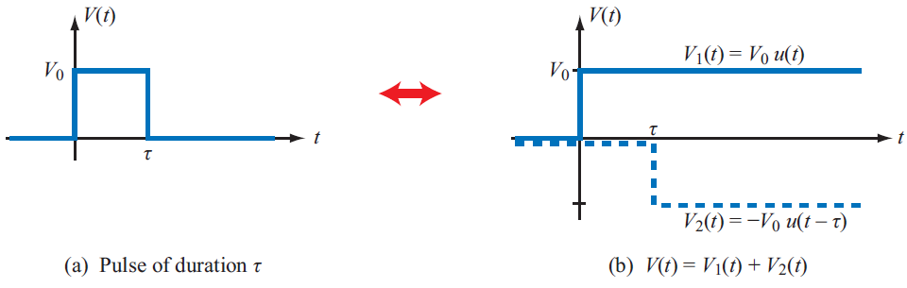
Example 2-15

Slide 3
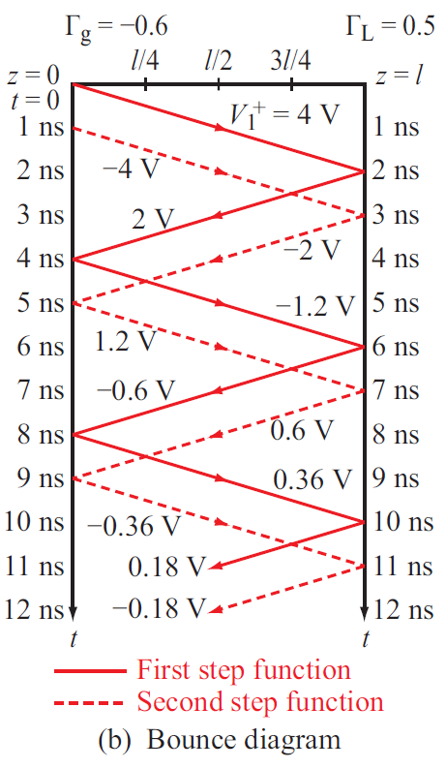
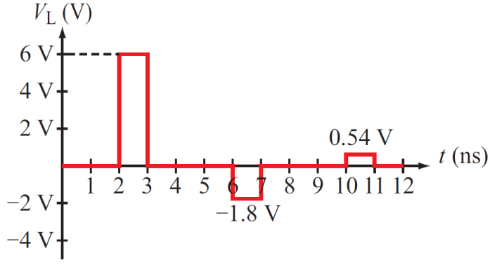
Example 2-15

Slide 4

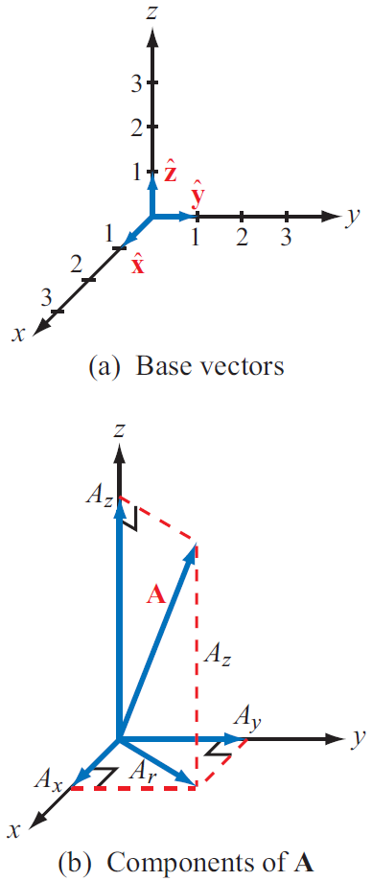


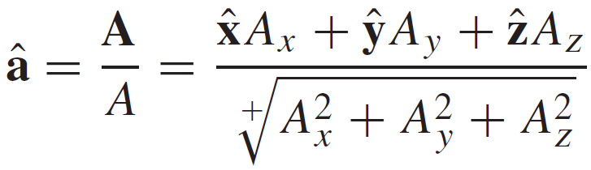
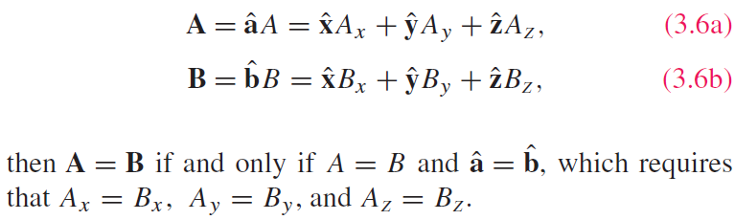
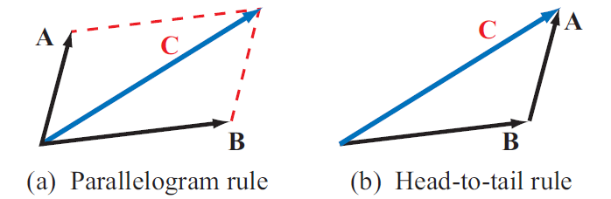
Vectors Analysis

Slide 5
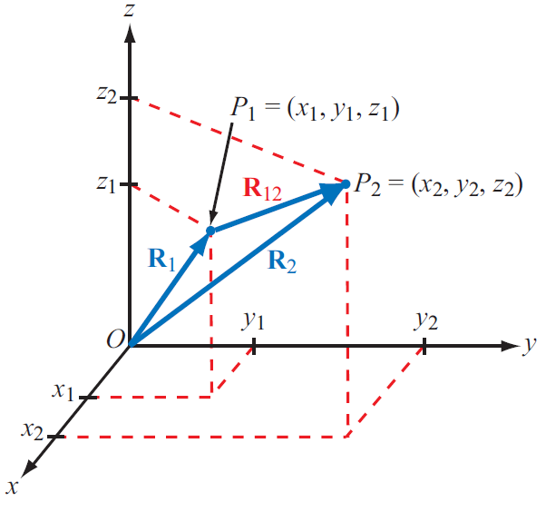
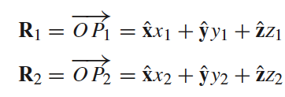
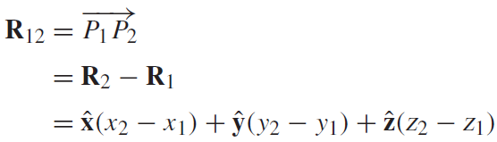
Position and Distance
Position Vector:
From origin to point P
Distance Vector:
Between two points

Slide 6


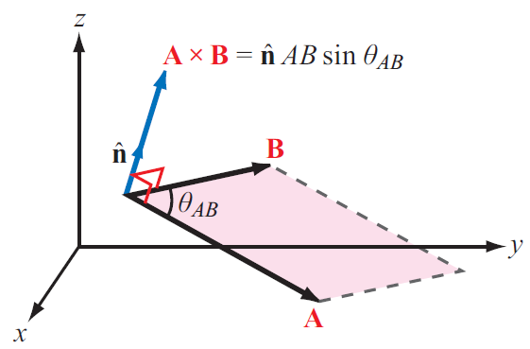
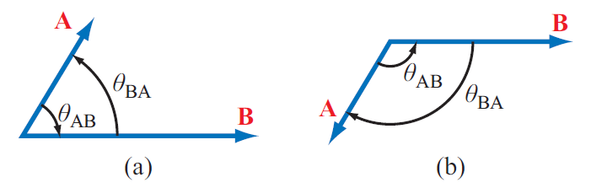

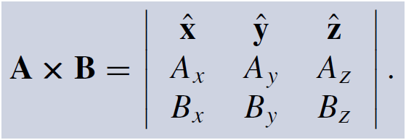

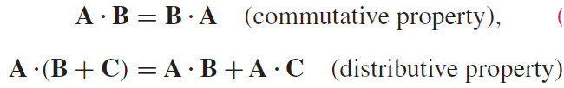

Multiplication
Dot Product
Cross Product

Slide 7
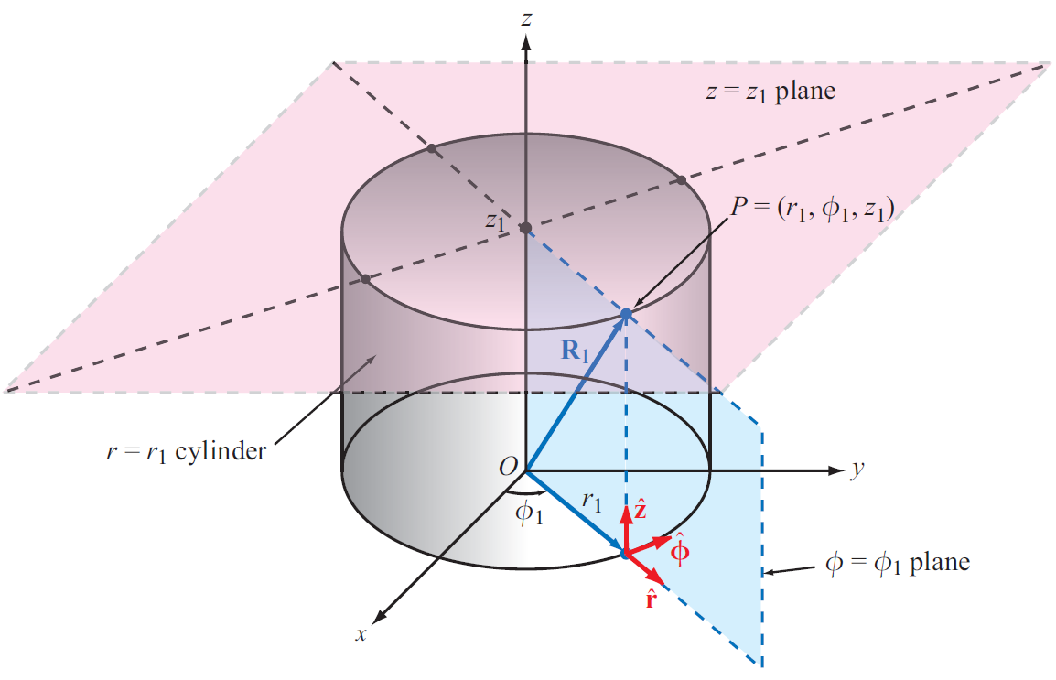
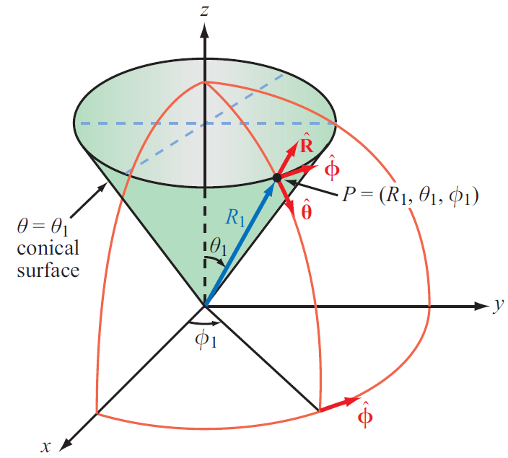
Coordinate Systems
Cartesian
Cylindrical
Spherical

Slide 8
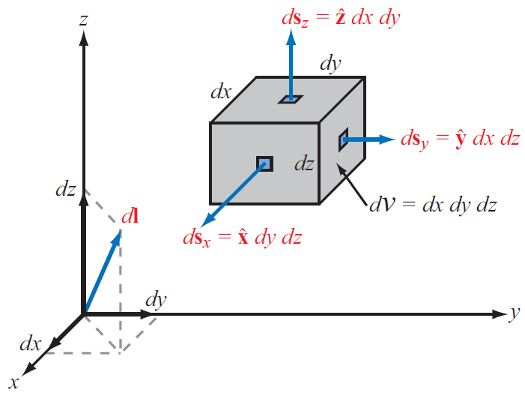
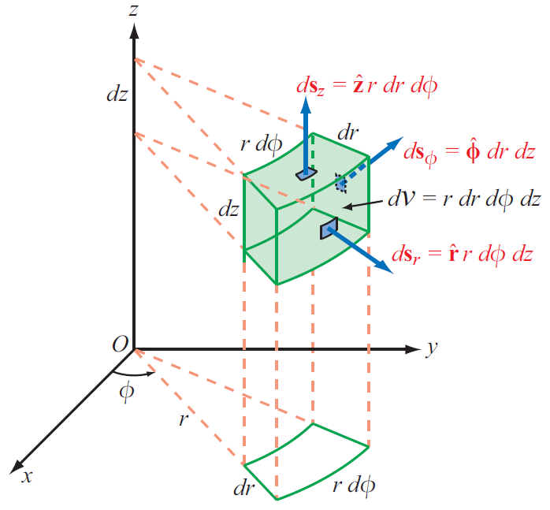
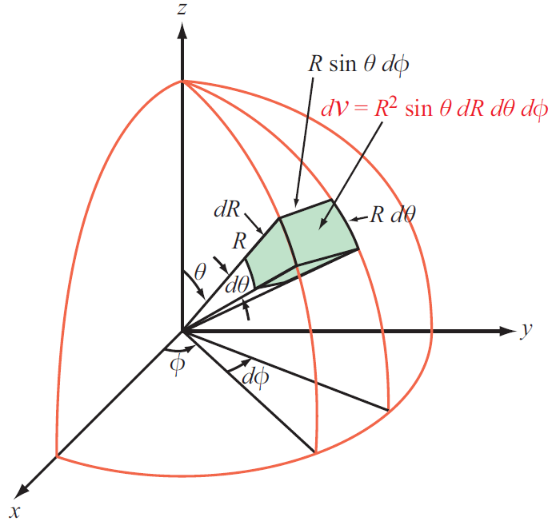
Differential Length, Area, and Volume

Slide 9
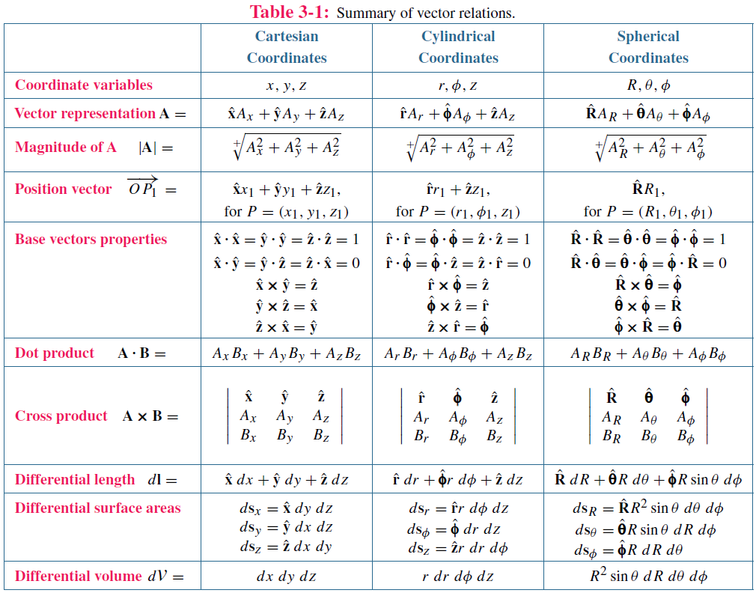

Slide 10
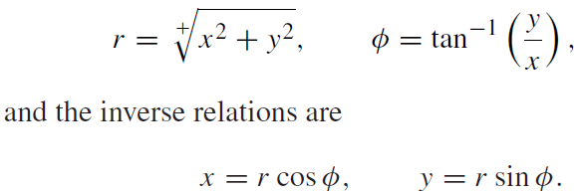
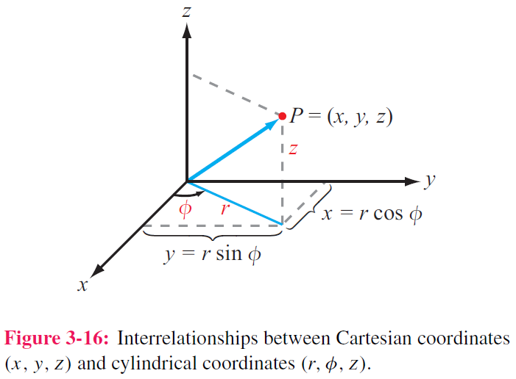
Transformation Between Coordinate Systems
To solve a problem, we select the coordinate system that best fits its geometry

Slide 11
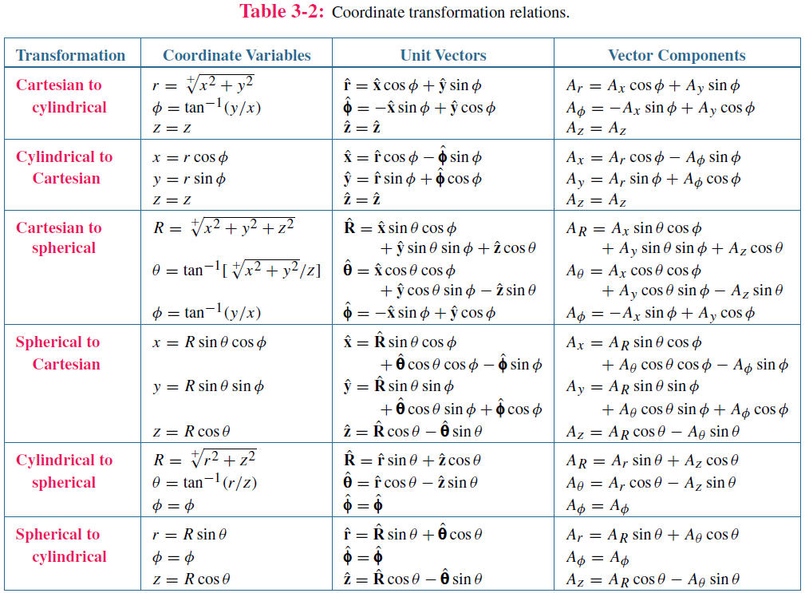

Slide 12
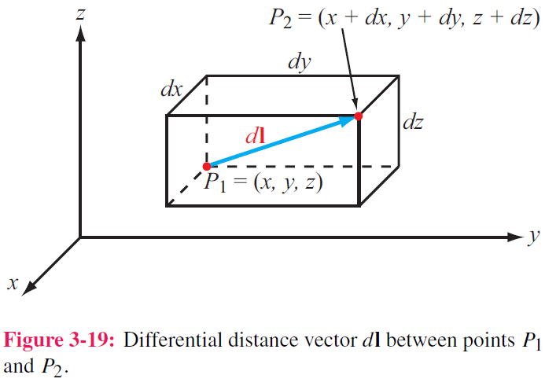
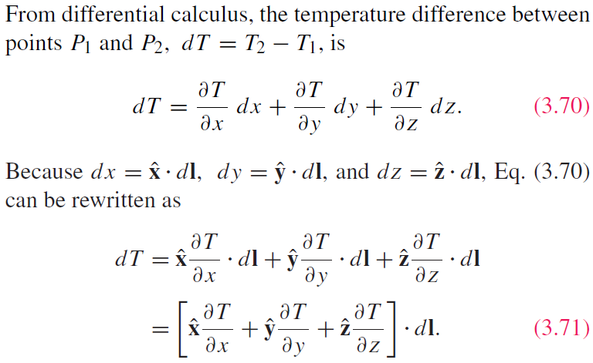
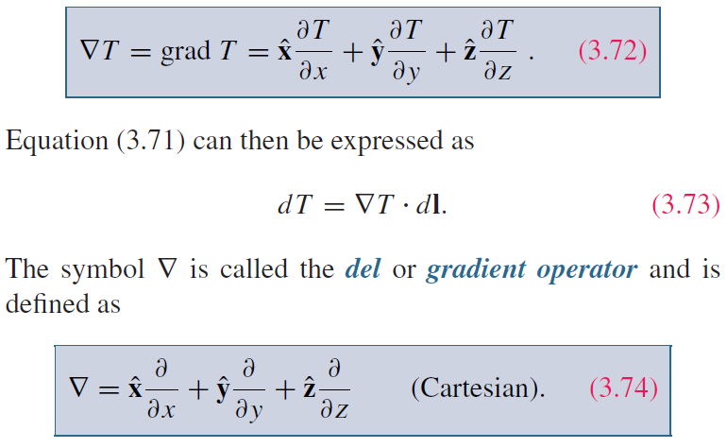
Gradient of A Scalar Field

Slide 13
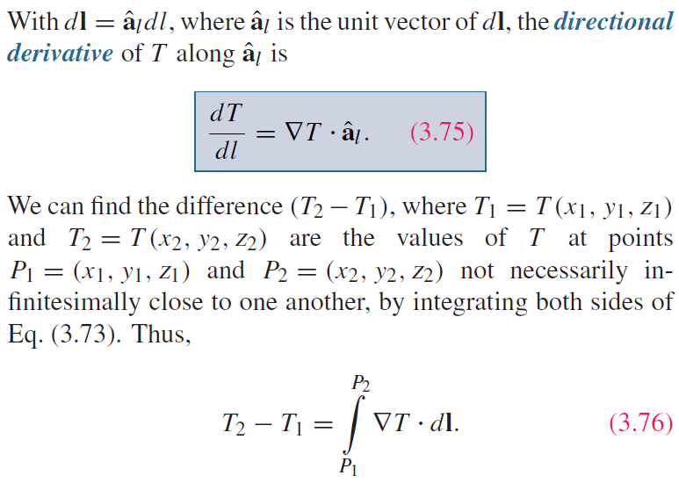
Directional Derivative

Slide 14
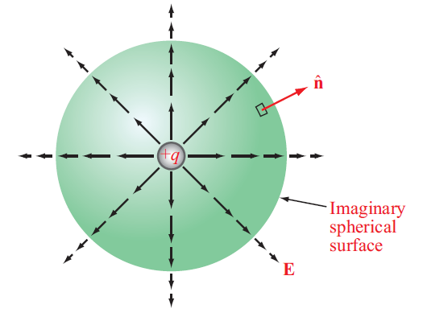
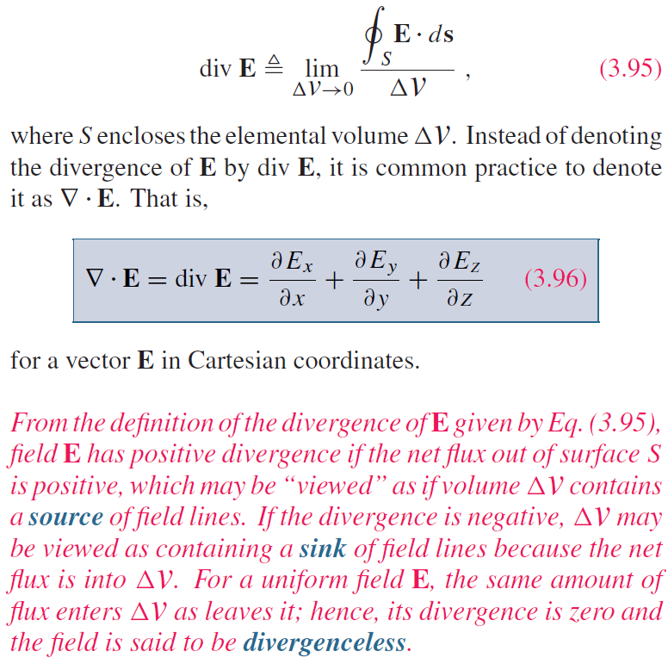
Divergence of a Vector Field
Total flux out of an enclosed volume
Scalar -> Vector

Slide 15
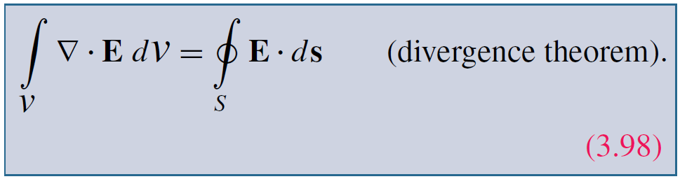
Divergence Theorem
Useful tool for converting integration over a volume to one over the surface enclosing that volume, and vice versa

Slide 16
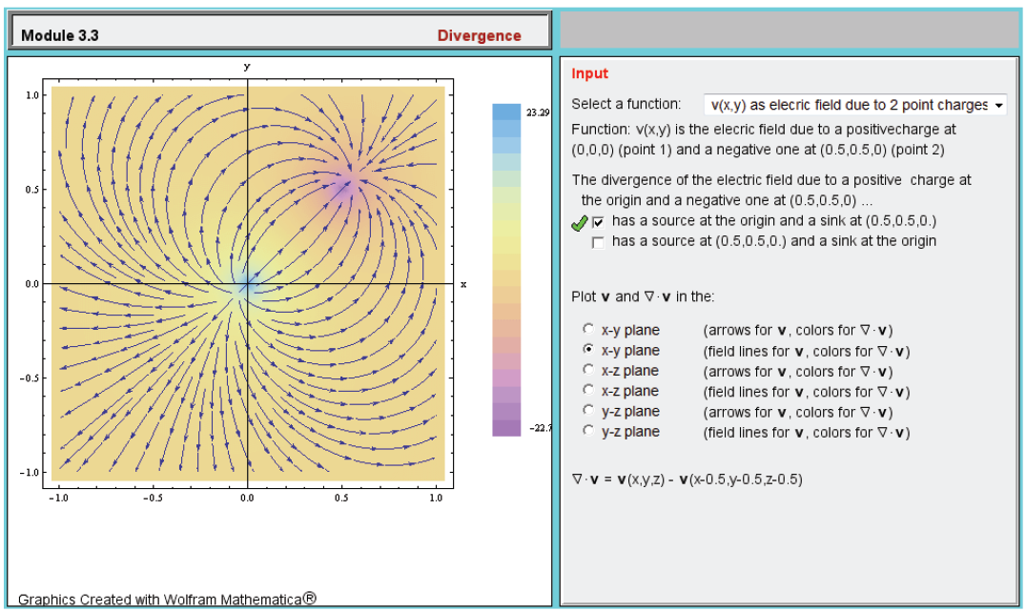

Slide 17
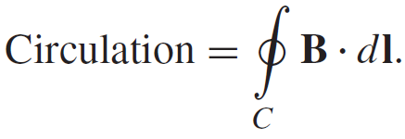
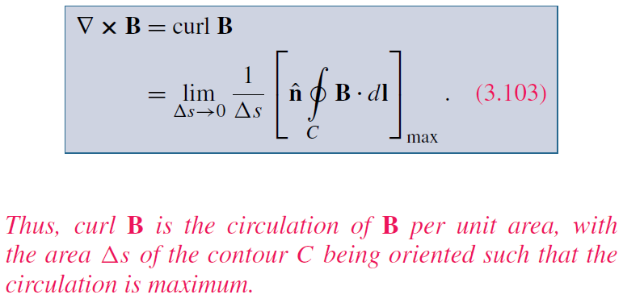
Curl of a Vector Field

Slide 18
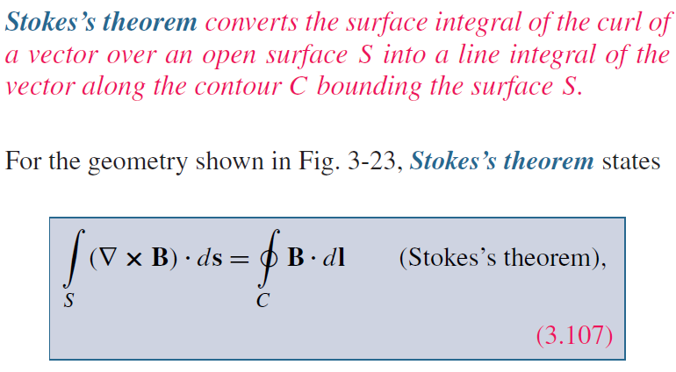
Stokes’s Theorem

Slide 19
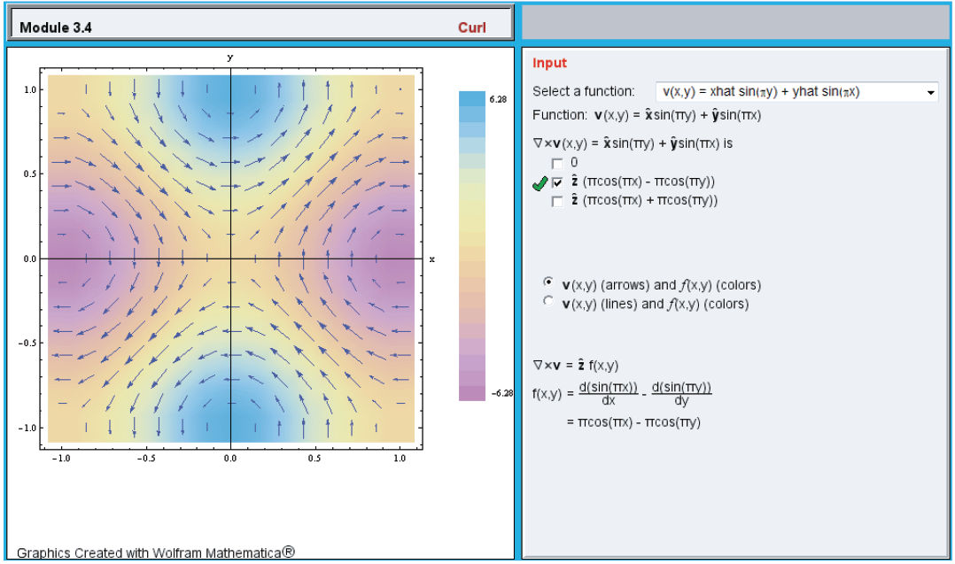

Slide 20
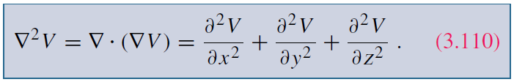
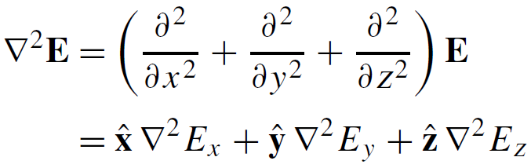

Laplacian Operator
Laplacian of a Scalar Field
Laplacian of a Vector Field
Useful Relation

Slide 21
Quick Review
Coordinate Systems
Unit vector
Differential length, surface, volume
Transformation between coordinate systems
Gradient
Divergence
Divergence theorem
Curl
Stokes theorem
Lapacian

