Slide 1
POLITICAL PARTY SHYSTEM AND ITS CHALLENGES : HOW THE HEGEMON MANAGES THE WEAK AND MAINTAINS ITS POWER

Slide 2
History of Political Parties
Largely a function of the political system: can discern a number of phases
First : 1819-1945 : no political parties allowed by colonial authorities
: undercurrent presence of KMT, CCP, MCP
Second : 1946-1959 : British sanctioned growth to prepare colony for self-governance
Third : since 1959 : function of hegemonic politics under the PAP

Slide 3
Second World War and London’s Efforts at Decolonization
British returned to a hostile, increasingly nationalistic Singapore
Challenge posed by the Malayan Communist Party and its front organisations
Singapore elite response to changes in Malayan politics, especially the rise of Malay nationalism
Forced the British to provide a framework for legal existence of political parties as seen in reforms in politics
This led to the emergence of a number of political parties as follows:

Slide 4
Key Political Parties
Malayan Democratic Union (MDU) Dec 1945
Singapore Progressive Party (SPP) Aug 1947
Singapore Labour Party (SLP) 1948
Between 1948 and 1954, the SPP was the dominant political party. It won 3 out of 6 and 6 out of 9 of the Legislative Council electoral seats in 1948 and 1951 respectively.

Slide 5
Rendel & Key Political Parties
New constitutional framework for limited self-government
Prepare for first general election in 1955
Main Parties
People’s Action Party (PAP) – Nov 1954
Labour Front - LF (reorg SLP 1954), later changed to Singapore People’s Alliance)
Alliance (sister to Malayan UMNO-MCA)
Democratic Party (DP) - CCC
Liberal Socialists (alliance of SPP & DP)

Slide 6
PAP – rise of a hegemonic political party
PAP – basic data
PAP’s origin can be traced to the Malayan Forum established in 1949 in London to champion Spore’s independence. Key members included Lee Kuan Yew, Goh Keng Swee & Toh Chin Chye. Later joined by S Rajaratnam, Kenneth Byrne & C.V. Devan Nair.
21 November 1954 – Inaugural Meeting of the PAP at Victoria Memorial Hall
2 April 1955 – Legislative Assembly elections – out of 4, 3 PAP candidates are elected
4 April 1957 – pro-communist gained control of PAP CEC and moderates resigned. Lim Yew Hock govt arrested the communists and Lee and Toh regained control. Amended party constitution by introducing cadre and non-cadre membership

Slide 7
PAP – basic data
Dec 1957 – PAP won 13 of 32 seats for the City Council with Ong Eng Guan as first Mayor
Aug 1958 – All-Party Mission succeeded in gaining full self-government for the State of Singapore
30 May 1959 general elections – PAP wins 43 of 51 seats with Lee as Prime Minister
PAP’s victory is marred by internal and external challenges: 27 June 1960 – Ong Eng Guan, S.V. Lingam and Ng Teng Kian dismissed from PAP. They set up the United People’s Party
29 April 1961 – Hong Lim by-election. Ong defeats PAP candidate with 73.3 % of the votes

Slide 8
PAP – basic data
15 July 1961 – PAP lost Anson by-election to David Marshall, now Chairman of the WP
Led to calls for Lee and government’s resignation. On 21 July Lee called for a vote of confidence: 26 voted for the motion; 13 PAP Assemblymen abstained and were expelled.
17 September 1962 – dissident group set up Barisan Socialis with Dr Lee Siew Choh as Chairman and Lim Chin Siong as Sec-Gen

Slide 9
PAP – basic data
1 Sept 1962 – Referendum on Merger. PAP’s option wins resoundingly (71%)
16 Sept 1963 – Singapore joins Malaysia
21 Sept 1963 – PAP wins GE with 37 of 51 seats; BS 13, UPP 1
July-Sept 1964 – racial riots break out
6 Jun 1965 – PAP organises MSC to promote Malaysian Malaysia
10 July 1965 – PAP wins Hong Lim byelection
9 Aug 1965 – Spore separates from Msia, with a PAP-dominated Spore entering a new era
13 Apr 1968 – won all 58 seats in GE..and the trend continues to this day

Slide 10
PAP’s Imprimatur
Stamped dominance on Singapore politics without interruption since May 1959 and no sight of losing it to this day
Created modern Singapore in its image, impacting almost every aspect of life in the country
The Lee factor is equally significant, dominating key debates and directions of the country

Slide 11
The State of the Opposition
Opposition politics have been a feature since 1948
However, since the 1963 GE the Opposition has been systematically sidelined
From the 1968 to the 1980 GE, no Opposition Candidate was voted in
The 1981 by-election changed this with J.B. Jeyaretnam entering Parliament following his victory at Anson
Since then, there has always been a small Opposition presence in the Singapore Parliament

Slide 12
Registered Political Parties (- PAP)
Singapore Chinese Party (26/9/50)
Persatuan Melayu Singapura (2/2/52)
Partai Rakyat Singapore State Div (3/12/56)
Angkatan Islam (6/8/58)
The Workers’ Party (30/1/61)
Pertubohan Kebangsaan Melayu Spura(20/2/61)
United People’s Party (14/7/61)
Barisan Socialis (15/8/61)
Partai Kesatuan Rakyat(18/6/62)
Singapore Indian Congress (7/8/62)
United National Front (?)
National Party of Singapore (?)

Slide 13
Registered Political Parties (- PAP)
Alliance Party Singapura (172/66)
United National Front (6/3/70)
The People’s Front (21/5/71)
Singapore Justice Party (10/8/72)
Democratic Progressive Party (16/3/73)
People’s Republican Party (30/8/73)
United People’s Front (20 March 1975)
Singapore Democratic Party (8/9/80)
National Solidarity Party (6/3/87)
Singapore National Front (15/8/91)
Singapore People’s Party (21/11/94)
Singapore Democratic Alliance (7/01)
What are the new parties in Singapore?

Slide 14
Key Parties
Workers’ Party
Of all O.P. on the scene, the WP is the oldest
David Marshall was early leader and entered Parliament through the Anson by-election in July 1961
WP was dormant until revived by J.B.J in 1971
WP was given a boost by J.B.’s BE victory in October 1981
Since then, Low Thia Khiang has been an important flag-bearer of the WP and has held the Hougang seat since 1991

Slide 15
Key Parties
Singapore Democratic Party
Founded by Mr Chiam See Tong
Had run as an Independent in 1976 and 1979 GE and BE respectively
Established SDP in September 1980
Ran successfully as SDP candidate for Potong Pasir in 1984, 1988, 1991 and 1997
SDP suffered serious internal conflicts with Dr Chee Soon Joon’s entry into the party, forcing Mr Chiam to leave and Dr Chee to takeover the party’s leadership
SDP became the only OP to have taken most seats from the PAP since 1968. How many and when?

Slide 16
Key Parties
Singapore Democratic Alliance
Electoral Pact formed in July 2001 to compete in the GE between (SPP), ( NSP), SJP and PKMS.
Chiam, who heads the SPP, became Chairman of the SDA
In the last GE, two of its candidates, Chiam and Steve Chia were elected to Parliament

Slide 17

PAP’s Continued Hegemony. Why?
Charismatic and united leadership
Lee factor
Impressive track record and successes (ethnic peace, economic success, infrastructural development, incorruptible, external image and stature, etc)
Near-total control of every state and non-state apparatus including the economy, media, grassroots organisations, civil service, etc.
Centralised system and small size have made control easier
Highly talented party and its continuous ability to recruit the ‘best and brightest’ in the country
Succeeded in providing and winning the popular image as the ‘ideal’ political machinery in view of the various internal and external constraints

Slide 18

Highly weak Opposition. Why?
Various PAP’s policies that succeeded in marginalising its opponents, e.g, through the unsympathetic media, lack of access to facilities and various punitive policies such as bringing them to court or even jailing them.
Opposition inability to attract talented people
Opposition inability to present alternative policies or leadership to the PAP

Slide 19
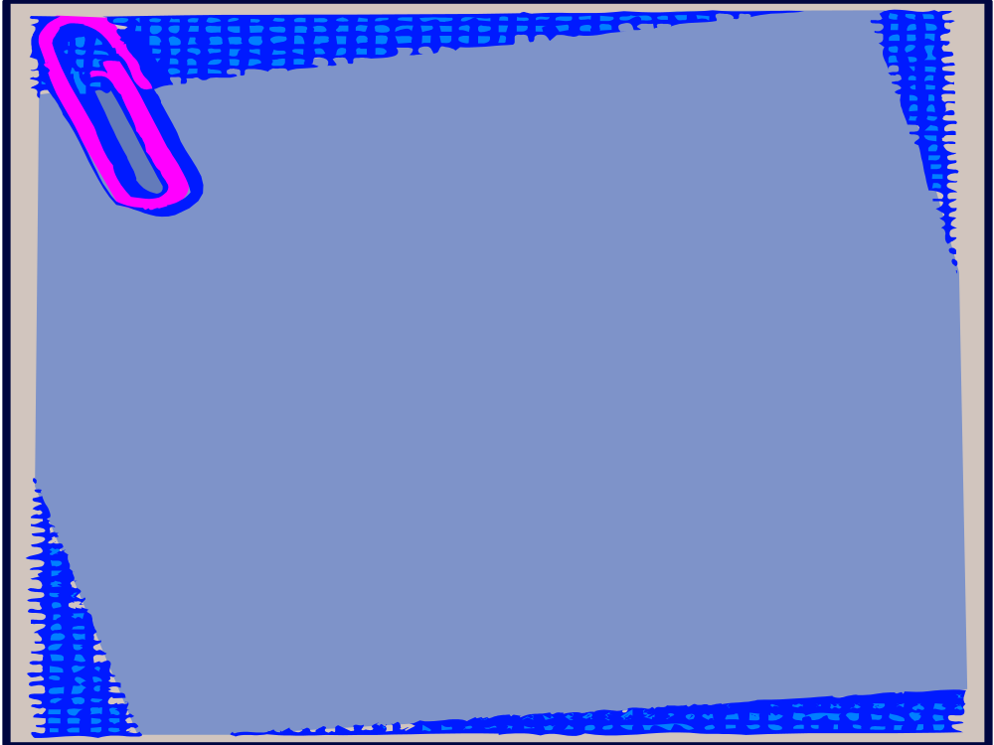
Is a Multiparty System Possible in Singapore?
Technically, Singapore is a multi-party democracy. There are more than 20 registered political parties and more than, at least, 6 active political parties at any one time. There are at least 4 parties represented in the present Parliament
Yet, by all counts, since 1963 and especially since 1968, a hegemonic party system under the PAP has operated in Singapore

Slide 20

Giovanni Sartori & a Predominant Party System
“a situation where in a more than one party system in which rotation does not occur in fact. It simply happens that the same party manages to win, over time, an absolute majority of seats, but not necessary of votes, in parliament”.
Singapore : in a multiparty system the PAP has been able to out-distant the others by way of strength and appeal, leading to its monopolistic hold on parliament, election after election.
Why did Mr Lee discuss the possibility of a split in the PAP into a liberal and non-liberal wing? Will a two-party system emerge in Singapore through a split in the PAP, especially once Mr Lee is not on the political scene?

Slide 21

Conclusion
Vitally important to understand the PAP and the party system in Singapore
Almost everything about Singapore politics flows out of the PAP dynamics. There is hardly anything in Singapore, especially its politics, that is without the party’s approval
The challenge is :
- how long will this last?
- historically, hegemonic parties have never survived forever. How long do you think the present political status quo will remain in Singapore? Why?

Slide 22
FACTBOX- Key Singapore opposition parties
Reuters Oct 25, 2001
Following is background on key Singapore opposition parties as the recession-hit city state gears up for an early general election on November 3.
The ruling People's Action Party (PAP) effectively won its 10th straight term in power on nomination day on Thursday, when the fragmented opposition contested just 29 seats in an expanded 84-seat parliament.
The 22 opposition parties held two of 83 seats in the last parliament and have won four seats, at most, in previous polls.
THE WORKERS' PARTY
Established in 1957, Singapore's oldest surviving opposition party is best known for its former chief, J.B. Jeyaretnam, who broke the PAP's 13-year parliamentary monopoly in 1981.
Jeyaretnam, a firebrand whose verbal jousts with then Prime Minister Lee Kuan Yew has become the stuff of legend, stepped down in May as head of the party after 30 years.
Jeyaretnam lost his parliamentary seat and barred from contesting elections after losing a bankruptcy appeal. He quit the party days before campaigning began for the current election.
New Workers' Party chief Low Thia Khiang has held a parliamentary seat since 1991.
The party, a long-time champion of the working class, has set its sights on the "new poor" for the upcoming elections as Singapore battles in worst recession in more than 30 years.

Slide 23
SINGAPORE DEMOCRATIC PARTY
Formed by veteran politician Chiam See Tong in 1980, the party won three of 81 seats in the 1991 elections -- the highest number held by any one opposition party.
Chiam lost his post to protege Chee Soon Juan in 1993 and quit the party in 1996 to form the Singapore People's Party.
Chee, a vocal advocate of free speech, was jailed for 12 days in 1999 for making speeches without a permit.
The party, a sharp critic of the government, aims to "eliminate all forms of authoritarianism" and "replace elitism with free competition and equal opportunity".
SINGAPORE DEMOCRATIC ALLIANCE
The four-party alliance groups Chiam's Singapore People's Party with the National Solidarity Party, Singapore Justice Party and the Malay-based Pertubohan Kebangsaan Melayu Singapura
(Singapore Malay National Organisation). Launched in July, the SDA marks the first time the opposition is trying to campaign under a common banner. The alliance hopes to steer the island state towards a two-party political system.
Chiam, who is chairman of the alliance, has held a seat in parliament since 1984.
What are the new changes worth noting?

