Slide 1





PS2249/SSA2209/GEK2003
THE MASS MEDIA IN SINGAPORE: BETWEEN DEMOCRATIC CAPITALISM AND A PRAGMATIC NATIONAL ROLE

Slide 2

Why Study the Mass Media?
Is this the new game changer?
Was the Arab Spring triggered by the new media?
Were the recent PAP’s poor electoral performance partly due to the new media being able to side-step PAP’s control of the traditional mass media?
In short, what is the political significance of the mass media in Singapore’s politics?

Slide 3


Slide 4
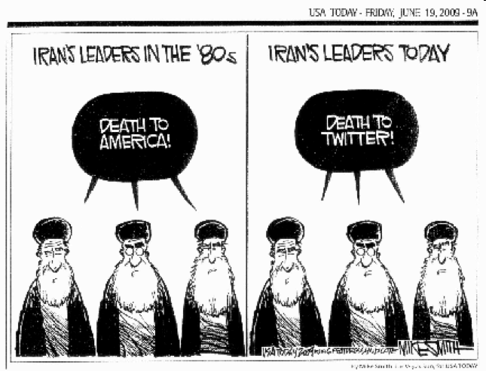

Slide 5

HISTORICAL OVERVIEW OF MASS MEDIA IN SINGAPORE: A TREND OF CAUTIOUS GOVERNMENT, CURBED MEDIA FREEDOM
East India Company 1800s:
1. Opposed criticisms of its operations; 2. Prevented vernacular press from stirring up racial strife in India and other profitable colonies

Slide 6
The Straits Times was founded in 1845 by Singapore-based foreign mercantile interests not only to report commercial intelligence,
  but also to transplant the press atmosphere created by ‘the laws and customs of England’ by affording protection to the colony from the abuse of power by the governing elite.
Vernacular Press : three Asian Languages of Malay, Chinese and Tamil, serving respectively the interests of the three main Asian communities living under colonial rule.

Slide 7
Mass Media in 1950s-60s
Nation-building problem
Challenged by wider Cold War and decolonisation politics afflicting Southeast Asia, China and India.
  Malays could be swayed by the media narratives of Malayan and Indonesian independence from neighbouring Malaya and Indonesia.
  The Chinese were vulnerable to cultural and ideological propaganda from Maoist China
  Indians were susceptible to Indian nationalism.

Slide 8
Radio served as a critical mouthpiece of the government of the day, whether they were the Japanese, the British, or the PAP, in countering propaganda against them by external radio broadcasts during the Japanese Occupation or communist radio from Peking and the Malayan jungles during the 1960s.
Little changed today in terms of national and public radio. Competition from Internet and other new media outlets?

Slide 9
The history of television in Singapore closely followed radio’s. The government in 1963 introduced it with the same aims as radio and the press: to inform, entertain and to cultivate a national identity.
    On the other hand, the government was aware of the educational and economic contributions of television from the outside to the wider goal of material development.
Heavy dependence on outside programming but filtered through decisions on purchasing.
CNN ‘effect’ – 1990-1 Gulf War stimulated broadcast demand for live round the clock news.

Slide 10
Some Statistical Anachronisms
NEWSPAPERS
  although the government-linked Singapore Press Holdings Group & Mediacorp Press Pte Ltd controlled 100% of the eight local dailies from 1996 to 2006,
  foreign daily newspapers, such as the Asian Wall Street Journal and International Herald Tribune, as well as weekly journals such as Time and Asiaweek, have been available at news stands and through both private and public subscriptions.
  There are 11 local daily & weekly newspapers as of today.
In 1999, these external print media outnumbered the local dailies by 14 to 8.
More than a million publications and 300,000 audio materials are imported into Singapore each year. (Media Development Authority 2006).

Slide 11
Radio & Internet Statistics
MediaCorp radio still enjoyed a chunk of the local radio market with 13 stations, but it was now ‘rivalled’ by other government-linked operators such as Singapore Armed Forces’ Radio, the trade union-run UnionWorks radio and the long-time BBC.
  By the late 1990s, Singapore was rated as having achieved a 45.84% personal computer-to-home ratio, which is the world’s third highest after the USA and Luxembourg. In 1998, the number of Internet users (per 100 persons) in the country ranked one of the highest in Asia and the world at 17.39, which compared favourably with Japan’s 13.26, Denmark’s 18.87, USA’s 22.19 and Sweden’s high of 39.53.

Slide 12
Media Liberalisation and Pluralism 2001-2006
All these wired outlets provided complementarity and competition to the Government-linked and privatised TV and Radio channels.
By 2001, the television scene had been privatised into two conglomerates – the MediaCorp Group, incorporating the former state-owned Television and Radio Corporations, and the press grouping, SPH Mediaworks, entering the television market for the first time with two channels, Channel I and U. Other TV channels:
  CHANNEL NEWSASIA
  Starhub Cable Vision operates a subscription television service, offering more than 35 channels of quality international programming, 24 hours a day.
2004: SPH and Mediacorp merge their TV and free newspaper operations citing reasons of unhealthy market rivalry.

Slide 13
Then-PM Lee’s Statement of Media Policy 1990
It (the Singaporean government) will not allow interference by foreigners in its domestic debate. Singapore's voters are English-educated unlike voters in other countries in Asia.
Singapore is a totally urban society with state-of-the-art telecommunications and no government can effectively censor what the people read. But the government can and will insist on no foreign interference in the domestic politics of Singapore. We do this by insisting on our right to reply.

Slide 14
Statement of Media Policy 1990 (cont’d)
…[I]t brings home to Singaporeans that regardless of the pontifications of foreign correspondents and commentators, it is the values of the elected government of Singapore that must and will prevail.
Ministers in Singapore are rational and logical people. They do understand the Western world and the changes which Western technology has brought about.
They welcome, indeed they embrace, these changes. Singapore has found its niche in the world as a centre for trade, finance, banking, transportation and telecommunications because its ministers have recognised and embraced these innovations. But the Singapore Government cannot change its stand that the political process of Singapore is reserved only for Singaporeans. (Lee, 1990)

Slide 15
The Issues
1. Does the media posture assist NATION-BUILDING by representing Singapore to Singaporeans?
The PAP government has consciously maintained a ‘national’ media policy emphasising the nation-building role of media channels…
  avoiding the incitement of racial and religious hatreds within Singapore, or in neighbouring Malaysia and Indonesia.;
  furthermore, Singaporean media could not become agents of foreign interests;
  ought to inform objectively within the limits set out above, to educate, and to build a national consensus on desirable values.

Slide 16
Free to Air TV Programme Code http://www.mda.gov.sg/wms.file/mobj/mobj.612.fta_tv_prog_code.pdf, accessed 23 Aug 2006
PART 1: NATIONAL INTEREST
1.1 Television programmes should not:
(a) promote values and attitudes which are contrary to national interest;
(b) present information or events in a manner likely to mislead or cause alarm
to the public;
(c) contain propagandist and ideological messages on behalf of any foreign
country, group or organisation;
(d) contain extremist or anarchic messages, including the incitement of
violence for political ends or other purposes; or
(e) sensationalise the treatment of any issue whether local, nationalistic or
foreign in nature.
1.2 Broadcasters must ensure that due impartiality is observed in programmes dealing with matters of public policy or controversial issues of public importance in Singapore. Due impartiality requires programme producers to deal even-handedly when opposing points of view are presented in a programme. On matters of public importance, balance should be sought through the presentation, as far as possible, of principal relevant viewpoints. Programmes should not be slanted by the exclusion of facts or by misleading emphasis. Every reasonable effort must be made to ensure that the factual content of programmes is accurate.
PART 2: RACIAL & RELIGIOUS HARMONY
2.1 Matters pertaining to race and religion are sensitive and capable of evoking strong passion and emotions. Broadcasters should exercise due caution when featuring the views, beliefs, practices, or activities of racial and religious groups.
2.2 For the purpose of this part, race includes dialect groups and ethnic groups.
Race & Religion
2.3 Television as a mass medium should be kept secular. Programmes of a
proselytic nature should not be broadcast.
2.4 Programmes which denigrate or are likely to offend the sensitivities of any racialor religious group should not be broadcast.

Slide 17
What a Nation-Building Media Policy Means in Practice…
the political, social and economic agenda for news should be primarily about material development;
  the live tensions of race, language and religion should not be played up and instead trodden softly (sensitively) upon in reporting; some censorship is a good measure;
    media postures should also harmonise with the grand national objectives of fostering pro-work and pro-unity policies – this means the media should also act as cultural filters: distinguish and displace ‘bad values’ from ‘good values’; media as watchdog for ‘the national cause’;

Slide 18
Meaning of National Media Policy…(cont’d)
where occasion calls, the media worker should carry on struggles against ideological neo-colonialism, individualism and materialism of all forms;
  journalism should aspire to being ‘pro-Government and pro-state without being partisan and propagandist’ [a very tall order indeed!]

Slide 19
2. THE QUESTION OF POLITICAL CONTROL
The entire rationale for imposing controls appears, on the surface, linked to the nation-building conception of the media,
  but more specifically it is about sovereignty protection based on past concerns.
The regulatory and licensing role of the Media Development Authority.

Slide 20
Other Negative Controls
Regulating press through ‘security deposit’ against legal judgments and annual licensing, as well as restrictions on circulation; and TIME (1986), FEER (1987) and AWSJ (1989) had their circulation restricted.
  Why? Firstly, measures short of outright bans shows the government is not afraid of criticism while inflicting punitive measures.
  Second, restricted circulation, court actions, and fines are expected to manage the press through its own sense of self-interest while justifying the action by appealing to the fear – either actual or conveniently exploited – that society can become the victim of the press’ profit-seeking.

Slide 21


Control is also exercised from the corporate dimension of local media companies.
Whereas media ownership and participation in the Board of Directors is strictly limited to Singapore citizens by law (the 1974 Newspaper and Printing Presses Act), the present government drive to enhance Singapore’s media hub status has seen an invitation to foreign partners to form collaborative ventures
OUTRIGHT CENSORSHIP: graphic portrayals of sex, ethnicity and politics still on ‘OB markers’. The 1998 Undesirable Publications (Amendment) Act makes sedition a crime, but makes no explicit mention of political grounds for banning books.

Slide 22

Self-censorship is encouraged under the discourse of ‘national interest/stability/multiracial harmony/public order/decency’. Cheong Yip Seng, the one-time editor in chief of the Straits Times acknowledged that in much of Southeast Asia, government and press enjoy a cosy relationship with the elected ministers, characterized by frequent informal gatherings where the politicians acquaint the journalists with national realities (cited in Birch 1993, 18).

Slide 23
Internet Politics of Singapore
MDA emphasises ‘light touch’ regulation so is fear and control more imagined than real?
Policing falsehoods: MITA and Young PAP spokespersons intervened actively on the unregulated chat-site soc.culture.singapore to defend the Singapore Government during the Williams College affair 1995.
SDP’s Chee Soon Juan’s comment upon the unveiling of the SBA’s Internet Regulations in 1996: that it was aimed at prolonging PAP’s domination of the Singapore political scene. NSP’s then Assistant Secretary-General Steve Chia also queries whether criticism of the PAP could be deemed as ‘objectionable content’. A year later following nomination day for the 1997 General Elections, the SDP’s Jufrie Mahmood complained that the government wanted to censor opposition candidates’ biodata so as to reduce their credibility with the public, hence the elimination of biographical pages from the respective websites (Rodan 1998).
Sintercom community shut down because of the need to accept ‘political status’.
James Gomez’s colourful comments (2002) on his ‘encounters’ with police surveillance and harassment following his publication of the book ‘Self-Censorship: Singapore’s Shame’.
Investigation of Fateha.com for possible defamation proceedings (2002).
2004-5 Clampdown on ‘blogging’ by PSC Scholars and other young Singaporeans
2005-6: Ban on podcasts; Sedition Act against racist bloggers; religious incitement; case of Mr Brown’s column. PM Lee Hsien Loong’s 20 Aug 2006 National Day Rally reminder of fine balance.
19-20 Sep 2006: IMF/World Bank ‘test’

Slide 24
CLOSING POINTS
ON MASS MEDIA – how is it integrated into Singapore’s politics and society? A history of illiberal practices?
Is a national media policy at odds with trends of commercial media liberalisation?

Slide 25

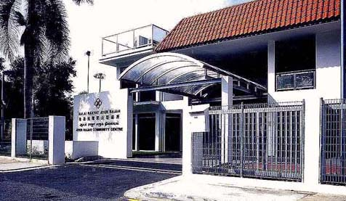
Para-political Organisations
(the Grassroots)

Slide 26
THE PARAPOLITICAL OR GRASSROOTS ORGANISATIONS
‘Parapolitical’ refers to organisations that are non-political or partisan in their objectives but whose activities invariably have specific political implications.
  According to Seah Chee Meow, parapolitical organisations tend to be supportive in character. Also known as ‘para-statal’. (1985)

Slide 27
ORIGINS of the parapolitical go back to the days of the PAP’s struggle with the covert communists within the party in 1961-65, as well as with the overt rivalry with the Barisan Sosialis.
Recall communist organisational strategies of
forming lateral cells
group leaders reaching down to the town and neighbourhood levels.

Slide 28
PM Lee Kuan Yew: “When we took office in 1959, we knew that the average person in Singapore did not want to be openly identified with any political party, whatever his personal feelings or loyalties may be”.
  “He was more fearful than apathetic”.
  “The communists were all-powerful and intimidating. Most people, especially the Chinese, believed with good reason that if they were seen opposing the communists, then if the communists won, retribution would be inevitable….”
(Lee 1985: 1)

Slide 29
“People need not be openly identified with a political party like the PAP, or a government department like the Social Welfare Department, but with a semi-independent, semi-government statutory board”.
(Lee, 1985: 1) [Cont’d]
  The PA’s [Peoples’ Association] objective was to get the discrete, almost self-contained, social and communal groups to meet across racial, language, religious, and cultural barriers.

Slide 30
How did Lee’s 1962-63 constituency tours work the grassroots in the PAP’s favour?
To get the tour organised, respected members of the local community along with dedicated officers in both the PA and civil service joined together to notify the residents of :
a. opportunities to speak directly with the PM on what they needed, or wanted changed in their estate or village.
b. They would also organise the residents into receptions etc.
Lee Kuan Yew has paid tribute to all these early grassroots leaders either collectively or individually; furthermore even today, many get listed on a National Day honours’ list;

Slide 31

These ‘local leaders’ and those following PM Lee’s entourage would take notes of the residents needs and queries and see to their implementation in the fastest time possible;
These meetings also allowed the Prime Minister to interact with the common citizen at first hand without the intervening levels of bureaucracy and officialdom. It also allowed him to explain what could not be delivered by his government, and accept criticism in a frank manner.

Slide 32

PA GOALS (www.pa.gov.sg)
1. To promote active citizenship and multiracial harmony
2. To connect the citizens for community bonding and volunteer work
3. To provide affordable access to life skills and lifestyle activities
4. To bring the people closer to one another and to the government
PA’s FUNCTIONS
consultative and feedback channel for the government of the day.
fomenter of national identification and solidarity.
foster the ‘Singapore Heartbeat’.

Slide 33
PEOPLE'S ASSOCIATION BOARD OF MANAGEMENT
Chairman
Mr Lee Hsien Loong
Deputy Chairman
Mr Lim Swee Say (wef 21.05.2011)
Minister, Prime Minister’s Office
Member
MG(NS) Chan Chun Sing
Acting Minister for CommunityDevelopment, Youth and Sports &Minister of State,Ministry of Information, Communicationsand the Arts
Ms Grace Fu Hai Yien
Senior Minister of State,Ministry of Information, Communicationsand the Arts &Ministry of the Environment and WaterResources
Mr Masagos Zulkifli
Minister of State,Ministry of Home Affairs &Ministry of Foreign Affairs
Dr Janil Puthucheary

Slide 34
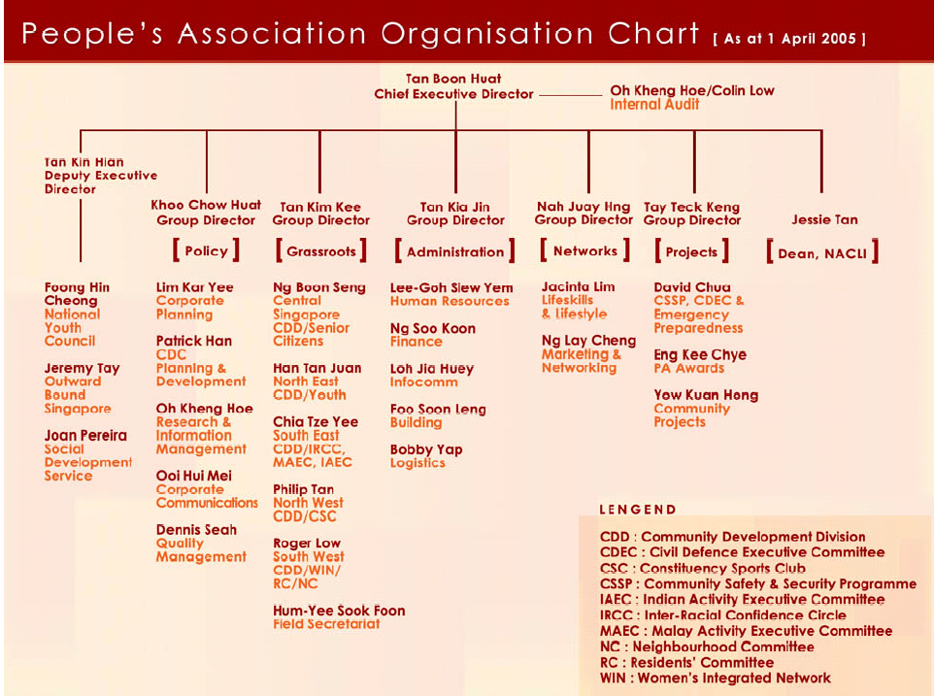

Slide 35
Community Centres (Clubs)
Recreational facilities
Meeting points
Political Socialisation
Political Contestations

Slide 36
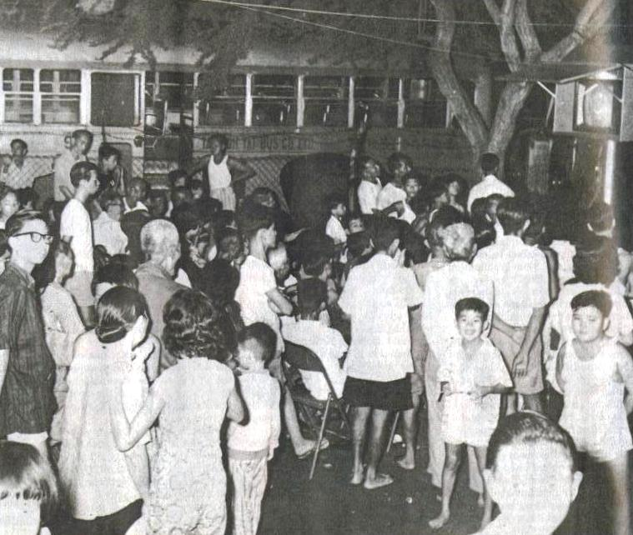
Public Watching TV in CC

Slide 37
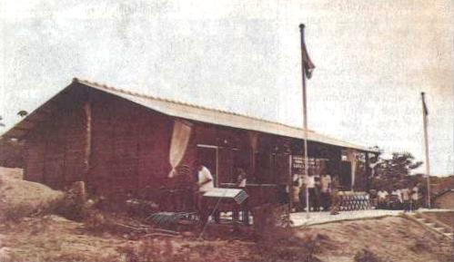
A typical CC built in rural areas - a simple wooden structure not unlike a
kampung house. Some of them were about as big as two bedrooms in an HDB flat.

Slide 38
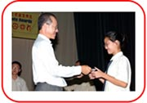
CCC (Citizens’ Consultative Committee) – there is one in each constituency.
It plans leads and coordinates community activities at constituency level.
Channels the needs and problems of the residents to the Government and keeps them informed of the government’s actions and policies. Previously it also raised funds for welfare aid to the needy, bursaries and scholarships for deserving students and other community projects, but it is being eclipsed by the CDCs.
Often the CCCs are the ones introducing ministers and would-be party candidates to the grassroots and the people.

Slide 39
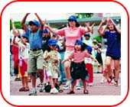

RCs (Residents Committees) – established in the public housing estates.
They promote neighbourliness, racial harmony and community cohesiveness among the residents
  through a wide range of activities such as block parties, neighbourhood watch, educational tours, dialogue sessions and health screenings.
    Through these activities it is hoped that residents interact with one another and understand better government actions and policies which affect them.
Meant to stimulate a sense of belonging and sociability to counteract the alienation of being uprooted from the traditional landed village/kampong/dilapidated estate.

Slide 40
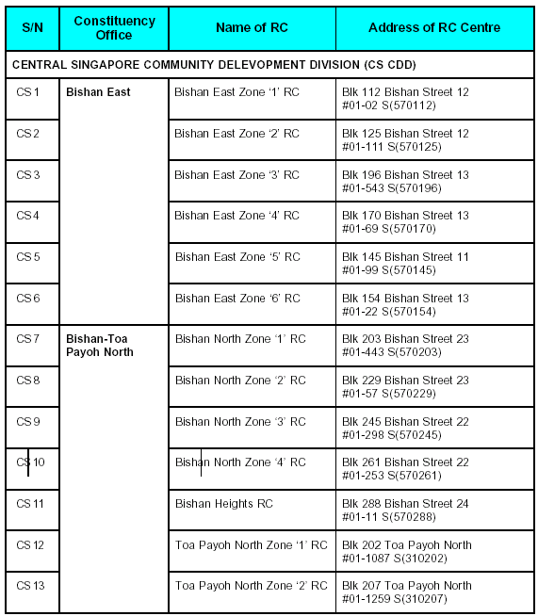







COMMUNITY CLUBS)))

Slide 41
Neighbourhood Committees (NCs) are rather recent.
They are meant to create opportunities for Singaporeans and permanent residents in private estates to serve the community and thereby foster strong community bonds in Singapore.
  Just like the RCs, the NCs will help improve the social and physical environment in their private estates.
    A difficulty with penetrating the self-enclosed nature of private estates.

Slide 42


Others such as the Senior Citizens Committees,
Youth Executive Committee,
Women’s Executive Committee,
Malay Activity Committee,
Indian Activity Committee,
Civil Defence Executive Committee and so on serve a socio-political function as their names would hint.

Slide 43
Community Development Councils
The CDC proposal reflected the ruling elite’s unease about becoming afflicted with the developed country disease of weak social cohesion and community bonding due to the pattern of state usurpation of social responsibilities for caring for the disadvantaged.
  ‘Community development’ as a partnership and ownership logic as a remedy.
  Aim is to coordinate efforts of existing grassroots along with NGOs in ‘community problem-solving and implement programmes to enhance social and family well-being’ (Vasoo 2001).

Slide 44
CDCs (Cont’d)
Emphasis on strengthening social support networks; e.g. unemployment relief and job search as seen in press coverage and ‘SPRING’ magazine of the Northeast CDC. Also to encourage voluntarism: e.g. in Northeast CDC, one swaps payments for conservancy charges for inspection of public facilities for the CDC.
Just as importantly, CDCs get people of different backgrounds to bond especially in view of the digital divide, heartlanders versus cosmopolitans.

Slide 45

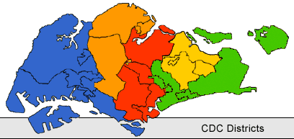


THINK
SOCIAL WELFARE!

Slide 46
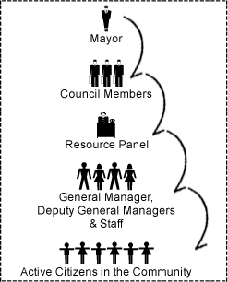
CDC
Structure

Slide 47
Issues likely to arise concerning the future of the CDCs include :
Attracting younger professionals and ‘people-centred’ community leaders.
Rousing the alienated, sated citizenry; are Singaporeans apathetic because they are too comfortable?
Racial harmony and intensification of rich poor gaps amidst uneven wealth distribution, if coincided with racial exclusions may bode ill for cohesion.
Ageing society

Slide 48
Under the CDC scheme, the space is open for NGOs to initiate social and healthcare programmes – their service is on tap for the disadvantaged but at the same time it might create new dependencies for the citizens.
CDCs and TCs might serve as positions of rivalry between PAP appointees and Opposition members. Again this potential conflict raises the issue of grassroots autonomy from the government of the day.(Quah 2001)

Slide 49
Future Challenges for Grassroots
Generational divide
Democracy?
      – just Singapore-style democracy?
Can service in committee compare in prestige with careers in a more competitive economy in the mid-twentieth century?

