Slide 1
POLITICS OF LEADERSHIP RENEWAL/NEW BLOOD/REGENE-RATION – MEANING FOR SINGAPORE POLITICS?

Slide 2
Fifth Generation Post-2011 GE
VIEW THE PAP CEC : 31 May 2011
Chairman Khaw Boon Wan
Vice-Chairman Yaacob Ibrahim
Secretary-General Lee Hsien Loong
1st Assistant Secretary-General Teo Chee Hean
2nd Assistant Secretary-General Tharman Shanmugaratnam
Treasurer Lim Swee Say
Assistant Treasurer K Shanmugam
Organising Secretaries Gan Kim Yong and Ng Eng Hen
Members
Vivian Balakrishnan
Indranee Rajah
Teo Ser Luck
MG (NS) Chan Chun Sing
Fu Hai Yien, Grace
Heng Swee Keat
Phua Lay Peng, Denise
Seah Kian Peng
BG (NS) Tan Chuan-Jin

Slide 3
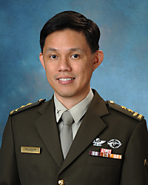

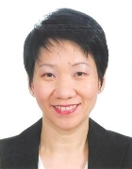
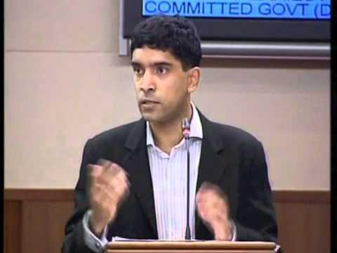
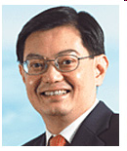
The New Leading Faces
MG (NS) Chan Chun Sing
BG (NS) Tan Chuan-Jin
Fu Hai Yien, Grace
Vikram Nair
Heng Swee Keat

Slide 4
Leadership Succession
In most Asian democracies, the question of leadership succession is perilous as it raises expectations and changes that could de-stabilise the balance of power. For example, when Taiwan was under the Kuomintang’s rule in the 1980s, speculations or publications on the prospective successors of Chiang Ching-Kuo were banned. Usually, strong leaders strive to hold on to power for as long as possible or show little interest in developing a means of providing a successor. But this is not a case in Singapore.
Over the last five decades, the PAP has engineered two party leadership successions without public infighting or power struggles. In Singapore’s short history, two Prime Ministers have stepped aside for a younger successor. While the fourth Prime Minister successor has not been identified, the precedence of Prime Ministers stepping down is expected to continue.
As Goh Chok Tong once said, he stepped down voluntary “because Mr Lee had set the example” (Goh’s speech at PAP 50th Anniversary Dinner, 2004). Singapore’s leadership succession is unique as Lee Kuan Yew had made leadership succession a priority and PMs retire voluntary – not an easy feat, considering how often coups and protests are the main mechanisms for leadership change.
A Closer Look at the Mechanism
The PAP is an odd party as it avoids vertical integration of its cadres and does not appear to overtly reward party loyalists. This is perhaps another of Lee’s legacy as he said: “We have resisted the temptation, and the pressure, to fill up the Parliament with party loyalists. We have to field the best that Singapore has” (Petir 30th Anniversary Issue 1984, 22).
Since 1984, the PAP has “talent spotted” widely and adopted the Civil Service recruitment process of tea sessions, interviews and psychological tests to select its candidates. As discussed, the PAP “talent spots” from within the state structures and integrates them horizontally into the Party. The PAP’s incumbency advantage and access to state institutions such as the Public Service Commission that administers 13 prestigious government scholarships helps to channel highly qualified scholars into its party (see Chen and Neo 2007; Barr 2006).

Slide 5
Another feature of Singapore’s leadership succession system is that retired PMs and senior Cabinet Ministers do not leave the political scene, but remain in office to lend expertise as Senior Ministers (SM) or Minister Mentor (MM). Currently, the Cabinet has one ESM and another former PM, SM and MM. The expansion of the Cabinet is an ingenious innovation as it mitigates possible power struggles that come with leadership transition.
The new cabinet positions encourage intra-party elite cohesion as it compensates the outgoing leader with a prestigious position and high salary; and allows the new leader to tap his predecessors for knowledge and expertise. While the specific job scopes are unclear, the current MM and SMs are seen to act as consultants and ambassadors by travelling overseas to improve Singapore’s international standing.
Observation and Criticism
Most observers contend that the PAP’s cohesion over last 40 years owed much to Lee Kuan Yew’s forceful personality. Yet, it is more than charisma or ideological commitments that sustain the party. Lee and his successors have institutionalised a process by which the PAP as an organization has incorporated the founder’s values and aims. As Lee Kuan Yew once said: “My colleagues and I have institutionalised honesty, integrity and meritocracy into the systems we have created. Each generation of leaders has the duty to recruit the people of integrity, ability and commitment as their successors” (cited in Rodan 2009, 192).
Critics argue that the PAP’s “meritocratic” based recruitment and candidate selection process are “ruthless winnowing process” that promotes elitism and “politics of envy” (Barr 2006; Tan 2008). Much has been written about the elite-selection process may result in the ruling class renewing itself with the people of same mindset, promoting in-breeding of ideas. But, despite complaints of elitism, Singapore voters also rarely vote for candidates who are not well educated or qualified professionally (Mauzy 2002, 64).

Slide 6
By Way of Introduction
Each time we call a general election, one key consideration is the lineup of candidates – whether we have enough candidates, what new faces to field, which serving MPs to retire. It is a long process which starts very early. In fact immediately after every general election, the party is already hunting for potential candidates to field the next time.

Slide 7
Importance of Renewal/New Faces
"If you don't have new faces and it's the same face, the same team, after one or two elections, people will get tired of you. They'll want a change to a new team. So if we want to continue to move forward, then our team has to change, even though the logo is the same. That is critical”.
PM Lee Hsien Loong. 20 June 2006, Auckland, New Zealand

Slide 8
Importance of Political Leadership in Singapore
1. Prominence devoted to leadership themes by the PAP leadership.
2. A one party dominant political system and regime and where the only way to sustain itself is through leadership (moral) maintenance, renewal, responsiveness and representation.

Slide 9
3. The fact that the leadership has been in power for a long time and even more important, had borne great successes.
4. Since the moderates in the PAP succeeded in sidelining the more extreme faction within the party, the emphasis has been on ‘good and quality leaders’ and this emphasis gained momentum once the PAP’s policies proved successful.

Slide 10
Leadership as political theme not new,
having being discussed since the late
1960s, especially early 1970s.
Goh Chok Tong : “the governing of a country is too serious a matter to be left to chance. Changes in political leadership at the very top should be planned, and carried out smoothly and quietly”.

Slide 11
Lee Kuan Yew in 2000
“It is easier to recognize a man who is already a leader than to identify a man before he becomes one. During my 40 years in office, I have met many foreign leaders in government, in the military and in business. The characteristics they had in common were self-confidence, breadth of mind, the ability to see the wood for the trees, and to communicate”.
Source: Lee Kuan Yew, ‘For Third World Leaders: Hope or Despair? SM Lee’s Speech at John F. Kennedy School of Government 17 October 2000

Slide 12
Is nature of political personalities or political system the key to self
-renewal of the PAP?
In the PAP, and hence in Singapore, ‘political renewal’ did not come as a consequence of democratisation. It was never a function of democracy. Rather, it was undertaken by selectively replacing older and inept politicians by younger ones and more capable ones, especially during elections.

Slide 13
PAP’s political renewal or the ‘politics of new faces’ has taken place in almost every general or by-election: 17 in 68, 9 in 72, 13 in 76, 18 in 80,26 in 84….25 in 2001. How many in the 2006 and 2011 GEs?
‘

Slide 14
2 types of PAP Foundational experience critical for PAP’s Leadership Outlook
First, the struggle for power or the power of struggle with the Communists and Socialists shaped the attitudes of the founding leaders about the way to approach leadership. They realised that it was the key to political power and control – get the wrong man in, and you are in trouble.
Second, once this problem was settled, how to ‘renew’ from a position of hegemony, especially since 1968.

Slide 15
In the initial round, power was held by LKY and his close associates, esp Goh Keng Swee, Toh Chin Chye, S. Rajaratnam, E.W. Barker, Devan Nair – these were comrades-in-arms who struggled alongside Lee against the British, Communists, Communalists, Malaysia and Indonesia. This group remained in power until about the 1980s.
‘

Slide 16
Due to concerted policies of self-renewal, by the 1980s, a second tier of leaders could be discerned, namely, Goh Chok Tong, Tony Tan, Ong Teng Cheong and S. Dhanabalan, Mah Bow Tan, Richard Hu, Lee Hsien Loong, Wong Kan Seng. In Sept 1984, power in the PAP CEC was transferred to the second generation with only LKY as Sec-Gen. (Choo 1985; Mauzy 1993)
‘

Slide 17
Goh Chok Tong, in turn, has developed the third-tier leadership (Hawazi Daipi, Lim Hng Kiang, Teo Chee Hean, Lim Swee Say, Vivian Balakrishnan, Khaw Boon Wan and Raymond Lim etc.) with Lee Hsien Loong as the star.
‘

Slide 18
Lee Hsien Loong’s ‘team’
Lim Hng Khiang, Teo Chee Hean, Lim Swee Say, Yaacob Ibrahim, Khaw Boon Wan, Tharman Shanmugaratnam, Ng Eng Hen and Vivian Balakrishnan : in helm of power NOW.

Slide 19
Leadership Renewal – 2 Levels
At the Helm : PM, DPM, SM, MM and Cabinet
‘Foot politicians’ : MPs
PM – LKY, GCT, LHL
MPs – continuous process

Slide 20
Criteria for Selection: Principles, Practices and Statements
Top political leaders:
Highly capable people
Leadership style includes vision, purpose, energizing and mobilising people
Provided for collective national economic success and political stability

Slide 21
Criteria for Selection (Cont’d)
Leadership and the Small Pool: A recurrent theme of the PAP has been the difficulties of renewal and the small number of the ‘best and brightest’ it can tap at any one time. This is all the more when the ‘market’ shrank from Malaysia to Singapore.

Slide 22
Political recruitment is an exercise to induce an individual to undertake specific politically-oriented role.
involves 3 stages:
Identification - by people close to power centre
Selection - screening process
Induction – how to become a cadre member:

Slide 23
An insight from Koh Buck Song, “The 1000 PAP ‘cardinals’ who appoint the ‘Pope’”, ST Weekly Edition 11 April 1998.
1. BE ACTIVE in social community or grassroots work, or at least show promise of ability and leadership in some other area of public life;
2. APPLY to join the PAP. Membership is for life, unless the member resigns or is dropped if he gets involved in undesirable activities. A subscription fee has to be paid…;
3. Get through the INTERVIEW or tea session that branches may hold to screen new members. Some have been turned away.

Slide 24
Induction for cadres (cont’d)
4. Once a member, be active in PARTY WORK, such as helping out at MPs’ weekly meet-the-people sessions or organizing ministers’ walkabouts. Better still, serve on a branch sub-committee and become an office-holder. Be dynamic and show commitment and understanding of the party’s values and goals.
5. Serve for THREE YEARS. This is the minimum seniority for all except those who are brought in as potential MPs just before a General Election. All MPs are cadres.
6. Catch the EYE of your MP, who will then nominate you to be a cadre.

Slide 25
Induction for cadres (cont’d)
7. Get through an INTERVIEW by one of three panels of four or five ministers and MPs from other wards. This is done once a year. There is no quota for candidates to be elected to cadre status.
8. Be CLEARED by a committee chaired by the Party’s Assistant Secretary-General Wong Kan Seng.
9. Be approved by the CENTRAL EXECUTIVE COMMITTEE, the party’s highest body, headed by the Secretary-General himself, the Prime Minister.

Slide 26
SOME RECURRING ISSUES SINCE THE OPPOSITION ‘SHOCKS’ OF
1981-4:
new PAP recruits have to mirror changing society: age and background – doctors, lecturers, engineers, ex-civil servants, journalists, grassroots leaders, doctors, military men, women incrementally.

Slide 27
Some recurring leadership issues…
‘problem of internal criticism’ detracting from party discipline – ex-DPM Toh Chin Chye once said in an interview: “People abroad say to me: you Singaporeans seem to be nervous, always looking over your shoulders. And it’s true. Singaporeans are so bloody scared…[W]e’re all ball bearings produced by quality control.” (Choo 1985, 192)

Slide 28
Some recurring leadership issues…
Listening but not heeding or fundamentally correcting policies in response;
What is an acceptable/ ‘loyal’ Opposition? Does it mean they have to be indirectly PAP-vetted? In this context recall, J.B. Jeyaretnam’s withering comment on the NCMP scheme: “…a ruse to keep the electorate thinking of the PAP as the only government, providing everything including opposition MPs.” (Choo 1985, 205)

Slide 29
Some recurring leadership issues…
Baton-passing between the generations within the PAP has not been without frictions. LKY seen as ‘backseat driver’ in the early years of Goh’s premiership (Mauzy 1993).

Slide 30
PROBLEMS & CHALLENGES
Despite attractions of power, status & money, it has been a difficult task:
- costly nature of politics ;
- shrinking pool; &
- political patronage.

Slide 31
Problems & challenges
Role of Foreign Born Talent. Critical since the days
of anti-colonial struggle through independence.
  “When I formed my first Cabinet in 1959, only two out of nine Ministers were born in Singapore. Seven came all the way from Jaffna [Sri Lanka], from Malaya, and from South China. Even now, in 1982, with the exception of E.W. Barker, all my senior colleagues are not Singapore-born…It was this extra concentration of talent which gave Singapore that ‘high compression’ or ‘high rev’ in its leadership. It was not chance that brought so many able and outstanding persons to Singapore.” (Lee 1982)
Link to talent inflow into the PAP, immigration into Singapore under conditions of globalization.

Slide 32
Leadership and Rewards
PM Goh once likened Singapore to one big corporation. He compared its gross national product to a company’s revenue, and its population, to its employees.
Hence a national economy competes with other national economies for market shares in the world. Therefore if Singapore fails to compete, its population or employees will not be paid well. Logically, if it is competitive, its standard of living will rise.

Slide 33
Absence of Alternative Leadership from Society
Opposition parties and the PAP ‘Standard’
Civil Society – weak and divided or stifled?
Business and Grassroots Leaders co-opted.

Slide 34
TWO PARTY SYSTEM?
Lee Hsien Loong has in the past said that the government favours democracy through grassroots consultations, intra-PAP discussions and more intensive exchanges in Parliament. He has however cautiously expressed doubts without dismissing outright the possibility of a two-party democracy:
  “We are not likely to end up with two equally plausible parties, unless something very drastic has changed….It depends on the leaders the PAP throws up, as well as on the mood of the times”.

Slide 35
Two Party System? (Cont’d)
  “Provided the PAP continues to find good people, and persuades them to join the party, and find among them leaders who command the respect and trust of Singaporeans, then we can continue to represent the overwhelming majority of Singaporeans”. BG Lee.
[Source: ‘Two-party system? Not likely, says BG Lee’, ST 16 November 1999]

Slide 36
INTERNAL PARTY SPLIT
Goh Chok Tong revealed in November 1999 that he reflected on whether a two-part split in the PAP might be productive for Singapore, but he concluded against it.
Firstly, it was a matter of insufficient talent for the formation of a second faction.
Secondly it would be detrimental to the good of Singapore as a whole.

Slide 37
“Supposing, I stayed neutral or am out of it, and the two deputy prime ministers, BG Lee Hsien Loong and Dr Tony Tan, agree to split.
Say we play this game and divide the Cabinet right down the middle. Would that be better for Singapore?...
[But, w]hen you have to do a job, you really don’t have enough people to be divided into opposing camps. You need one strong team.”
Mr Goh went on to say the better solution was to recruit more to join the PAP and encourage a diversity of views within the party.
Source: ‘Should PAP have split into two?’, ST Weekly Edition 20 November 1999.

Slide 38
Taking over from Goh : The Lee Hsien Loong Phenomenon
“From the 1970s, I brought younger men into the government and gave them responsibilities to gain experience to run the country on their own. This they have now done after I stepped down in 1990 and remained as Senior Minister.
That process is continuing as the second generation leaders in turn prepare young members to take their place in the next 10 years”.
SM Lee, July 1996

Slide 39
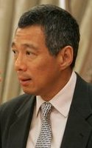
Who will takeover from LHL?
born on 10 Feb 1952
learned Jawi script since he was five, has been interested in the affairs of Singapore and often following his father to the rally grounds since 1963
been talking about “who after me”?

Slide 40
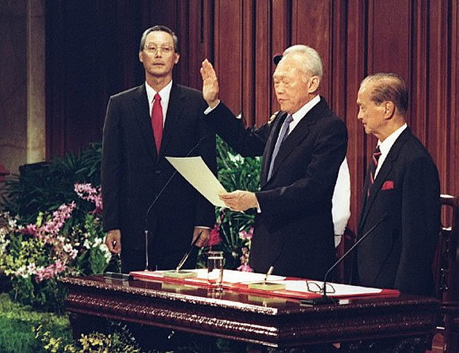
Power Transfer – Nov 1990

Slide 41
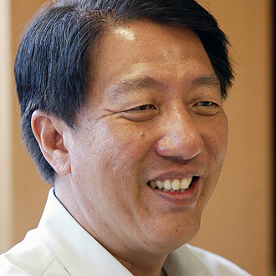
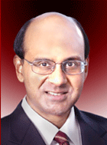
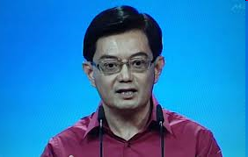
Who will LHL transfer power to?

Slide 42
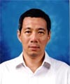
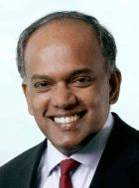
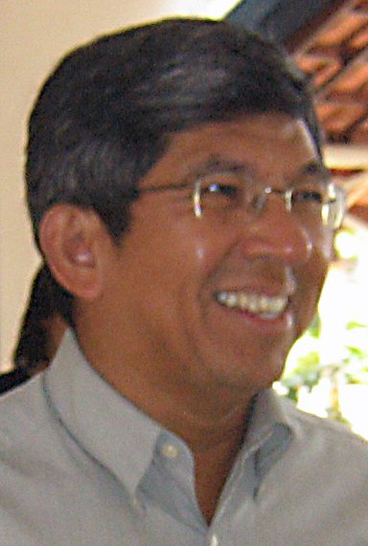
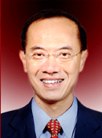
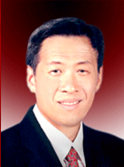

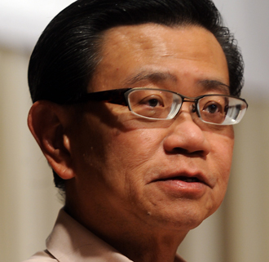
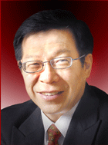
PAP’s Third Generation

Slide 43
The New Leading Faces
MG (NS) Chan Chun Sing
BG (NS) Tan Chuan-Jin
Fu Hai Yien, Grace
Vikram Nair

Slide 44


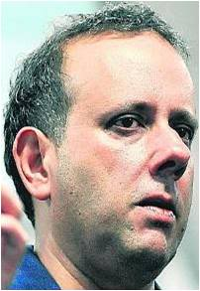
How about Leaders-in-waiting outside the PAP?

Slide 45
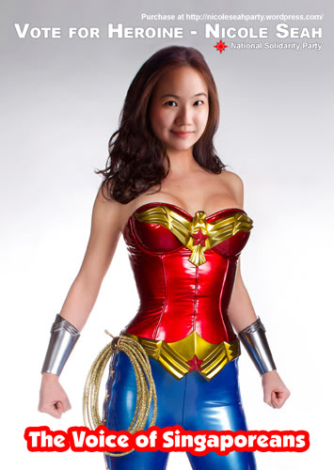

Slide 46
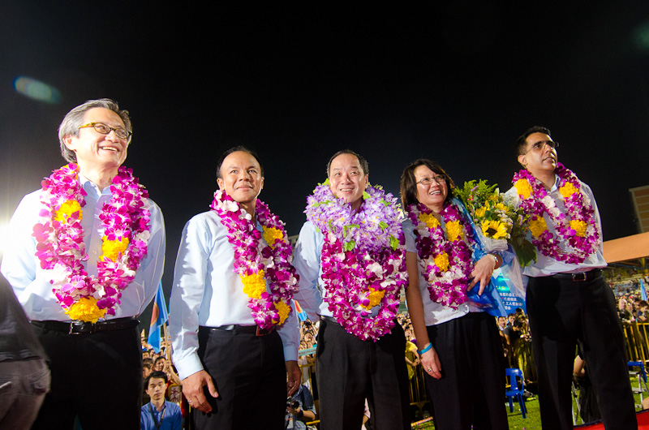
Will the WP emerge as the key threat to
PAP’s political Leadership in Singapore?

Slide 47
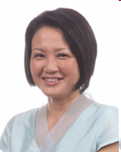
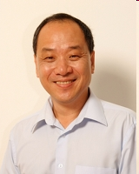
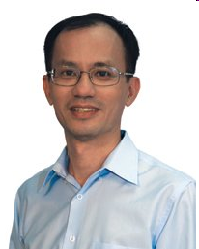
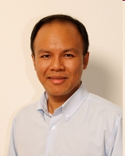
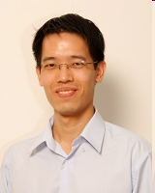
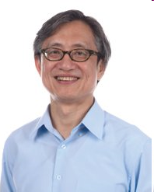
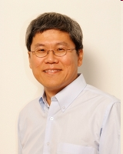
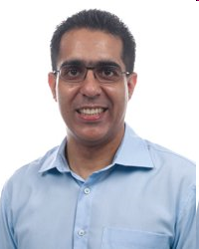
Workers’ Party

Slide 48
National Solidarity Party
President: Sebastian Teo
Vice President: J.C. Aruldoss
Secretary-General: Hazel Poa
Asst. Sec-General: Reno Fong
Treasurer: Christopher Neo
Asst. Treasurer: Noraini Bte Yunus
Organising Sec.: Gan Theng Wei
Asst. Organising Sec.: Ivan Yeo

Slide 49
Singapore Democratic Party
Dr. Chee Soon Juan, Secretary-General
Mr. John L. Tan, Assistant Secretary-General
Mr. Jufrie Mahmood, Chairman
Mr. Vincent Cheng, Vice-Chairman
Dr. Vincent Wijeysingha, Treasurer
Mr. John Law Swee Keat, Assistant Treasurer

Slide 50
Singapore’s People Party
Chairman
Loh Woon Lee, Lina
Secretary-General
Chiam See Tong
Vice Chairman
Jason Leong Oi Mun
Singapore Reform Party
Mr Andy Zhu (Chairman)
Mr Kenneth Jeyaretnam

Slide 51
Some snapshots of the PAP ‘Old Guard’
Toh Chin Chye: Political backbone and nationalistic gadfly
Lim Kim San: first Chairman of HDB – competent all-rounded administrator with a non-antagonistic political profile.
Goh Keng Swee: classical economist emphasizing prudence and economic interdependence for Singapore.
E.W. Barker: able & competent Minister for Law (till 1988), and briefly Home Affairs, Environment and Labour; helped LKY publicly explain innovations such as GRC and EP; Lee’s much-appreciated Cabinet critic.
S. Rajaratnam: quick wit, charismatic and articulate defender of the PAP’s vision and helmsman for foreign policy; very cooperative ‘right hand man’ to Lee and colleagues; supportive of Lee Hsien Loong’s entry into politics
Othman Wok: PAP’s quiet direct link to Malay community and role in assuring calm and Singaporean orientation among Singaporean Malays post-Separation; dedication was honoured publicly by LKY.

Slide 52
In Summary
Leadership has many strategies, faces.
Which is the ‘Right Combination’: Good Men v. Good System?
When and how should leadership transition take place without rocking the boat of success & stability: can things be left to chance for an island state that has reached First World economic status in 30 years? [How to respond to change (e.g. demographic shifts among electorate, globalization etc.)?
Can past leadership qualities be relevant today?
What has PMship under Lee HL meant for Singapore politics?
What does leadership change mean for PAP hegemony?
Is Singapore ready for a post-PAP era?

