Slide 1
ELECTORAL POLITICS IN SINGAPORE

Slide 2
Electoral Standing
(non-PAP)- Pre-59
ELECTION RESULTS
Year | Party | Seats | % Votes
1948 | SPP | 3 | -
1951 | SPP | 6 | -
1955 | LF | 10 | 26.7

Slide 3

Singapore’s politics was never always
dominated by the PAP
In fact, the PAP was once a member of the OPPOSITION (1955-59) even though it performed extremely well during this period
Meaning?

Slide 4
SINGAPORE GE RESULTS
Year | Seats | % Votes
1959 | 43 | 53.4
1963 | 37 | 46.4
1968 | 58 | 84.4
1972 | 65 | 69.0
1976 | 69 | 72.4
1980 | 75 | 75.5
1984 | 77 | 62.9
1988 | 80 | 61.7
1991 | 77 | 59.3
1997 | 81 | 63.5
2001 | 82 | 75.3
2006 | 82 | 66.6
2011 | 81 | 60.1
PAP’s
Electoral Standing

Slide 5
Meaning of the Statistics?
PAP’s political hegemony has been a matter of fact, esp. since 1963
What accounts for this state of affairs?
What so unique, clever and appealing about the PAP political machinery?
Is it the party or its leaders or its programmes or simply the lack of better alternatives?

Slide 6
Year | Seats
1955 | 15
1959 | 8
1963 | 14
1968 | 0
1972 | 0
1976 | 0
1980 | 0
1984 | 2
1988 | 1
1991 | 4
1997 | 2
2000 | 2
2006 | 2
2011 | 6
OPPOSITION
IN PARLIAMENT

Slide 7
Meaning of the Figures?
Why is the Opposition marginalised?
Why was there ZERO representation from 1968-1980?
Why has there been a token presence
since 1981?
What is the meaning of the token presence?

Slide 8
Meaning of the Figures?
Has it impacted Singapore politics in anyway?
Is the opposition’s presence only of symbolic value?
Is Opposition’s presence due to PAP’s tolerance?
Does the opposition have any future in
Singapore’s politics?

Slide 9
ELECTORAL POLITICS
IN SINGAPORE
1. Function of :
Political History – from SS, Japanese Occupation, Crown Colony, Malaysia to independence – where we came from?
Political System – hybrid ‘localised’ Westminster Parliamentary ‘controlled’ democracy – what is it?
What are the rules of the game?

Slide 10
ELECTORAL POLITICS
Political Culture – Multiracial with a Chinese majority with a large immigrant background – What are we?
Political Environment – small state in a regional and global sea of ‘uncertainties’ – Where are we?

Slide 11
Evaluating ELECTORAL POLITICS
Key Imperatives
Electorate’s demography & Fault lines
Politics of a Small State
Political Leadership and role of the PAP ( esp. Mr Lee Kuan Yew and its maintenance by the second generation PAP leaders)
Position (esp. weakness) of the Opposition
Political Socialisation and Control
Electorate’s Character (Spectators? Apathetic?)

Slide 12
Watershed Polls
1955 – First GE
1959 – PAP’s victory (and ever since)
1963 – entrenched PAP dominance after split
1981 – By-election that breaks PAP monopoly
1984 – challenging the PAP
1997 – PAP holds the ground
2001 – PAP’s excellence performance
NEXT KEY GE : PROBABLY IN 2016?
Post-Lee and post-Goh eras and
NEW LEADER’S ABILITY TO MAINTAIN RESULTS
AMIDST A MORE DEMANDING YOUNGER ELECTORATE.

Slide 13
Evident from:
1. Parliamentary dominance since 1959
2. Incapacitation of all opposition
3. Control of political and non-political organisations
4. Control of grassroots organisations
5. Control of mass media
6. Credit for ethnic and inter-state peace, development and prosperity
7. Control of civil service, trade unions and economy
PAP’s Dominance

Slide 14
GEs in Singapore a function of:
Need to retain PAP as the GOVERNING PARTY
Nature of NATIONAL ISSUES
Nature of LOCAL ISSUES
Electorate’s Need to SIGNAL to the Hegemonic Government on the
Do’s and Don’t's.

Slide 15
1991 GE
PAP won 77 of 81 seats with a valid vote of 59.3 per cent.
Victory due to :
Good Timing
Goh’s Popular Policies and Style
PAP’s Track Record
Credible Candidates and Political Machinery

Slide 16
1991 GE
Opposition Gains due to:
Unpopular PAP policies such as streaming
‘dirty tactics’ of limited election time
Some weak candidates
Bread-and-butter issues
Better candidates
By-election strategy

Slide 17
1997 GE
PAP won 81 of 83 seats with valid vote increasing from 59.3 to 63.5 percent
Key Issues
Linking local Govt programmes to votes
Bread and Butter issues
Need for alternative voice in parliament

Slide 18
PAP Victory due to:
Track record since 1959
Good programmes
Discerning electorate – goodies, not democracy
Goh’s appeal
Local Government Strategy
PAP’s election tactics of GRC, electoral boundaries, etc
Effective PAP machinery

Slide 19
Weak Opposition
Performance due to:
No match for the PAP
No answer to local govt concept
No good programmes
Opposition credibility questioned (Tang Liang Hong/Chee Soon Juan)
The Tang effect

Slide 20
2001 GE
CHANGES :
Massive Electoral Boundary Redrawing : affected 91% of voters
No. of Seats : 83 to 84
Voters : from 1,880,560 to 2,035,422
GRCS : 14 (1 less) (9x5, 5x6)
Cheng San disappeared
SMCs: 9 (6 plus 3 new ones)

Slide 21
Opposition cry foul – gerry-mendering?
Super GRCs disadvantages Opposition.
Setting : Crisis-Crisis Everywhere!
International
Impact of September 11 attack
Global Economic Downturn
Expectation of trouble from the region
Domestic
Worst Economic Crisis and its consequences
Unemployment and Social Cohesion
Analysis

Slide 22
2001 ELECTIONS
KEY STATISTICS
Parties | Seats | % votes
PAP | 82 | 75.3
WP | 1 | 39.3
SDA | 1 | 27.6
SDP | 0 | 20.4
DPP | 0 | 14.3
IND | 0 | 9.9

Slide 23
WHY PAP
WON BIG?
Uncertain international and regional environment
Tested and powerful PAP machinery
Good Candidates
Goh’s Appeal (last term?)
Disarray in Opposition

Slide 24
Opposition’s Rout
Could not match Herculean PAP
Unattractive leadership and parties
Divided opposition
Chee’s blunder
Lacked attractive policy alternatives

Slide 25
2006 ELECTIONS
KEY DATA
Parliament Dissolved : 20 April 2006
Nomination Day : 27 April 2006
Polling Day : 6 May 2006
PAP won : 82 out of 84 contested seats [won 37 seats through walkovers on ND in 7 GRCs]
Opposition : won 2 seats
PAP garnered : 66.6% of overall votes
Electoral Divisions : 14 GRCs & 9 SMCs

Slide 26
2006 ELECTIONS
GE DATA
Parliament dissolution: Thursday, 20 April 2006
Nomination day: Thursday, 27 April 2006
Polling day: Saturday, 6 May 2006
Eligible voters: 2,158,704
Voters in walkover constituencies: 935,820 (43.4%)
Total voters: 1,222,884 (56.6%)
Total voter turnout: 1,150,003 [OV: 335] (94.0%)

Slide 27

KEY
ISSUES
James Gomez’s Integrity
Need for PAP dominance
System of elections and alleged gerrymendering
Progress Package and Budget goodies
Leadership transition

Slide 28
Parties | Seats Contested | Total % of votes | Seats won | Walkovers | Seats in Parliament
PAP | 47 | 66.6 | 45 | 37 | 82
WP | 20 | 16.3 | 1 | 0 | 1
SDA | 20 | 13.0 | 1 | 0 | 1
SDP | 7 | 4.1 | 0 | 0 | 0
KEY 2006 GE Statistics

Slide 29
Fall in PAP’s support from last GE
PAP’s concerned with trends among
younger electorate. Directly led to the
launch of the ‘P65 Team’
Support for OP, especially WP increased.
Mainly attributed to support
from younger electorate
OP managed to get a better, younger and
more credible team
IMPACT

Slide 30
Photo finish in Aljunied GRC
PAP : 56.1 %
OP : led by attractive WP team under Sylvia Lim
: arena of the Gomez Saga PAP : led by q George Yeo
George – why close fight?
Singaporeans reacting against what they saw as the PAP’s determined effort to wrest back Hougang and Potong Pasir
Voters turned off by PAP’s calls on Gomez to account for his non-submission of his minority form.
No Tamil or Malay version of letter sent to GRC to remind voters of its future plans.

Slide 31
Food for Thought
What does the GE results indicate?
Will things be the same again for Singapore in the coming years?
What can lead to changes? Why?
What will not lead to changes? Why?

Slide 32
The 2011 GE, PE and 2012 BE
What does the results tell you?
Why was there a decline in the PAP’s
electoral support?
What explained the Opposition’s upsurge?
Will this trend continue? Why and why not?
What has and is changing in Singapore politics?

Slide 33
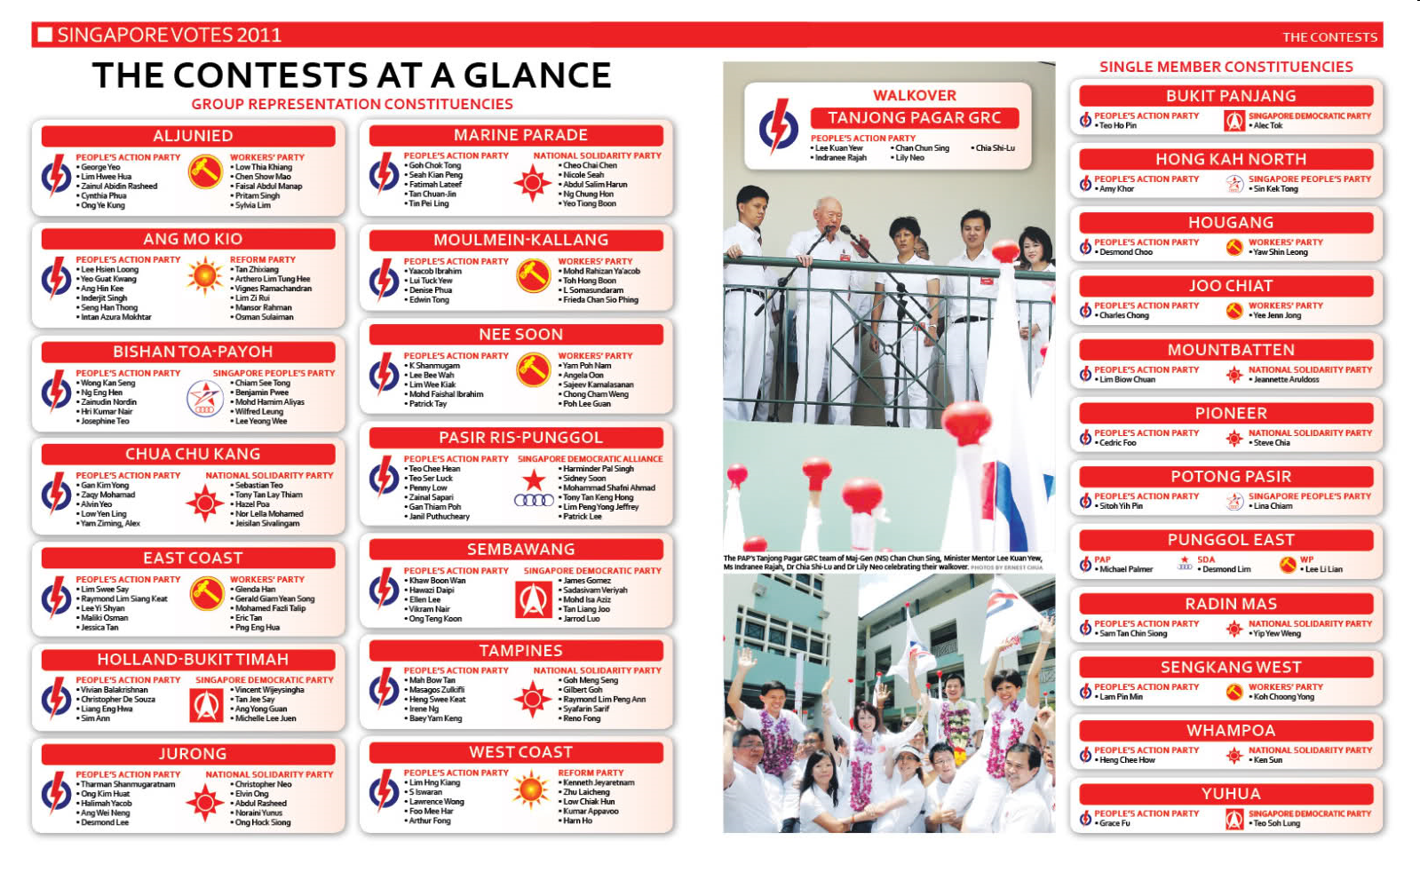

Slide 34
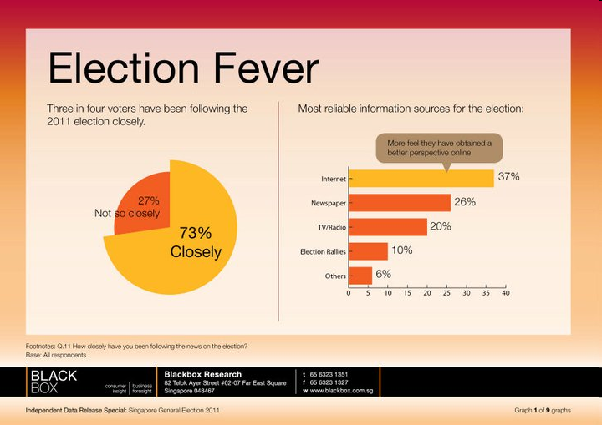

Slide 35
2011 GE Results
PAP 81 Seats 60.1%
WP 6 Seats 12.8% [+ 2 NCMP Seats]
NSP 0 Seats 12.0%
SDP 0 Seats 4.8%
RP 0 Seats 4.3%
SPP 0 Seats 3.1% [+ 1 NCMP Seat]
PAP returned to power controlling 93.10% of parliamentary seats. What does this tell you of hegemony in Singapore’s politics since it won its first GE in 1959?

Slide 36
Presidential Elections
1993 : Chua Kim Yeow vs Ong Teng Cheong
1999 : Uncontested – S R Nathan
2005 : Uncontested – S R Nathan
2011 : Tony Tan Keng Yam (35.20%), Tan Cheng Bock (34.85%), Tan Jee Say (25.04%) and Tan Kin Lian(4.91%).

Slide 37
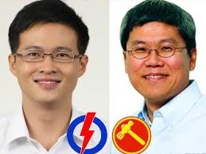
WHY BIG PARTIES LOSE SMALL ELECTIONS – explaining the Singapore Hougang
May 2012 By-election
Desmond Choo
Png Eng Huat

Slide 38
Definitions
Big Parties – hegemonic parties – tend to keep winning elections all the time
Small Parties – keep losing elections all the time
Big Elections – general elections – voting for all constituencies in a country
Small Elections – by-elections – just one or more constituencies and don’t tend to affect the overall balance of power

Slide 39
QUESTION
WHY HEGEMONIC PARTIES CAN FACE PROBLEMS [LOSE ELECTORAL SUPPORT] UNDER CERTAIN CIRCUMSTANCES, ESP IN THE CONTEXT OF SINGAPORE’S POLITICS WHERE THE RULING PEOPLE’S ACTION PARTY [PAP] HAS BEEN IN PRE-EMINENT POWER SINCE 1959?
?
?
?
?

Slide 40
Dominant/Hegemonic Parties –
How they remain and lose power?
Charismatic leaders
Historical parties – key events associated with parties and leaders
Successful Program and Policies
Sense of dependency – no one else can do the job or save the country
How they make ground infertile for opponents

Slide 41
Small Parties in
Hegemonic Setting
  Inhospitable setting – unable to affect national programmes and policies due to weak power position – electorate keep rejecting them vis-à-vis the dominant forces. Why weak
  a. Policies and Programmes can’t match the hegemon
  b. Persecution – legal and illegal

Slide 42
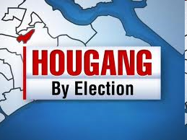
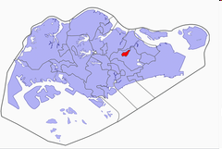
Who won and lost from 1988 to 2011
Always a contest between the
PAP and WP
Since created, except once, Hougang has remained a WP stronghold
Hence, the ‘special one’ in the context of PAP’s hegemony since 1959
Hougang- the special case

Slide 43
Year | Party | Results Votes | Results % | Results Majority
1988 | PAP WP | 11,983 8342 | 59.0 41.0 | 3641
1991 | WP PAP | 10,621 9487 | 52.8 47.2 | 1134
1997 | WP PAP | 13,458 9736 | 58.0 42.0 | 3722
2001 | WP PAP | 12,070 9882 | 55.0 45.0 | 2188
2006 | WP PAP | 13,989 8308 | 62.7 37.3 | 5681
2011 | WP PAP | 14,850 8065 | 64.8 35.2 | 6785
2012 | WP PAP | 13,447 8,210 | 62.1 37.9 | 5237
Hougang Election History

Slide 44
Why the By-election?
Yaw Shin Leong and his indiscretions
Expelled by WP [Westminster system]
Feb 15 2012 – seat vacant
PM did not call for BE immediately
Court case – eventually announced by President – Nomination and Polling Day

Slide 45
BE CAMPAIGN AND ISSUES
PAP on the Offensive
Hardships on people caused by integrity issues and malfunction within the WP
Yaw’s indiscretions
WP’s poor leadership rejuvenation
Png’s Non-Constituency MP stand
Care and Concern of the ward – people suffering and now benefiting national programmes
Low abandoned you – gone to greener pastures. Time to abandon Low and WP

Slide 46
BE CAMPAIGN AND ISSUES
WP’s Defence and Offense
Yaw’s undoing and we are sorry; cant really be sure of a person’s private weaknesses; anyway, the PAP is not innocent either
Discovered, held him accountable and expelled him – moral benchmark
Png’s NCMP’s stance – a non-issue
Ward’s care and concern – done much and anyway, it is PAP’s vindictive politics
Will always care for Hougang as it is special – bastion of national opposition – never succumb to PAP’s threats or bribes; not for sale
Voters’ faith in WP, esp Low Thia Khiang and Png a known face
PAP’s ‘dirty politics’ backfired; ‘Huat Ah Rallying cry’

Slide 47
26 May 2012 BE Results
Party 2012 % 2011 %
WP 13,447 62.1 14,833 64.8
PAP 8,210 37.9 8,053 35.2
Spoilt Votes 294 261
Total Votes 21,951 23,147
-----------------------------------------------------------
WP drops : votes (1543) % (2.7)
WP kept seat with majority of 5237

Slide 48
WHY WP WON?
WP Territory since 1991
WP policies and programmes
PAP image – hurt party –victimised the WP/Ward
Low Thia Khiang’s personality
National and Local Issues
PAP’s hard policies backfired – HIAT AH?
BE Effect – PAP already a governing party and Hougang a WP ward
WP’s trust still strong
Continuation of 2011anti-PAP GE sentiments

Slide 49
EXPECTED THE WP TO SUFFER A BIG DROP BUT NOT LOSE –
BUT NOT REALLY. WHY?
NEW MAN
YAW’S INCIDENT
PEH’S INTEGRITY ISSUE
POH’S FACTOR
PAP HARD SELL APPROACH – WHOLE OF GOVT PRESSURE
YET DID WELL – WHY
PNG CONNECTED – GOOD MAN
WP AND LTK HARD TO BEAT
PAP STRATEGY BACKFIRED – THUGGISH AND STRONG ARM APPROACH NOT LIKED BY SPOREANS – OLD NORMAL, NOT ACCEPTED AND APPROVED NOW
‘HUAT AH’ – RALLYING CRY – PROSPER ON - FIRST RAISED BY DPM TEO – CYNICAL BUT BACKFIRED
BLOWBACK – NEVER UNDERESTIMATE OR HUMILIATE YOUR OPPONENT AND NEVER TAKE VOTERS FOR GRANTED!

Slide 50
MEANING
How long PAP’s Hegemony will last?
PAP in a trying era:
Much for PAP to do – the ground remains sour – otherwise can expect not regime change but serious shift in national power away from the PAP.
Post LKY era – no longer attached to the party
PAP blamed for all ills – all problems, hardships and issues on PAP’s lap
No attachment and respect for new leaders – too technocratic, not mobilizers and too detached.
Knock-on effect of regional and international developments - democratization, stronger society and greater checks and balance for political accountability

Slide 51
STUDY
WP’s ALJUNIED VICTORY – ARE GRCs INVULNERABLE AS CLAIMED BY OPPOSITION?
WHY DID THE PAP LOSE IN THE HOUGANG BE? ANSON-SYNDROME OR SOMETHING MORE SUBSTANTIAL NOW?
Later, lost again in Punggol-East BE!

