Slide 1
CS2010 Lab 01
2012/08/30
Yuan Yuan

Slide 2
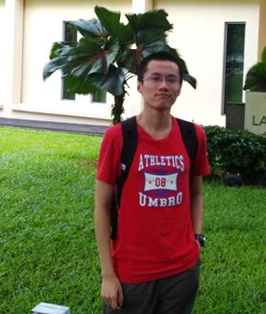
About Myself
Yuan Yuan (袁远)
Quantitative Finance
3rd-year FoS
Member of NUS ACM Team
Contact:
8539 8470
a0077839@nus.edu.sg

Slide 3
Lab Policies
Be on time.
No Multithreading.
Discussion and Participation is encouraged.
Unless proved, No extension in the homework deadline.
You will be given a participation CA according to your performance in labs.

Slide 4
About CS2010
Data Structural and Algorithm II
Java is used
More Object Oriented Programming

Slide 5
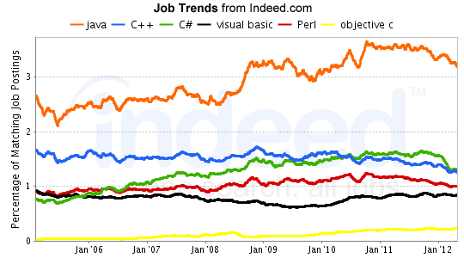
Other Languages？

Slide 6
Java Techniques
UVA579
find the angle between the minute hand and the hour hand on a regular analog clock.
12:00 0.000
9:00 90.000
8:10 175.000
0:00

Slide 7
Java Techniques
import java.util.*;
import java.io.*;
import java.math.*;
class Main{
public static void main(String args[]){
Scanner sc = new Scanner(System.in);
sc.useDelimiter(":|\\s+");
int h,m;
double hAngle,mAngle,angle;
while (true){
h = sc.nextInt();
m = sc.nextInt();
if (h+m==0) break;
hAngle = 0.5 * (h * 60 + m);
mAngle = 6 * m;
angle = Math.abs(hAngle - mAngle);
angle = Math.min(angle, 360 - angle);
System.out.printf("%.3f\n",angle);
}
}
}

Slide 8
Why data struct & algr?
Limitations in the computer
Complexity analysis

Slide 9
PS1 – Baby Name
Grading Scheme:
mixture of blackbox and whitebox testing.
code quality is concerned (comments, readability)
R-Option.
Highly Recommended.

Slide 10

Self Intro

