Slide 1
Tubular Bells
Opera, Rock, and Anime

Slide 2
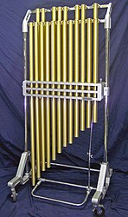
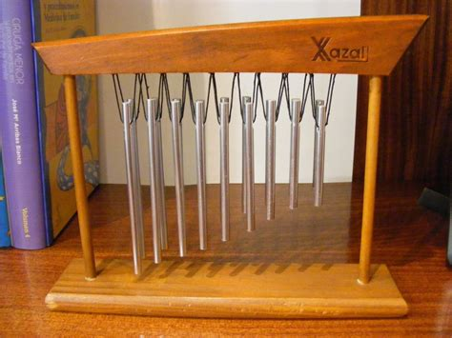
Origins
One of the few good things to come from France
(the statue of liberty is also pretty cool)
Ability to mimic church bells without the size
(who invents instruments anyway?)

Slide 3
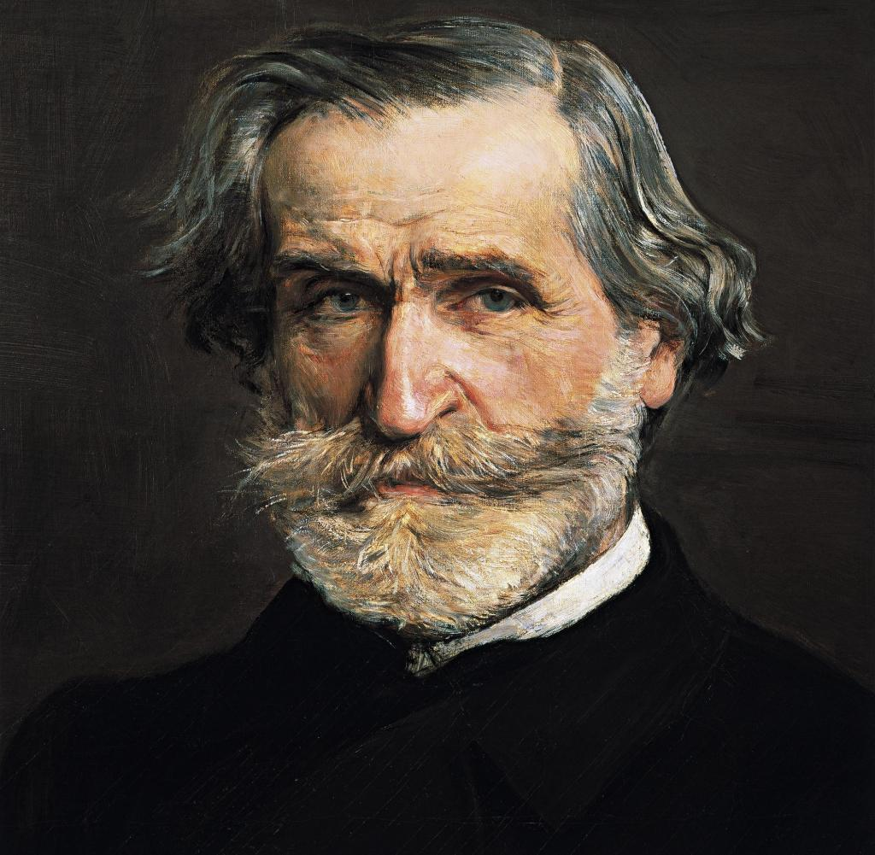
Opera
Der Ring des Nibelungen
(not used in this one but it’s fun to say)
IL trovatore (Guseppe Verdi) 1853
The Planets (Gustav Holst) (not an opera)
Symphony No. 3 (Aaron Copland) (also not an opera) (I need to go to copland)
(Very nice mustache)

Slide 4

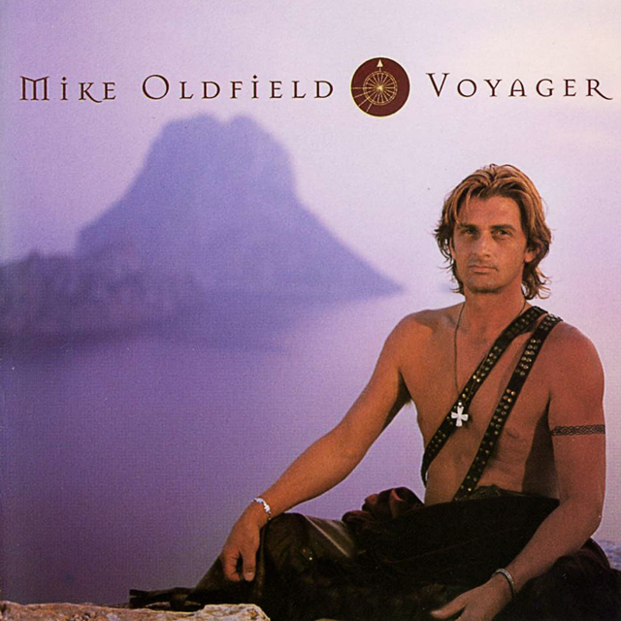
Rock and tubular bells…
Tubular Bells (1973)
Tubular Bells II (1992) (Alan Rickman is on this one)
Tubular Bells III (1998)
Tubular Bells 4? (2023)

Slide 5



Anime
Mike. O. from JoJo’s bizzare adventure
His stand ability is called tubular bells and is to blow into metal objects to inflate them
Which he then uses to make balloon animals

