Slide 1

Course MGT - 415, 11.05.2020
Aubry Yannick, Fontannaz Benoît
Muret Gabriel Pierre Etienne
Tedeschi Julien Brian, Terrier Cédric

Slide 2
Name

Slide 3
Name

Slide 4
Name

Slide 5
Name

Slide 6
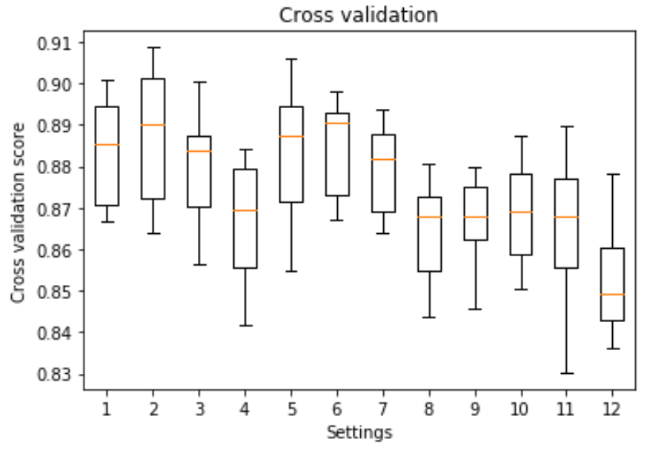
Random Forest
Pros and Cons:
Lower impact from outliers
Lower risk of overfitting
Longer computational time
Hyperparameter Tuning:
Number of decision trees
Maximum depth of each tree
Maximum number of features to consider 60 from PCA
Name

Slide 7
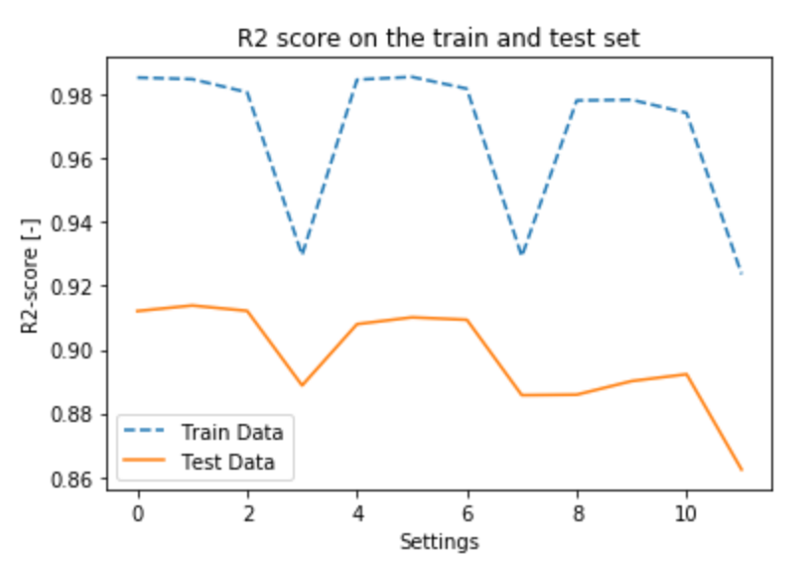
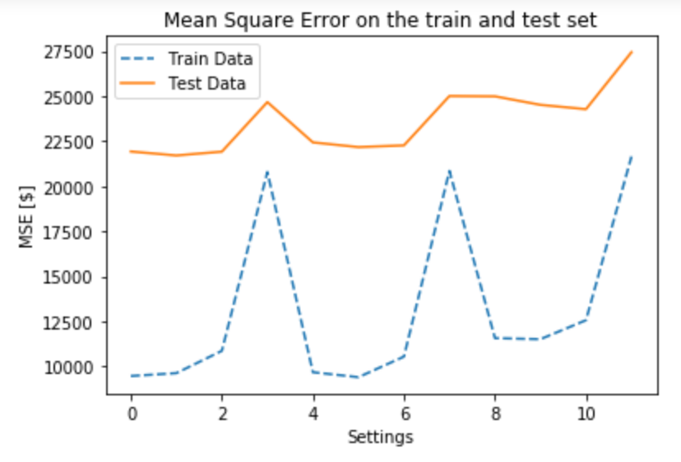
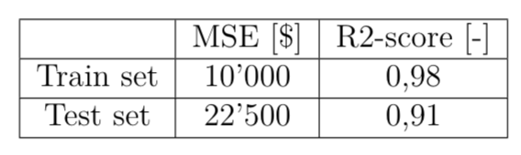
Random Forest
Name

Slide 8
Name

Slide 9
Name

Slide 10
Name

Slide 11
Name

Slide 12
Name

Slide 13
Name

Slide 14
Name

Slide 15
Name

Slide 16
Name

Slide 17
Name

Slide 18
Template
Name

