Slide 1
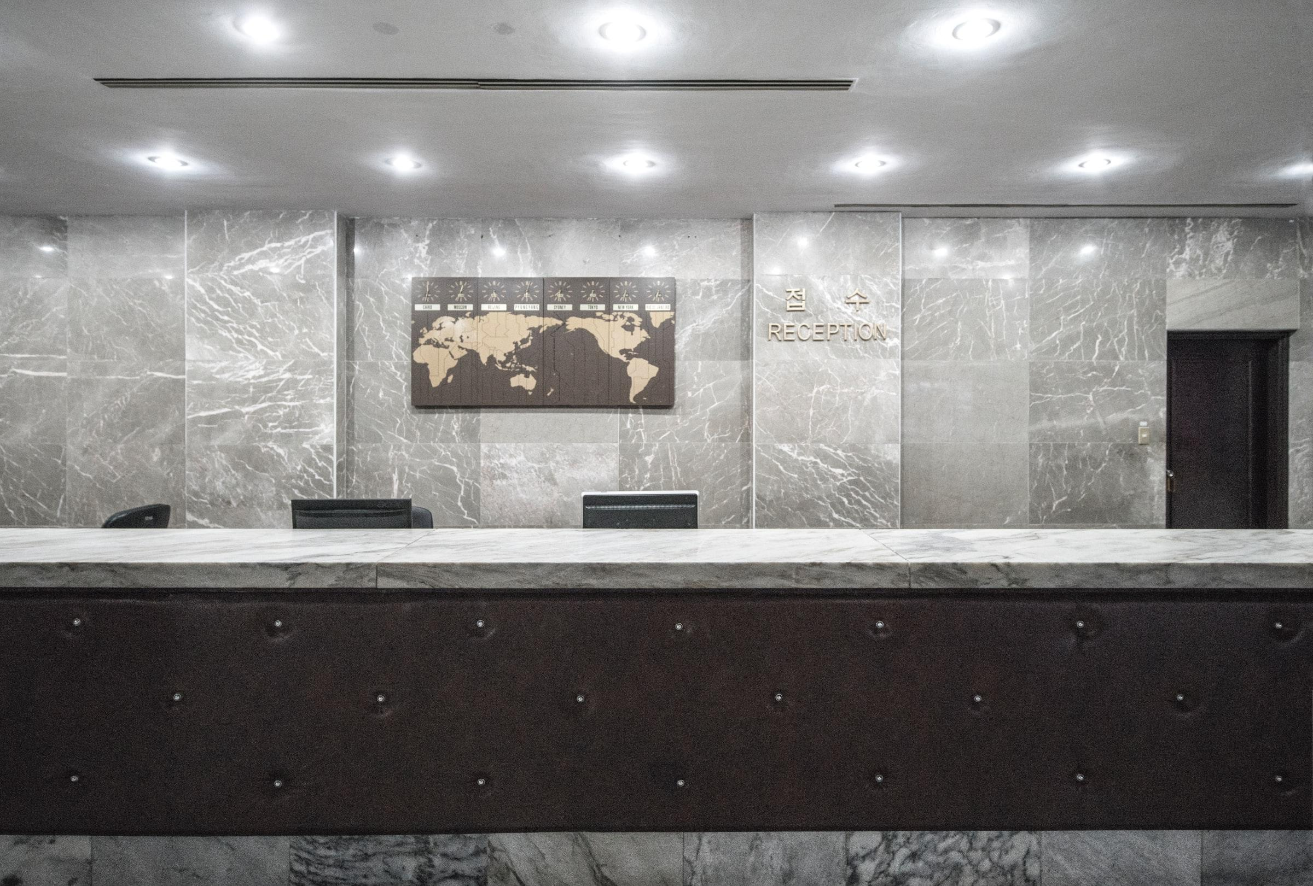
Hotel Cancel Culture
Predicting Reservation Cancellations
Notes:
Speaking with on-site hotel leadership focusing on daily operations – GM/Front Desk/Housekeeping.

Slide 2
Overview
“Heads in Beds” Philosophy
Guiding Questions
Reservation Results
Final Recommendations
Next Steps
Notes:
Reviewing “heads in beds” philosophy
Prior q’s from prior experience
Reviewing results
Giving advice
Future work

Slide 3
“Putting Heads in Beds”
Maximize revenue
Oversell rooms with expectation of cancellations
Minimize cost
Weekly scheduling and ordering supplies
Relocating guests when sold-out
Notes:
Balance revenue and costs
Sell as many rooms as possible at best prices
Minimize operations costs and risks of covering relocation costs

Slide 4
Goal:
To identify the top and bottom 3 attributes when predicting whether a reservation will cancel.
Notes:
Most/least likely to cancel

Slide 5
Guiding Questions:
Check-Out or Cancel?
What is the likelihood of a given reservation canceling?
Pros and Cons
Practical use for same-day decision-making
Useful for forecasting future demand
Guest Generalizations
Can we generalize certain attributes are more/less likely to cancel?
Pros and Cons
Simple/easily understood
Less accurate vs. full analysis
May lead to biases about guests
Notes:
Basic q; useful for short- and long-term planning
Generalizations – useful for quick decisions during busy times

Slide 6
Data Details
Hotel reservation data from two anonymous European hotels
Reservations from 2015 to 2017
Details including stay dates, rates, preferences, and more
Notes:
Anonymized - Limited reservation data available due to privacy laws

Slide 7
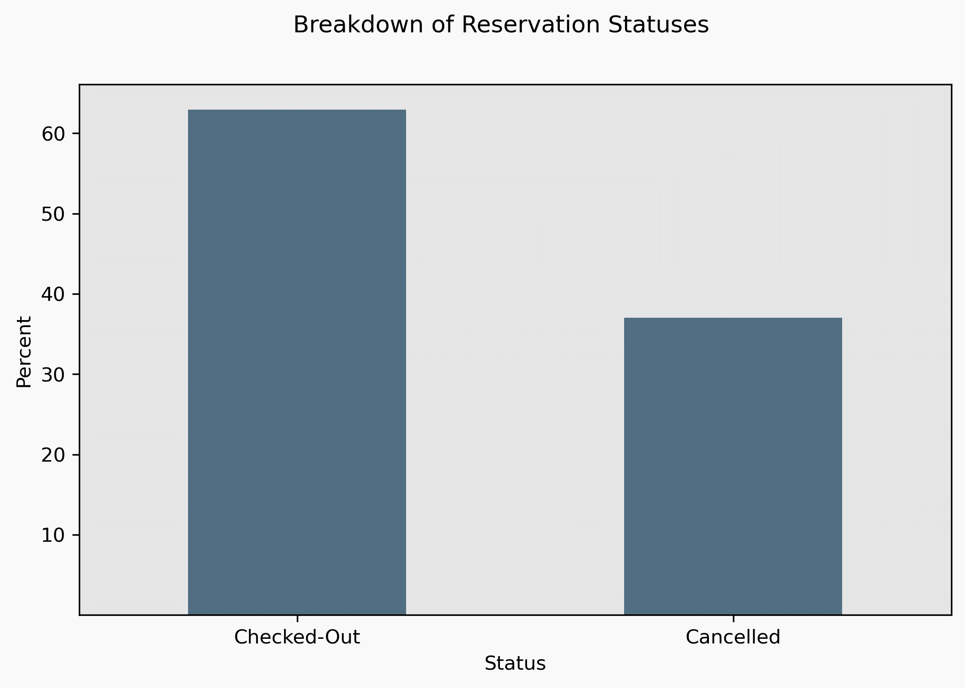
Checkouts vs. Cancellations

Slide 8
Getting to Know Your Guests

Slide 9
Cancellations are Most Likely When...
Booked for December
Booked for November
Book Room Type “P”
Increased leisure travel during holidays
Inclement weather, changing plans lead to cancellations
Assumes hotel in Northern Hemisphere (winter season)
Winter weather less likely
Business travel still active
Assumes hotel in Northern Hemisphere (winter season)
Hotel-Specific
May indicate higher-quality room types are more likely to cancel
Anonymous data limits interpretability
Notes:
Details specific for each hotel – different locations, room types, etc.

Slide 10
Cancellations are Least Likely When...
Known # of Cars
Booked for January
Booked for February
Assumes guests disclose information prior to arrival
Guests more likely to be committed to their stay – planning ahead
Business travel resumes post-holidays
Fewer leisure travelers
Assumes hotel in Northern Hemisphere (winter season)
Valentine’s Day increases leisure travelers
Business travel still strong
Notes:
# cars may not be known

Slide 11
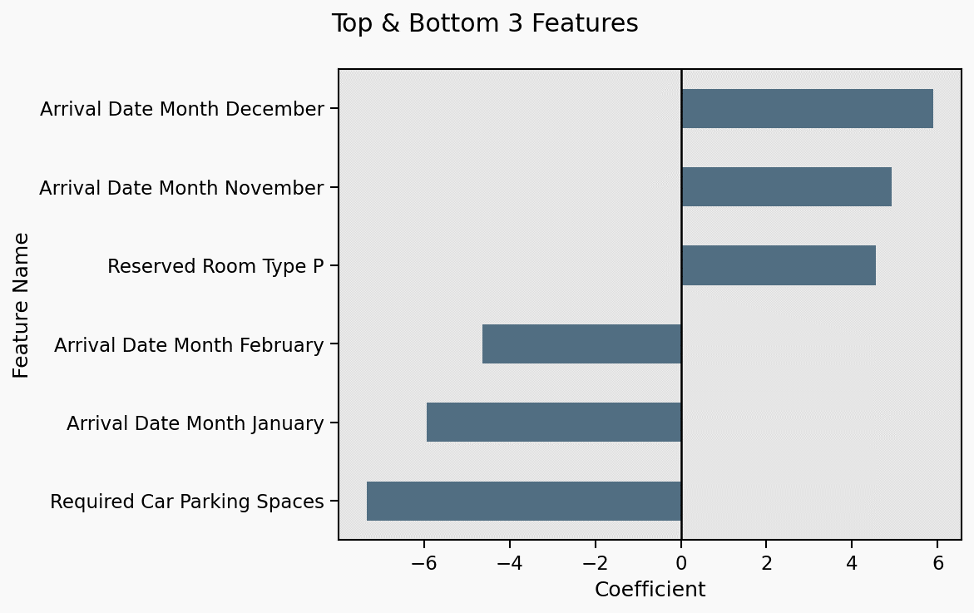
Visualizing Results
Notes:
Laser pointer helpful!!

Slide 12
Recommendations:
Lower-income areas more volatile
Higher-income more stable
Oversell During Winter Holidays
Highest odds from October-December
Limit Oversells
Post-New Year’s
Lowest odds from January-March
Increase Limit for Certain Room Types
Certain room types more likely to cancel – depends on property

Slide 13
What’s Next?
Consider additional factors
Holidays, recurring local events
Sales/promotions
Group sales/events
Forecast cancellations
Predict, forecast bookings by room type

Slide 14

Thank You!
Benjamin McCarty
Email: bmccarty505@gmail.com
Github: github.com/BenJMcCarty
LinkedIn: linkedin.com/in/bmccarty505

