Slide 1
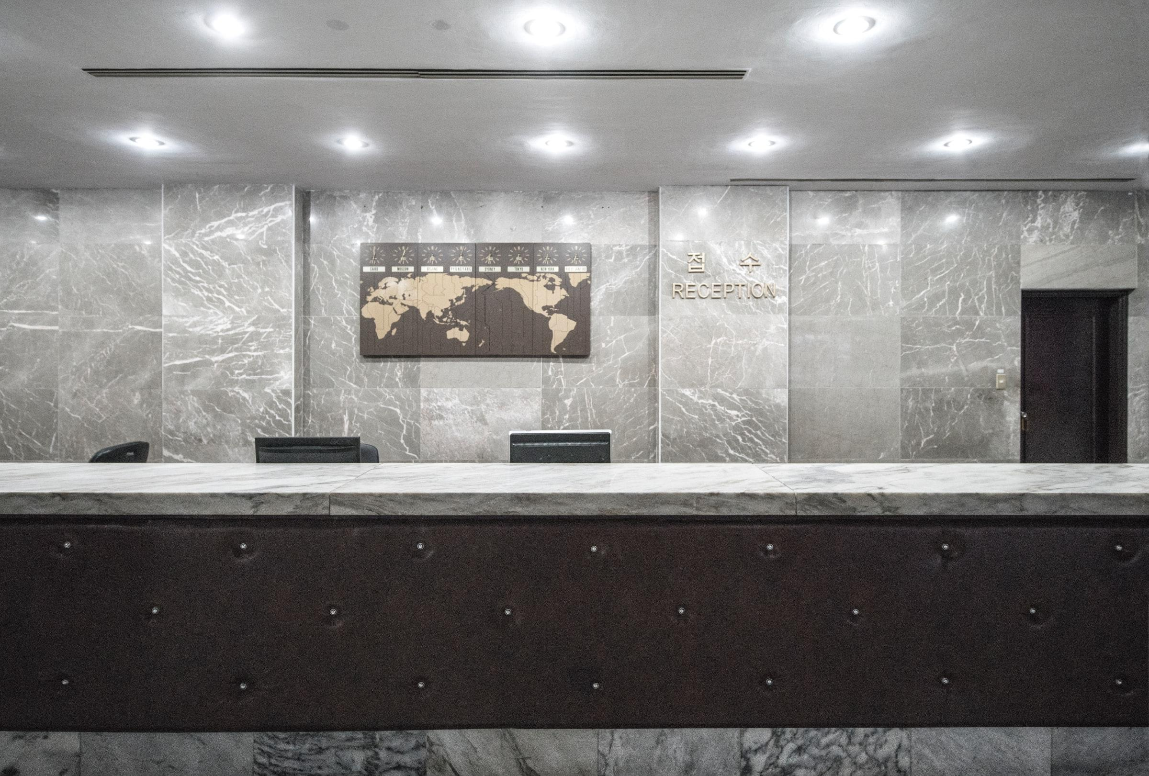
Hotel Cancel Culture
Predicting Reservation Cancellations
Notes:
Speaking with on-site hotel leadership focusing on daily operations – GM/Front Desk/Housekeeping.

Slide 2
Overview
“Heads in Beds” Philosophy
Guiding Questions
Reservation Results
Final Recommendations
Next Steps
Notes:
Reviewing “heads in beds” philosophy
Prior q’s from prior experience
Reviewing results
Giving advice
Future work

Slide 3
“Heads in Beds” Philosophy
Maximize revenue
Oversell rooms with expectation of cancellations
Minimize cost
Weekly scheduling and ordering supplies
Relocating guests when sold-out
Notes:
Balance revenue and costs
Sell as many rooms as possible at best prices
Minimize operations costs and risks of covering relocation costs

Slide 4
Goal:
To identify the top and bottom 3 attributes when predicting whether a reservation will cancel.
Notes:
Most/least likely to cancel

Slide 5
Guiding Questions:
Check-Out or Cancel?
What is the likelihood of a given reservation canceling?
Pros and Cons
Practical use for same-day decision-making
Useful for forecasting future demand
Guest Generalizations
Can we generalize certain attributes are more/less likely to cancel?
Pros and Cons
Simple/easily understood
Less accurate vs. full analysis
May lead to biases about guests
Notes:
Basic q; useful for short- and long-term planning
Generalizations – useful for quick decisions during busy times

Slide 6
Data Details
Hotel reservation data from two anonymous European hotels
Nearly 120,000 reservations from 2015 to 2017
Details including stay dates, rates, preferences, and more
Notes:
Anonymized - Limited reservation data available due to privacy laws

Slide 7
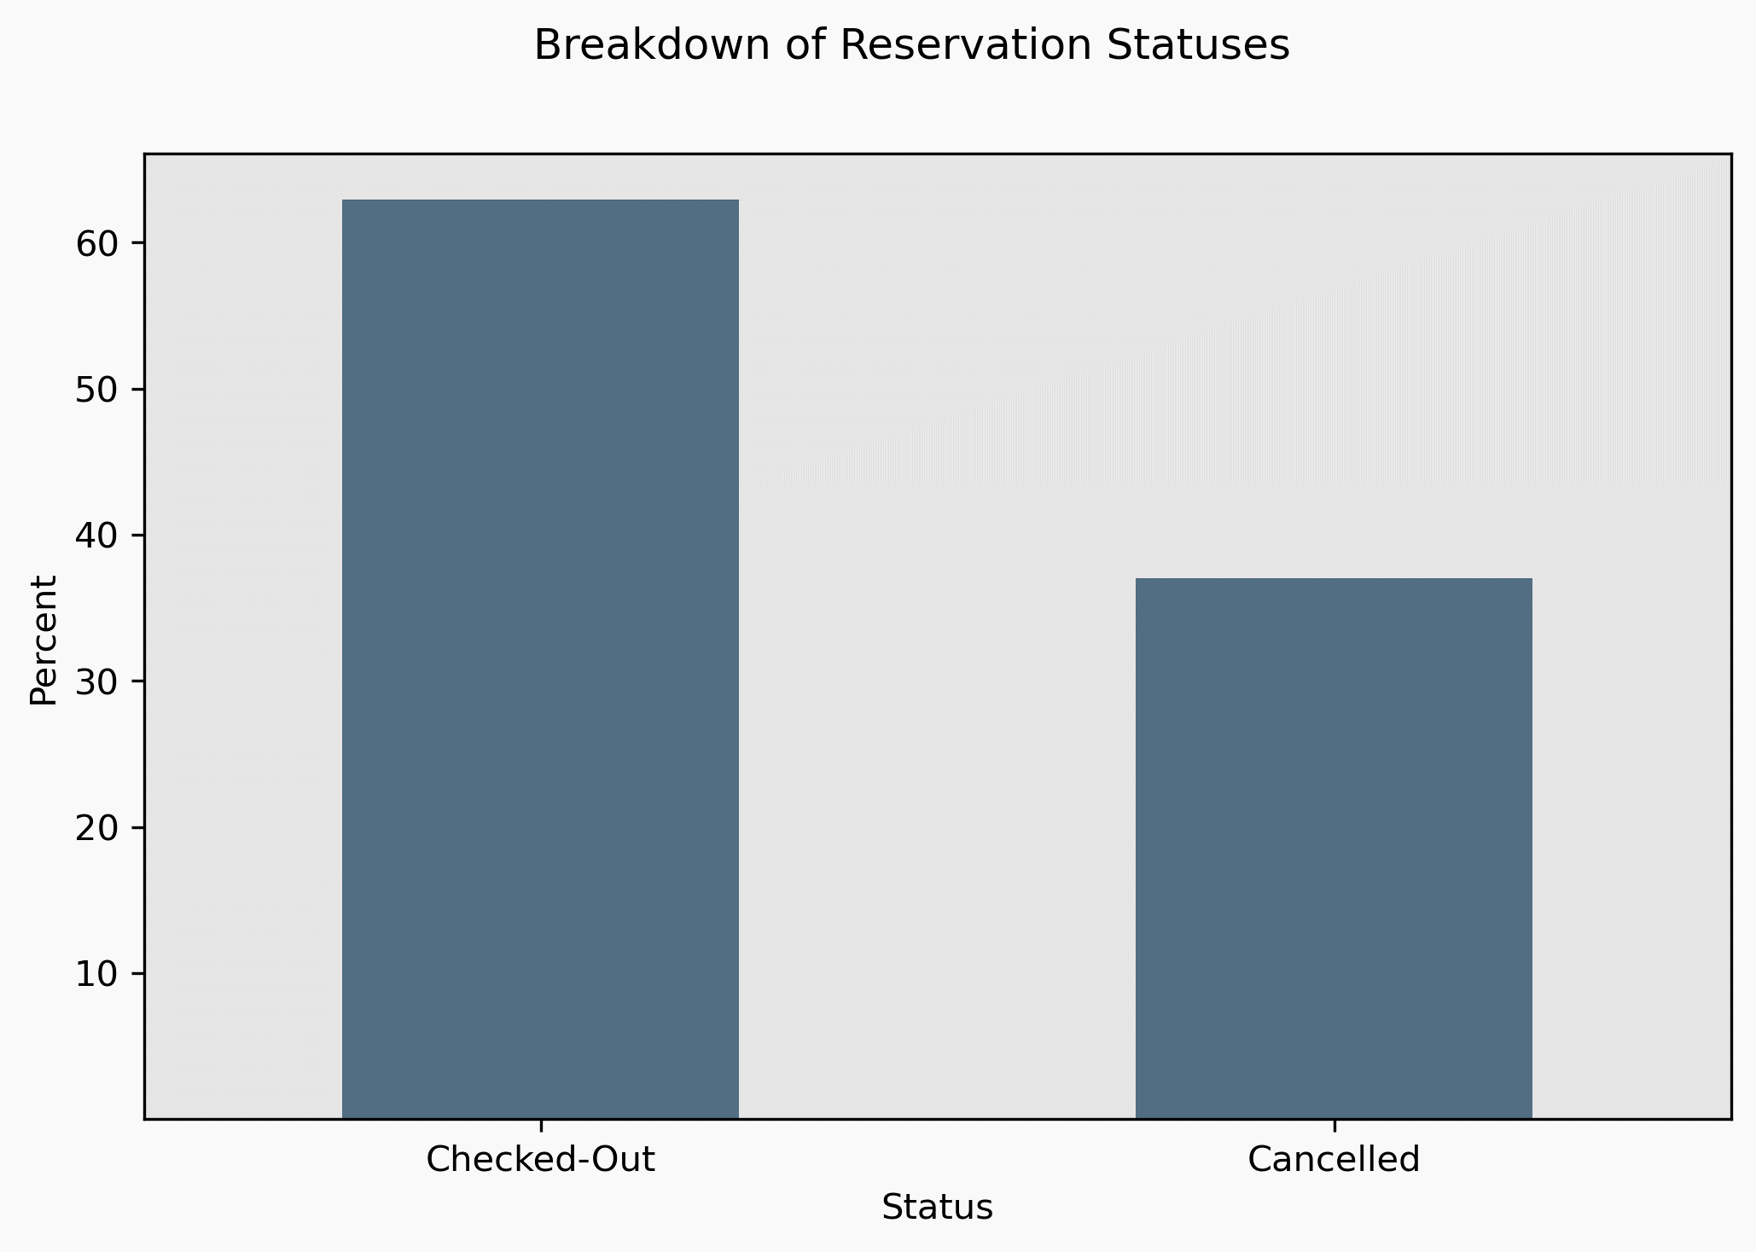
Checkouts vs. Cancellations

Slide 8
Getting to Know Your Guests

Slide 9
Models and their Results
Baseline
Logistic Regression
Random Forest Classifier
50% accuracy
Not better or worse than random chance.
80% accuracy
Negatively impacted by imbalanced reservation statuses.
88% accurate
Negatively impacted by imbalanced reservation statuses.
Notes:
Details specific for each hotel – different locations, room types, etc.

Slide 10
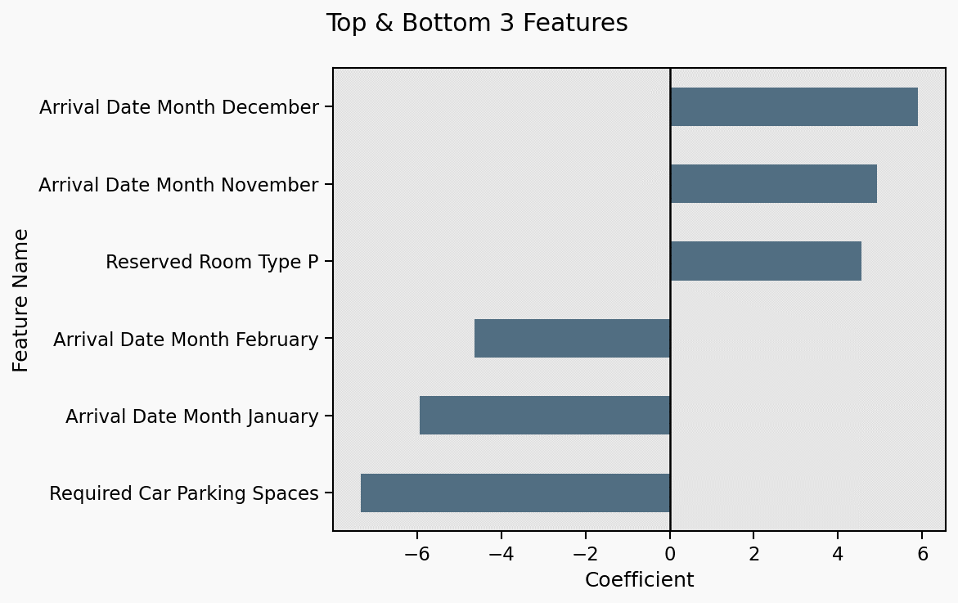
Visualizing Results of the Logistic Regression
Notes:
Laser pointer helpful!!

Slide 11
Most Significant Aspects:
Winter Holidays
Post-New-Year’s
Hotel-Specifics
Increased odds of cancellations
Increased leisure travel during winter holidays
Lower business travel as people take time off
Decreased odds of cancellations
Business travel resumes
Leisure travel slows post-holidays
Room types (standard, premium, suite) may increase odds of cancellation
Anonymous data limits interpretability
Notes:
Details specific for each hotel – different locations, room types, etc.

Slide 12
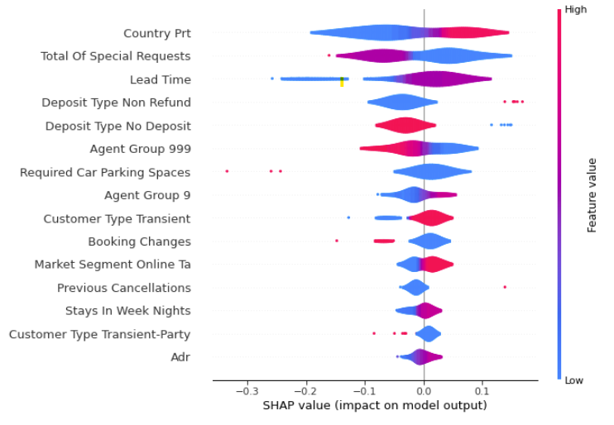
Branching Out with the Random Forest Classifier
HOW TO INTERPRET THE VISUALIZATION
Notes:
Res from Portugal: more likely to cancel vs. not
Total of Special requests: fewer requests more likely to cancel

Slide 13
Strongest Characteristics – Random Forest Classifier
Country of Origin
Number of Requests
Lead Time
Reservations from Portugal
Most reservations from Portugal – limits impact of other countries
Fewer requests
Greater number of requests may indicate guest is committed to staying
Book far in advance of arrival - more time for plans to change
Shorter time – more committed to stay
Notes:
Details specific for each hotel – different locations, room types, etc.

Slide 14
Recommendations Based on Random Forest Classifier:
Lower-income areas more volatile
Higher-income more stable
Oversell During Winter Holidays
Highest odds from October-December
Limit Oversells
Post-New Year’s
Lowest odds from January-March
Increase Limit for Certain Room Types
Certain room types more likely to cancel – depends on property

Slide 15
Guiding Questions:
Check-Out or Cancel?
What is the likelihood of a given reservation canceling?
Pros and Cons
Practical use for same-day decision-making
Useful for forecasting future demand
Guest Generalizations
Can we generalize certain attributes are more/less likely to cancel?
Pros and Cons
Simple/easily understood
Less accurate vs. full analysis
May lead to biases about guests
Notes:
Basic q; useful for short- and long-term planning
Generalizations – useful for quick decisions during busy times

Slide 16
What’s Next?
Consider additional factors
Holidays, recurring local events
Sales/promotions
Group sales/events
Predict, forecast bookings and cancellations by room type
Reduce reservation details – more generalizable to other hotels

Slide 17

Thank You!
Benjamin McCarty
Email: bmccarty505@gmail.com
Github: github.com/BenJMcCarty
LinkedIn: linkedin.com/in/bmccarty505

