Slide 1
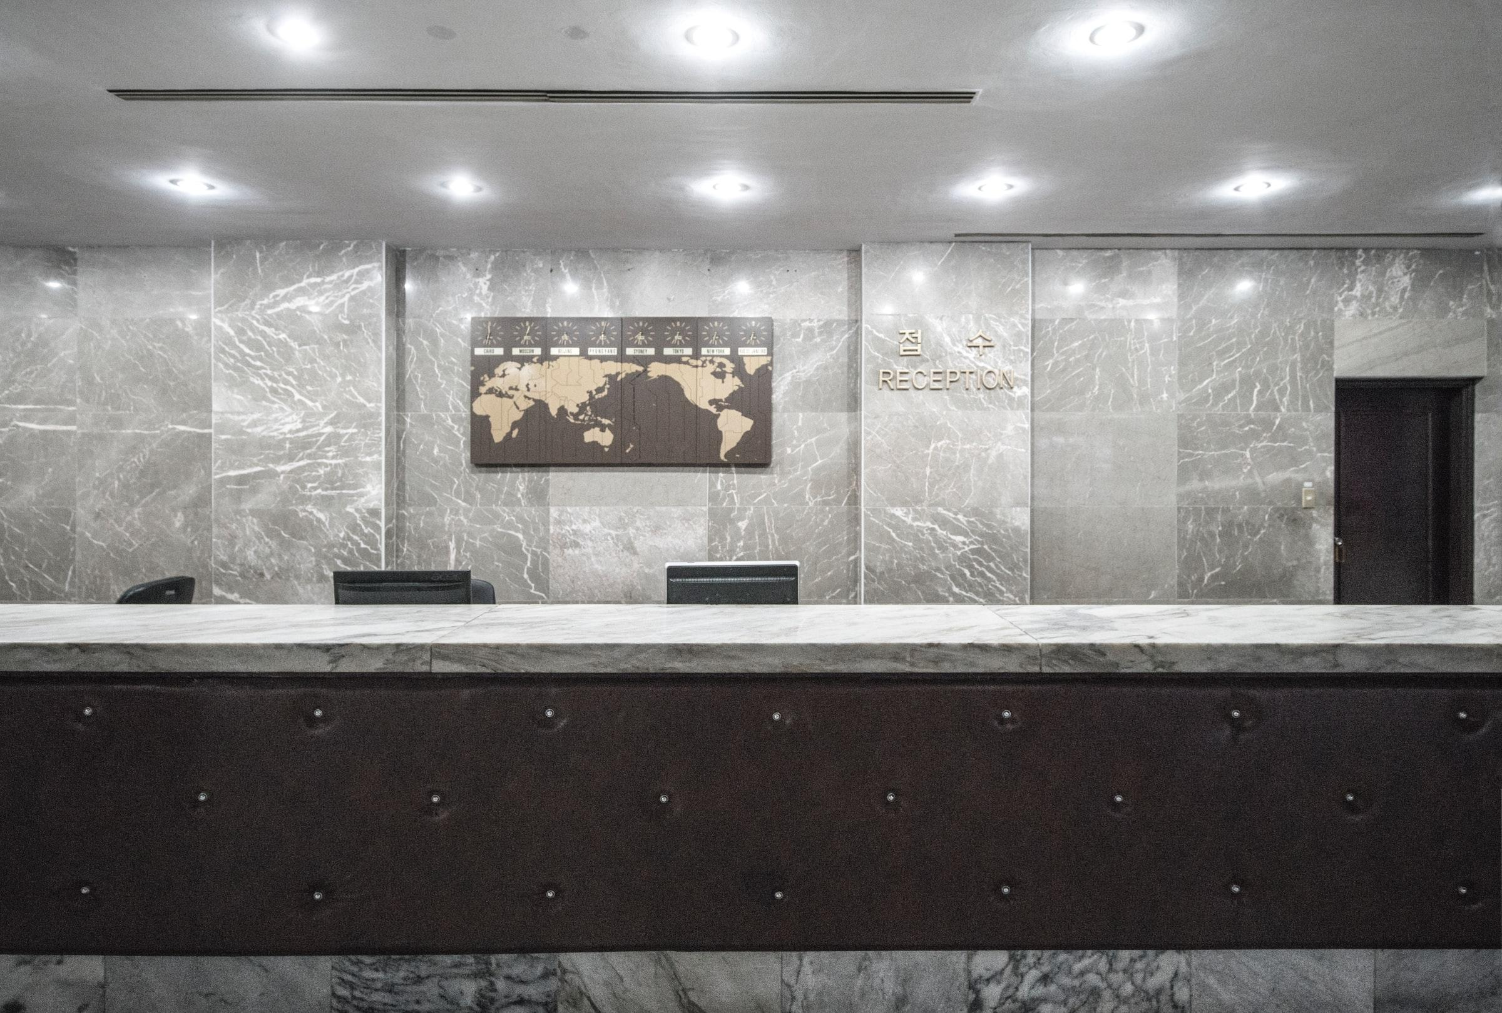
Hotel Cancel Culture
Predicting Reservation Cancellations
Notes:
Data scientist w/ background in hotel operations here to discuss reservation cancellations

Slide 2
Agenda
“Heads in Beds” Philosophy
Guiding Questions
Reservation Results
Final Recommendations
Next Steps
Notes:
Reviewing “heads in beds” booking philosophy
Prior q’s from prior experience
Results and Recommendations
Future work

Slide 3
Goal:
To predict cancellations and identify the top 3 reservation predictors.
Notes:
Most/least likely to cancel and why

Slide 4
“Heads in Beds” Philosophy
Balancing revenue and costs:
Oversell rooms – expect cancellations
Minimize costs – relocating reservation/loss of future business
Notes:
Sell as many rooms as possible while limiting operations costs – staffing and relocation in case of oversold nights
Sell as many rooms as possible at best prices
Balance revenue and costs
Staffing largest expense – schedule to anticipated demand
Relocation: cost of stay, potential lost business

Slide 5
Guiding Questions
Who Will Cancel?
Generalizations?
Practical for same-day decisions
Useful for forecasting future demand
Simple/easily understood
May lead to biases about guests
Notes:
Who will cancel and why?

Slide 6
Data Details
Hotel reservation data from two anonymous European hotels
Nearly 120,000 reservations from 2015 to 2017
Details including stay dates, rates, preferences, and more
Notes:
Anonymized - Limited reservation data available due to privacy laws

Slide 7
Models, Predictions, and Results

Slide 8
Models and their Results
Baseline
Logistic Regression
Random Forest Classifier
50% precision
Used for comparison with other models
80% precision
Easy to interpret likelihoods per characteristic
88% precision
Best results overall
More difficult to interpret results
Notes:
Precision metric of choice – unexpected cancellations (false negatives) less costly than relocation/lost business when guests arrive that were expected to cancel (false positives).

Slide 9
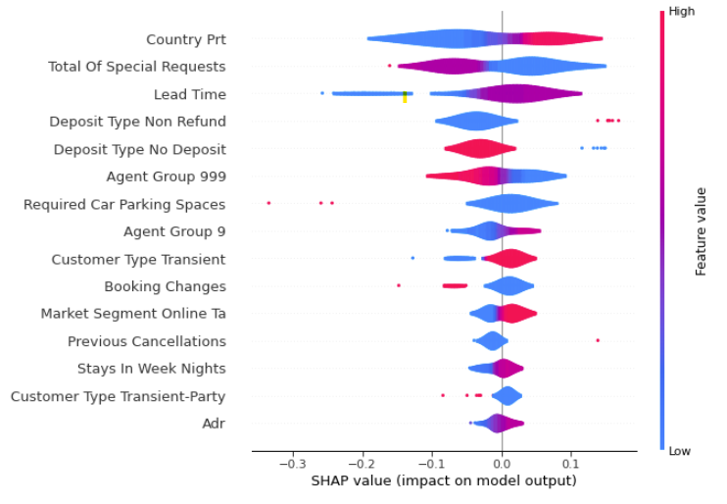
Visualizing the Random Forest Classifier
1. Country of Origin: Portugal
Portuguese reservations more likely to cancel than other countries
2. Total Number of Requests
Fewer requests (especially no requests) more likely to cancel
3. Lead Time
Higher lead time (earlier bookings) more likely to cancel
Notes:
Res from Portugal: more likely to cancel vs. not – most likely host country due to 40% res. From Portugal
More requests – more planning going into the stay
Longer lead times – more time for plans to change

Slide 10
Counterintuitive Results
Counterintuitive Results:
Reservations without a deposit are LESS likely to cancel
Notes:
Reservations that are refundable less likely to cancel, incl. “no deposit”
Would expect reservations to be more likely to stay as they prepaid

Slide 11
Recommendations Based on Random Forest Classifier:
Lower-income areas more volatile
Higher-income more stable
Confirm Early Bookings
Proactively contact bookings with large lead time
Focus on domestic bookings
Minimize domestic reservation cancellations
Limit Non-Refundable Rates
Reduce the number of these risky bookings.
Notes:
Catch cancellations early
Focus on domestic reservations vs. international
Cap prepaid rates

Slide 12
Caveats
Hotel-specific factors affect results
Location, guest type, brand, etc.
Reliably-available information
Dependent on Historical Data
Abnormal data (COVID-19) impairs modeling
Unforeseeable events change predictions/forecasting
Notes:
Amenities vary
Details not always available
Relies on past data – sensitive to anomalies/unexpected events

Slide 13
What’s Next?
Additional Demand Generators
Holidays, recurring local events
Reduce reservation details
More generalizable to other hotels
Forecast bookings & cancellations by room type
Notes:
Special events
Use bare-minimum details
Use results for forecasting occupancy

Slide 14

Thank You!
Benjamin McCarty
Email: bmccarty505@gmail.com
Github: github.com/BenJMcCarty
LinkedIn: linkedin.com/in/bmccarty505

