Slide 1
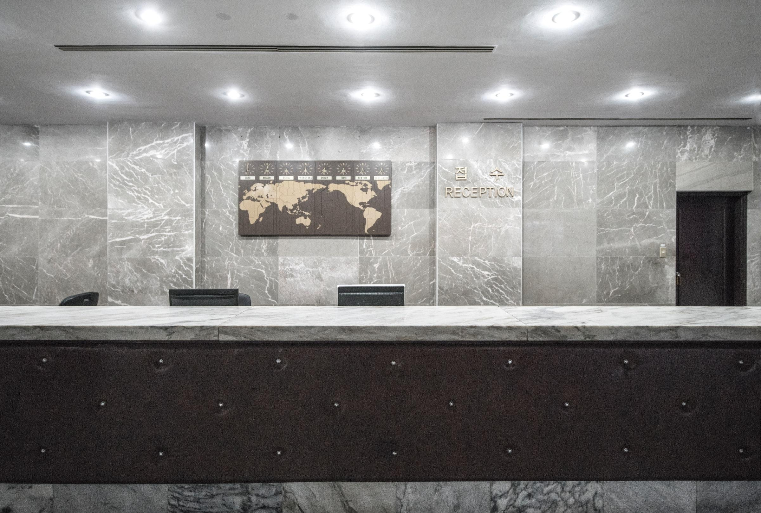
Hotel Cancel Culture
Predicting Reservation Cancellations
Notes:
Speaking with on-site hotel leadership focusing on daily operations – GM/Front Desk/Housekeeping.

Slide 2
Overview
“Heads in Beds” Philosophy
Guiding Questions
Reservation Results
Final Recommendations
Next Steps
Notes:
Reviewing “heads in beds” philosophy
Prior q’s from prior experience
Reviewing results
Giving advice
Future work

Slide 3
“Heads in Beds” Philosophy
Maximize revenue
Oversell rooms with expectation of cancellations
Minimize cost
Weekly scheduling and ordering supplies
Relocating guests when sold-out
Notes:
Balance revenue and costs
Sell as many rooms as possible at best prices
Minimize operations costs and risks of covering relocation costs

Slide 4
Goal:
To identify the top and bottom 3 attributes when predicting whether a reservation will cancel.
Notes:
Most/least likely to cancel

Slide 5
Guiding Questions:
Check-Out or Cancel?
What is the likelihood of a given reservation canceling?
Pros and Cons
Practical use for same-day decision-making
Useful for forecasting future demand
Guest Generalizations
Can we generalize certain attributes are more/less likely to cancel?
Pros and Cons
Simple/easily understood
Less accurate vs. full analysis
May lead to biases about guests
Notes:
Basic q; useful for short- and long-term planning
Generalizations – useful for quick decisions during busy times

Slide 6
Data Details
Hotel reservation data from two anonymous European hotels
Nearly 120,000 reservations from 2015 to 2017
Details including stay dates, rates, preferences, and more
Notes:
Anonymized - Limited reservation data available due to privacy laws

Slide 7
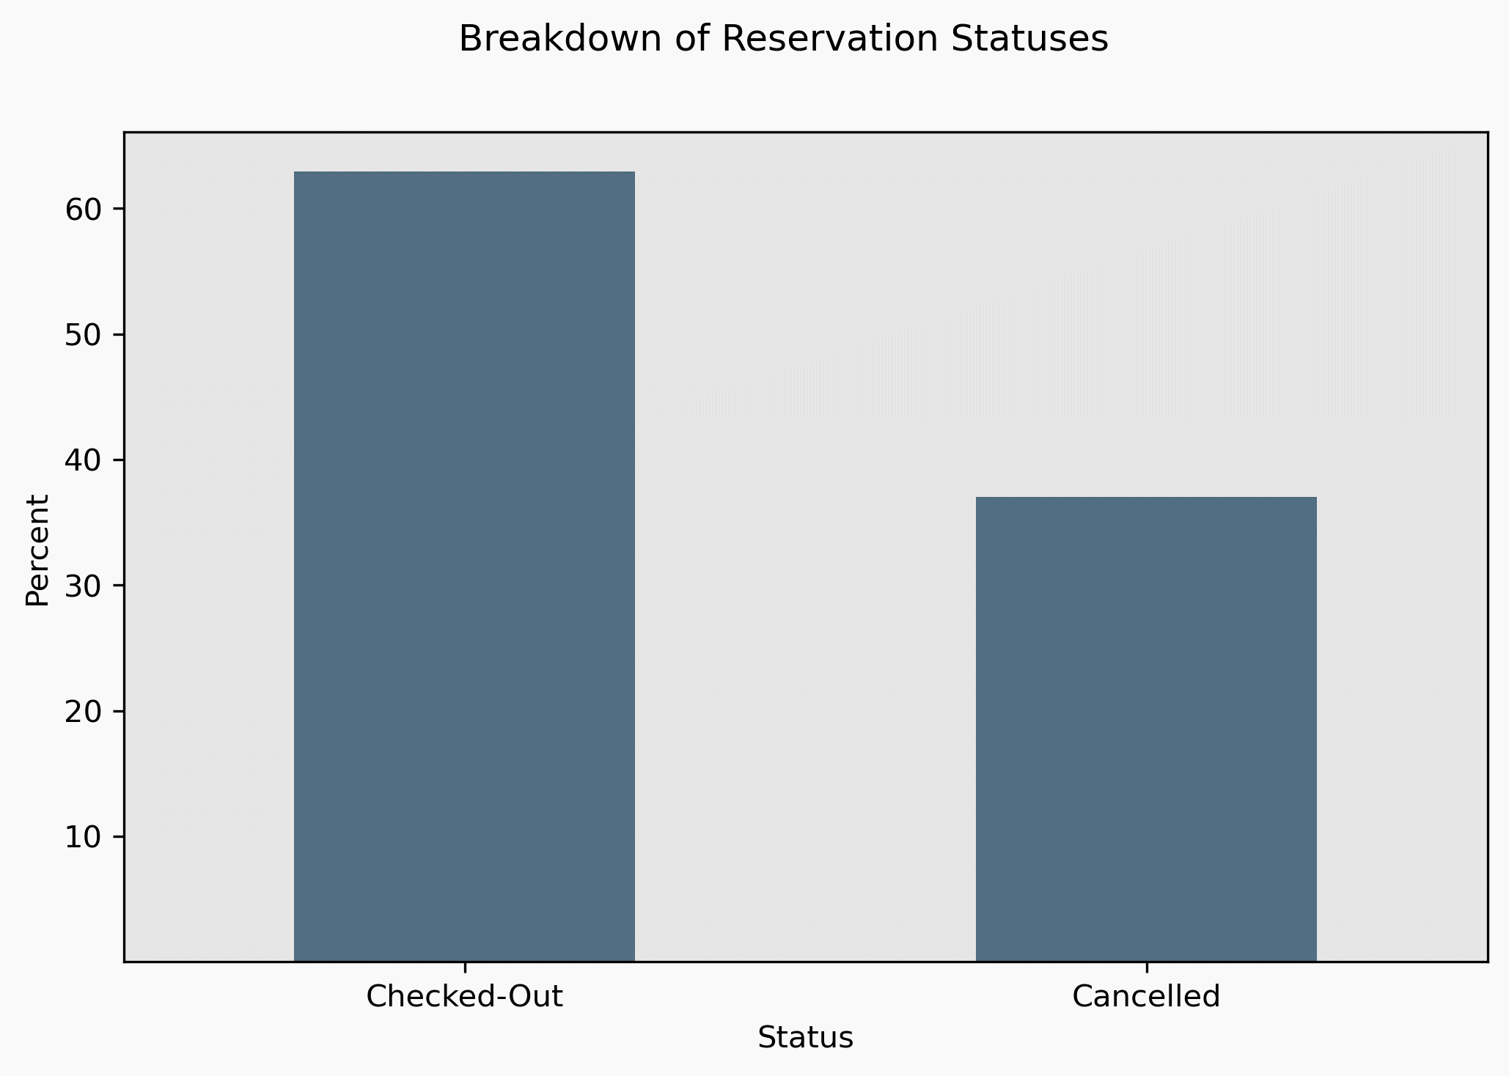
Checkouts vs. Cancellations

Slide 8
Getting to Know Your Guests

Slide 9
Models and their Results
Baseline
Logistic Regression
Random Forest Classifier
50% accuracy
Not better or worse than random chance.
80% accuracy
Negatively impacted by imbalanced reservation statuses.
Best model results
88% accurate
Negatively impacted by imbalance.
Notes:
Details specific for each hotel – different locations, room types, etc.

Slide 10
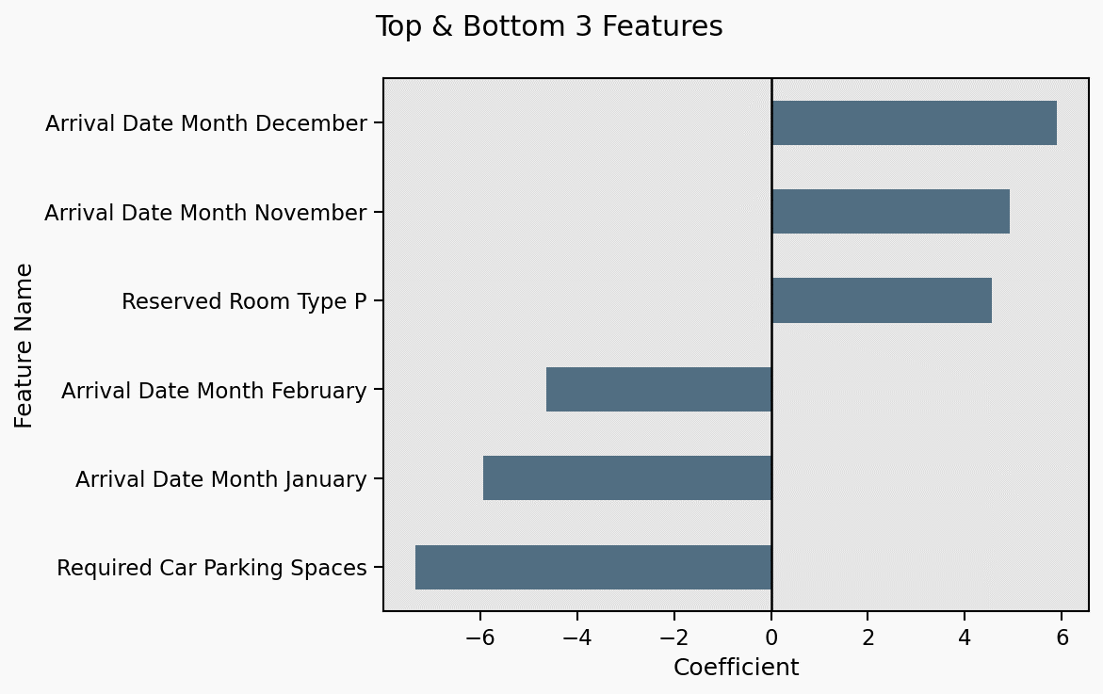
Visualizing Results of the Logistic Regression
Notes:
Laser pointer helpful!!

Slide 11
Strongest Characteristics – Logistic Regression:
Winter Holidays
Post-New-Year’s
Hotel-Specifics
Increased odds of cancellations
Increased leisure travel during winter holidays
Lower business travel as people take time off
Decreased odds of cancellations
Business travel resumes
Leisure travel slows post-holidays
Room types (standard, premium, suite) may increase odds of cancellation
Anonymous data limits interpretability
Notes:
Details specific for each hotel – different locations, room types, etc.

Slide 12
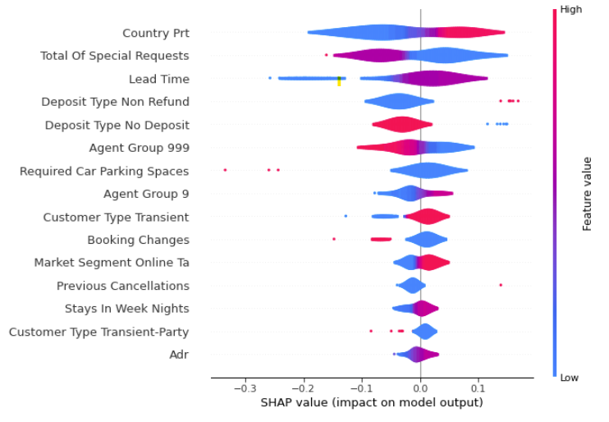
Branching Out with the Random Forest Classifier
HOW TO INTERPRET THE VISUALIZATION
Notes:
Res from Portugal: more likely to cancel vs. not
Total of Special requests: fewer requests more likely to cancel

Slide 13
Strongest Characteristics – Random Forest Classifier
Country of Origin
Number of Requests
Lead Time
Update!
Fewer requests
Greater number of requests may indicate guest is committed to staying
Book far in advance of arrival - more time for plans to change
Shorter time – more committed to stay
Notes:
Details specific for each hotel – different locations, room types, etc.

Slide 14
Recommendations Based on Random Forest Classifier:
Lower-income areas more volatile
Higher-income more stable
Oversell During Winter Holidays
Highest odds from October-December
Limit Oversells
Post-New Year’s
Lowest odds from January-March
Increase Limit for Certain Room Types
Certain room types more likely to cancel – depends on property

Slide 15
Guiding Questions:
Check-Out or Cancel?
What is the likelihood of a given reservation canceling?
Pros and Cons
Practical use for same-day decision-making
Useful for forecasting future demand
Guest Generalizations
Can we generalize certain attributes are more/less likely to cancel?
Pros and Cons
Simple/easily understood
Less accurate vs. full analysis
May lead to biases about guests
Notes:
Basic q; useful for short- and long-term planning
Generalizations – useful for quick decisions during busy times

Slide 16
What’s Next?
Consider additional factors
Holidays, recurring local events
Sales/promotions
Group sales/events
Predict, forecast bookings and cancellations by room type
Reduce reservation details – more generalizable to other hotels

Slide 17

Thank You!
Benjamin McCarty
Email: bmccarty505@gmail.com
Github: github.com/BenJMcCarty
LinkedIn: linkedin.com/in/bmccarty505

