Slide 1
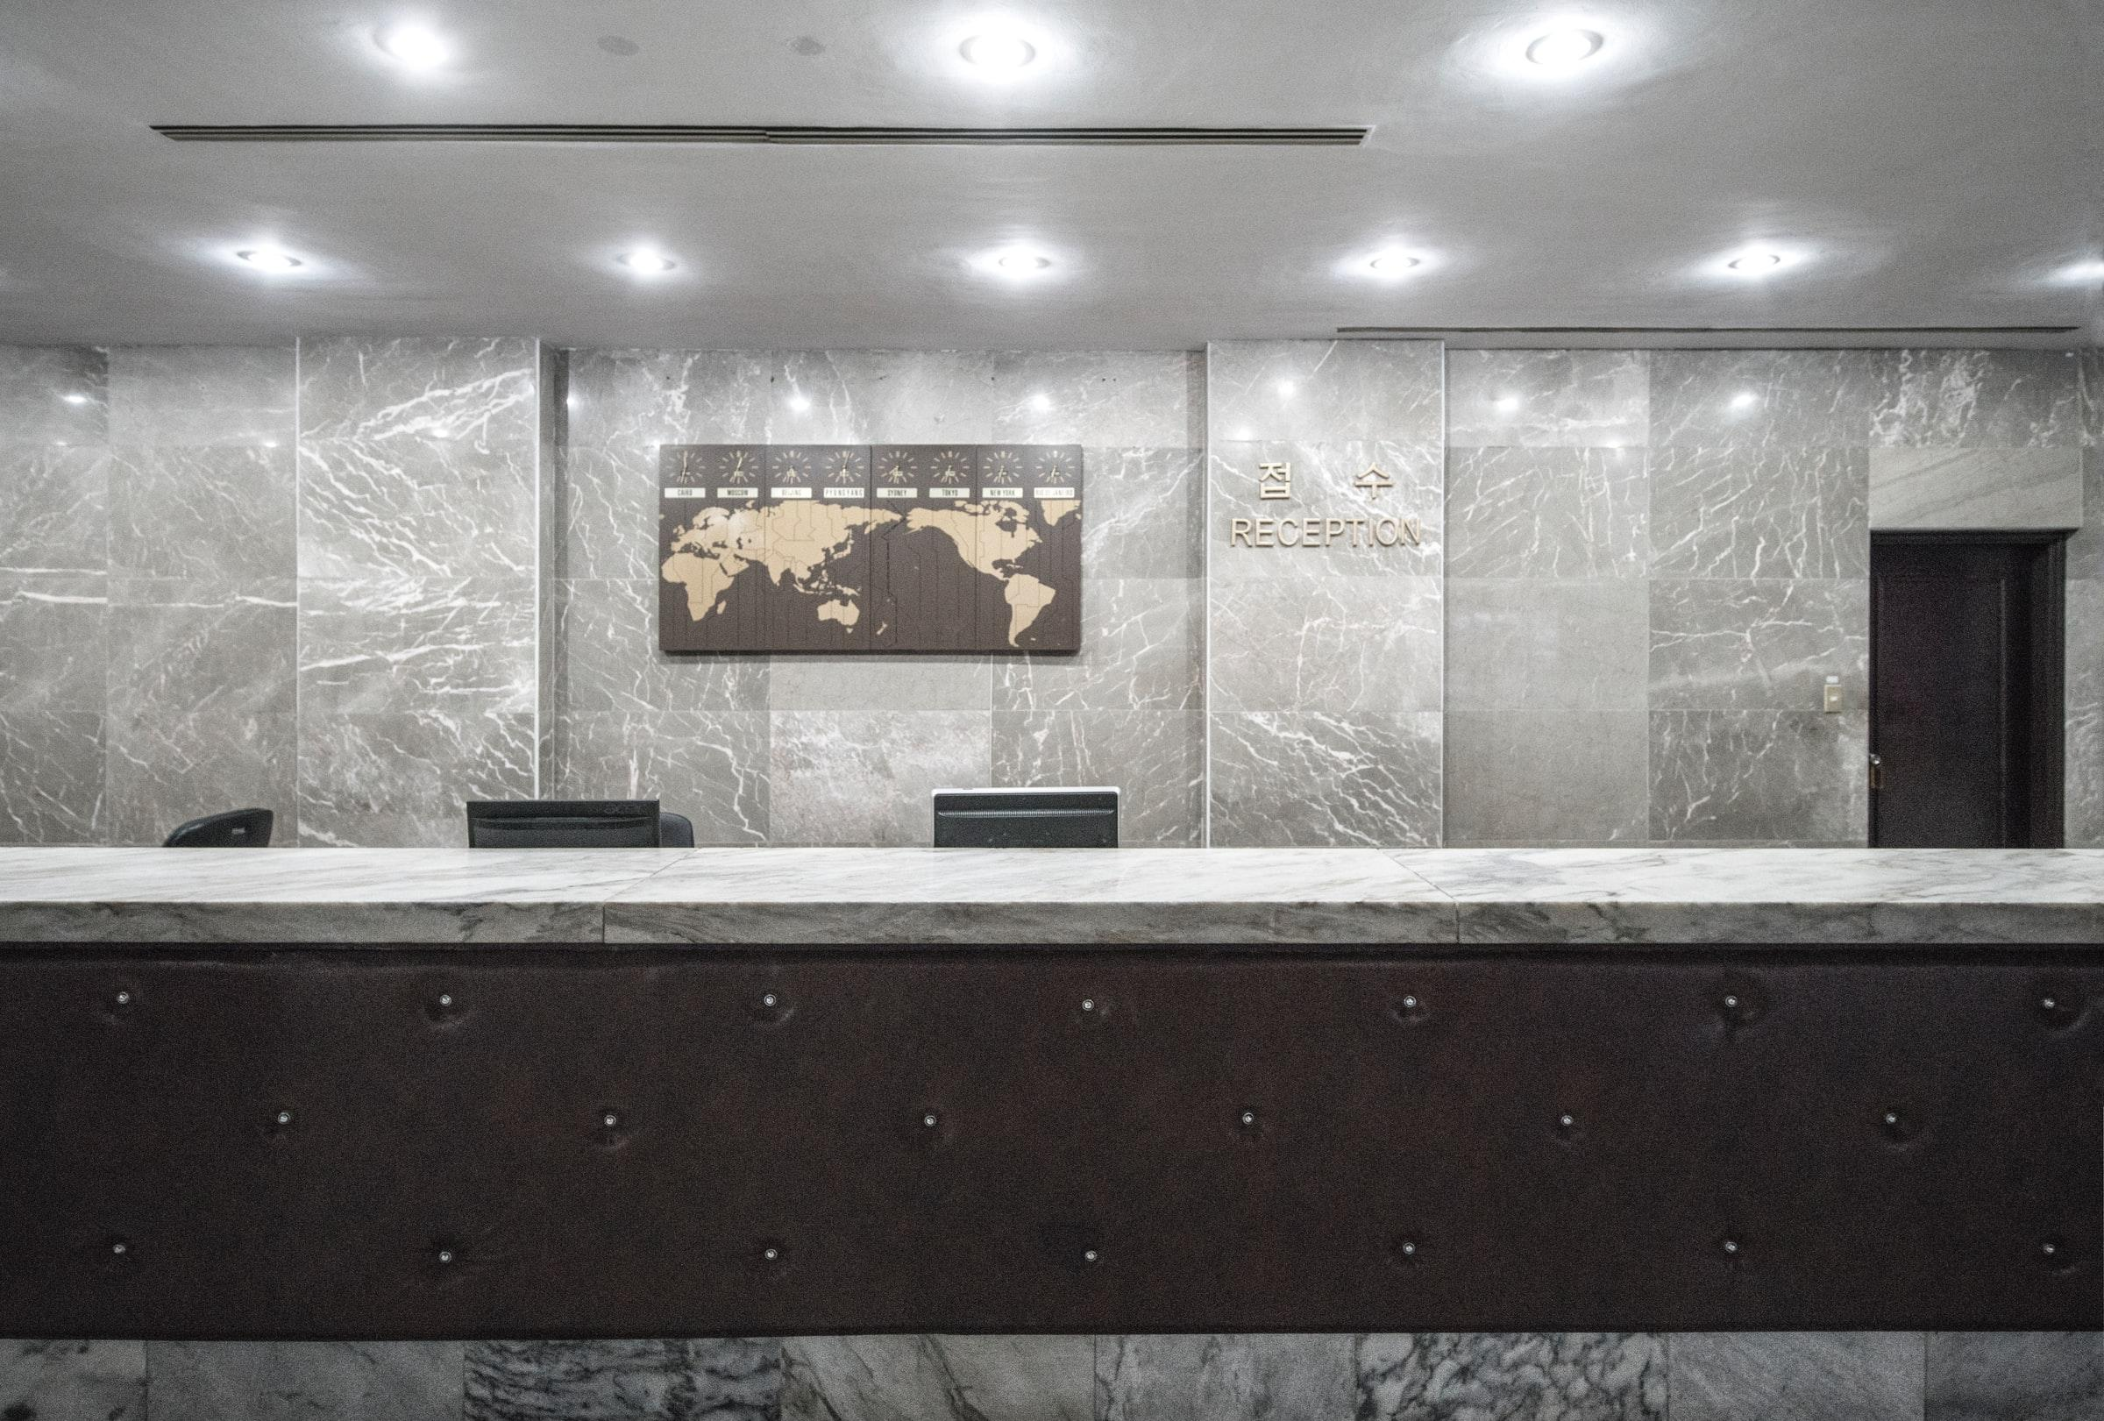
Hotel Cancel Culture
Predicting Reservation Cancellations
Notes:
Speaking with on-site hotel leadership managing

Slide 2
Agenda
“Heads in Beds” Philosophy
Guiding Questions
Reservation Results
Final Recommendations
Next Steps
Notes:
Reviewing “heads in beds” philosophy
Prior q’s from prior experience
Reviewing results
Giving advice
Future work

Slide 3
Goal:
To predict cancellations and identify the top 3 reservation predictors.
Notes:
Most/least likely to cancel and why

Slide 4
“Heads in Beds” Philosophy
Balancing revenue and costs
Oversell rooms with expectation of cancellations
Optimize staffing – largest, most controllable expense
Relocations costs money, future business
Notes:
Sell as many rooms as possible while limiting operations costs – staffing and relocation in case of oversold nights
Sell as many rooms as possible at best prices
Balance revenue and costs
Staffing largest expense – schedule to anticipated demand
Relocation: cost of stay, potential lost business

Slide 5
Guiding Questions
Who Will Cancel?
Generalizations?
Practical for same-day decisions
Useful for forecasting future demand
Simple/easily understood
Less accurate vs. full analysis
May lead to biases about guests
Notes:
Quick decisions required – but may lead to conscious/subconscious biases based on reservation details.

Slide 6
Data Details
Hotel reservation data from two anonymous European hotels
Nearly 120,000 reservations from 2015 to 2017
Details including stay dates, rates, preferences, and more
Notes:
Anonymized - Limited reservation data available due to privacy laws

Slide 7
Models, Predictions, and Results

Slide 8
Models and their Results
Baseline
Logistic Regression
Random Forest Classifier
50% precision
Not better or worse than random chance.
80% precision
Easy to interpret likelihoods per characteristic
88% precision
Best model results overall
More difficult to interpret results
Notes:
Precision metric of choice – unexpected cancellations (false negatives) less costly than relocation/lost business when guests arrive that were expected to cancel (false positives).

Slide 9
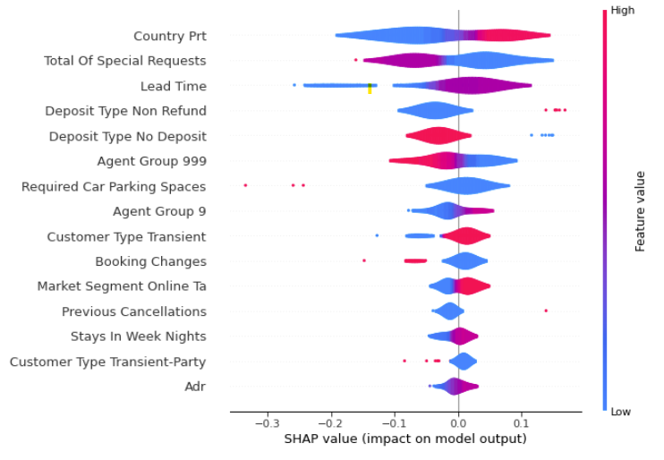
Visualizing the Random Forest Classifier
1. Country of Origin: Portugal
Portuguese reservations more likely to cancel than other countries
Counterintuitive Results:
Non-refundable reservations MORE likely to cancel
Reservations without a deposit are LESS likely to cancel
2. Total Number of Requests
Fewer requests (especially no requests) more likely to cancel
3. Lead Time
Higher lead time (earlier bookings) more likely to cancel
Notes:
Res from Portugal: more likely to cancel vs. not
Total of Special requests: fewer requests more likely to cancel
Longer lead times more likely to cancel

Slide 10
Strongest Characteristics – Random Forest Classifier
Country of Origin
Number of Requests
Lead Time
Reservations from Portugal are more likely to cancel for these hotels.
Fewer requests increase likelihood of cancellations
Greater number of requests may indicate guest is committed to staying
Booking far in advance of arrival allows for more time for plans to change
Shorter time – more committed to stay
Notes:
Details specific for each hotel – different locations, room types, etc.

Slide 11
Recommendations Based on Random Forest Classifier:
Lower-income areas more volatile
Higher-income more stable
Confirm Early Bookings
Proactively contact bookings with large lead time
Balance Domestic & International Bookings
Balance mix of domestic & international travelers
Limit Non-Refundable Rates
Reduce the number of these risky bookings.

Slide 12
Caveats
Hotel-specific factors affect results
Location, guest type, brand, etc.
Amenities offered
Information availability
Dependent on Historical Data
Abnormal data (COVID-19) impairs modeling
Unforeseeable events change predictions/forecasting

Slide 13
What’s Next?
Additional Demand Generators
Holidays, recurring local events
Sales/promotions
Group sales/events
Reduce reservation details
More generalizable to other hotels
Forecast bookings & cancellations by room type

Slide 14
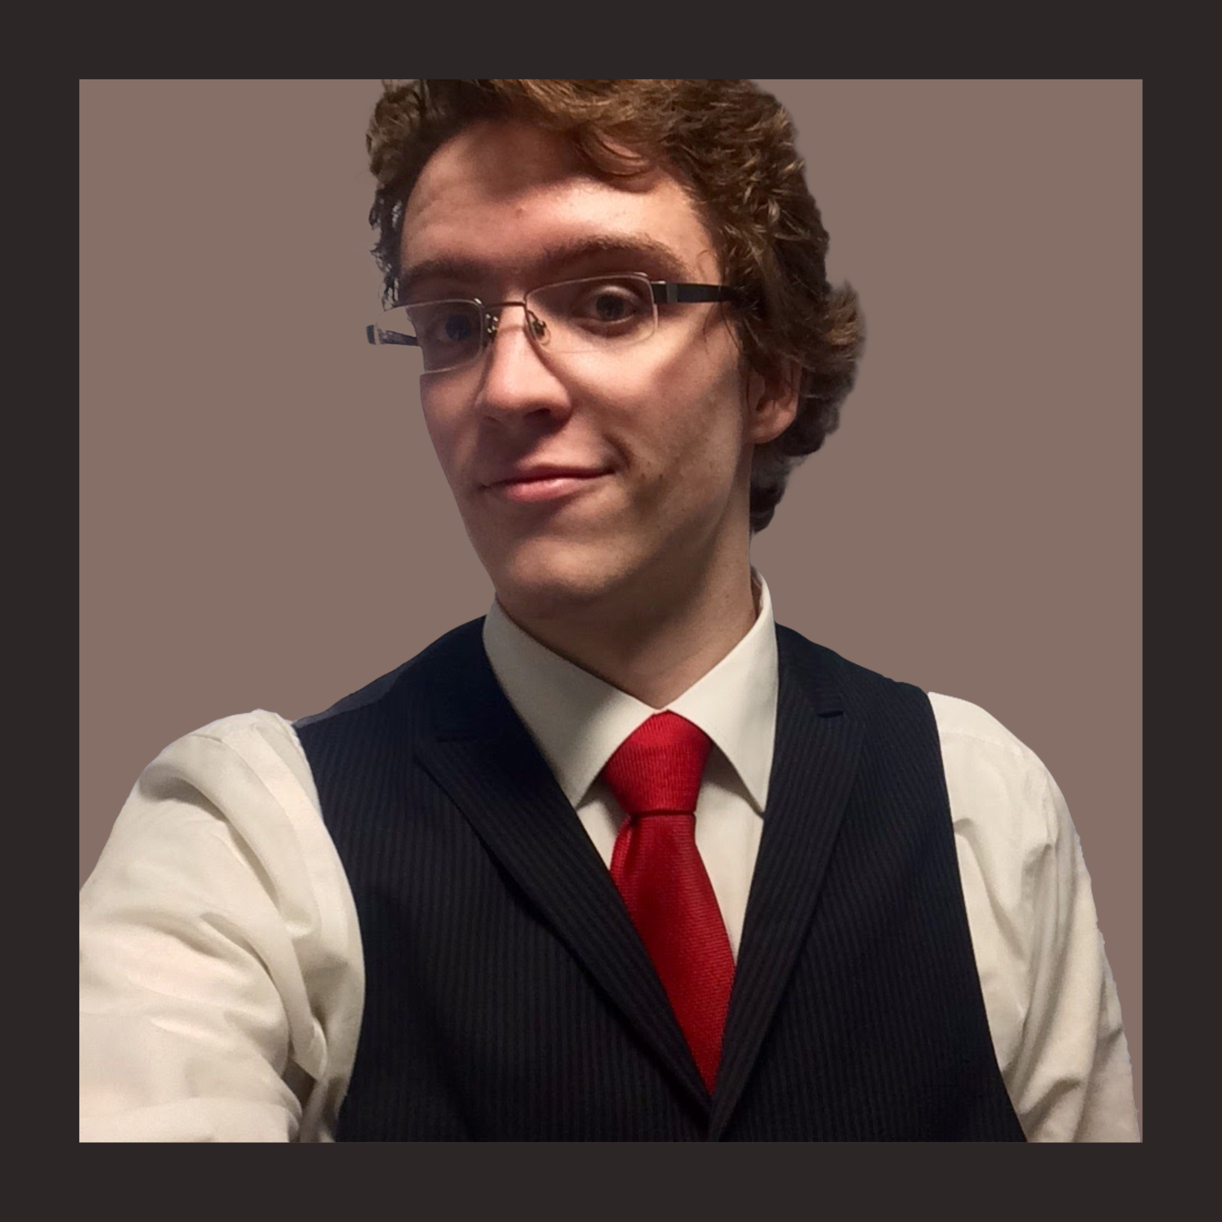
Thank You!
Benjamin McCarty
Email: bmccarty505@gmail.com
Github: github.com/BenJMcCarty
LinkedIn: linkedin.com/in/bmccarty505

