Slide 1

Predicting Housing Sale Prices for King County
James M. Irving, Ph.D.
03/16/19

Slide 2
FRAMEWORK & DATA
Analyzed price of houses sold in King County from May, 2014 – May, 2015
18 – characteristics of the property:
Size of home, land
Size of neighboring properties
Housing condition, grade
Waterfront, view
Zip code, location

Slide 3
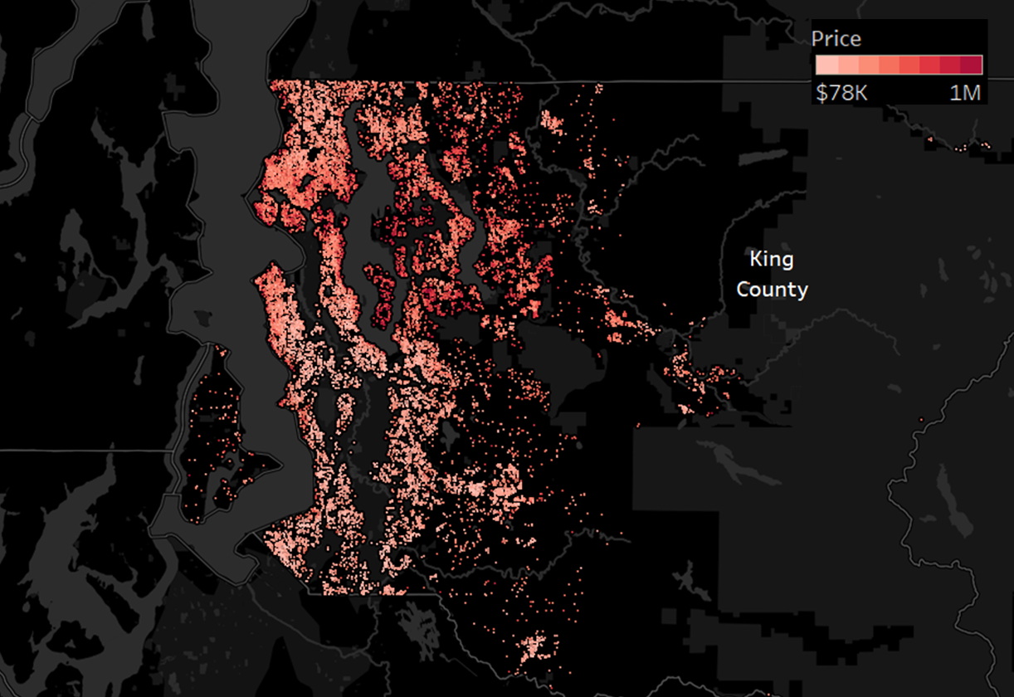
Multiple linear regression with Ordinary Least Squares (OLS) to predict house price

Slide 4
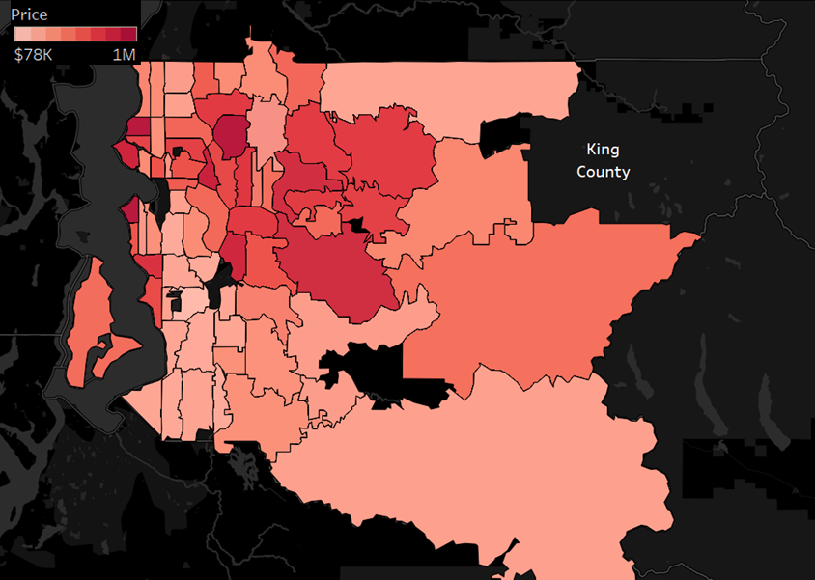
FINDINGS
Applied Recursive Feature Elimination (RFE) to determine the best predictors of sales price:
Zip code
Housing grade
Size of Living Areas (ft²)
Size of neighboring homes (ft²)

Slide 5
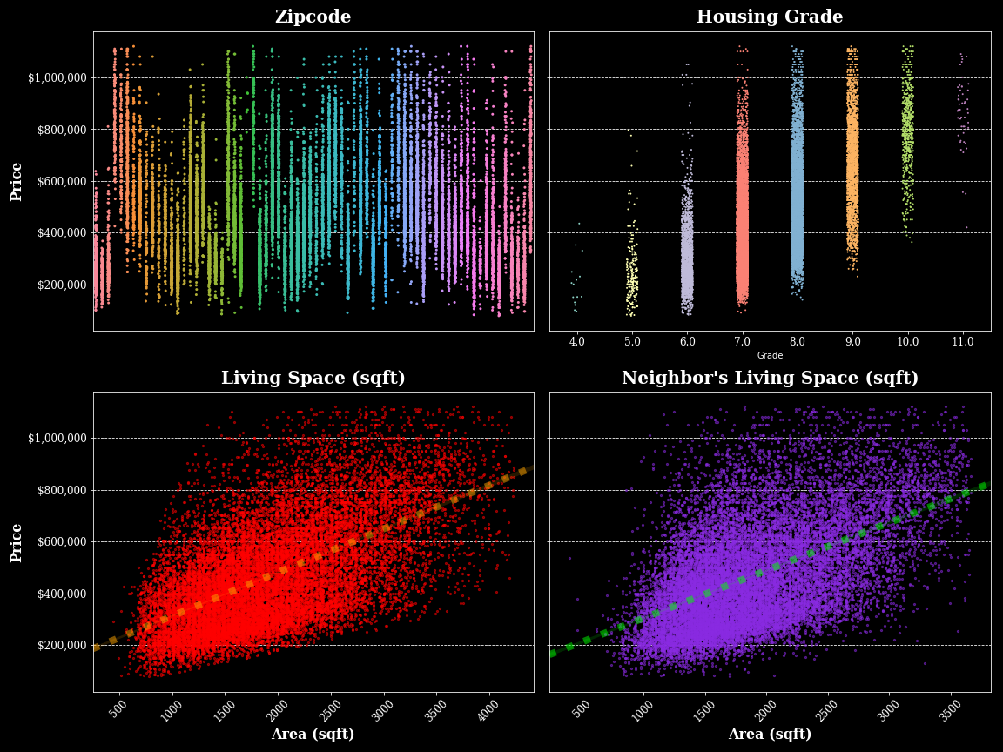
FINDINGS

Slide 6
Strategy to Increase Sales Price
Two major determinants of sales price are beyond owner’s control
Size of neighbor’s living area.
Zip code
Investing in modifying your home will increase price
Increase square footage your living space.
Use high-quality construction material to increase the housing grade.

