Slide 1
Project :: Automatic Text Summarizer and Organiser
(USING TEXT MINING)
-Ayush Pareek (Sophomore)
The LNM Institute of Information Technology
Notes:
Our Project is an automatic text summarizer that can effectively convert a big chunk of text into a small summary

Slide 2
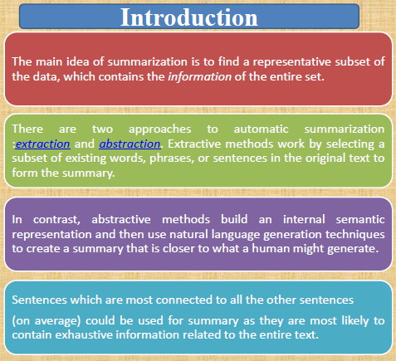
Literature stuff, topics covered, definitions
TOPICS COVERED:
Pre-processing
Stemming algorithms
Generic and Query-based Stemming
Zipf's Law
Stop-word removal
frequency matrix
Clustering
Sentence Weighting
Pearson Correlation Coefficient
Cosine Similarity
Abstraction Extraction based Summary
=>For coding purposes we sharpened our knowledge of C/C++ file handling, Standard Template Library, diverse libraries etc.
Notes:
Abstraction based summarization involves building internal semantic representation and then using NLP to weave it into human-readable text. In contrast, extraction means selecting the appropriate subset of the text as summary.

Slide 3
Basic Intuitive Idea & Mathematical Basis
same words were used in sentences containing redundant information.
notion of “Connectivity”
But which Sentences should we use for summary?
From Literature survey of Statistics::
a)Pearson Correlation Coefficient
b)Cosine Correlation Coefficient
c) Classical Info. Retrieval F-measure.
Notes:
So, the basic idea is to use the notion of “Connectivity” between two sentences.
If we could somehow measure how connected two given sentences are, we can exploit this technique to generate a ranking of sentences. Sentences which were most connected to the all other sentences on average could be used for a summary. We are going to see how to do that.
Now I’m using this term “connectivity” in an abstract sense right now, but we are going to see the rigorous mathematics which can define this notion.
From Literature survey on the subject , we found some very promising mathematical models to describe connection between two entitie.

Slide 4
ALGORITHM::
STEP 1“Preprocessing”
Extracting only those words from the text which are relevant for analysis.
STEP 2 “Stemming”
Step 3 “Sorting and Removing Stop Words
Common words like the, and, is, are, for, am, so…
=>Symbols, numbers and punctuations.
“do”, “doing”, “done” ➔ do
“agreed”, ”agree” ➔ agree
“gone”, “go”, ”went” ➔ go
“plays”, ”play”, “playing” ➔ play
Notes:
In step1, we remove all punctuations, commas, full-stops etc. Those kind of symbols not relevant for our analysis
In step 2 , we perform stemming which means converting different tenses of the same verb into its root. So “do”, “doing” and “done” are derived from “do”. So, we replace that
In Step3, we arrange them in lexicographical order for our convenience.
So, we remove symbols,numbers,punctuations and common words like “the”, “and”, ”is” and all these “articles”, “conjunction”, ”prepositions” etc which do not contribute in our analysis
One of the major problems in text mining is that a document can contain a very high number of words. We are going to see that in the mathematical model we have used to implement the notion of “connectivity”, each word is represented as a vector coordinate and so the number of dimensions would be too high for the text mining algorithm.
Now you might have noticed that there are certain group of words with a common root. An Eg; could be “do”, “doing”, “done” which are different tenses of the same verb “go”. So in our next step, we convert all the words to their root word

Slide 5
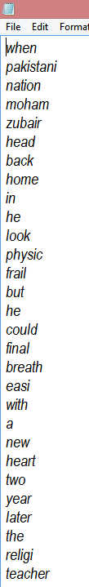
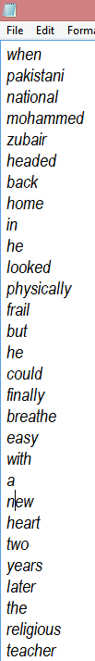
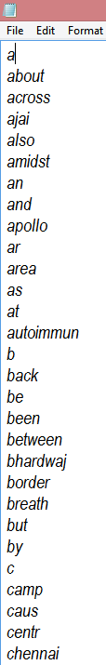
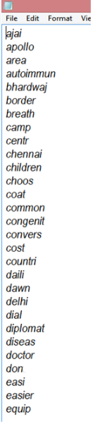
After Formatting
After Sorting
After Stemming
After Removing
Stop Words
Notes:
This is the actual O/P of our program. On the extreme left is the text after removing punctuation marks, symbols and numeric data. After that we have sorted them in Lexicographical order. Then the most crucial step i.e. converting every word to its “root”. And on the extreme right, you won’t find any stop word. So, this text is free of “the”, “a” ,”is” , “am”, “for” and all such conjunctions and articles etc which are used in grammar have been removed.

Slide 6
Sentence v/s Words Matrix
 | Pakistan | India | Surgery | Medical | Patient
Sentence 1 | 1 | 2 | 0 | 1 | 2
Sentence 2 | 0 | 0 | 3 | 1 | 1
Sentence 3 | 2 | 0 | 0 | 1 | 0
Sentence 4 | 1 | 0 | 0 | 0 | 1
Finding Correlation between Sentence Vectors
Now the Vector Corresponding to sentence 1 is:: [1 2 0 1 2]
Notes:
Now Our program will generate a Sentence v/s Word matrix which shows the frequency of any word in a sentence. For eg; In our original document, the word “Pakistan” occurs once in sentence 1 and twice in Sentence 3. In the same way, India occurs twice in the first sentence.
Now , this is the key part of the entire process. How do you represent a “sentence” is a mathematical form? The idea is to use the row of this matrix as a sentence vector. Now whenever you want to run any analysis on sentences, you can use this “sentence vector”.
From this we extract a Sentence vector corresponding to all the sentences of the document. This is called the VECTOR SPACE MODEL

Slide 7
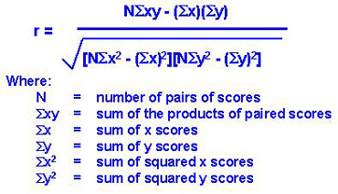
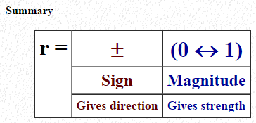
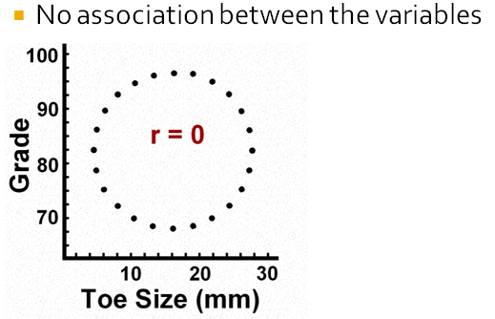
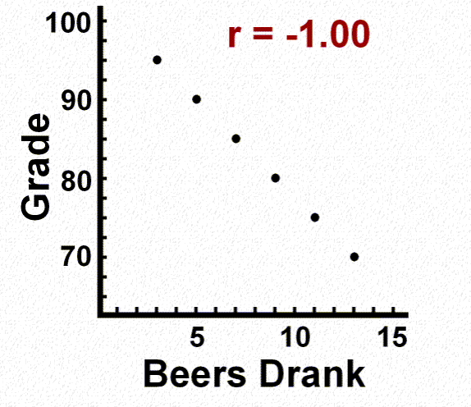
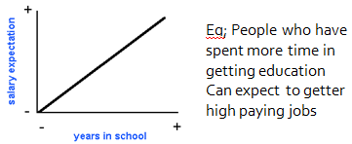
Pearson Correlation Coefficient
Text->Sentences -> Vectors->PCC-> value of r
->gives connectivity between vectors
->connectivity between sentences
The coefficient value can range between
-1.00 and 1.00.
COEFFICIENT VALUE
CASE 2:: PCC = 0
CASE 3:: PCC < 0
CASE 1:: PCC > 0
As one variable increases, the other also increases.
>0.5 =>Considerable connectivity
>0.7 =>Strong Connectivity
NoegativeAssociation
between variables
Notes:
Pearson Coefficient is a statistical formula which shows the strength of association between two variables. Now we have used this formula in the format which requires input in VECTOR form. So, you can already guess what our next step is going to be. We converted Text to Sentences, then they are converted to Sentence vectors using Frequency Matrix-> Then we’ll put those vectors in the PCC formula -> This gives the magnitude and nature of association between vectors -> which in turn gives the amount of connectivity between sentences which is what we aimed for in the beginning.
So, the O/P of this formula gives a coefficient value which can range from –1 to 1 and Lets see what this means
If the coefficient value is in the positive range, then that means the association between the variables is in DIRECT PROPORTION.
As one variable increases, the other one also increases.
A PCC value greater than 0.5 gives some considerable connectivity
A PCC value greater than 0.7 gives a STRONG connectivity
If the coefficient value is in the positive range, then that means the association between the variables is in INVERSE PROPORTION.
As one variable increases, the other one decreases.
So, in short this is first mathematical concept to describe connectivity . The nature of the association is shown by the sign and the magnitude gives its strength.

Slide 8

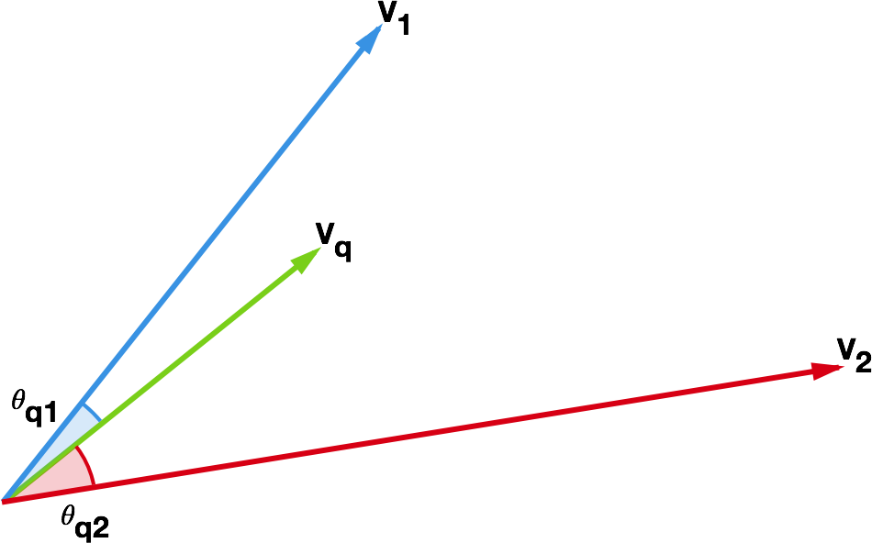
Cosine Similarity
Shortest dog found in China
China has the biggest short-dog population
China keen on cutting population growth
Notes:
Now the second model of mathematical association used is something called the Cosine Association. The difference between this and PCC is that it measures the coefficient in terms of angle between vectors and not based on magnitude. Also, it can’t be negative.
As an intuitive example, we know that we have already converted sentences into vectors. So, how do you find strength of association between vectors? By using this neat formula. If the vectors have a small angle between them then theta would be close to zero and in turn cos(theta) would be close to one.

Slide 9
Sentence v/s Sentence Matrix
 | Sentence 1 | Sentence 2 | Sentence 3 | Sentence 4 | Sentence 5 | Sentence 6
Sentence 1 | 1 | 0.224862 | 0.125127 | 0.40471 | 0.127615 | 0.224413
Sentence 2 | 0.224862 | 1 | 0.317351 | 0.328374 | 0.0122265 | 0.116916
Sentence 3 | 0.125127 | 0.317351 | 1 | 0.297626 | -0.0922254 | -0.0502292
Sentence 4 | 0.40471 | 0.328374 | 0.297626 | 1 | 0.0799604 | 0.349622
Sentence 5 | 0.127615 | 0. 0122265 | -0.0922254 | 0.0799604 | 1 | -0.0791082
Sentence 6 | 0.224413 | 0.116916 | -0.0502292 | 0.349622 | -0.0791082 | 1
Notes:
So, now we create another matrix in which each element is the O/P of a mathematical model of association. So, if I ask you what is the extent of connectivity between Sentence 1 and 2… you can go to the row of s1 and col of s2 and give the strength of association between sentences. This matrix shows the connectivity of every sentence which every other sentences. Now what to do now ? An intuitive Idea is to take the avg. connectivity of each sentence and then rank them according to that basis.

Slide 10
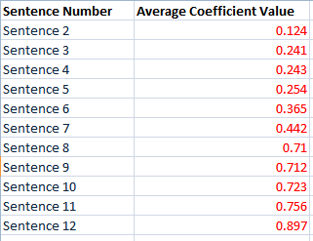
SENTENCE WEIGHTING(ALGORITHM 1)
We need to rank these sentences in order of “connectivity”
We take the average of each sentence Vector to compute their order of importance to the entire text.
Eg; sentence 3 >sentence 5>
sentence 7> sentence 8> sentence 9
Notes:
So, the same thing…we get the avg. connectivity of each sentence and now we can assign ranks to every sentence based on that.

Slide 11
CLUSTERING (Algo 2)
RANK:: S1 > S3
Highest Value
S1 S2 S3 S4 S5 S6
S1 1 0.225 0.40471 0.125 0.127 0.224
S2 0.225 1 0.317351 0.328374 0.0122265 -0.116916
S3 0.40471 0.317351 1 0.297626 -0.0922254 -0.0502292
S4 0.125127 0.328374 0.297626 1 0.0799604 0.349622
S5 0.127615 0.0122265 -0.0922254 0.0799604 1 -0.0791082
S6 0.224413 -0.116916 -0.0502292 0.349622 -0.0791082 1
Notes:
The second way is to Find highest coefficient and do clustering of sentence vectors. So, whats the highest number you can see here? This one!.. So First the row and column sentence corresponding to highest coefficient will be clustered. And we are also giving the top rank. So the most important sentence is S1 and then S3.

Slide 12
Cluster these two sentence vectors
RANK:: S1 > S3 > S2
S2 S1+S3/2 S4 S5 S6
S2 1.000000 0.317351 0.276618 0.012226 -0.116916
S3+S1/2 0.317351 1.000000 0.211376 -0.092225 -0.050229
S4 0.276618 0.211376 1.000000 0.103788 0.287017
S5 0.012226 -0.092225 0.103788 1.000000 -0.079108
S6 -0.116916 -0.050229 0.287017 -0.079108 1.000000
Highest value. Cluster its row and column
Notes:
S1 and s3 are clustered. Now repeat the process i.e. find the highest coefficient in the matrix and cluster its row and column… SO the next rank is assigned to s2.

Slide 13
And so on..
(S1+S2+S3)/3 S4 S5 S4
(S1+S2+S3)/3 1.000000 0.243997 -0.039999 -0.083573
S4 0.243997 ` 1.000000 0.103788 0.287017
S5 -0.039999 0.103788 1.000000 -0.079108
S6 -0.083573 0.287017 -0.079108 1.000000
RANK:: S1 > S3 > S2 > S4
Notes:
And then the same process goes on.

Slide 14
START
Basic Steps used in all our algorithms
Get Document and perform Preprocessing
Sentence Weighting
ALGO 1
Make a WORD v/s SENTENCE FREQUENCY MATRIX
COEFFICIENT MATRIX USING P.C.C.
TAKE CONSENSUS OF FINAL RANKS FROM ALL 4 METHODS
ALGO 2
Sentence Clustering
COEFFICIENT MATRIX USING COSINE SIMILARITY
Sentence Clustering
ALGO 3
Sentence Weighing
ALGO 4
Notes:
After making the word by frequency matrix, we diverged into two paths. One using PCC to make Coefficient matrix and another using Cosine association. Then it again diverged into 2 braches of algorithms. One was sentence weighting and another was sentence clustering. In the end we took the avg. of the results obtained from all these algorithms to get the final rank.
Now the neat observation about this approach is that the efficiency of this algorithm can be boosted by using a QuadCore processor. Each core can implement one of the algorithms and hence the time required will be reduced by one fourth. Parallel Processing:- The algorithms being used can work independently from each other, opening doors for processing them simultaneously using multiple processors while handling big-datasets.

Slide 15
CONSENSUS Techniques(1/3)
METHOD 1:: (GENERIC SUMMARY) Giving Equal Weights to all 4 algorithms
Shortcomings of one algorithm is compensated by the strength of another algorithm.
Thus, we get the reasonably accurate accurate ranking possible.
P.C.C.
Signed
Magnitude
Cosine
No magnitude
Unsigned
Angle
Sentence Clustering
Sentence Weighting
Notes:
We combined all 4 algorithms to get the best possible order of sentences.

Slide 16
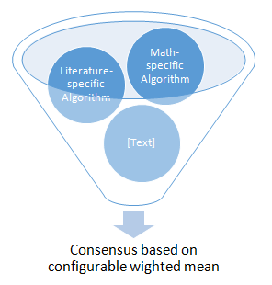
CONSENSUS Techniques(2/3)
METHOD 2(Identifying DataSets)::
Algorithm for Literature Dataset
What is the Genre of Data? Use algorithm on that Basis
Algorithm for Math-Dataset
Algorithm for Encyclopedia articles
Algorithm for New Reports
Algorithm for Biographies
Notes:
Unlimited number of algorithms which might have data-specific importance can be incorporated under our unified project. For Eg; While making summaries of academic papers involving formulas and mathematical expressions, if an a few algorithms give better results than others, we can give them more weight-age during consensus and so on.

Slide 17
CONSENSUS Techniques(3/3)
Keyword/Title based Summary Selection
Algorithm 1
Algorithm 2
Take Keywords from user or use title of text for Word Matching with all the available summaries
Algorithm 3
Final Summary
Algorithm 4
Algorithm 5
Algorithm 6
Algorithm 7
Algorithm 8
Notes:
Lets take an example of a news article from ‘THE HINDU’ newspaper. Our software will try to create a summary of this text.

Slide 18
Average of all algorithms(of large test inputs)[Generic consensus]
Accuracy
MAXIMA = 87.4 %
Number of sentences (x-axis)
Notes:
MAX ACCURACY OF 87.4% WAS FOUND WHEN TESTS WERE DONE ON A BIG SET OF DOCUMENTS WITH ATLEAST 100 SENTENCES EACH.

Slide 19
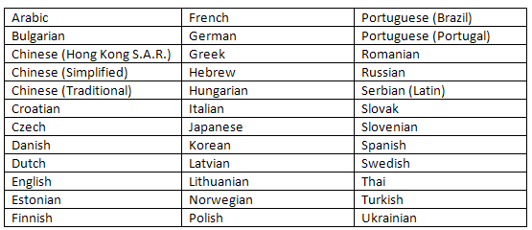
FEATURES::-
Language Independent summaries
Notes:
Language Independent summaries:- Except for the preprocessing stage, our algorithm works perfectly on any language that has the notion of words and sentences. Even for preprocessing, the stop words lists and stemming algorithms have already been developed and can be harnessed to make the summary platform universally

Slide 20
APPLICATIONS
Sub-Heading and Index Creator
Content Highlighter
Browser Add-On
Subjective Exam sheet checker
Making Abstract of Research papers and articles
Plagiarism Detector
Hypertext context-link based summarizer
Daily News feed summarizer / RSS
In search engines to present compressed descriptions of the search results
In keyword directed subscription of news which are summarized and pushed to the user.
Notes:
The project has Universal Applications.

Slide 21
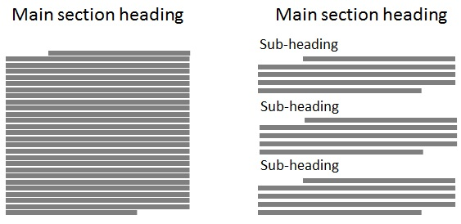
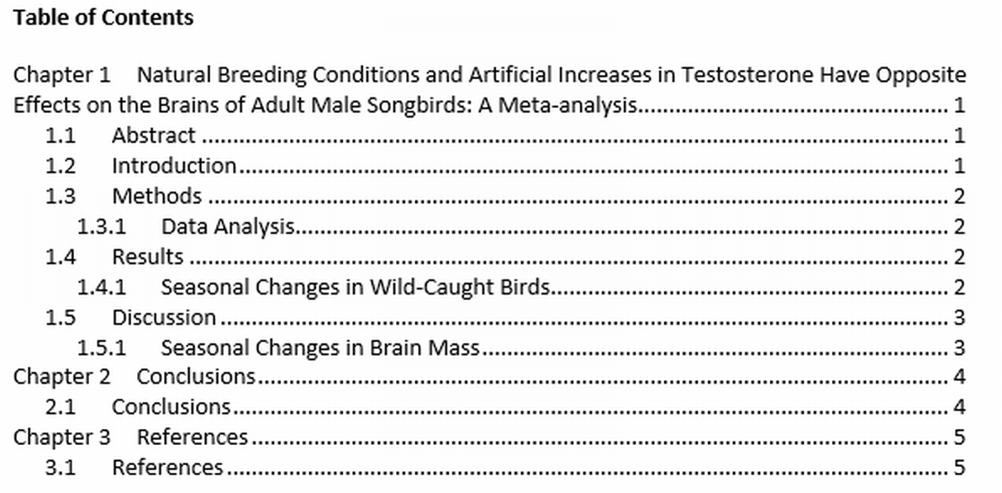
APP::Sub-Heading & Index Creator
The software can effectively convert BRUTE FORCE reading effort to DIVIDE-AND-CONQUER
Notes:
Our software can also convert a big chunk of text in an organized format with sub-headings and sub-points which can be used to form INDEX for a book

Slide 22
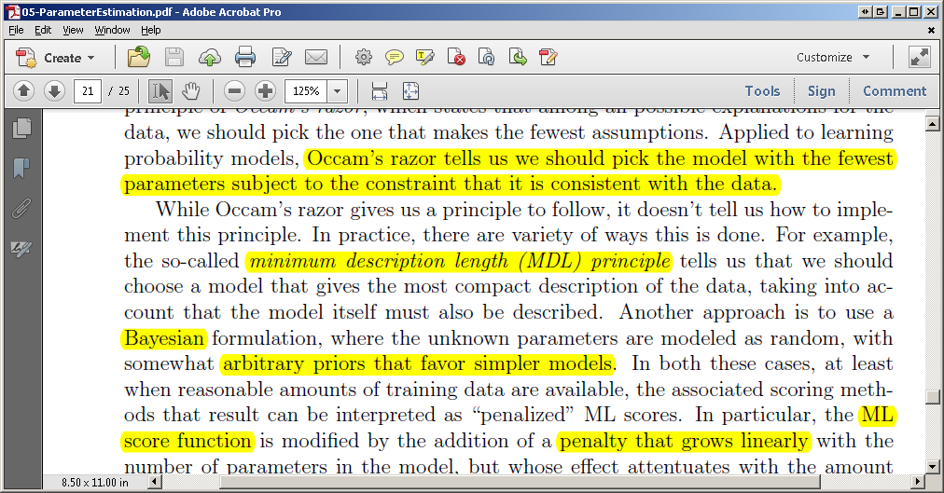
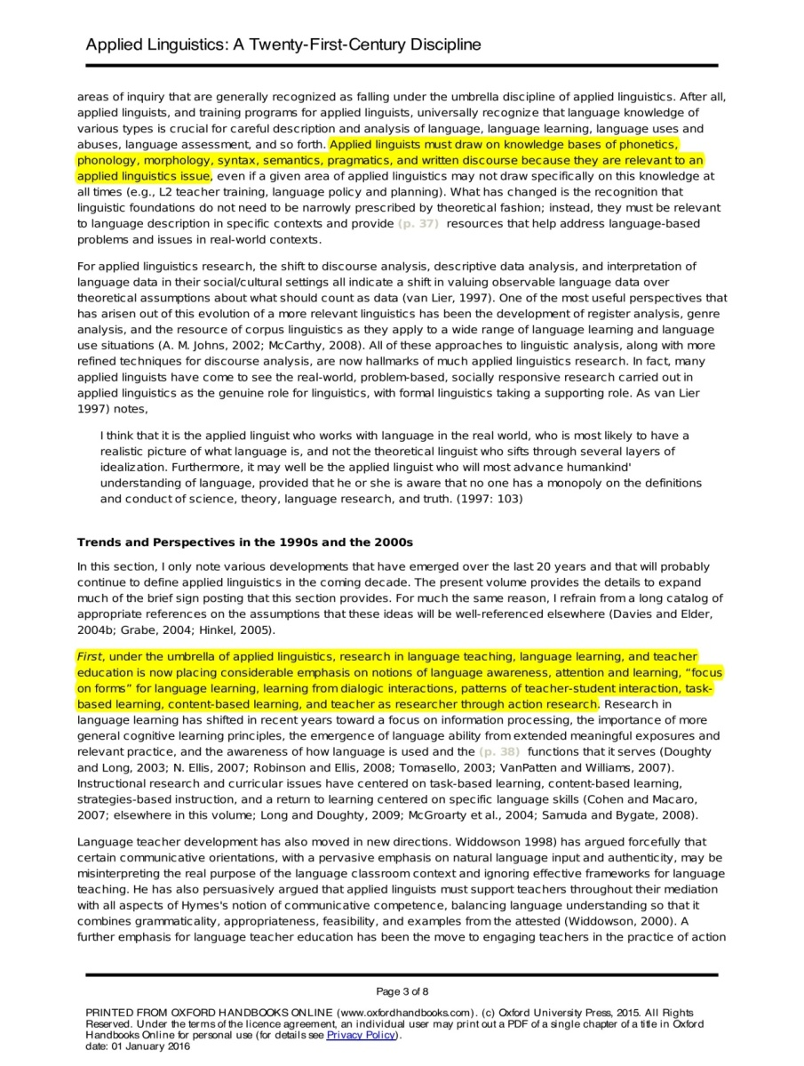
APP::Content Highlighter
Notes:
Instead of a summary maker, our project can also work as a content highlighter. It can mark the most important parts in each paragraph of the entire text so that a person can decide whether to read it or not just by reading those parts

Slide 23

APP::Plagiarism Detector
Notes:
Summaries of documents can be compared to check whether the most important parts of a document have been copied or not.

Slide 24
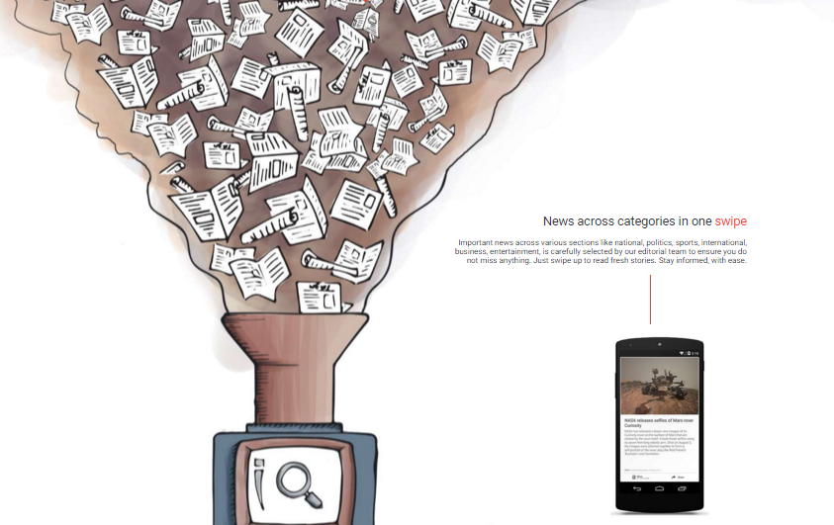
News summary maker
Notes:
Another good application is that of a news summary maker. What it means is that there are millions of news articles published per day. Our software can take all those articles on a specific subject and provide you the news in as many lines as you want. The news generated will capture exhaustive information on the subject in question from a variety of sources.

Slide 25
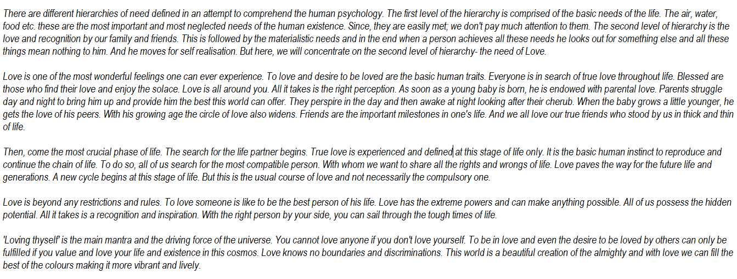
SAMPLE INPUT

Slide 26
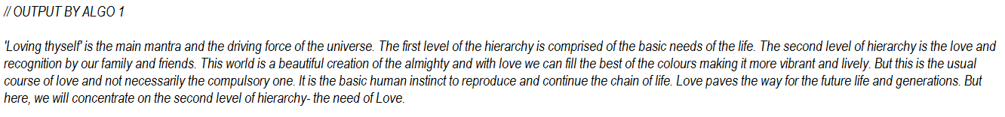
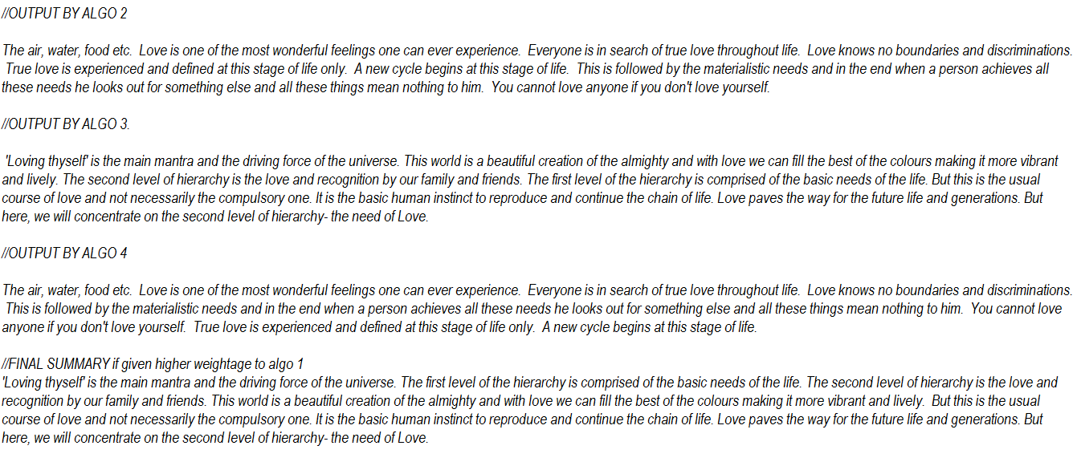
SUMMARY BY DIFFERENT ALGOS

